Slide 1
Documentation
What is it and who needs it?
Janelle Jenstad
JT </e> MH

Slide 2
What is Documentation?
JJ </e> MH

Slide 3
Why do we document?
JT </e> MH

Slide 4
Who needs it?
New RAs
Continuing RAs
The PI
External contributors
Users
Librarians/Archivists
JT </e> MH

Slide 5
Project Continuity
Where are other team members preparing and storing their work?
What email account are they using for project correspondence?
Where are they documenting their work?
JT </e> MH

Slide 6
Consider …
Versioning your working documents (in the repository)
JT </e> MH

Slide 7
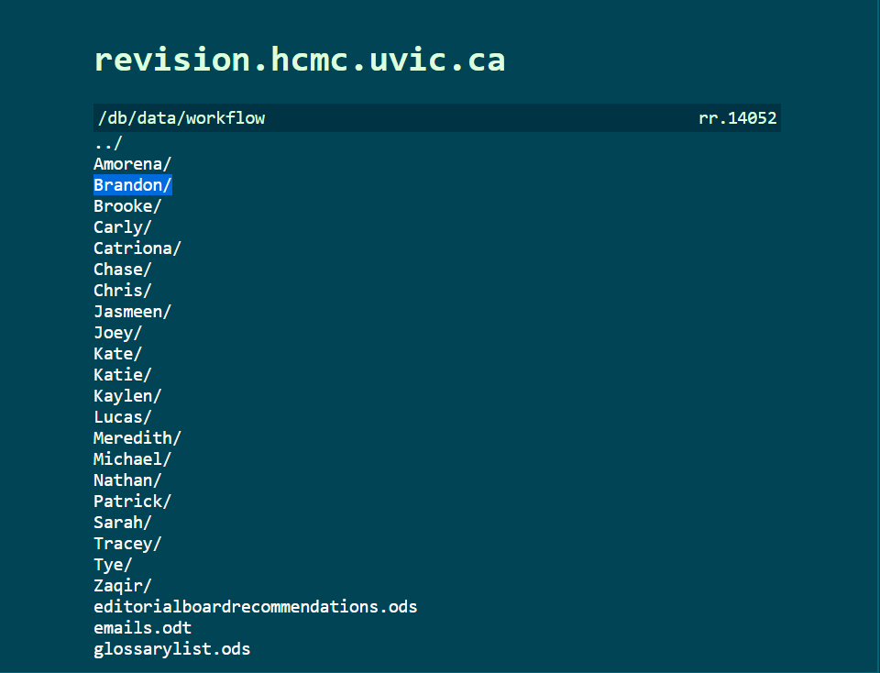
Consider …
Versioning your working documents (in the repository)
Setting up shared workspaces
JT </e> MH

Slide 8
Consider …
Setting up shared workspaces
GoogleDrive – make sure the project is the owner (via the project email)
JT </e> MH

Slide 9
Consider …
Project email accounts:
  london@uvic.ca
  digitalrenaissanceeditions@gmail.com
Role-based email accounts:
  moemlras@uvic.ca
  moemljuniorprogrammer@uvic.ca
  londonpm@uvic.ca
  lemdotech@uvic.ca
JT </e> MH

Slide 10
What do you need to document?
Scope and content of project
Who worked on it: Contributors and credit
“How to do things” and/or “How things were done”
Editorial decisions
How the processing works (if project still under construction)
Programming and processing
Records Management System
JT </e> MH

Slide 11
What do you need to document?
Permissions and rights
JT </e> MH

Slide 12
Where do you keep documentation?
JT </e> MH

Slide 13
Debunking Myths
Code is not self-documenting.
ODD files are not self-documenting either.
JT </e> MH

Slide 14
Your “hit-by-a-bus” document
A list of where data and files are stored.
Access information.
Grant numbers, signing authorities, delegates.
JT </e> MH

Slide 15
JT </e> MH

