Slide 1
Building static websites
Why it's a good strategy for Endings

Slide 2
I am seeking to rescue the poor stockinger, the Luddite cropper, the "obsolete" hand-loom weaver, the "utopian" artisan, and even the deluded follower of Joanna Southcott, from the enormous condescension of posterity.
(E.P. Thompson, The Making of the English Working Class)

Slide 3
A little detour into history
Here's an old old site of mine:
  http://web.uvic.ca/lancenrd/martin/weblang/contents.htm
It still works. It's also in the Wayback Machine...
...where it also still works.
The HTML still works.
The JavaScript still works.
It predates CSS, but if it didn't, the CSS would still work.
Out of 17 links on the Links page, only 11 work in the Wayback Machine; only 7 work on the current Web.

Slide 4
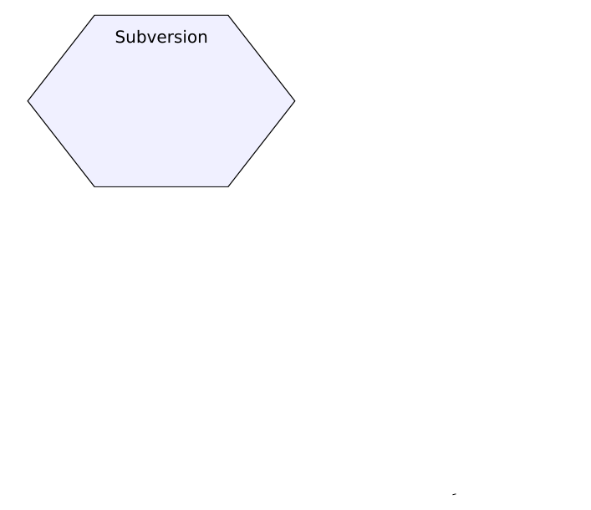
Our current workflow

Slide 5
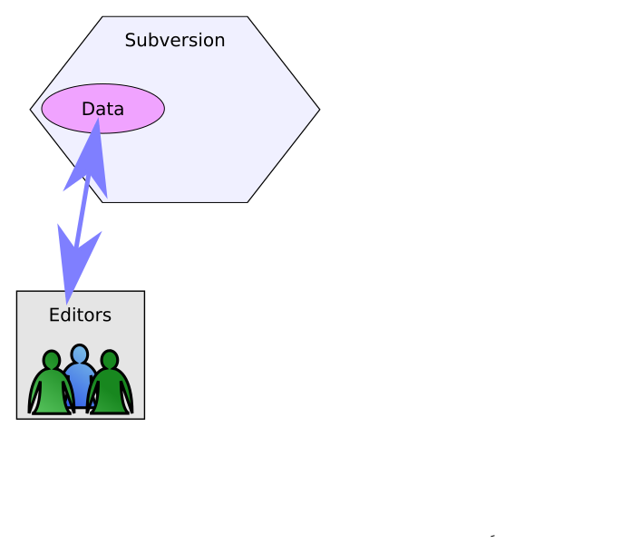
Our current workflow

Slide 6
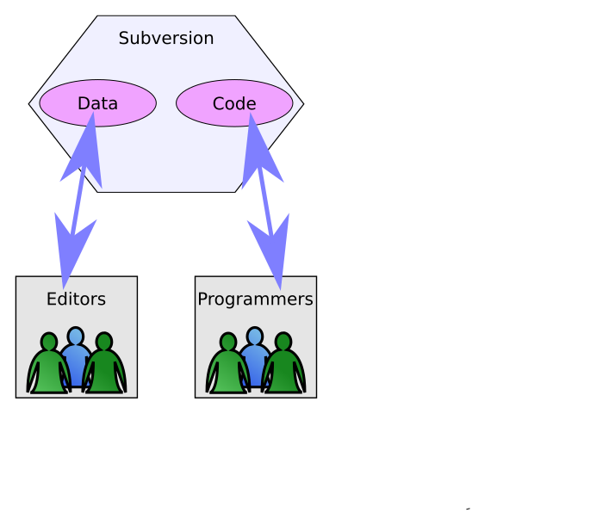
Our current workflow

Slide 7
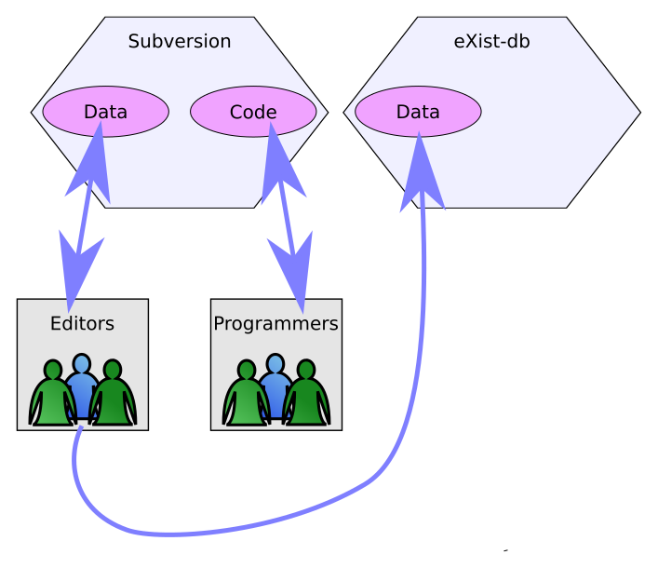
Our current workflow

Slide 8
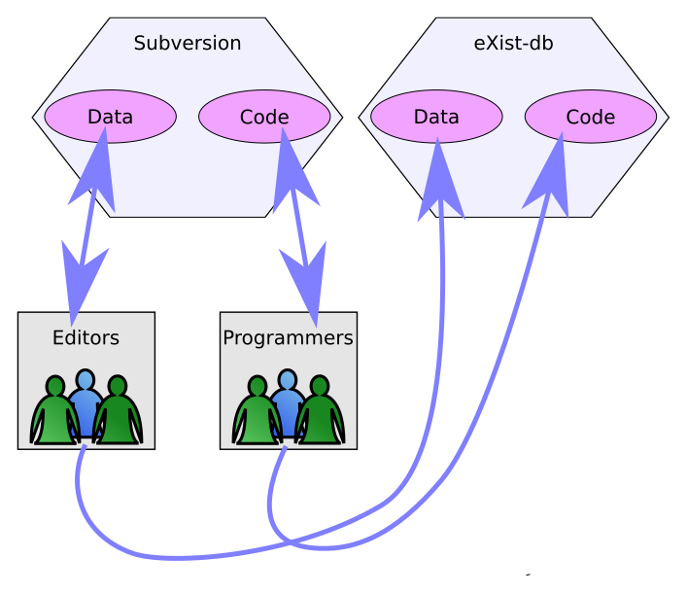
Our current workflow

Slide 9
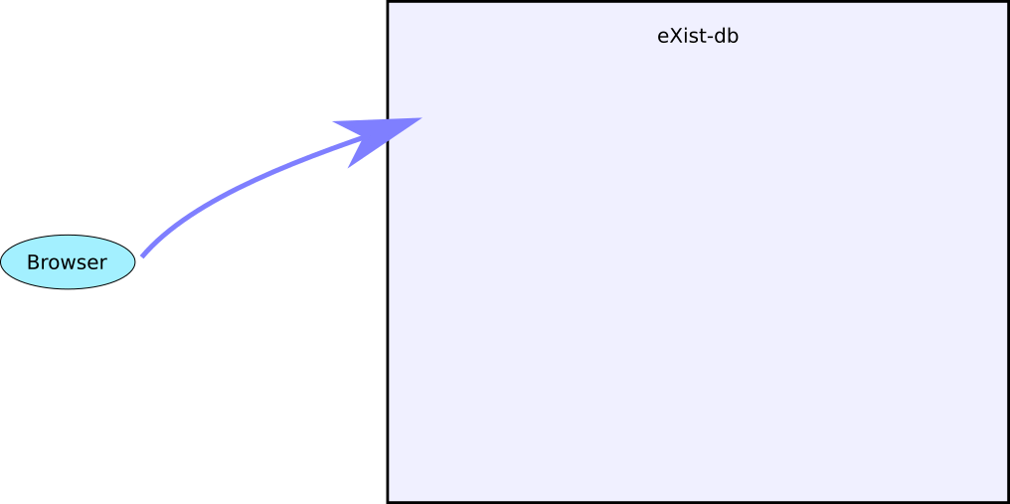
Our current webapps

Slide 10
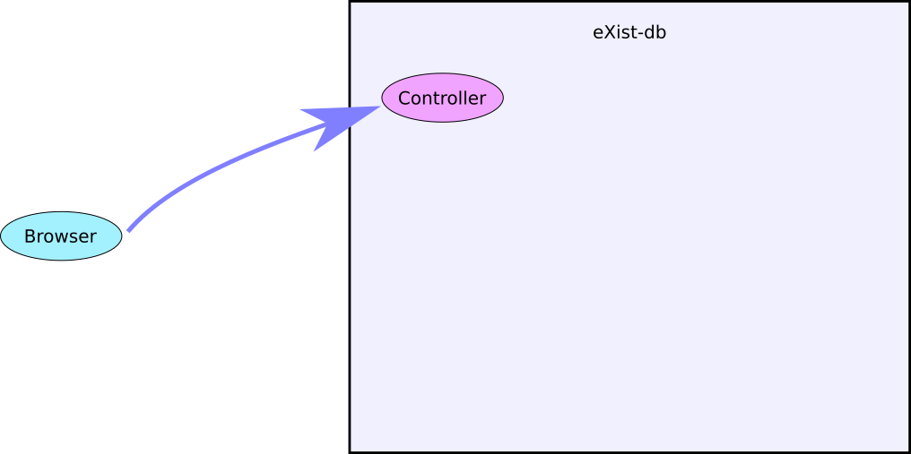
Our current webapps

Slide 11
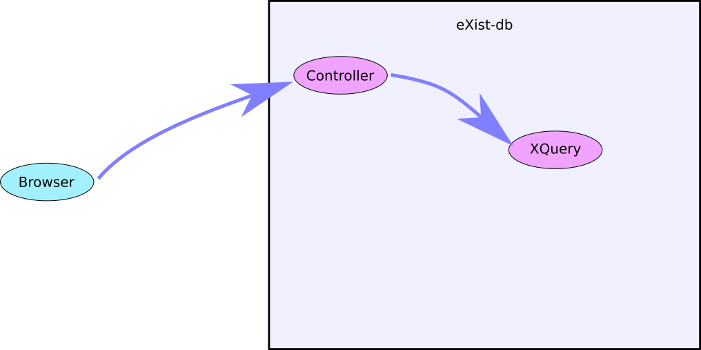
Our current webapps

Slide 12
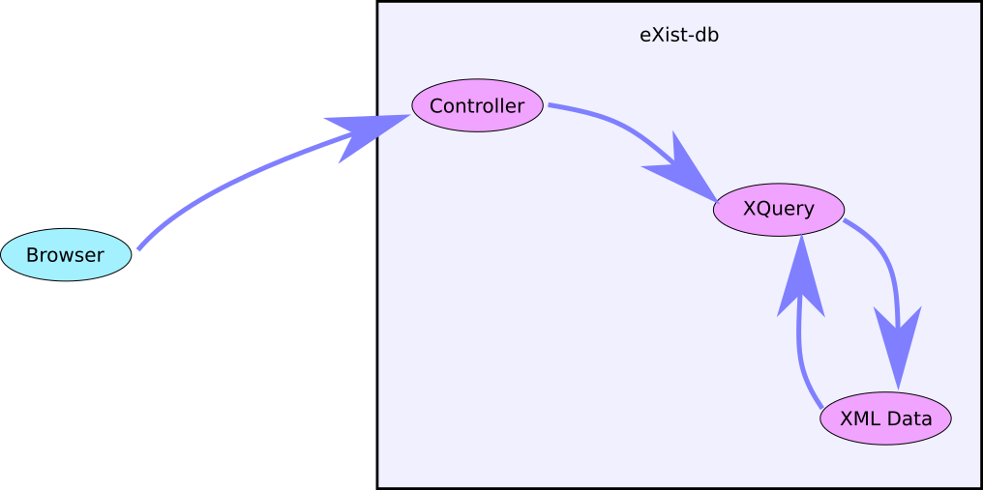
Our current webapps

Slide 13
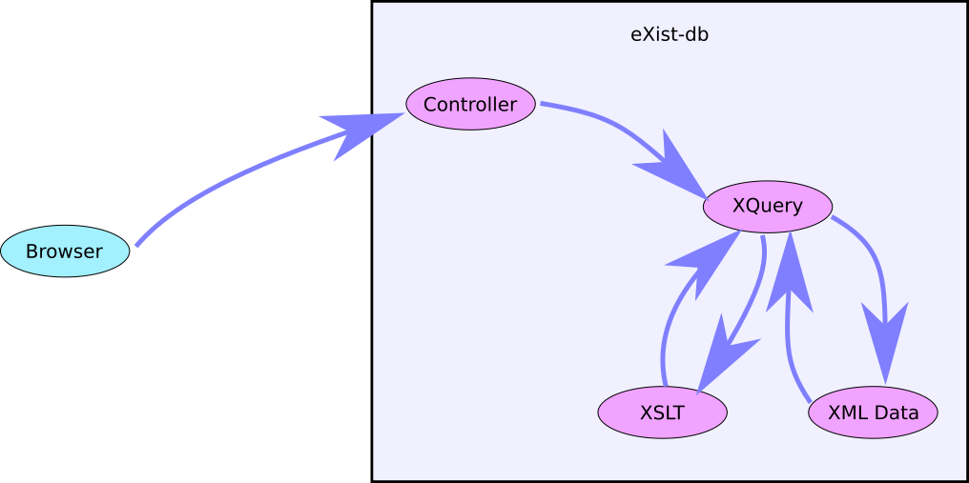
Our current webapps

Slide 14
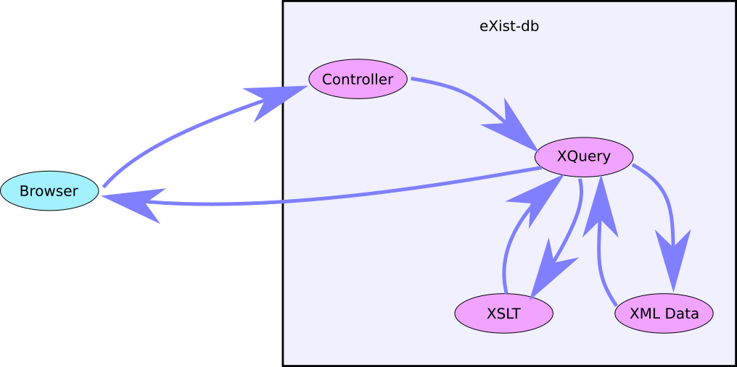
Our current webapps

Slide 15
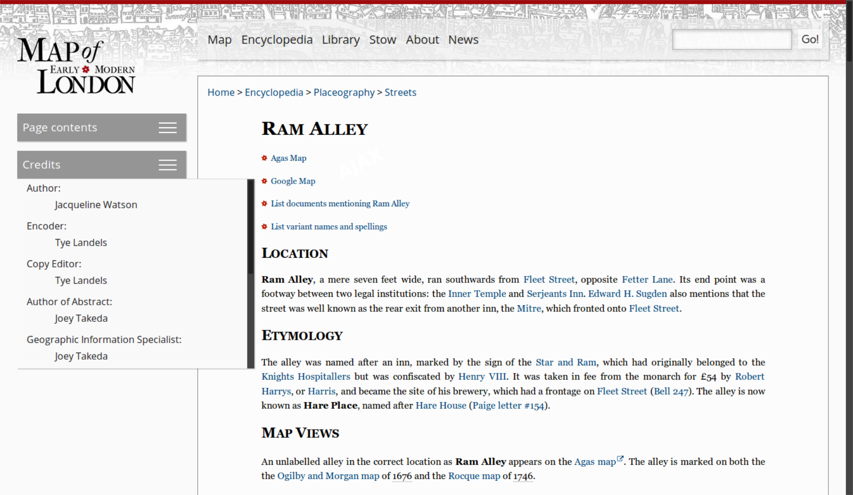
MoEML page

Slide 16
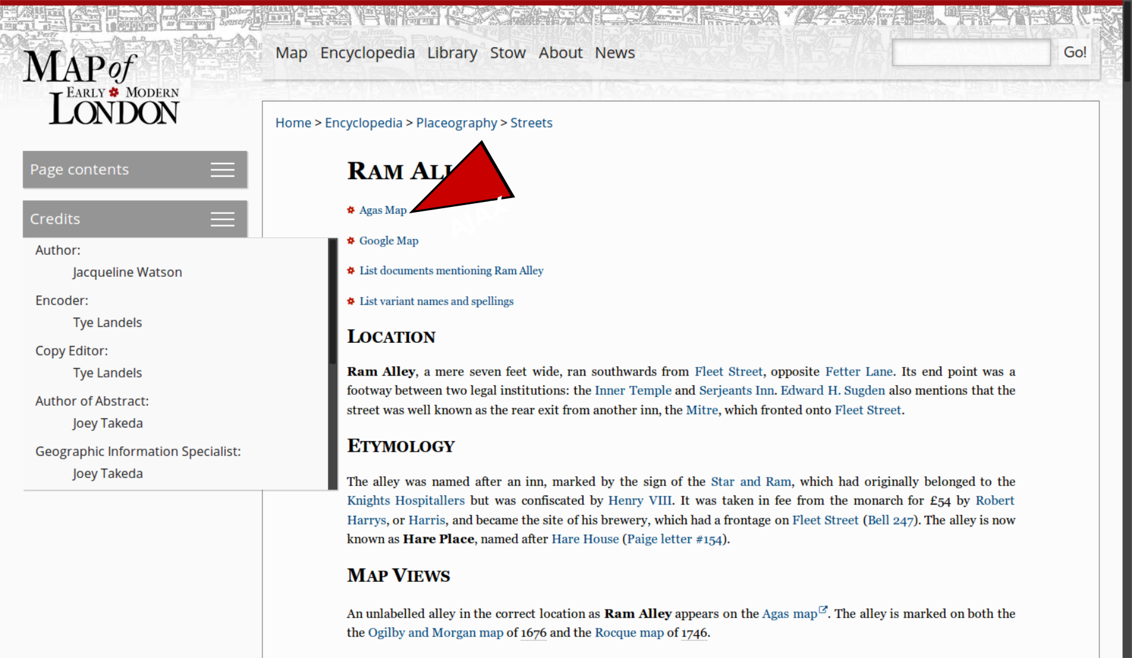
MoEML page

Slide 17
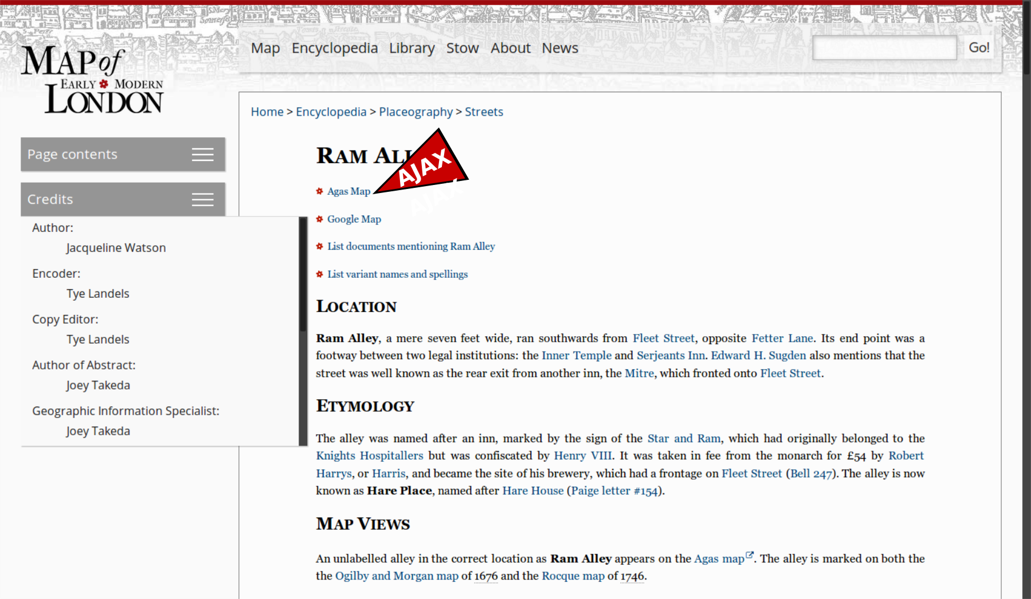
MoEML page

Slide 18
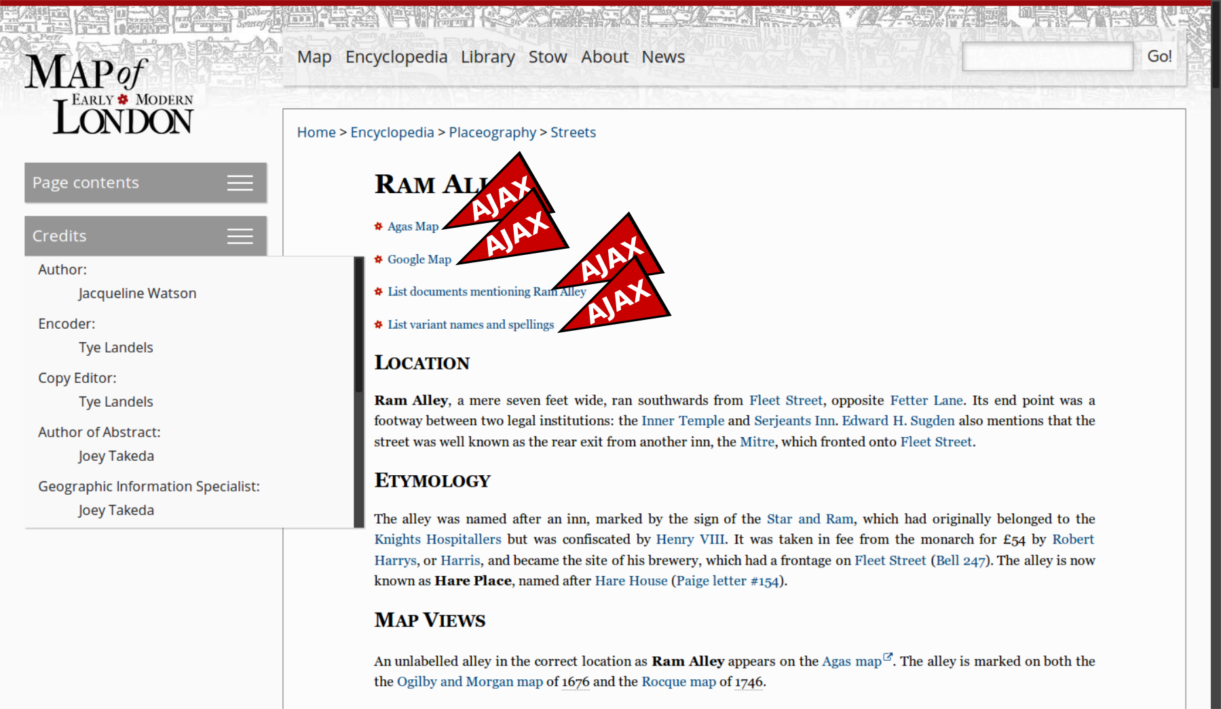
MoEML page

Slide 19
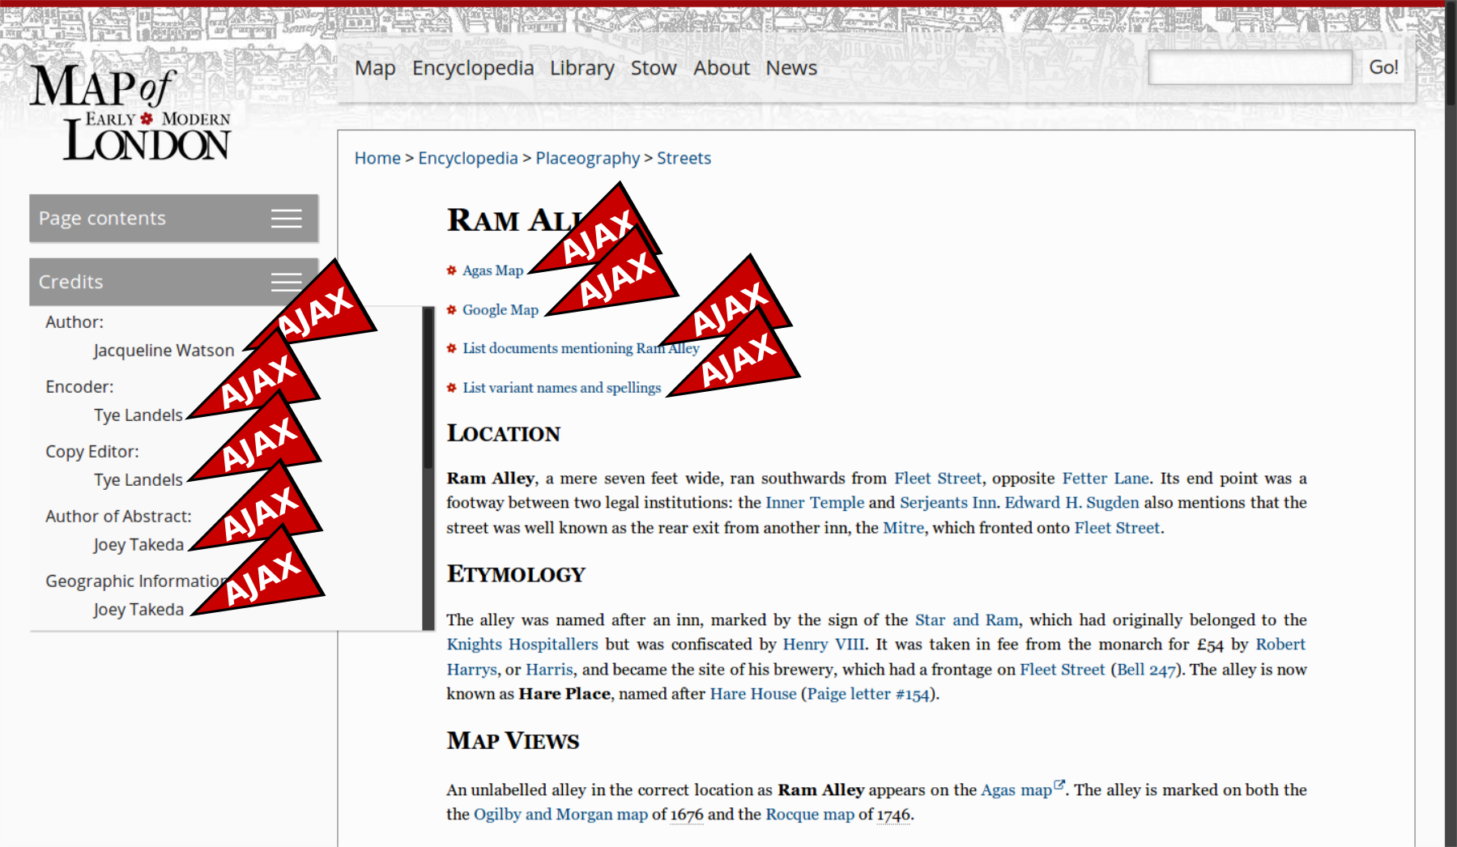
MoEML page

Slide 20
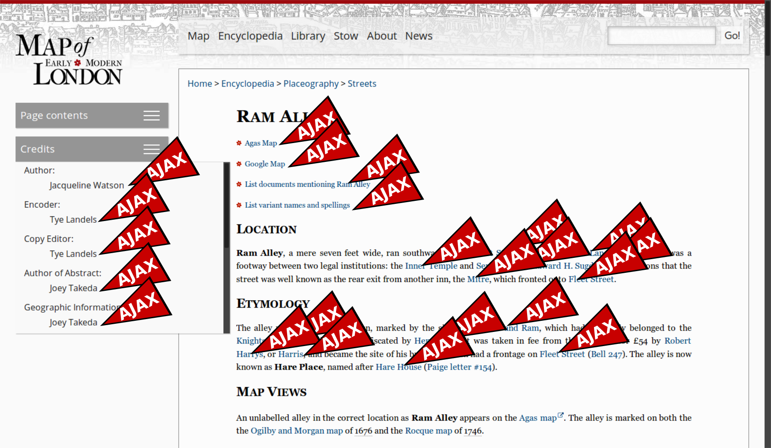
MoEML page

Slide 21
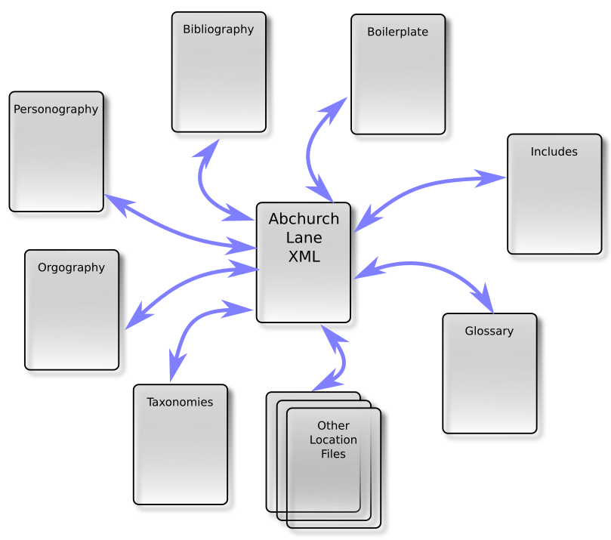

Slide 22
Problems with the current model
Collection-level coherence is difficult to maintain.
Web applications are difficult to archive.
Taking and using a single document from the collection is tricky.
Search has to be specially-crafted for each application.
Versioning is incoherent and editions don't exist.

Slide 23

Where's Joey?
Search MoEML for “Joey”.
  You get 4 documents.
  None of them is Joey's actual page (because it's not a page).
  But look at Joey's “page”:http://mapoflondon.uvic.ca/TAKE1.htm

Slide 24
Static build principles
Build everything all the time.
Validate and diagnose relentlessly.
Make every document coherent and complete.
Duplicate everything wherever you need it.
Make HTML documents degrade gracefully.
Create every possible version of your documents you can imagine being useful.

Slide 25
The MoEML Build Process (1)
Validate the source XML (RNG and Schematron).
Create a better version of those documents (“original XML”).
Add generated XML versions of all the index, TOC, JSON, tabular and other pages currently created on the fly by eXist.
Validate this “original XML”.
Create “standalone” versions of all the original XML documents (“standalone XML”).
Validate the standalone XML.
Create more normative versions of all the XML documents, in which project-specific idiosyncracies are replaced with more conventional encoding strategies (“standard XML”).
Validate the standard XML.

Slide 26
MoEML build process (2)
Create TEI Simple versions of all the docs.
Validate the TEI Simple documents.
Create TEI Lite versions.
Validate the TEI Lite.
Create KML output from all the location files.
Validate the KML.
Create all the fragments required for responses to AJAX requests (12,172 items).
Create XHTML5 versions of the documents.
Validate the XHTML5 versions.

Slide 27
“Standalone XML” contains:
  Every person mentioned
  Every org mentioned
  Every bibliography item referenced
  The abstract for every location mentioned
  All the variant spellings for all locations mentioned
  Full copies of the document type taxonomy and the responsibility taxonomy.

Slide 28
So instead of this:

Slide 29
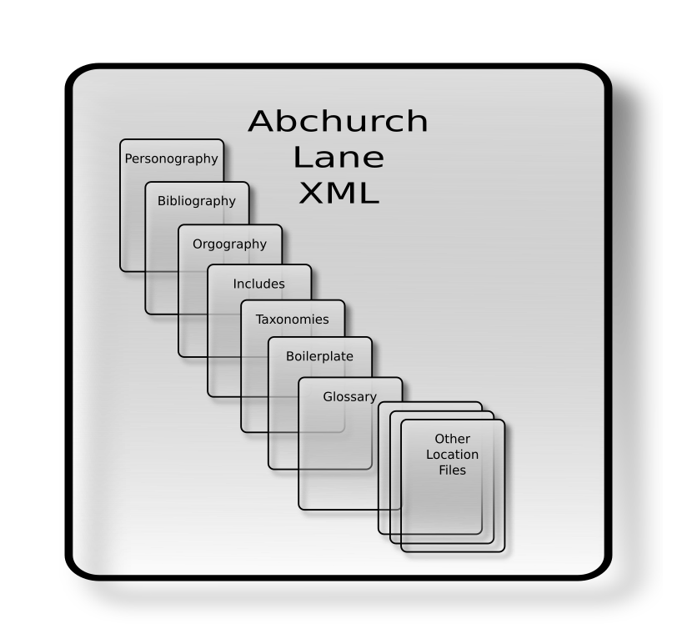
...we now have this:

Slide 30

Who's going to do all this building?
Meet Mr Jenkins.

Slide 31
Advantages
All your documents actually exist.
All your documents actually contain what they appear to contain.
Searching your documents will work more intuitively.
Each build is globally coherent, and can constitute a single edition.
Every document can function outside the collection.
Future users can take what they want, in a convenient self-contained package, in the format they need.
Everything works without a web server.*
*Except search. Over to Stew and Greg.

