Slide 1
The Prefabricated Website
Who needs a server anyway?
Martin Holmes and Joseph Takeda
University of Victoria Humanities Computing and Media Centre

Slide 2
Quick summary
The projects: Endings and The Map of Early Modern London
What is a static site, and why would you build one?
The site build process
Advantages
Disadvantages

Slide 3

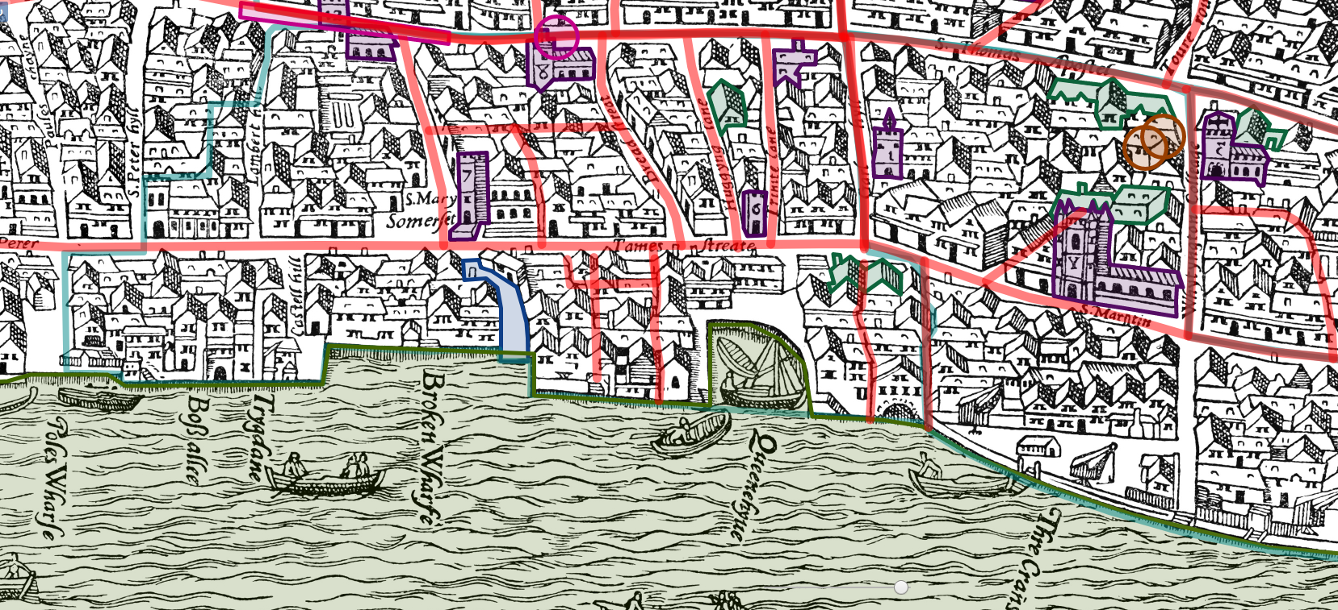
The Map of Early Modern London
Currently version 6.3 / 6.4, versions dating back to 1999
2,000+ documents, 1,600+ locations, 6,500+ people, 1800+ bibliography items
Gazetteer / encyclopedia / digital edition publication platform

Slide 4
/e Project Endings
Endings is a four-year project funded by the Social Sciences and Humanities Research Council (SSHRC) that is creating tools, principles, policies and recommendations for digital scholarship practitioners to create accessible, stable, long-lasting resources in the humanities.
Thank you SSHRC!

Slide 5
Endings principles
Data
Products
Processing
Documentation
Release Management

Slide 6
Endings principles
Data
Products
Processing
Documentation
Release Management

Slide 7
Static sites: what and why?

Slide 8
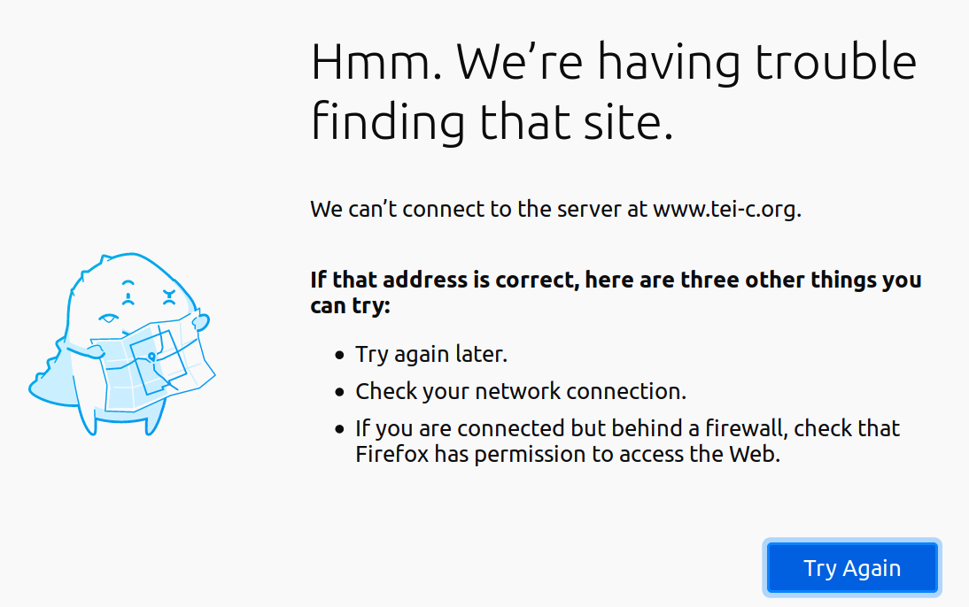
www.tei-c.org, early 2019...

Slide 9
Dependencies
The TEI site depends on WordPress.
WordPress depends on PHP and MySQL (single point of failure).
Getting a new server running requires
Installing PHP and MySQL
Restoring the DB from backup
Configuring WordPress
...

Slide 10
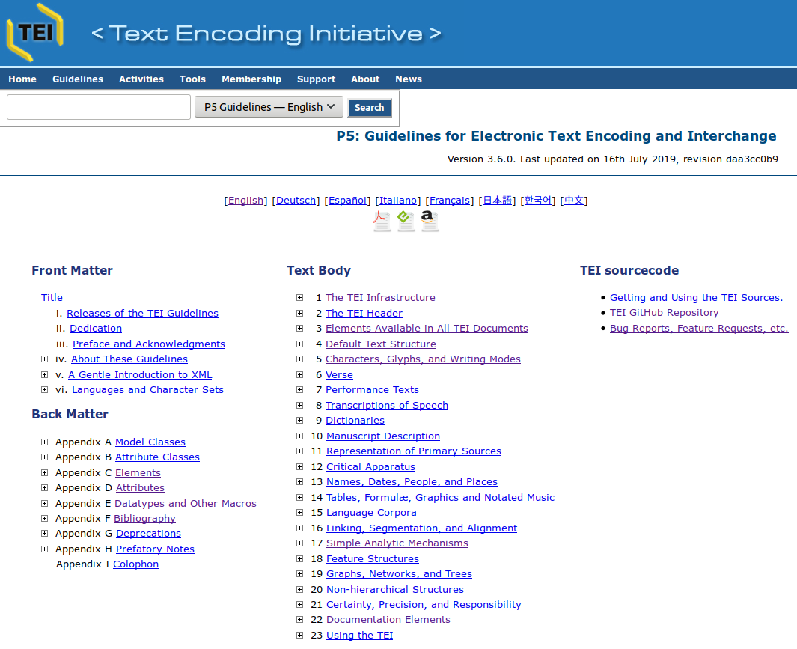
No such problem with the Guidelines
The online version of the TEI Guidelines consists only of HTML, CSS and JavaScript.
It’s always in multiple places.
You can put a copy of it on any server.
You can use it from a local drive.
You can put as many copies as you like wherever you want.
That’s a static site.

Slide 11
Static sites:
Have no dependencies (other than a web server) ✔
Are pure HTML, CSS and JavaScript ✔
Can be replicated endlessly ✔
Need little or no curation ✔
Therefore have more chance of survival ✔

Slide 12
We’re not the only people who think so...
Jamstack.org is an initiative to champion “modern web development architecture based on client-side JavaScript, reusable APIs, and prebuilt Markup,” in the interests of “better performance,” “cheaper, easier scaling,” “higher security,” and a “better developer experience.”

Slide 13
MoEML’s static site build process: Part 1
Validate (Relax NG)
Validate (Schematron)
Diagnose
  Coherence: all links point to things.
  Consistency: all documents conform to encoding and editorial guidelines.
  Completeness: everything mentioned actually exists.
  (See Holmes and Takeda 2019, http://dx.doi.org/10.1093/llc/fqz011)
If anything is wrong, then stop. A Website with errors is not worth building.

Slide 14
In the bad old days before Endings...
...project members would happily upload anything they thought was finished into the live web application.
They linked to things that didn’t yet exist or might never exist.
They added images and documents that were never linked to.
The site was always slightly broken in numerous ways.

Slide 15
In the bad old days before Endings...
...project members would happily upload anything they thought was finished into the live web application.
They linked to things that didn’t yet exist or might never exist.
They added images and documents that were never linked to.
The site was always slightly broken in numerous ways.
We’ll have no more of that.

Slide 16
MoEML’s static site build process: Part 2
Make more XML!
“Original” TEI: Better versions of our actual encoded files.
“Synthesized” TEI: New documents computed from existing pages.
“Standalone” TEI: Versions with no external dependencies.
“Standard” TEI: Versions with less common encoding practices normalized.
TEI Lite and TEI simplePrint: Versions for simple interchange.
(See Holmes 2017, http://dx.doi.org/10.1093/llc/fqw048)

Slide 17
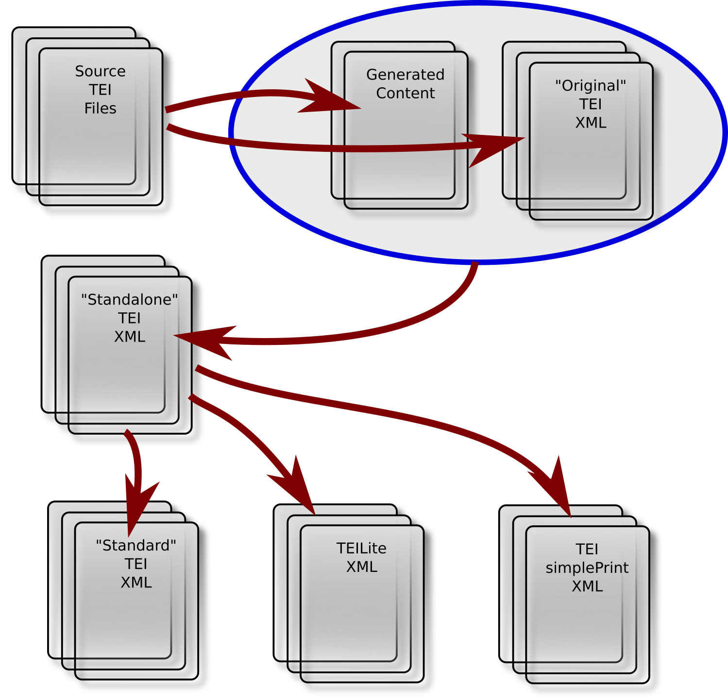

Slide 18
MoEML’s static site build process: Part 3
Build the HTML, CSS and JavaScript.
Validate all the HTML.
Validate all the CSS.
If anything is wrong, then stop. A Website with errors is not worth building.

Slide 19
Rules for Website generation
Every entity (location, person, org, article etc.) has a unique id, and its own unique page on the site.
No URL is ever abandoned. Obsoleted ids still get a page, redirecting as appropriate.
Every page stands alone and complete in terms of content.
All pages live together in the same folder.

Slide 20
“But but but ….”
But massive duplication of content across the site!
We don’t care.
But thousands of files no-one may ever see!
We don’t care.
But 10,591 files all in the same folder!
We don’t care.

Slide 21
Advantages: 1
You can build hugely complex resources that could not be built on the fly.
For example:
the Gazetteer (9000 entries)
the A-Z Index (a single page with 10,500 entity ids)
(Because Control + F.)

Slide 22
Advantages: 2
You can do really complicated, multi-pass processing of gnarly markup.
For example: @style, <rendition>/@selector
Collect all identical @style on elements into a <rendition>
Convert all <rendition>/@selectors into XPath, then to @rendition
Then generate HTML/CSS

Slide 23
Advantages: 3
Archiving the site is easy:
cp -r site somewhere_else/
Replicating the site is easy:
cp -r site somewhere_else/

Slide 24

Advantages: 4
Everything is there.
Internal links never break.
Everything works.
Everything is valid.
Everyone is happy.

Slide 25
Disadvantages
Deferred gratification.
Builds take a long time.
Builds often fail.
It can be hours before you can see your work on the build server.
But guess what?

Slide 26
Disadvantages
Deferred gratification.
Builds take a long time.
Builds often fail.
It can be hours before you can see your work on the build server.
But guess what?
We don’t care.
Patience is a virtue.

Slide 27
Conclusions

Slide 28
Conclusions
Everything that can be prefabricated should be prefabricated.

Slide 29
Conclusions
Everything that can be prefabricated should be prefabricated.
Everything that could conceivably be useful should be created and included.

Slide 30
Conclusions
Everything that can be prefabricated should be prefabricated.
Everything that could conceivably be useful should be created and included.
Redundancy is beneficial; in fact it is elegant.
  If the same personography entry is replicated in fifty pages that mention that person, then good; any of those pages can now be used outside the context of the collection without loss.

Slide 31
Conclusions
Everything that can be prefabricated should be prefabricated.
Everything that could conceivably be useful should be created and included.
Redundancy is beneficial; in fact it is elegant.
  If the same personography entry is replicated in fifty pages that mention that person, then good; any of those pages can now be used outside the context of the collection without loss.
Patience is a virtue: let your build take a long time; let your releases be well-separated.

Slide 32
Thanks for listening!
https://mapoflondon.uvic.ca
https://projectendings.github.io/
mholmes@uvic.ca
joey.takeda@gmail.com

