Slide 1
Selecting Technologies for Long-Term Survival
Martin Holmes
Humanities Computing and Media Centre
Endings project
https://onlineacademiccommunity.uvic.ca/endingsproject/

Slide 2
The problem
“Interactive digital assets are far more complex to preserve and manage than single, uniform digital media files. A single interactive work can comprise an entire range of digital objects, including files in different types and formats, applications to coordinate the files, and operating systems to run the applications. If any part of this complex system fails, the entire asset can become unreadable.”
Rieger and Casad 2014: “Interactive Digital Media Art Survey: Key Findings and Observations.”

Slide 3
Assumptions

Slide 4
Assumptions
No apocalypse

Slide 5
Assumptions
No apocalypse
Bits can be stored and retrieved

Slide 6
Assumptions
No apocalypse
Bits can be stored and retrieved
Archives exist to store and deliver them

Slide 7
Assumptions
No apocalypse
Bits can be stored and retrieved
Archives exist to store and deliver them
Change, innovation and obsolescence proceed at least as fast as in the last few years

Slide 8
Strategy
No software requirements
No network requirements
Easily-archivable bits
File formats with massive buy-in/investment
Functionality that gracefully degrades

Slide 9
50 years? Seriously?
Yes, seriously. 50 years.

Slide 10
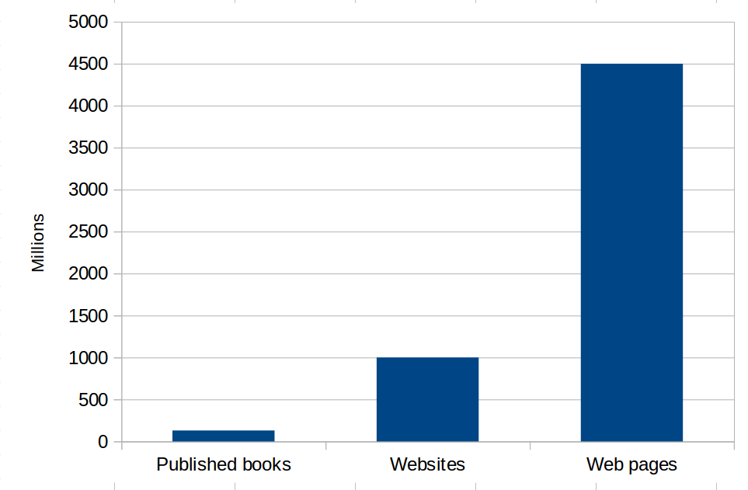
1. HTML
http://www.worldwidewebsize.com/
Notes:
Stats from http://www.worldwidewebsize.com/ (by Maurice de Kunder).

Slide 11
1. HTML
The world’s first website still works: http://info.cern.ch/hypertext/WWW/TheProject.html
This is because of backwards compatibility and error tolerance.
Notes:
Stats from http://www.worldwidewebsize.com/ (by Maurice de Kunder).

Slide 12
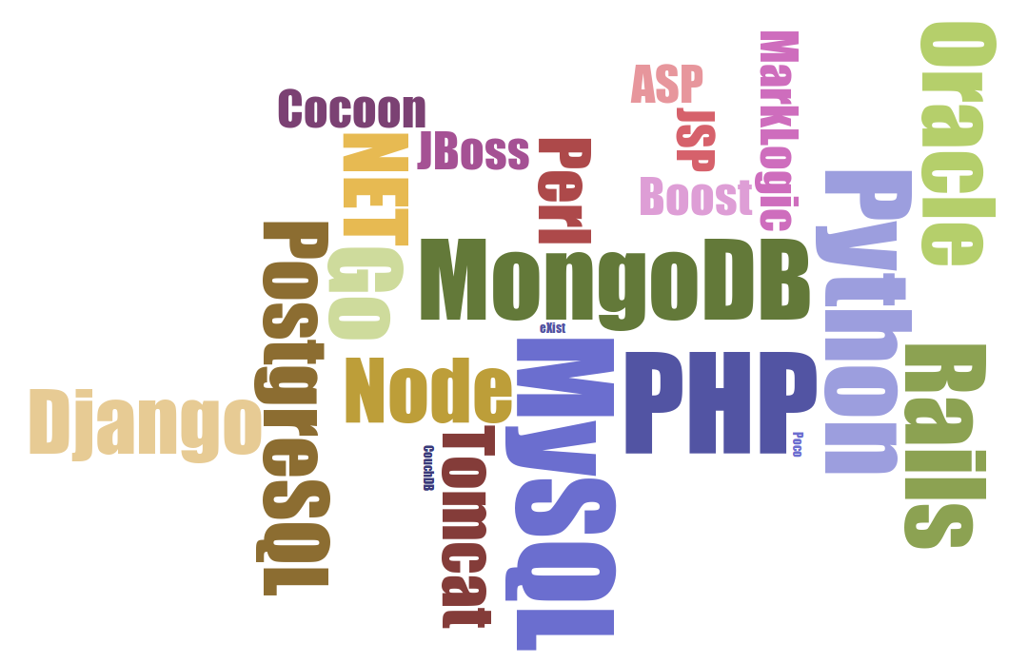
But what about...

Slide 13
But what about...
What are they mostly for?

Slide 14
But what about...
What are they mostly for?
Producing HTML.

Slide 15
XHTML5
Notes:
62.5% from https://w3techs.com/technologies/details/ml-html5/all/all

Slide 16
XHTML5
X = processable / transformable with XML tools
Notes:
62.5% from https://w3techs.com/technologies/details/ml-html5/all/all

Slide 17
XHTML5
X = processable / transformable with XML tools
HTML = 4.5 billion pages
Notes:
62.5% from https://w3techs.com/technologies/details/ml-html5/all/all

Slide 18
XHTML5
X = processable / transformable with XML tools
HTML = 4.5 billion pages
5 =
Notes:
62.5% from https://w3techs.com/technologies/details/ml-html5/all/all

Slide 19
XHTML5
X = processable / transformable with XML tools
HTML = 4.5 billion pages
5 =
62.5% of web sites
Notes:
62.5% from https://w3techs.com/technologies/details/ml-html5/all/all

Slide 20
XHTML5
X = processable / transformable with XML tools
HTML = 4.5 billion pages
5 =
62.5% of web sites
robust specification, which
Notes:
62.5% from https://w3techs.com/technologies/details/ml-html5/all/all

Slide 21
XHTML5
X = processable / transformable with XML tools
HTML = 4.5 billion pages
5 =
62.5% of web sites
robust specification, which
“defines the parsing rules for HTML documents, whether they are syntactically correct or not”
Notes:
62.5% from https://w3techs.com/technologies/details/ml-html5/all/all

Slide 22
XHTML5
X = processable / transformable with XML tools
HTML = 4.5 billion pages
5 =
62.5% of web sites
robust specification, which
“defines the parsing rules for HTML documents, whether they are syntactically correct or not”
allows custom data
Notes:
62.5% from https://w3techs.com/technologies/details/ml-html5/all/all

Slide 23
Custom data in XHTML5
<p> The <span data-teiEl="name" data-teiAttType="vessel"> Titanic </span> was a mighty ship. </p>

Slide 24
Whatever else happens...
...there will most likely be a migration path for HTML5.
Notes:
Our pages will ride along with 4.5 billion others. If 4.5 billion are lost, ours probably don’t actually matter.

Slide 25
2. Cascading Stylesheets
20 years old
Many properties, values and terms date back to early modern printing (font, italic, pt, en, justify)
Design principles incorporate forward and backward compatibility
Notes:
Forward and backward compatibility: https://www.w3.org/TR/CSS21/intro.html section 2.4.

Slide 26
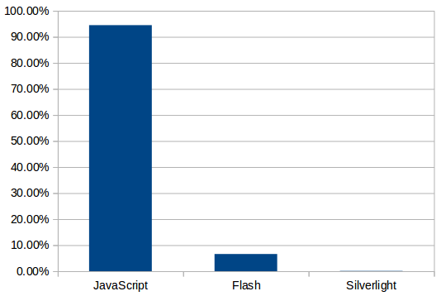
3. JavaScript
https://w3techs.com/
Notes:
Usage stat: https://w3techs.com/technologies/details/cp-javascript/all/all

Slide 27
3. JavaScript
Standardized as ECMA-262 and ISO 16262
Committed to backwards compatibility

Slide 28
XHTML5 + CSS + JS
Web pages
Mobile apps (Android, iOS)
EPUB3

Slide 29
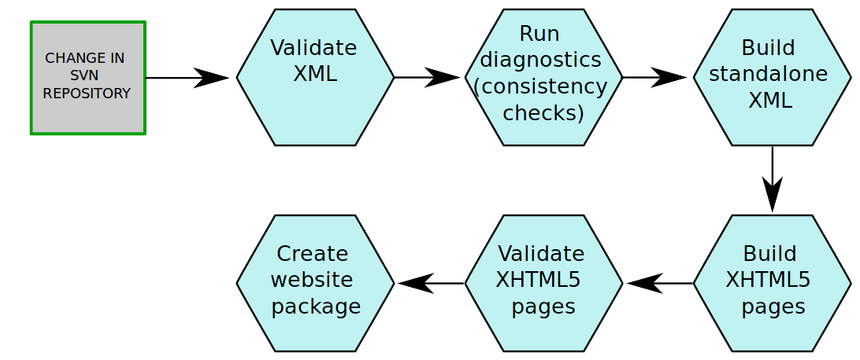
Build process

Slide 30
Goals and benefits

Slide 31
Goals and benefits
Site works from any web server.

Slide 32
Goals and benefits
Site works from any web server.
Site works off your hard drive.

Slide 33
Goals and benefits
Site works from any web server.
Site works off your hard drive.
Site works off a USB drive.

Slide 34
Goals and benefits
Site works from any web server.
Site works off your hard drive.
Site works off a USB drive.
Site can be copied from anywhere to anywhere.

Slide 35
Goals and benefits
Site works from any web server.
Site works off your hard drive.
Site works off a USB drive.
Site can be copied from anywhere to anywhere.
No JavaScript support? Site still works.

Slide 36
Goals and benefits
Site works from any web server.
Site works off your hard drive.
Site works off a USB drive.
Site can be copied from anywhere to anywhere.
No JavaScript support? Site still works.
No CSS? Site still works.

Slide 37
Further requirement
Every significant entity in the site has its own page at a unique URL. Not this: http://graves.uvic.ca/graves/site/xbrowse.xq?collection=%2Fdb%2Fgraves&type=diaryentry&query_stored=false&action=browse&search_text=-1&day=22&month=02&year=1935 but this: http://graves.uvic.ca/diary_1935-02-22.html

Slide 38
Implications

Slide 39
Implications
You must build every single page your site will ever need.

Slide 40
Implications
You must build every single page your site will ever need.
That’s a lot of pages (7663 for the Map of Early Modern London).

Slide 41
Implications
You must build every single page your site will ever need.
That’s a lot of pages (7663 for the Map of Early Modern London).
Every page must include all the information it needs to function, so lots of duplication.

Slide 42
Implications
You must build every single page your site will ever need.
That’s a lot of pages (7663 for the Map of Early Modern London).
Every page must include all the information it needs to function, so lots of duplication.
So what? Big deal. It’s text.

Slide 43
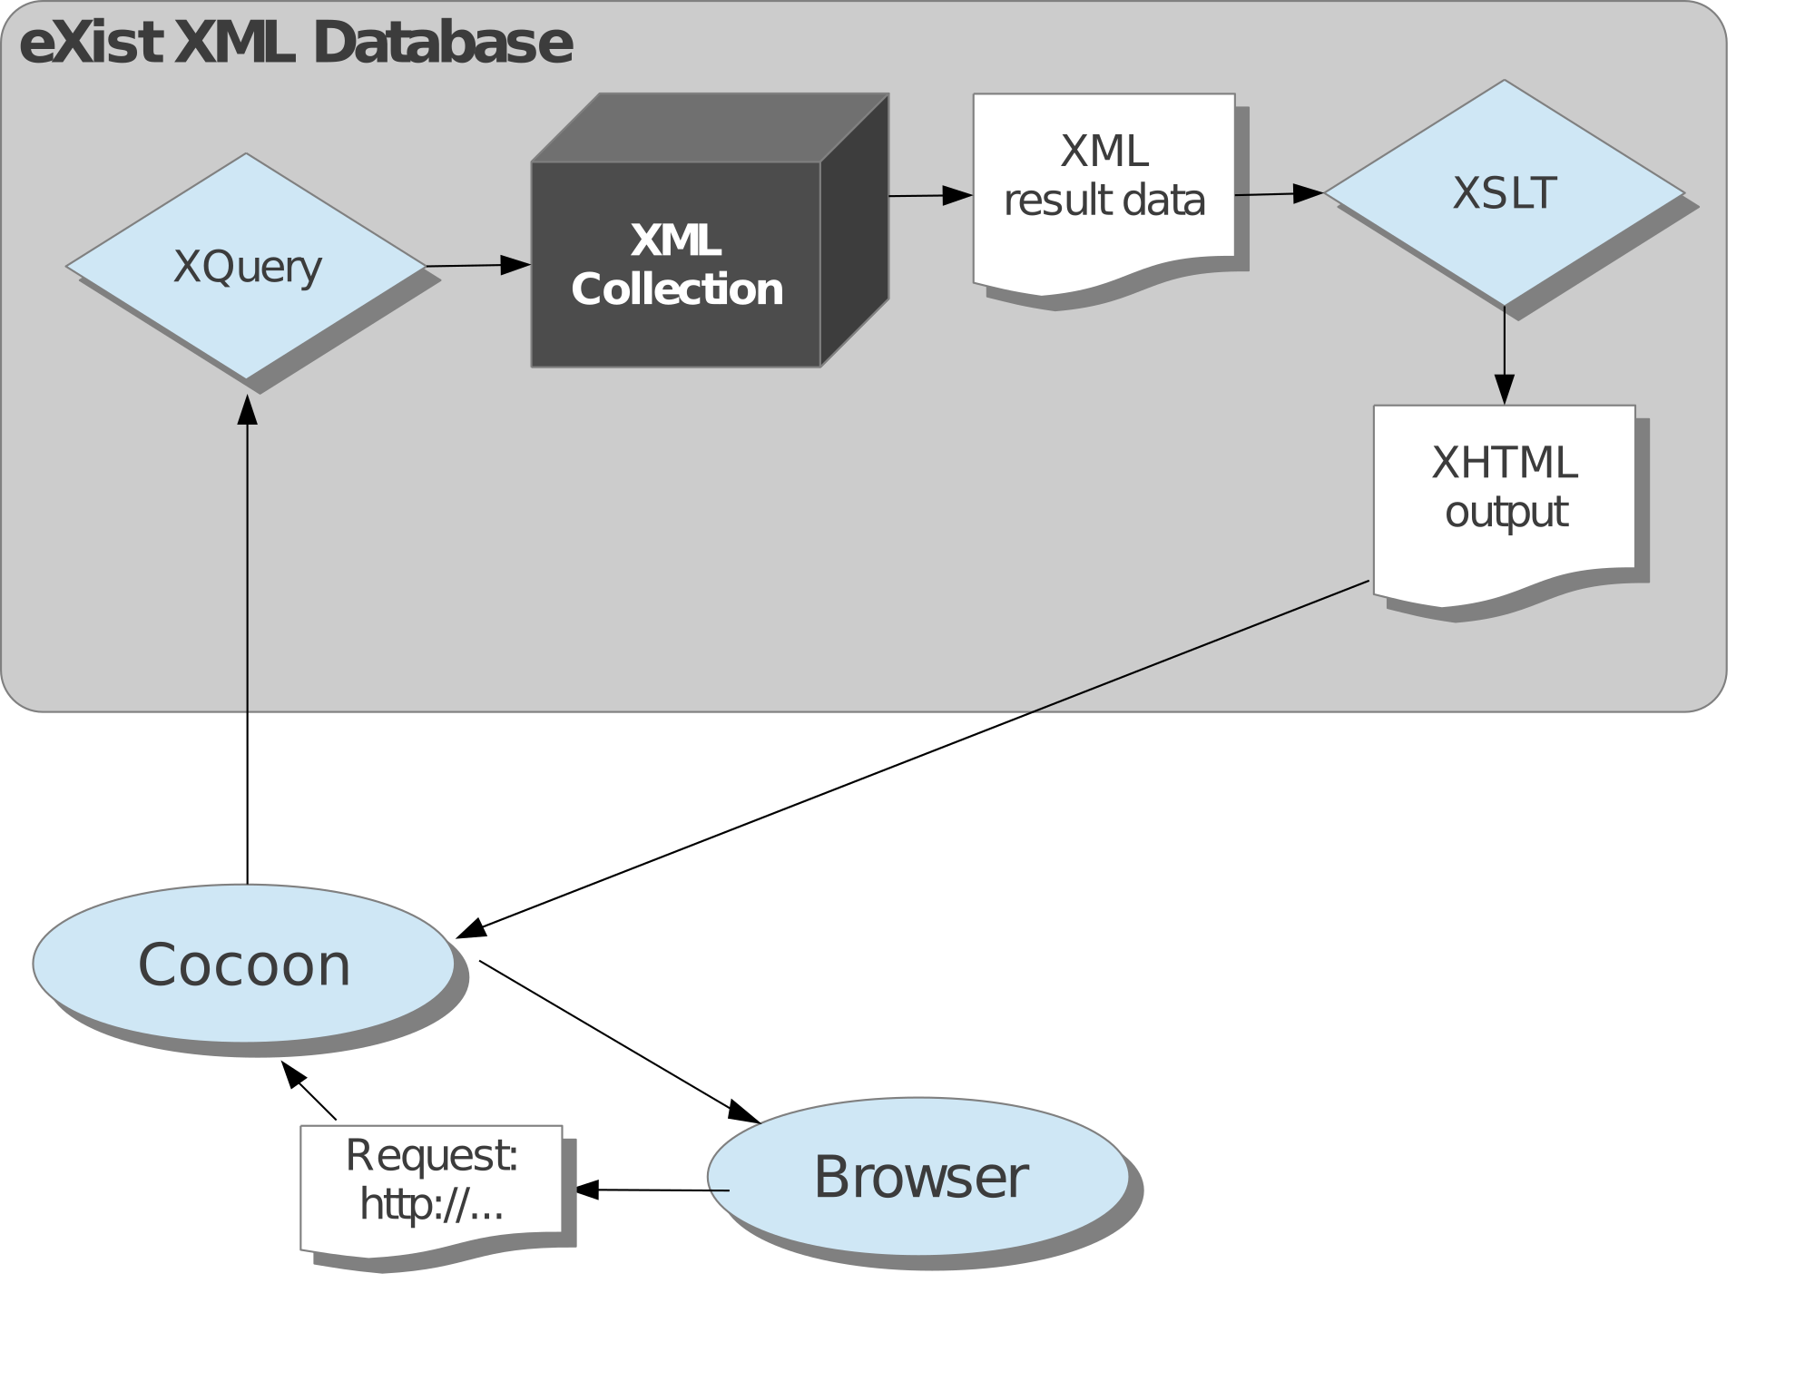
Old model

Slide 44
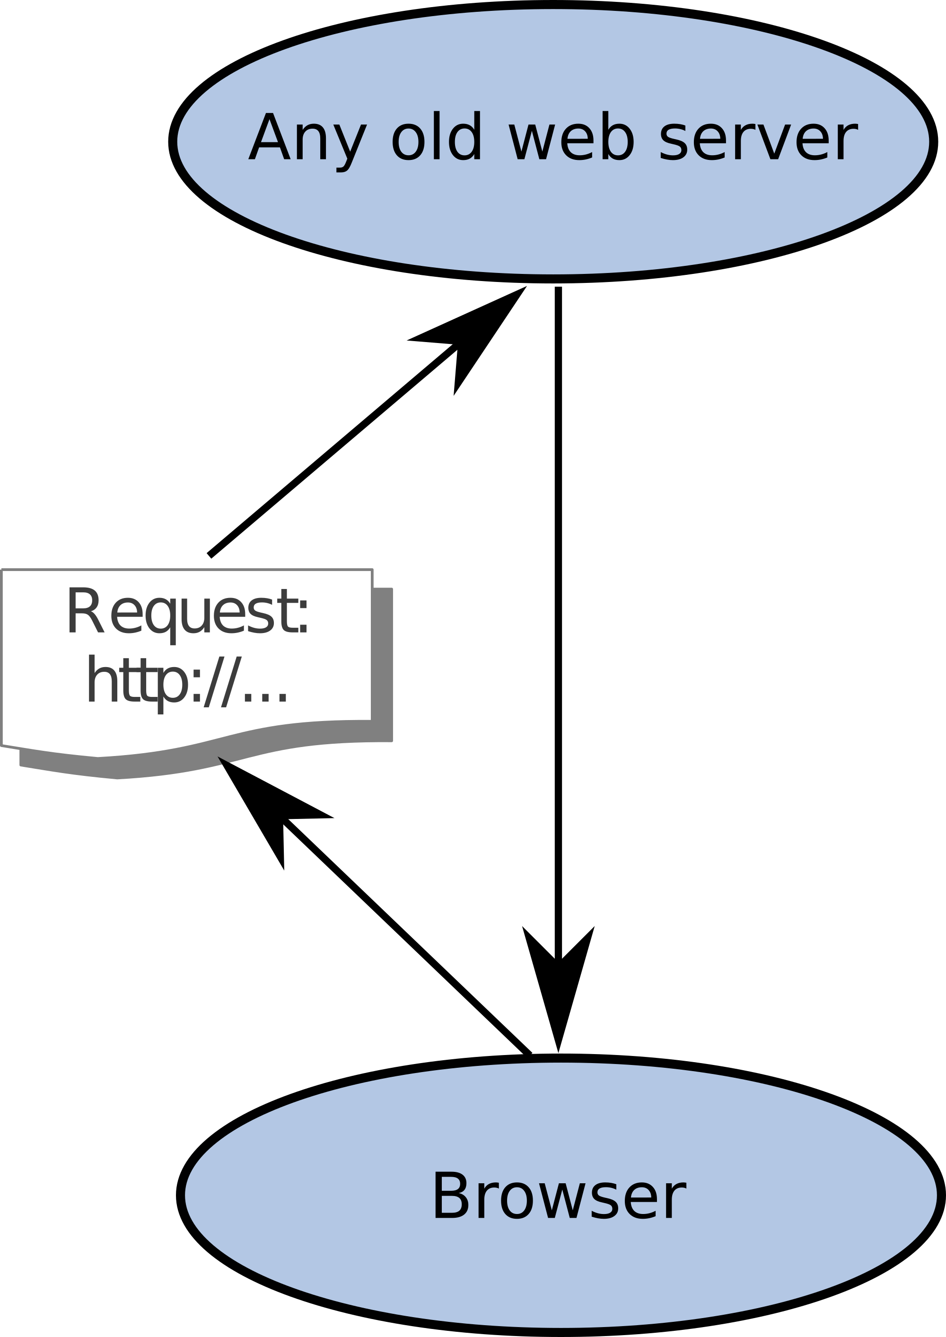
New model

Slide 45
What we can’t do
Site search
Combinatorially explosive query responses (search is a special case of this)

Slide 46
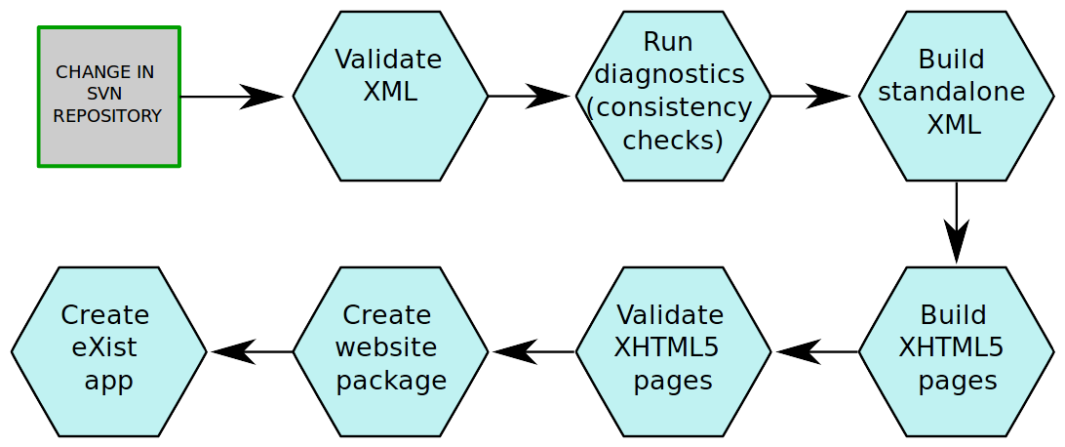
Back to eXist for search etc.

Slide 47




