Slide 1
Ending Your Digital Humanities Project from the Start
Joey Takeda
MA Student, Dept. of English, UBC
Programmer, University of Victoria

Slide 2
What we call the beginning is often the end And to make an end is to make a beginning. The end is where we start from.
— T.S. Eliot, “Little Gidding,” Four Quartets

Slide 3
The Endings Project

Slide 4
The Endings Project
Based at the University of Victoria

Slide 5
The Endings Project
Based at the University of Victoria
Comprised of four core projects:
The Map of Early Modern London (http://mapoflondon.uvic.ca)
The Robert Graves Diary project (http://graves.uvic.ca)
Le Mariage Sous L’Ancien Régime (http://mariage.uvic.ca)
The Nxaʔamxcín Dictionary Project

Slide 6
The Endings Project
Based at the University of Victoria
Comprised of four core projects:
The Map of Early Modern London (http://mapoflondon.uvic.ca)
The Robert Graves Diary project (http://graves.uvic.ca)
Le Mariage Sous L’Ancien Régime (http://mariage.uvic.ca)
The Nxaʔamxcín Dictionary Project
https://onlineacademiccommunity.uvic.ca/endingsproject/
https://github.com/projectEndings/

Slide 7
Not about how to “end” a project
… but rather how to start at an end

Slide 8
Not about how to “end” a project
… but rather how to start at an end
Our definition of “done” is not about content per se

Slide 9
Not about how to “end” a project
… but rather how to start at an end
Our definition of “done” is not about content per se
It’s about:

Slide 10
Not about how to “end” a project
… but rather how to start at an end
Our definition of “done” is not about content per se
It’s about:
Archivability

Slide 11
Not about how to “end” a project
… but rather how to start at an end
Our definition of “done” is not about content per se
It’s about:
Archivability
Coherence

Slide 12
Not about how to “end” a project
… but rather how to start at an end
Our definition of “done” is not about content per se
It’s about:
Archivability
Coherence
Correctness

Slide 13
“What we call the beginning is often the end”:
“Granting agencies reward innovation and originality, not steady, measured progress. No one writes a grant application to say, ‘With just two more years of funding we can finish the good work we’ve started. No, we’re not going to be doing anything new. We just want finally to put this thing to bed.’” (Kirschenbaum, p.3)

Slide 14
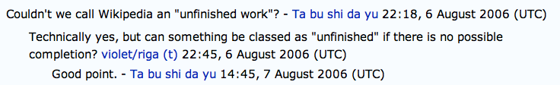
“What we call the beginning is often the end”:
Image from Sewell, “It’s For Sale, So It Must Be Finished”

Slide 15
The Endings Plan (Or Endings Compliance)

Slide 16
The Endings Plan (Or Endings Compliance)
No “boutique” software requirements

Slide 17
The Endings Plan (Or Endings Compliance)
No “boutique” software requirements
No network requirements

Slide 18
The Endings Plan (Or Endings Compliance)
No “boutique” software requirements
No network requirements
Easily-archivable formats

Slide 19
The Endings Plan (Or Endings Compliance)
No “boutique” software requirements
No network requirements
Easily-archivable formats
File formats with massive buy-in/investment

Slide 20
The Endings Plan (Or Endings Compliance)
No “boutique” software requirements
No network requirements
Easily-archivable formats
File formats with massive buy-in/investment
Functionality that gracefully degrades

Slide 21
Technologies

Slide 22
Technologies
TEI-XML

Slide 23
Technologies
TEI-XML
XHTML

Slide 24
Technologies
TEI-XML
XHTML
CSS

Slide 25
Technologies
TEI-XML
XHTML
CSS
JavaScript

Slide 26
Technologies
TEI-XML
XHTML
CSS
JavaScript
And only the first two are essential.

Slide 27
TEI

Slide 28
TEI
Text Encoding Initiative

Slide 29
TEI
Text Encoding Initiative
Large community with open standards

Slide 30
TEI
Text Encoding Initiative
Large community with open standards
Many, many users who create stylesheets to transform TEI back and forth between formats

Slide 31
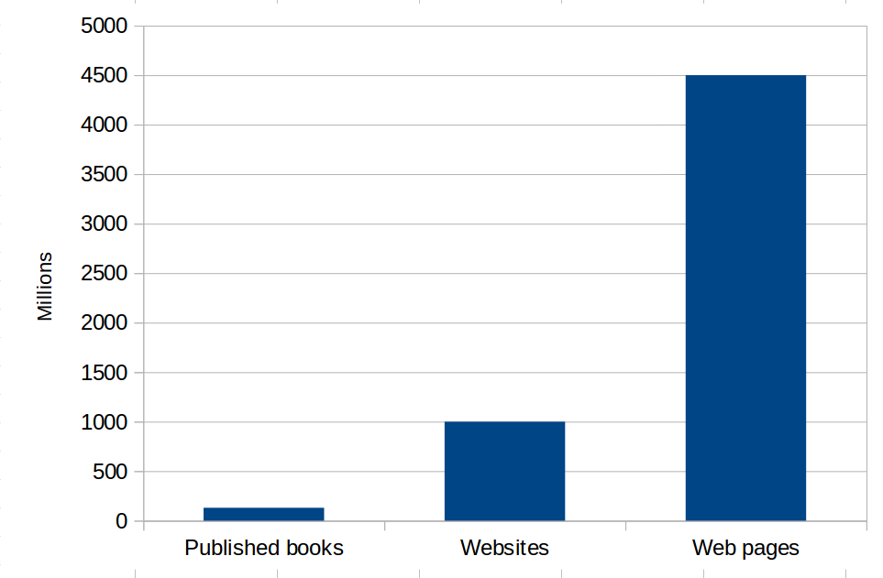
(X)HTML
http://www.worldwidewebsize.com/

Slide 32
(X)HTML
The world’s first website still works: http://info.cern.ch/hypertext/WWW/TheProject.html

Slide 33
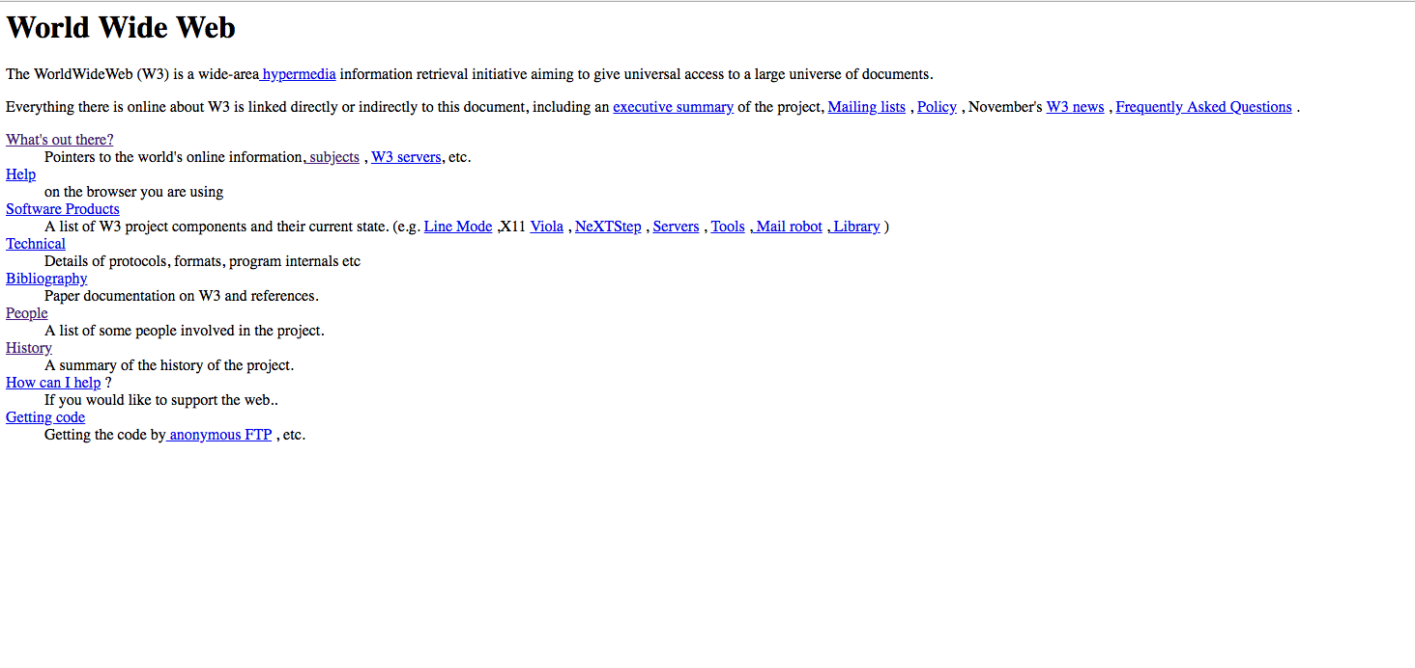
(X)HTML

Slide 34
(X)HTML
Why not…

Slide 35
(X)HTML
Why not…
Python
PHP
Rails
MySQL
Tomcat
Node
Perl
ASP
Cocoon
++++

Slide 36
(X)HTML
What are they mainly for?

Slide 37
(X)HTML
What are they mainly for?
Producing HTML

Slide 38
(X)HTML5
We use XHTML5

Slide 39
(X)HTML5
We use XHTML5
XML and thus easily processed

Slide 40
(X)HTML5
We use XHTML5
XML and thus easily processed
4.5 billion pages in HTML

Slide 41
(X)HTML5
We use XHTML5
XML and thus easily processed
4.5 billion pages in HTML
XHTML5 has a robust specification that gives strict validation of syntax

Slide 42
(X)HTML5
We use XHTML5
XML and thus easily processed
4.5 billion pages in HTML
XHTML5 has a robust specification that gives strict validation of syntax
Most likely there will be a conversion

Slide 43
Cascading stylesheets (CSS)

Slide 44
Cascading stylesheets (CSS)
20 years old

Slide 45
Cascading stylesheets (CSS)
20 years old
Many properties date back to early modern printing (font, italic, pt)

Slide 46
Cascading stylesheets (CSS)
20 years old
Many properties date back to early modern printing (font, italic, pt)
Design principles incorporate forward and backwards compatibility

Slide 47
Cascading stylesheets (CSS)
20 years old
Many properties date back to early modern printing (font, italic, pt)
Design principles incorporate forward and backwards compatibility
And if no CSS, the site still works

Slide 48
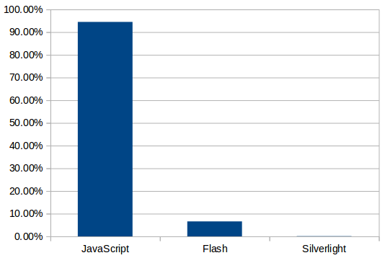
Javascript
https://w3techs.com/

Slide 49
Javascript

Slide 50
Javascript
Committed to backwards compatibility

Slide 51
Javascript
Committed to backwards compatibility
Very commonly used

Slide 52
Javascript
Committed to backwards compatibility
Very commonly used
If no JavaScript, the site still works

Slide 53
Static build

Slide 54
Static build…. meet mr. jenkins

Slide 55

Static build…. meet mr. jenkins

Slide 56
Build process

Slide 57
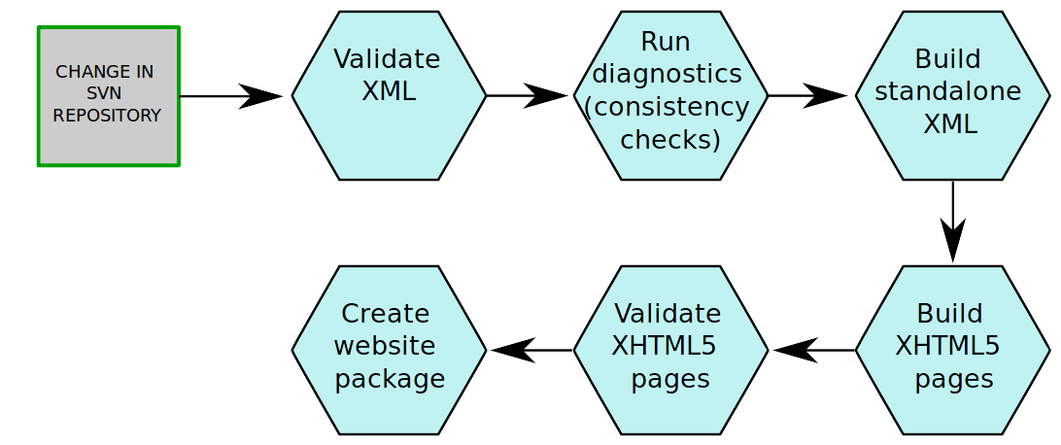
Build process

Slide 58
advantages
Fast and simple execution on the server

Slide 59
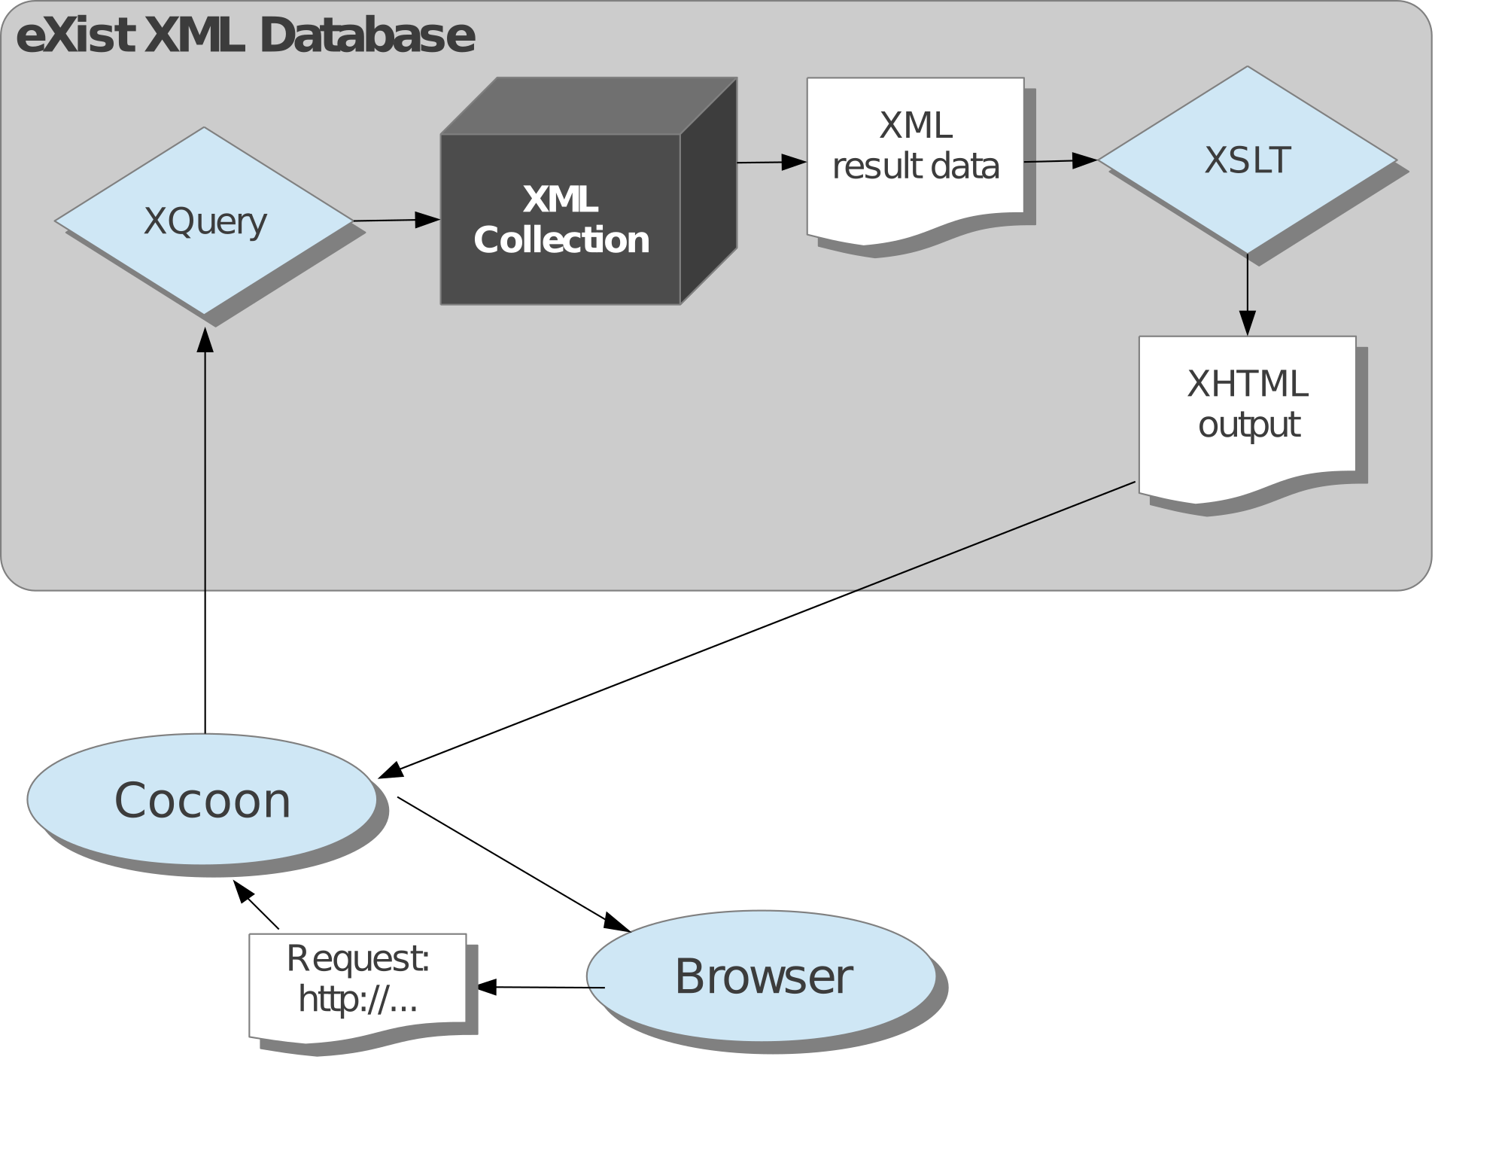
Old model

Slide 60
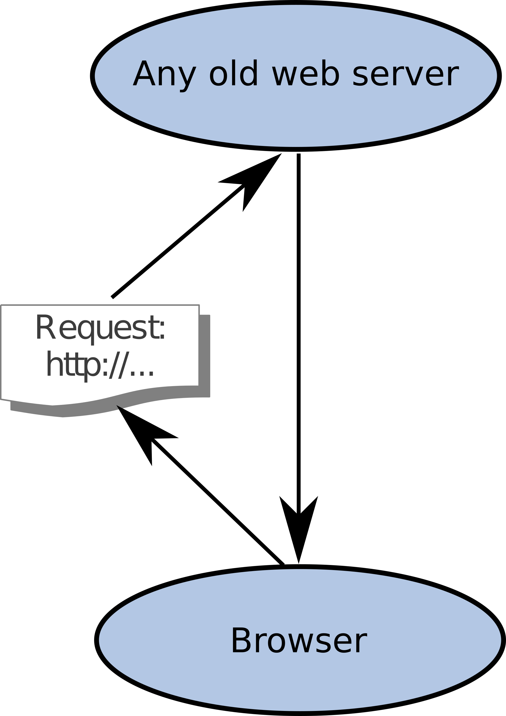
New model

Slide 61
advantages
Fast and simple execution on the server
Site works on any server

Slide 62
advantages
Fast and simple execution on the server
Site works on any server
Site works locally off of your hard drive

Slide 63
advantages
Fast and simple execution on the server
Site works on any server
Site works locally off of your hard drive
Site can be taken from anywhere to anywhere

Slide 64
advantages
Fast and simple execution on the server
Site works on any server
Site works locally off of your hard drive
Site can be taken from anywhere to anywhere
Site can be run off of a USB drive…

Slide 65
Drawbacks

Slide 66
Drawbacks
Takes a long time

Slide 67
Drawbacks
Takes a long time
Can’t just upload one page

Slide 68
Drawbacks
Takes a long time
Can’t just upload one page (there’s no such thing as a page)

Slide 69
Drawbacks
Takes a long time
Can’t just upload one page (there’s no such thing as a page)
Breaks often

Slide 70
Drawbacks
Takes a long time
Can’t just upload one page (there’s no such thing as a page)
Breaks often (but that’s good!)

Slide 71
Drawbacks
Takes a long time
Can’t just upload one page (there’s no such thing as a page)
Breaks often (but that’s good!)
You have to build everything you want every time (lots and lots and lots of pages)

Slide 72
Drawbacks
Takes a long time
Can’t just upload one page (there’s no such thing as a page)
Breaks often (but that’s good!)
You have to build everything you want every time (lots and lots and lots of pages)
Redundancy

Slide 73
Drawbacks
Takes a long time
Can’t just upload one page (there’s no such thing as a page)
Breaks often (but that’s good!)
You have to build everything you want every time (lots and lots and lots of pages)
Redundancy (but maybe that’s also an advantage)

Slide 74
Thanks!
You, for attending!
Allan Cho for the invitation
UBC Libraries
The Social Sciences and Humanities Research Council
The Endings Project / UVic Libraries
Martin Holmes and Stewart Arniel (materials)

Slide 75
Works Cited
Eliot, T.S. Little Gidding. Four Quartets. Harcourt Brace, 1971.
Kirschenbaum, Matthew G. “Done: Finishing Projects in the Digital Humanities.” DHQ, vol. 3, no. 2, 2009, http://www.digitalhumanities.org/dhq/vol/3/2/000037/000037.html.
Sewell, David. “Large-Scale Humanities Computing Projects: Snakes Eating Tails, or Every End Is a New Beginning?” DHQ, vol. 3, no. 2, 2009, http://www.digitalhumanities.org/dhq/vol/3/2/000039/000039.html.

