Slide 1
Diagnostics
Because validation is not enough.
Joey Takeda and Martin Holmes

Slide 2
Validation is great
...especially if you have created a solid, tightly-constrained schema.
But it’s not enough...
JT </e> MH

Slide 3
Extra Schematron
is a great help. We use Schematron to:
enforce curly apostrophes in text
ban quotation marks (use <quote> etc.)
ban leading and trailing spaces in some tags
enforce correct capitalization
limit the length of abstracts
...and lots more...
JT </e> MH

Slide 4
But that’s not enough
Validation works at the document level, but a digital edition project is typically a large collection of interrelated resources.
JT </e> MH

Slide 5
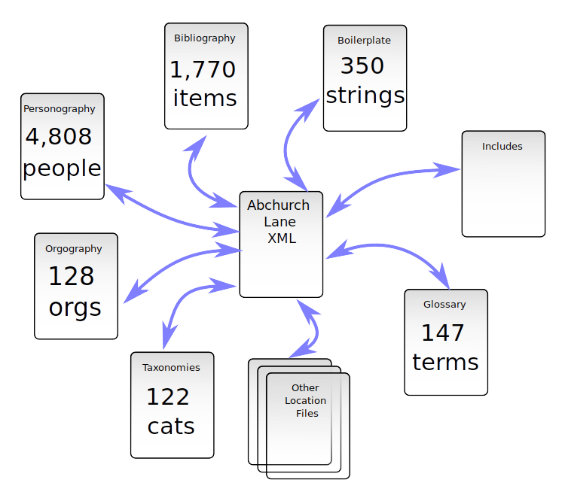

Slide 6
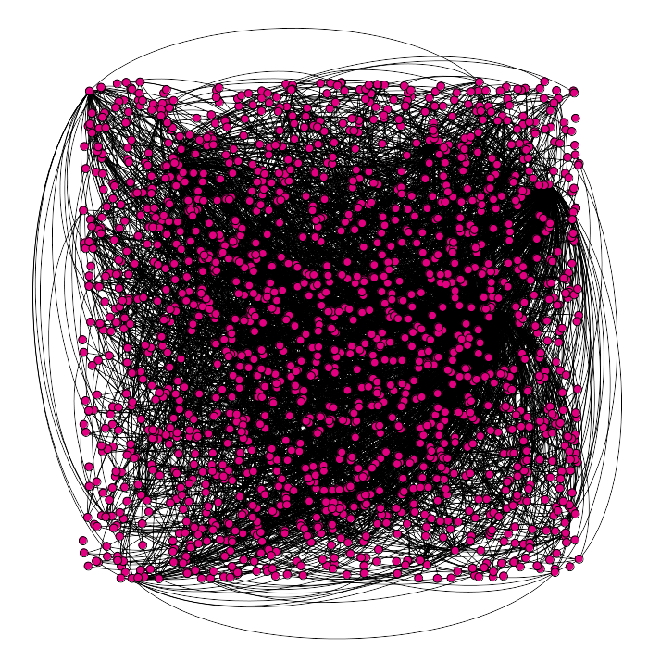
Network graph

Slide 7
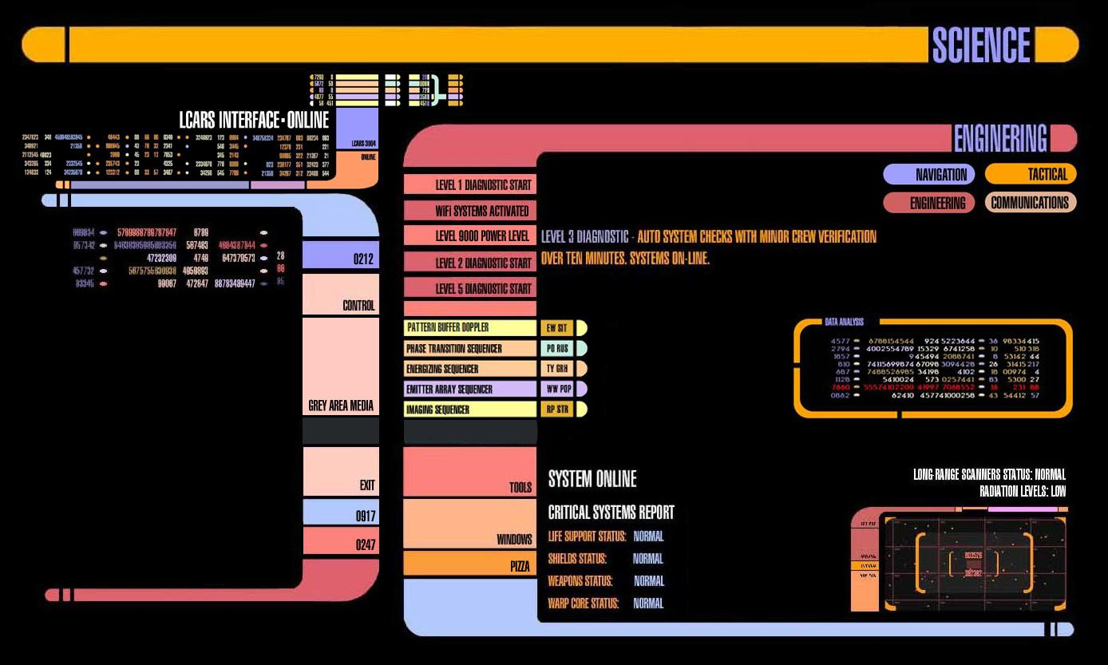
Diagnostics to the rescue!

Slide 8
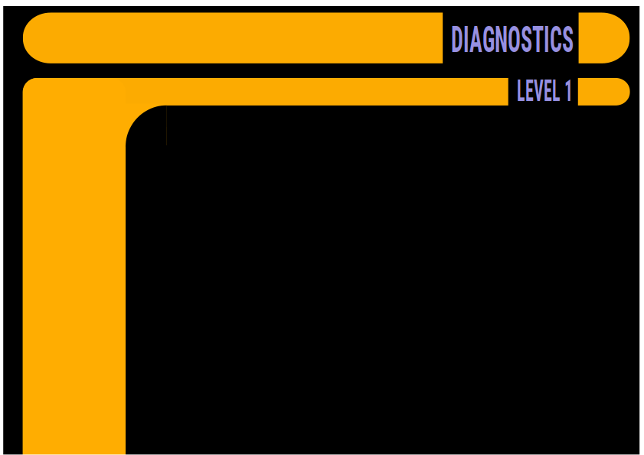
COHERENCE and CONSISTENCY

Slide 9
COHERENCE and CONSISTENCY
Project-level checking of referential integrity:

Slide 10
COHERENCE and CONSISTENCY
Project-level checking of referential integrity:
  non-existent pointers/targets

Slide 11
COHERENCE and CONSISTENCY
Project-level checking of referential integrity:
  non-existent pointers/targets
  duplicate @xml:ids

Slide 12
COHERENCE and CONSISTENCY
Project-level checking of referential integrity:
  non-existent pointers/targets
  duplicate @xml:ids
  entity type errors (persName / placeName / orgName)

Slide 13
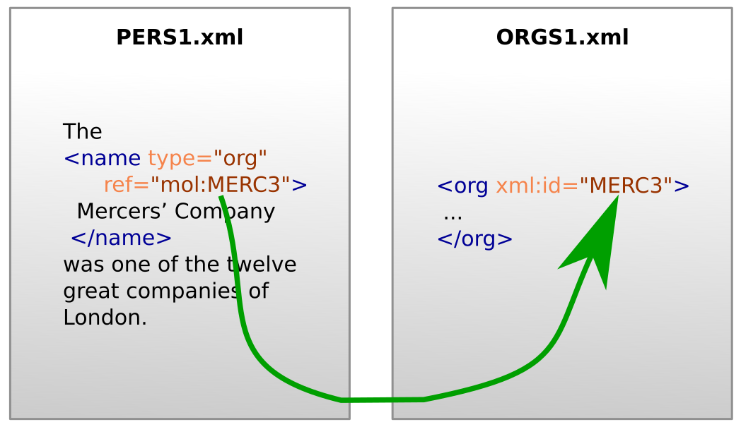

Slide 14
Every <name type="org"> points at an @xml:id which exists in the project.
The element pointed at by <name type="org"> is an <org> element in the ORGS1.xml document.
Every <name> element which points at an <org> element in ORGS1.xml has @type="org".
JT </e> MH

Slide 15
Every <name type="org"> points at an @xml:id which exists in the project.
The element pointed at by <name type="org"> is an <org> element in the ORGS1.xml document.
Every <name> element which points at an <org> element in ORGS1.xml has @type="org".
Can Schematron do this?
JT </e> MH

Slide 16
Every <name type="org"> points at an @xml:id which exists in the project.
The element pointed at by <name type="org"> is an <org> element in the ORGS1.xml document.
Every <name> element which points at an <org> element in ORGS1.xml has @type="org".
Can Schematron do this?
Yes, but only for small projects.
JT </e> MH
Notes:
Schematron checks to confirm the rules above may add around six seconds to document validation in the Oxygen XML Editor, causing frustration for editors, while simply checking that a linked location exists would require the processing of over a thousand files in this project, since each location is a distinct file.
Also, if adding a Schematron rule generates 5000 errors, the project can’t move forward; a diagnostic is better during the phase when the problem is being tackled, or when there’s a shift in encoding practice, but once all the errors are fixed, Schematron can prevent new ones. Schematron is PREVENTATIVE rather than DIAGNOSTIC.

Slide 17

COMPLETENESS

Slide 18
COMPLETENESS
Generate to-do lists, identify possible errors requiring human judgement:

Slide 19
COMPLETENESS
Generate to-do lists, identify possible errors requiring human judgement:
  Suspiciously similar bibliography entries

Slide 20
COMPLETENESS
Generate to-do lists, identify possible errors requiring human judgement:
  Suspiciously similar bibliography entries
  different names tagged to point to the same <person>

Slide 21
COMPLETENESS
Generate to-do lists, identify possible errors requiring human judgement:
  Suspiciously similar bibliography entries
  different names tagged to point to the same <person>
  unreachable (unlinked) documents

Slide 22
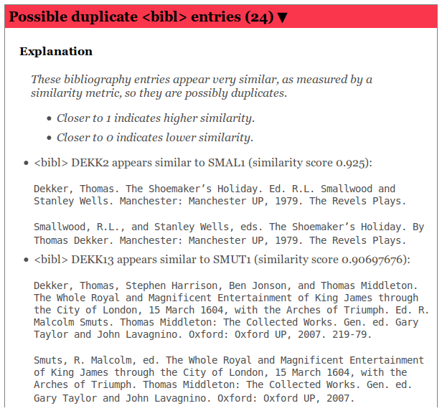
JT </e> MH

Slide 23

PROGRESS AND PREDICTIONS

Slide 24
PROGRESS AND PREDICTIONS
Provide progress analysis: are we hitting milestones?

Slide 25
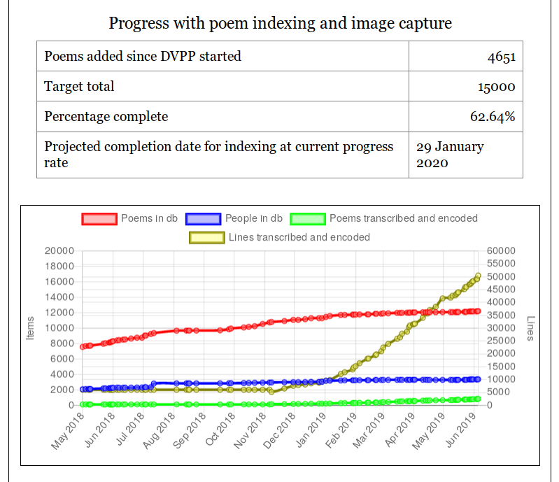
How are we doing?

Slide 26
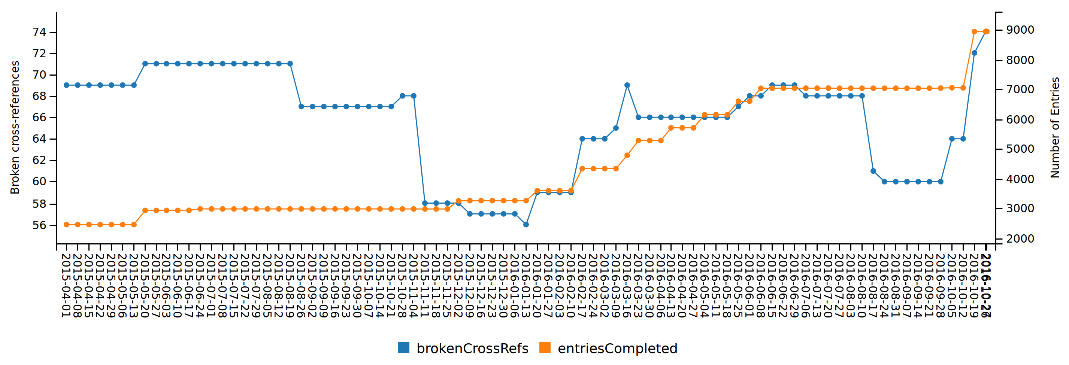
Broken cross-references keep
coming back.
JT </e> MH

Slide 27
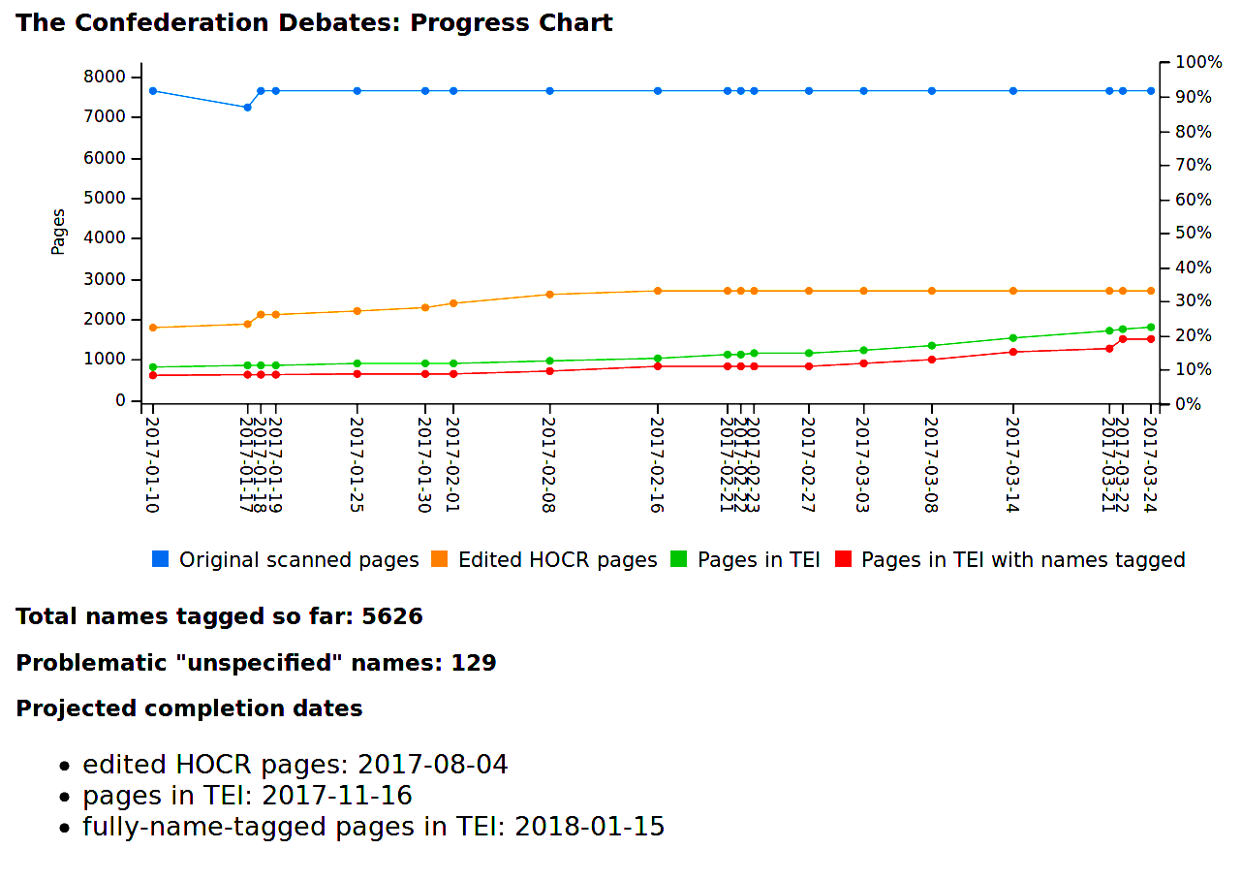

Slide 28
Diagnostics in action
The Digital Victorian Periodical Poetry project has detailed diagnostics, updated several times a day:
jenkins.hcmc.uvic.ca/job/DVPP/lastSuccessfulBuild/artifact/products/diagnostics.html
Link
JT </e> MH

Slide 29
A basic diagnostic toolkit
https://github.com/projectEndings/diagnostics
JT </e> MH

Slide 30
Run it against a folder containing a TEI project.
It checks that:
  All pointer attributes within a document point to @xml:ids that exist in the document.
  All pointers to other documents in the collection, or to @xml:id attributes in those documents, are correct.
  All values for the @xml:lang attribute are correct.
JT </e> MH

Slide 31
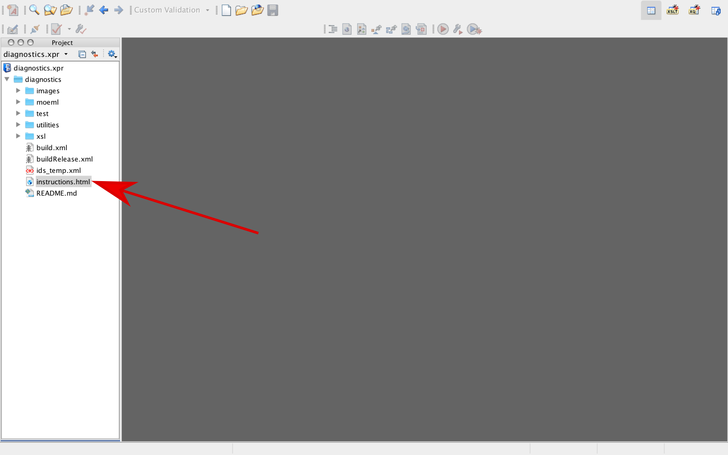

Slide 32
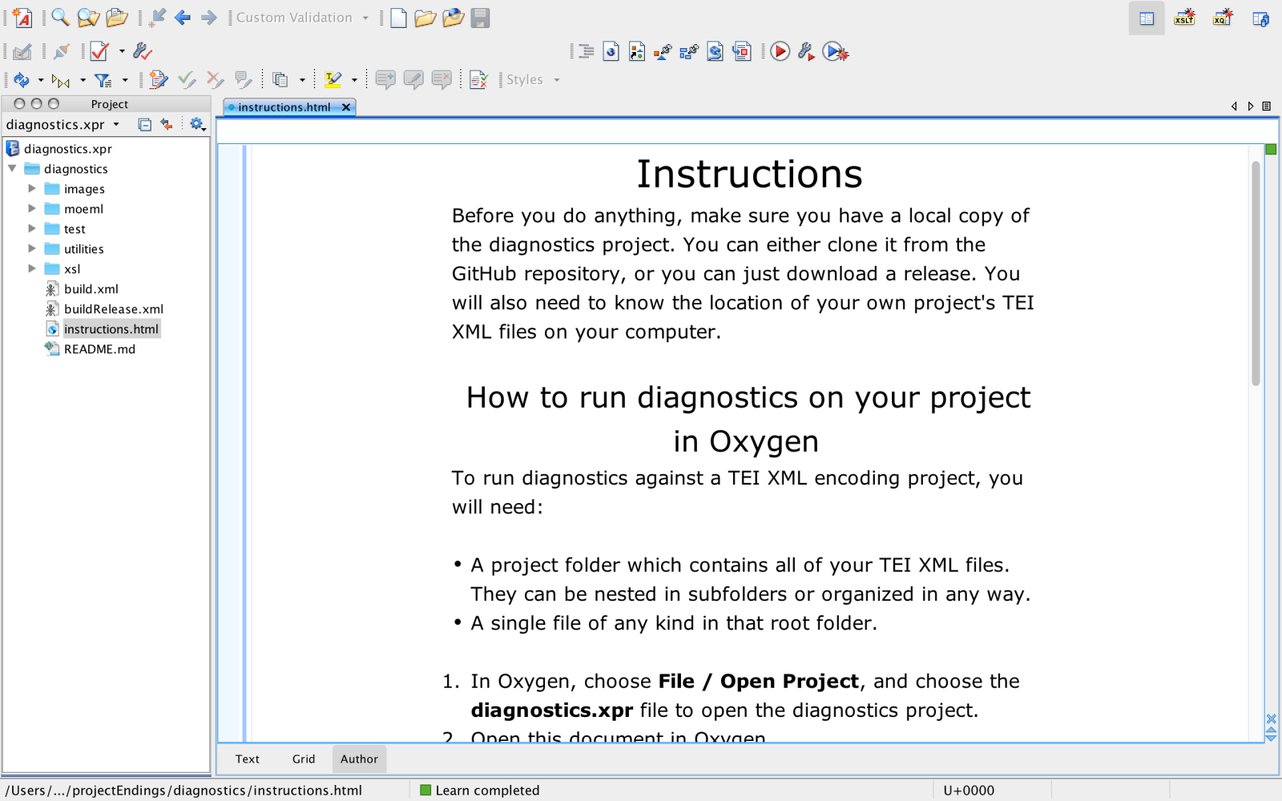

Slide 33
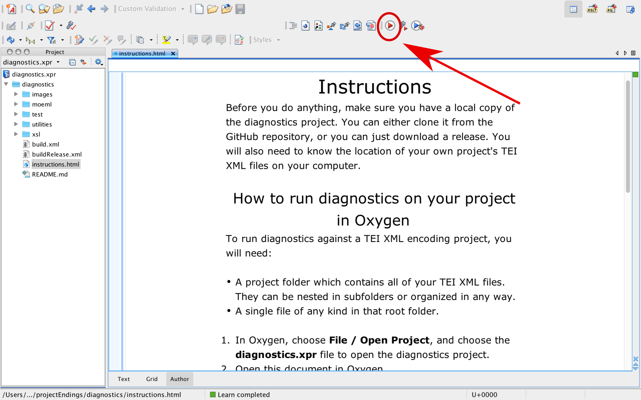

Slide 34
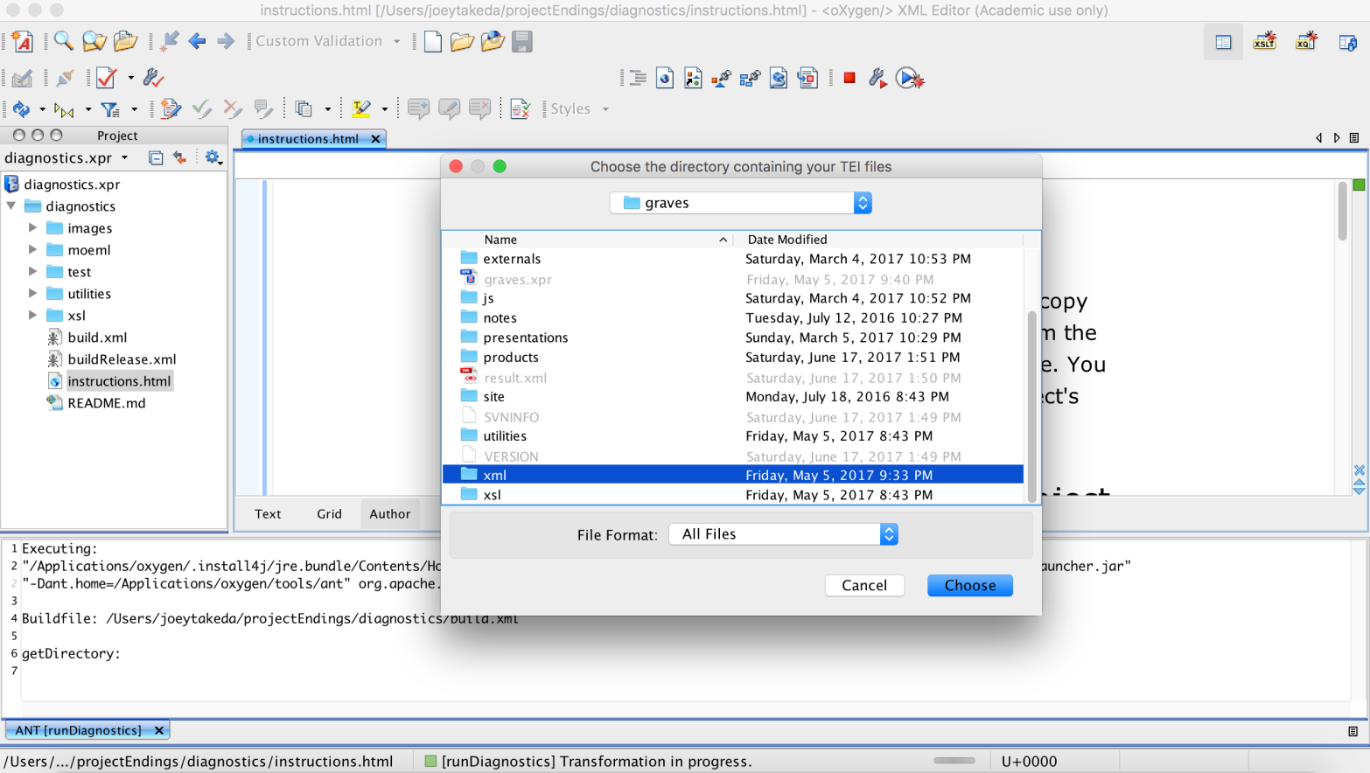

Slide 35
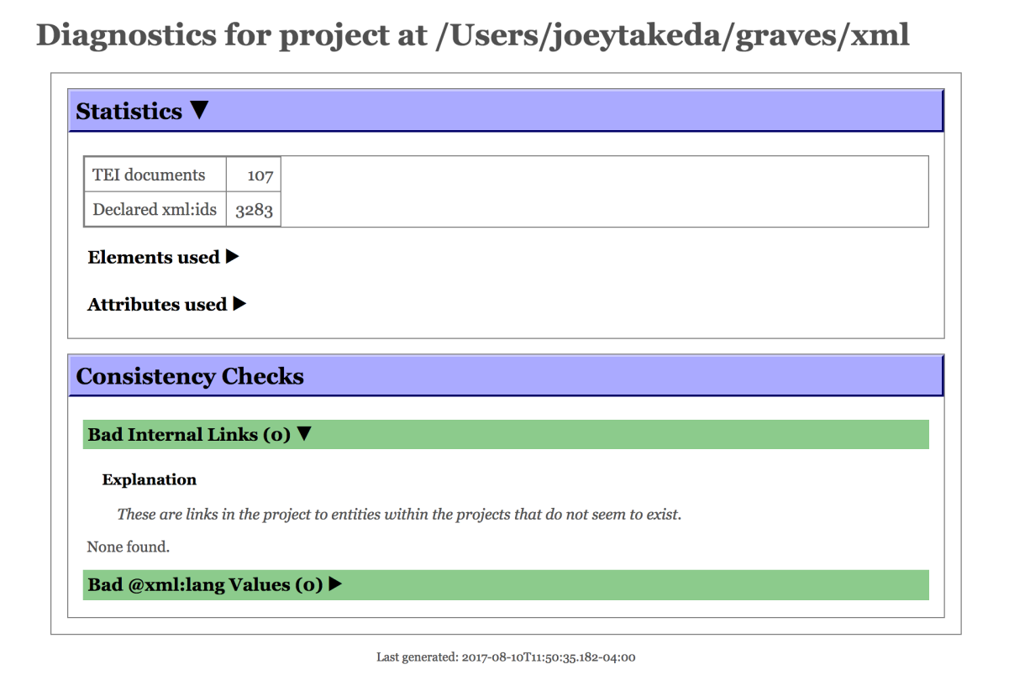

Slide 36
