Slide 1
Beyond Validation
Using programmed diagnostics to learn about, monitor, and successfully complete your DH project
Martin Holmes and Joey Takeda
University of Victoria Endings Project

Slide 2
The Endings Project
How to complete, publish and walk away from your digital edition project…

Slide 3
The Endings Project
How to complete, publish and walk away from your digital edition project…
...and have it last for 50 years.

Slide 4
The Projects
The Map of Early Modern London ↗
Le Mariage sous l’ancien régime ↗
The Nxaʔamxcín Dictionary Database
The Robert Graves Diary ↗
The Scandinavian-Canadian Studies Journal ↗

Slide 5
Validation is great
...especially if you have created a solid, tightly-constrained schema.
But it’s not enough...

Slide 6
Extra Schematron
is a great help. We use Schematron to:
enforce curly apostrophes in text
ban quotation marks (use <quote> etc.)
ban leading and trailing spaces in some tags
enforce correct capitalization
limit the length of abstracts
...and lots more...

Slide 7
But that’s not enough
Validation works at the document level, but a digital edition project is typically a large collection of interrelated resources.

Slide 8
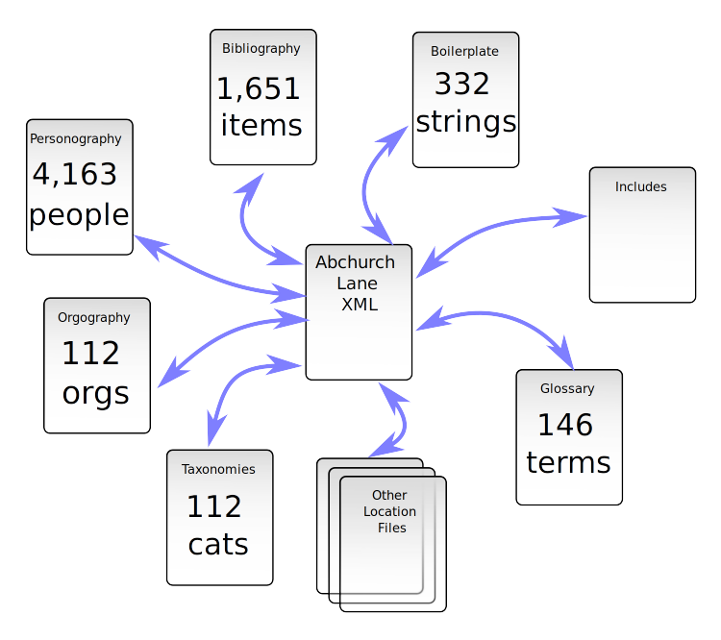

Slide 9
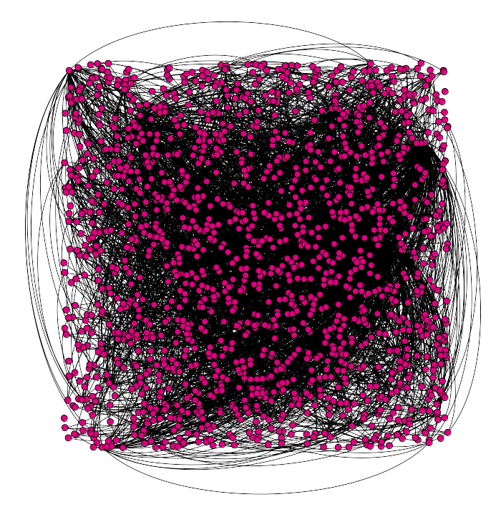
Network graph

Slide 10
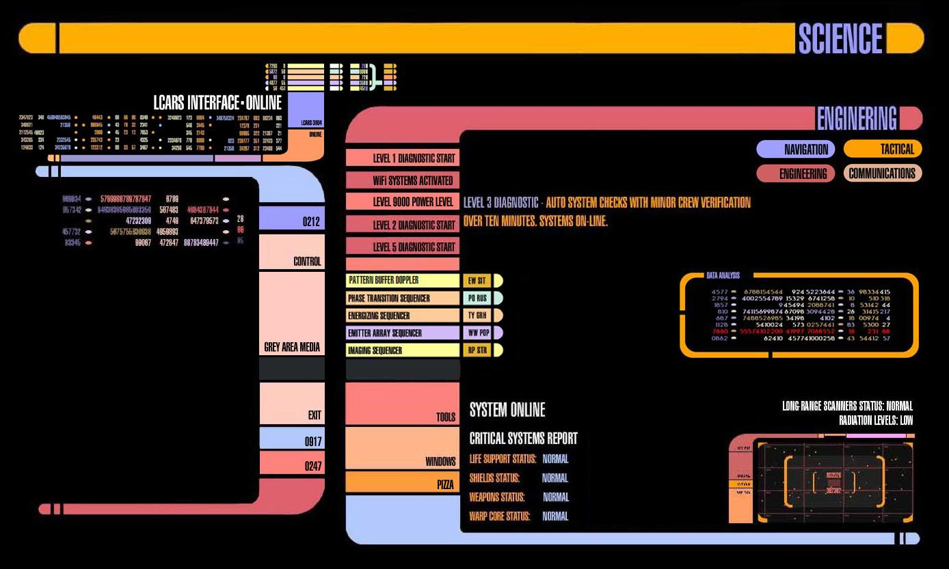
Diagnostics to the rescue!

Slide 11
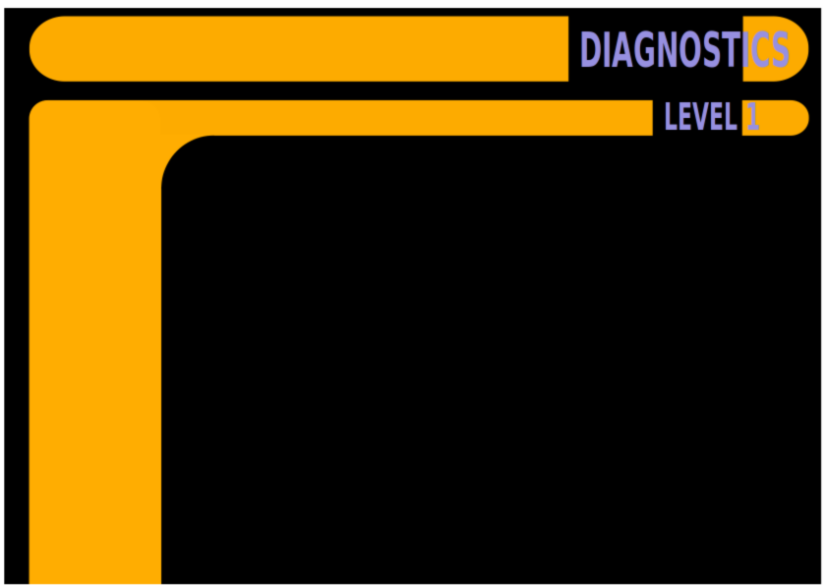
COHERENCE and CONSISTENCY

Slide 12
COHERENCE and CONSISTENCY
Project-level checking of referential integrity:

Slide 13
COHERENCE and CONSISTENCY
Project-level checking of referential integrity:
  non-existent pointers/targets

Slide 14
COHERENCE and CONSISTENCY
Project-level checking of referential integrity:
  non-existent pointers/targets
  duplicate @xml:ids

Slide 15
COHERENCE and CONSISTENCY
Project-level checking of referential integrity:
  non-existent pointers/targets
  duplicate @xml:ids
  entity type errors (persName / placeName / orgName)

Slide 16
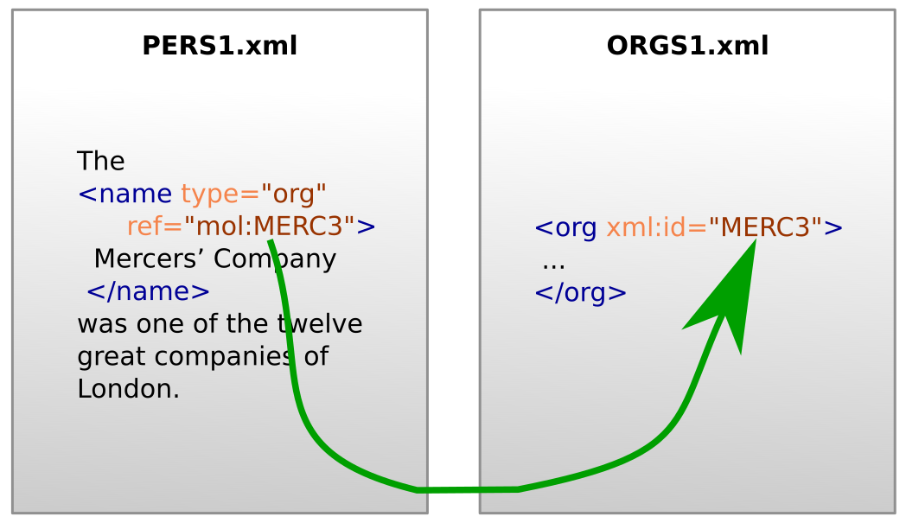

Slide 17
Every <name type="org"> points at an @xml:id which exists in the project.
The element pointed at by <name type="org"> is an <org> element in the ORGS1.xml document.
Every <name> element which points at an <org> element in ORGS1.xml has @type="org".

Slide 18
Every <name type="org"> points at an @xml:id which exists in the project.
The element pointed at by <name type="org"> is an <org> element in the ORGS1.xml document.
Every <name> element which points at an <org> element in ORGS1.xml has @type="org".
Can Schematron do this?

Slide 19
Every <name type="org"> points at an @xml:id which exists in the project.
The element pointed at by <name type="org"> is an <org> element in the ORGS1.xml document.
Every <name> element which points at an <org> element in ORGS1.xml has @type="org".
Can Schematron do this?
Yes, but only for small projects.
Notes:
Schematron checks to confirm the rules above may add around six seconds to document validation in the Oxygen XML Editor, causing frustration for editors, while simply checking that a linked location exists would require the processing of over a thousand files in this project, since each location is a distinct file.
Also, if adding a Schematron rule generates 5000 errors, the project can’t move forward; a diagnostic is better during the phase when the problem is being tackled, or when there’s a shift in encoding practice, but once all the errors are fixed, Schematron can prevent new ones. Schematron is PREVENTATIVE rather than DIAGNOSTIC.

Slide 20

COMPLETENESS

Slide 21
COMPLETENESS
Generate to-do lists, identify possible errors requiring human judgement:

Slide 22
COMPLETENESS
Generate to-do lists, identify possible errors requiring human judgement:
  Suspiciously similar bibliography entries

Slide 23
COMPLETENESS
Generate to-do lists, identify possible errors requiring human judgement:
  Suspiciously similar bibliography entries
  different names tagged to point to the same <person>

Slide 24
COMPLETENESS
Generate to-do lists, identify possible errors requiring human judgement:
  Suspiciously similar bibliography entries
  different names tagged to point to the same <person>
  unreachable (unlinked) documents

Slide 25
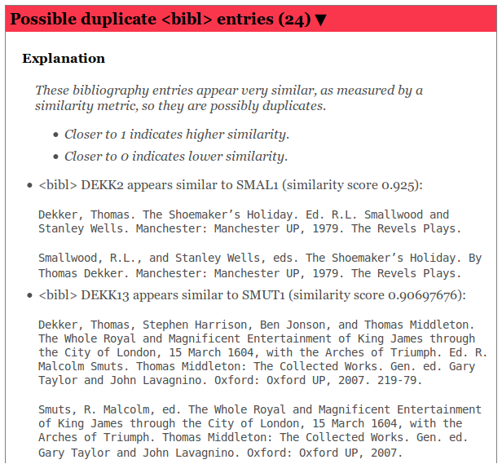

Slide 26
Beware
Diagnostics can get out of hand.
The Moses Dictionary Project has gone nuts with their diagnostics.
Possible result: project paralysis.
Notes:
Open local copy of Moses_Diagnostics.html.

Slide 27

PROGRESS AND PREDICTIONS

Slide 28
PROGRESS AND PREDICTIONS
Provide progress analysis: are we hitting milestones?

Slide 29
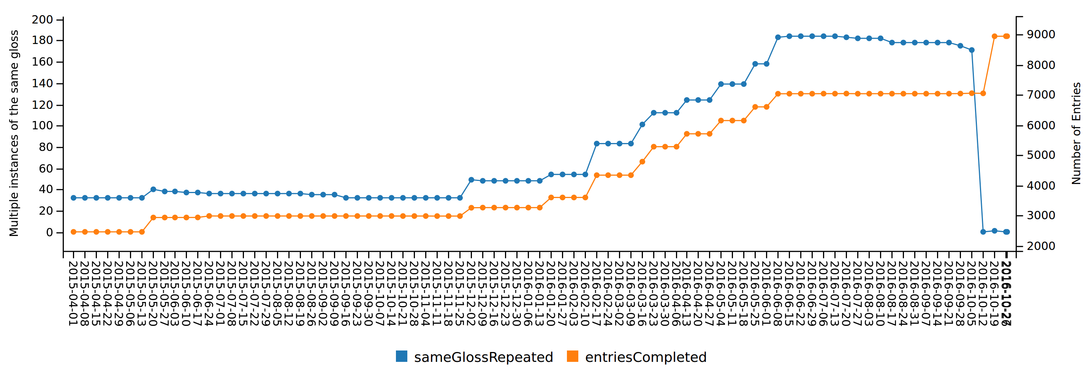
How are we doing?
Duplicate glosses rise with new entries, until
an editing blitz fixes them.

Slide 30
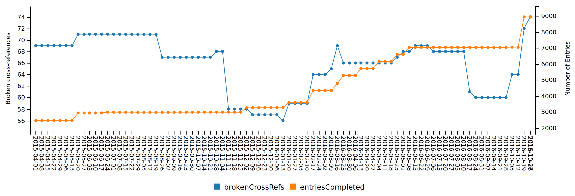
Broken cross-references keep
coming back.

Slide 31
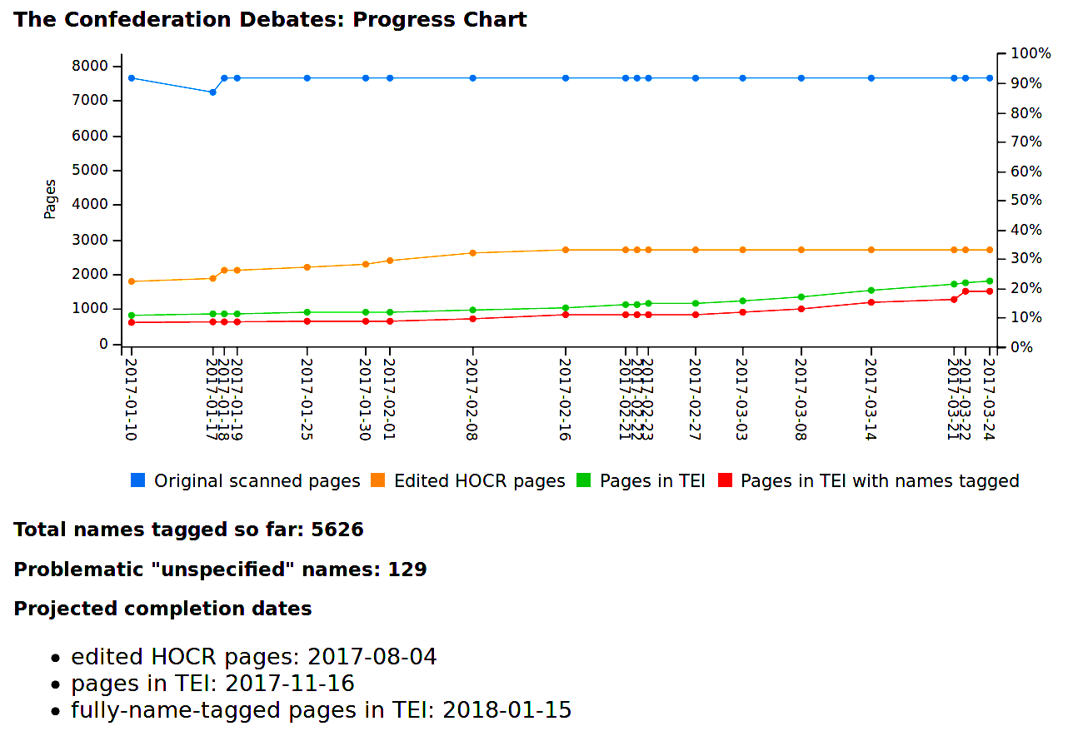

Slide 32
A basic diagnostic toolkit
https://github.com/projectEndings/diagnostics

Slide 33
Run it against a folder containing a TEI project.
It checks that:
  All pointer attributes within a document point to @xml:ids that exist in the document.
  All pointers to other documents in the collection, or to @xml:id attributes in those documents, are correct.
  All values for the @xml:lang attribute are correct.

Slide 34
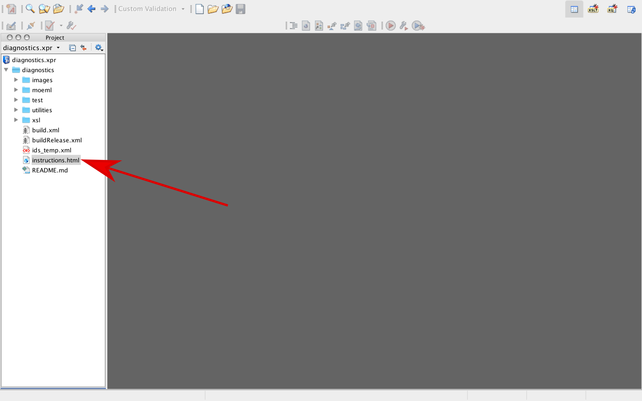

Slide 35
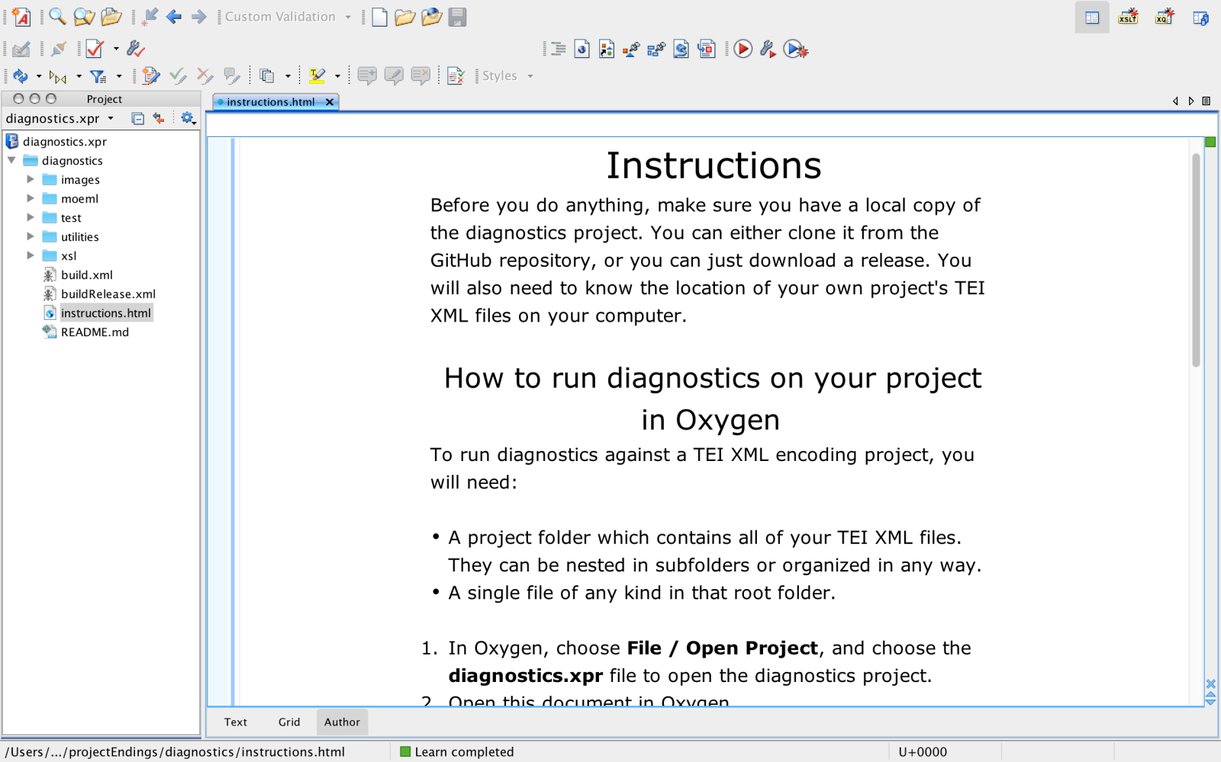

Slide 36
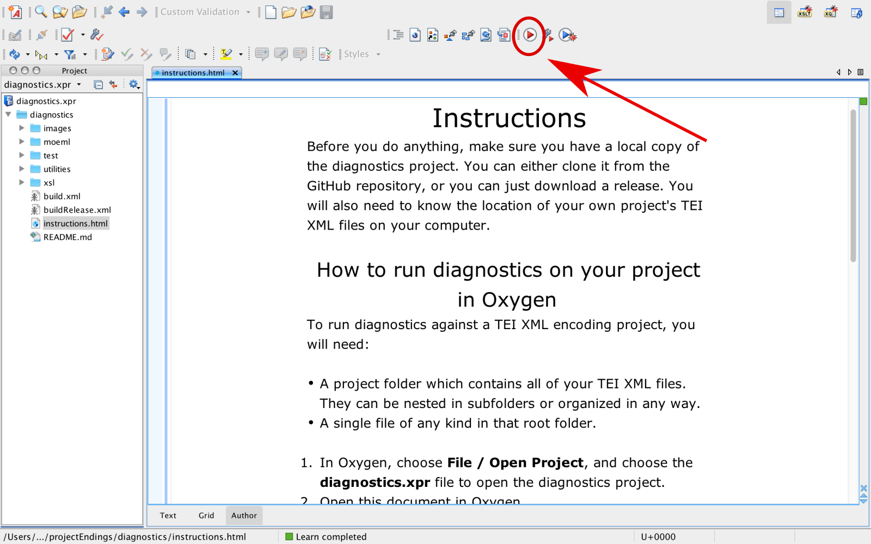

Slide 37
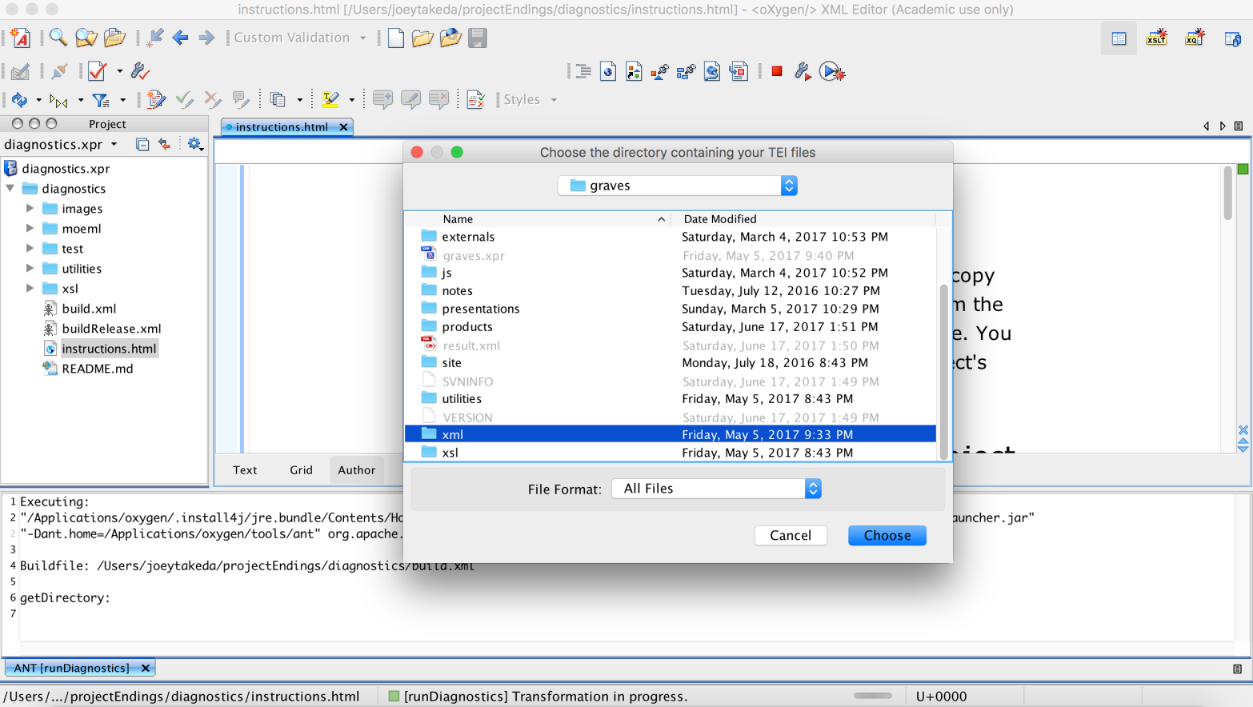

Slide 38
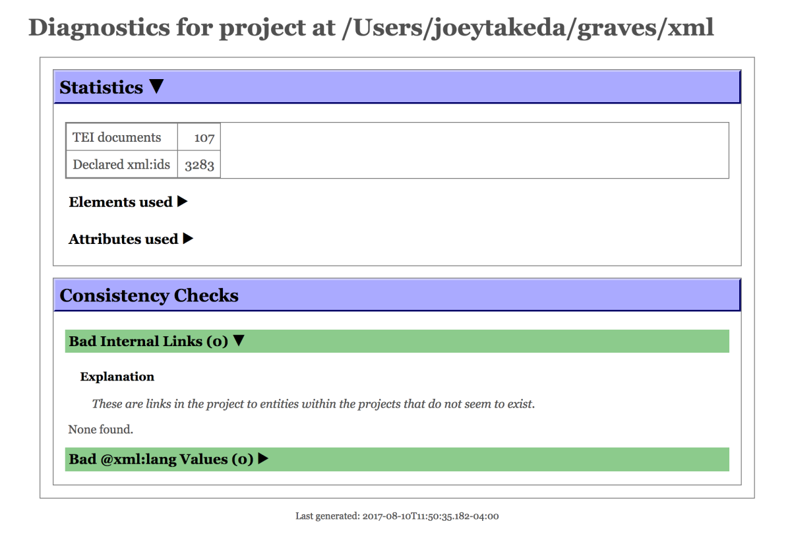

Slide 39


