Slide 1
How we finished a project: The Robert Graves Diary
Janelle Jenstad
Martin Holmes
</endings>

Slide 2
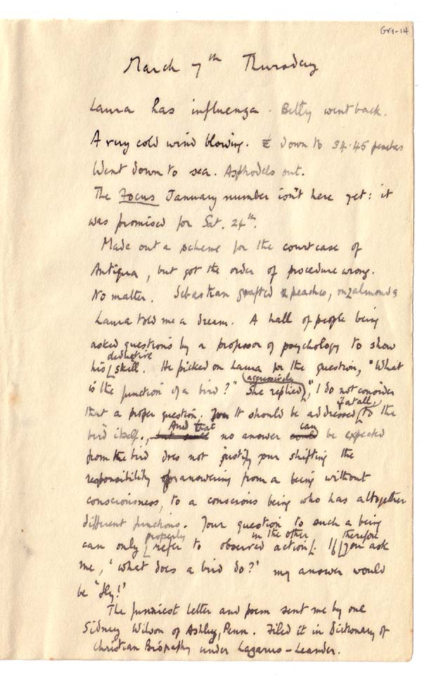
Graves’s Diary (1935-1939)

Slide 3
A brief history
Started 2003
First serious digital edition project for HCMC
Made every mistake imaginable

Slide 4
Stupid mistakes we made
Misunderstood TEI. Every diary month was a teiCorpus element.
Made up our own XML when we couldn’t easily make TEI work.
Failed to analyse the data before starting, so had to scramble to handle e.g. enclosures/attachments.
Added a MySQL database to make things yet more complicated.
Based the web application on version 0.9 of a new piece of software (eXist), running inside Cocoon.

Slide 5
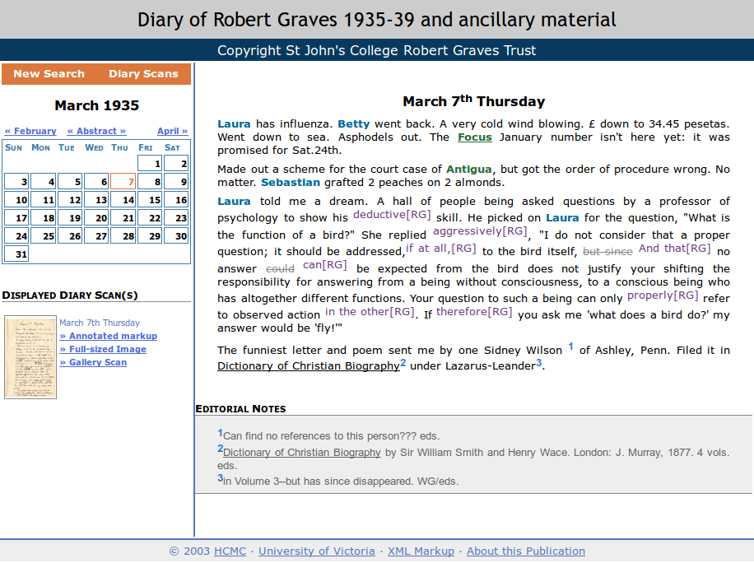
But it worked!

Slide 6
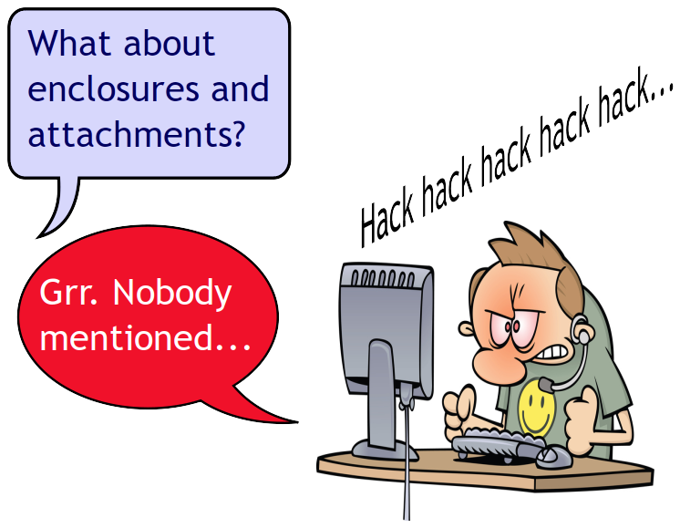
But then...

Slide 7
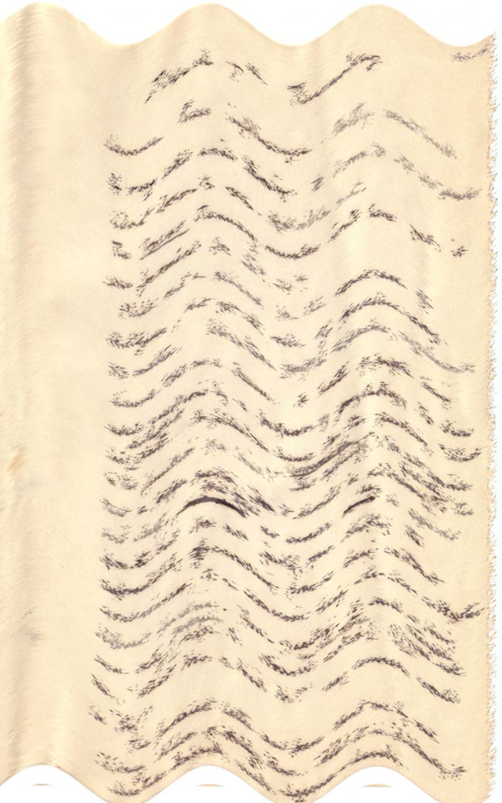
And then...
Cocoon is out of date.
eXist is out of date.
Things get flaky.

Slide 8
So we rewrite...
Cocoon 2.1.
eXist 1.4.

Slide 9
So we rewrite...
Cocoon 2.1.
eXist 1.4.
Spot the error.

Slide 10
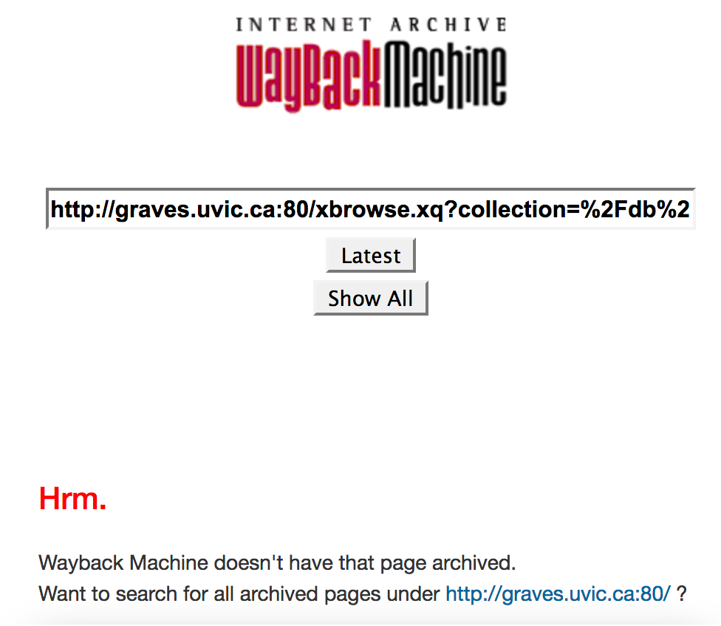
And then...

Slide 11
Query string nightmare!
http://graves.uvic.ca/xbrowse.xq;jsessionid=926A438A2B364B4B92488B9AC00AB013?query_stored=true&collection=/db/graves/entries&type=diaryentry&n=1935-02-22&start=1

Slide 12
Sigh.

Slide 13
Sigh.
Start again.

Slide 14
Sigh.
Start again.
Learn from mistakes.

Slide 15
Sigh.
Start again.
Learn from mistakes.
Do it properly.

Slide 16
Doing it properly
Data: all TEI P5, version-controlled.
Site: all HTML5 + JavaScript + CSS.
URLs: all simple, no query strings.
....

Slide 17
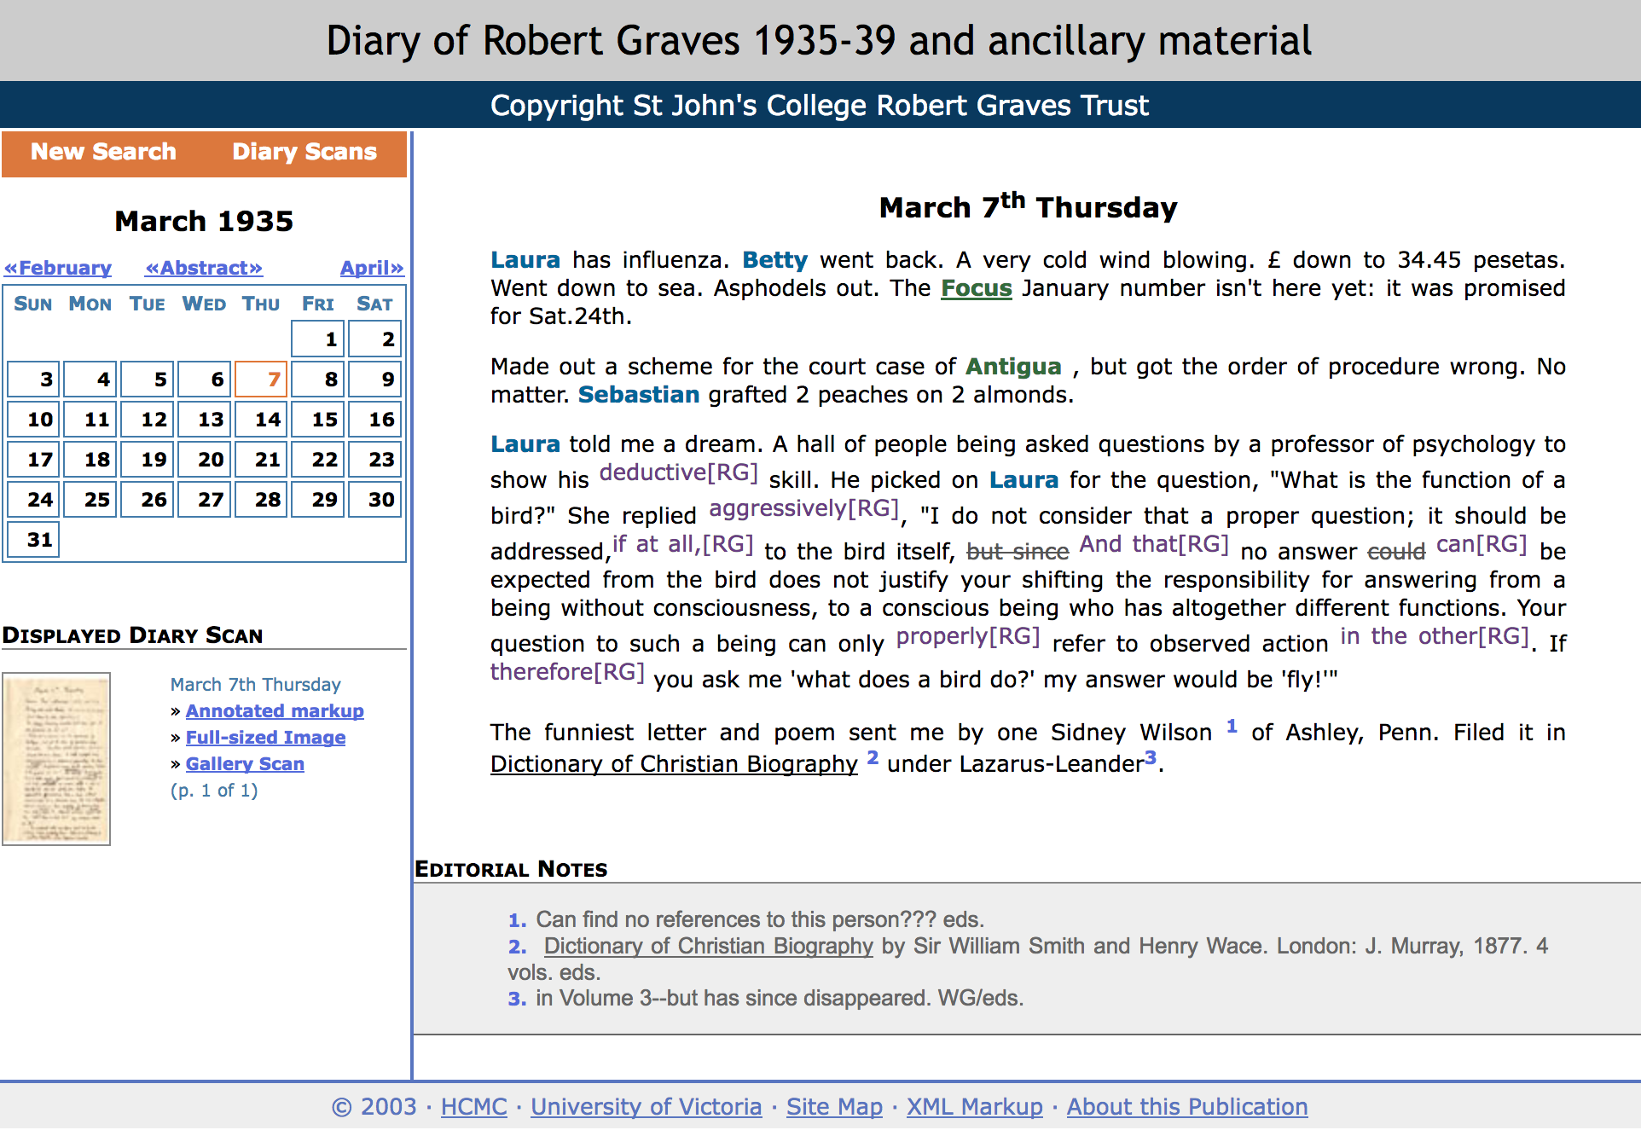
It works!

