Slide 1
Nine Projects, One Codebase
A Static Search Engine for Digital Editions
Martin Holmes
(Humanities Computing and Media Centre at the University of Victoria)
Joey Takeda
(Digital Humanities Innovation Lab at Simon Fraser University)

Slide 2
Project Endings
https://endings.uvic.ca/
Notes:
A collaborative project based out of the University of Victoria, the Endings Project has outlined a set of principles for preserving digital humanities projects from the outset.
We’ve been successful in creating static websites for even large digital humanities projects, like The Map of Early Modern London, which is comprised of over [[GET NUMBER]] densely interlinked documents.

Slide 3
Project Endings
Static Websites
  No server side dependencies
  Strictly XHTML5 + CSS + Vanilla JS
  Best chance for preservation 50 years + (we hope)
Notes:
A collaborative project based out of the University of Victoria, the Endings Project has outlined a set of principles for preserving digital humanities projects from the outset.
We’ve been successful in creating static websites for even large digital humanities projects, like The Map of Early Modern London, which is comprised of over [[GET NUMBER]] densely interlinked documents.

Slide 4
Endings Projects
Robert Graves Diary (graves.uvic.ca)
Map of Early Modern London (mapoflondon.uvic.ca)
The Winnifred Eaton Archive (winnifredeatonarchive.org)
Mapping Keats’s Progress (johnkeats.uvic.ca)
My Norse Digital Image Repository (myndir.uvic.ca)
Le mariage sous L'Ancien Régime (mariage.uvic.ca)
Digital Victorian Periodical Poetry (dvpp.uvic.ca)
Landscapes of Injustice (loi.uvic.ca)
Linked Early Modern Drama Online (lemdo.uvic.ca)

Slide 5
But...
Notes:
And while we’ve deployed our static sites with the goal of no longer relying on server side processing, we couldn’t be completely rid of the server just yet.
Researchers need robust searching mechanisms, which almost inevitably means using server side technologies like Solr. In the case of our Endings projects, the search has to match the needs of researchers, which means complex filtering mechanisms.

Slide 6
But...
All of these projects required robust searching mechanisms, including:
Notes:
And while we’ve deployed our static sites with the goal of no longer relying on server side processing, we couldn’t be completely rid of the server just yet.
Researchers need robust searching mechanisms, which almost inevitably means using server side technologies like Solr. In the case of our Endings projects, the search has to match the needs of researchers, which means complex filtering mechanisms.

Slide 7
But...
All of these projects required robust searching mechanisms, including:
  Keyword search
Notes:
And while we’ve deployed our static sites with the goal of no longer relying on server side processing, we couldn’t be completely rid of the server just yet.
Researchers need robust searching mechanisms, which almost inevitably means using server side technologies like Solr. In the case of our Endings projects, the search has to match the needs of researchers, which means complex filtering mechanisms.

Slide 8
But...
All of these projects required robust searching mechanisms, including:
  Keyword search
  Exact phrase search
Notes:
And while we’ve deployed our static sites with the goal of no longer relying on server side processing, we couldn’t be completely rid of the server just yet.
Researchers need robust searching mechanisms, which almost inevitably means using server side technologies like Solr. In the case of our Endings projects, the search has to match the needs of researchers, which means complex filtering mechanisms.

Slide 9
But...
All of these projects required robust searching mechanisms, including:
  Keyword search
  Exact phrase search
  Wildcard search
Notes:
And while we’ve deployed our static sites with the goal of no longer relying on server side processing, we couldn’t be completely rid of the server just yet.
Researchers need robust searching mechanisms, which almost inevitably means using server side technologies like Solr. In the case of our Endings projects, the search has to match the needs of researchers, which means complex filtering mechanisms.

Slide 10
But...
All of these projects required robust searching mechanisms, including:
  Keyword search
  Exact phrase search
  Wildcard search
  Filtered search (by date, by author, +++)
Notes:
And while we’ve deployed our static sites with the goal of no longer relying on server side processing, we couldn’t be completely rid of the server just yet.
Researchers need robust searching mechanisms, which almost inevitably means using server side technologies like Solr. In the case of our Endings projects, the search has to match the needs of researchers, which means complex filtering mechanisms.

Slide 11
Why not use...?
Notes:
Beyond the digital humanities, various industries have started to turn toward static sites and, accordingly, there have been some steps toward creating browse-side searching mechanisms.
The most common is Google Custom Search, of course, which provides limited text searching.
Lunr is another frequently used Javascript library for creating browser-based search

Slide 12


Why not use...?
TM
Notes:
Beyond the digital humanities, various industries have started to turn toward static sites and, accordingly, there have been some steps toward creating browse-side searching mechanisms.
The most common is Google Custom Search, of course, which provides limited text searching.
Lunr is another frequently used Javascript library for creating browser-based search

Slide 13
Why not use...?
Not particularly reliable
Notes:
But these don’t really meet our needs. As the recent removal of the free Google Maps API demonstrates, Google makes no guarantee that their services will persist into the future
And Javascript libraries like Lunr index the entirety of a website in memory, meaning that a site like MoEML—which contains about [[SIZE]] GB of HTML—would bring the browser to its knees.

Slide 14
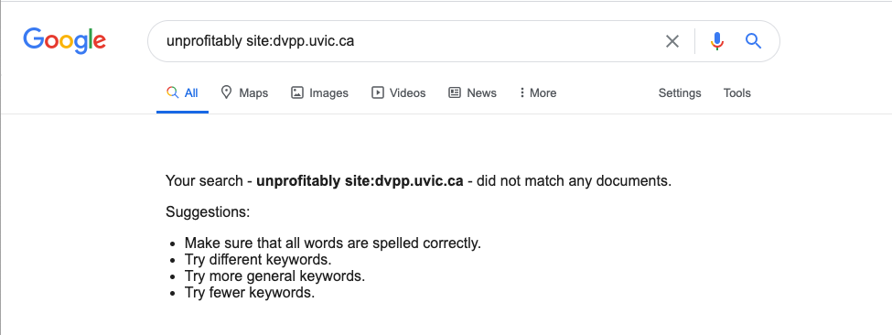

Slide 15
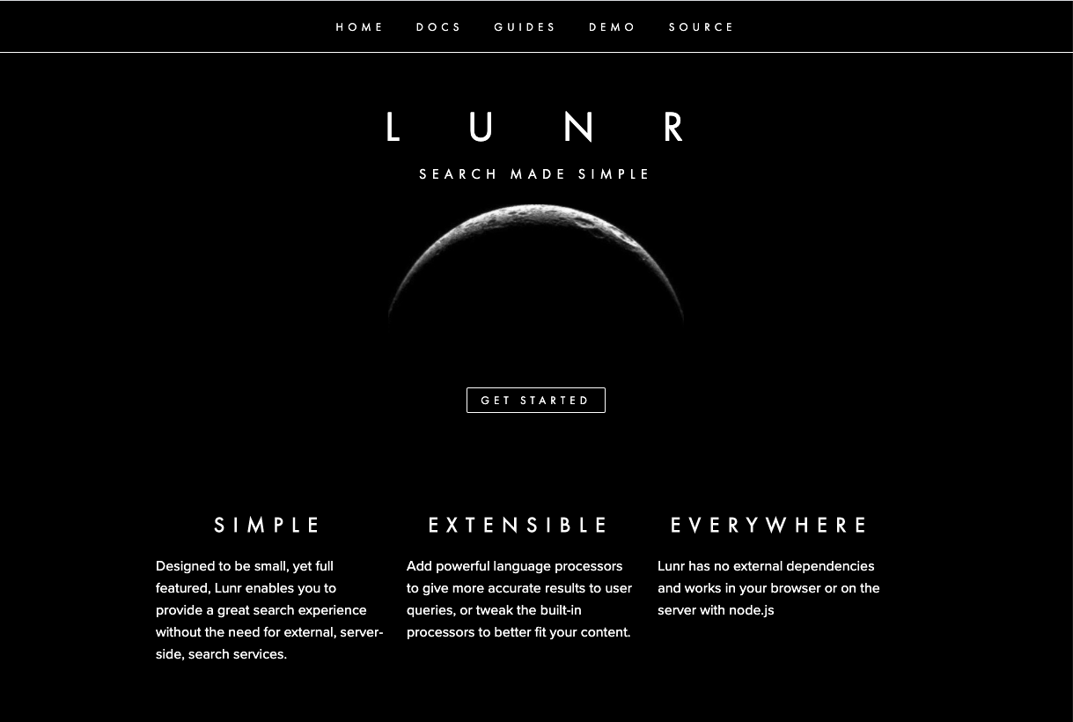
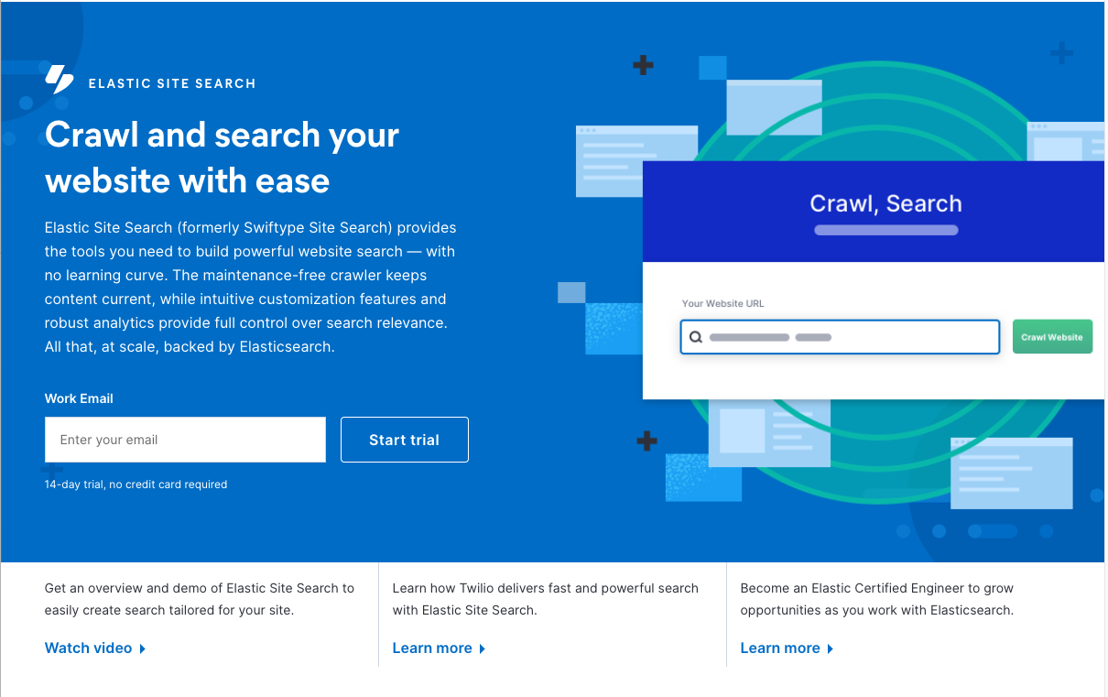
Why not use...?
Notes:
Beyond the digital humanities, various industries have started to turn toward static sites and, accordingly, there have been some steps toward creating browse-side searching mechanisms.
The most common is Google Custom Search, of course, which provides limited text searching.
Lunr is another frequently used Javascript library for creating browser-based search

Slide 16
Why not use...?
Not particularly reliable
External dependency = technical debt
Notes:
But these don’t really meet our needs. As the recent removal of the free Google Maps API demonstrates, Google makes no guarantee that their services will persist into the future
And Javascript libraries like Lunr index the entirety of a website in memory, meaning that a site like MoEML—which contains about [[SIZE]] GB of HTML—would bring the browser to its knees.

Slide 17
Why not use...?
Not particularly reliable
External dependency = technical debt
Too many documents to put in one index
Notes:
But these don’t really meet our needs. As the recent removal of the free Google Maps API demonstrates, Google makes no guarantee that their services will persist into the future
And Javascript libraries like Lunr index the entirety of a website in memory, meaning that a site like MoEML—which contains about [[SIZE]] GB of HTML—would bring the browser to its knees.

Slide 18
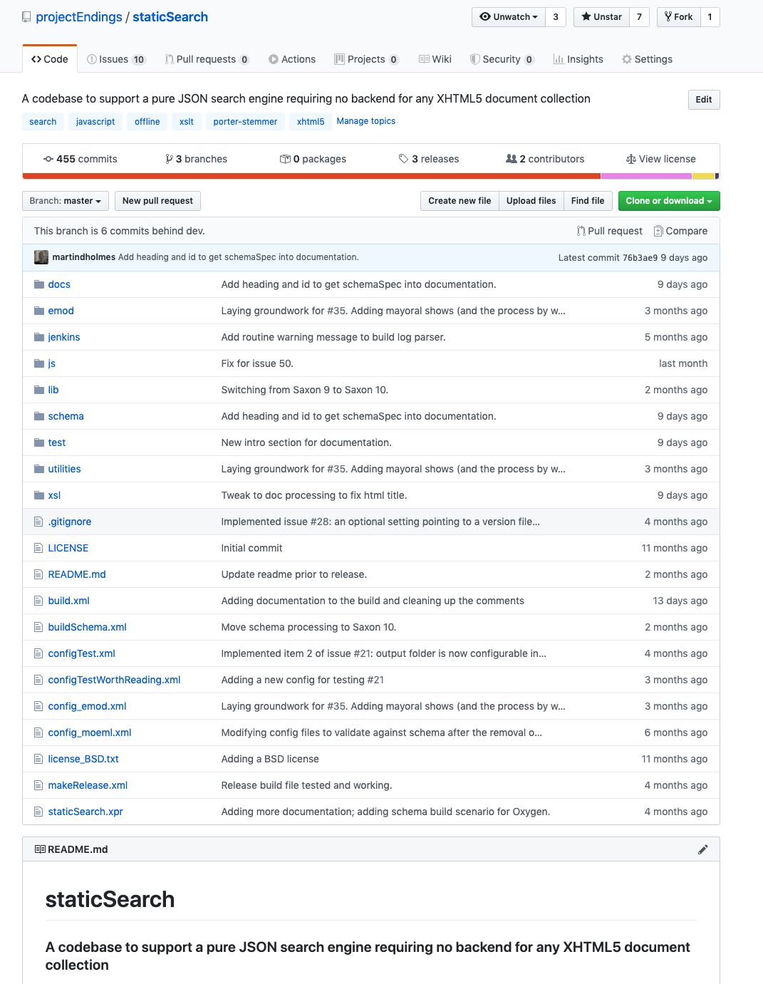
So we built our own
Notes:
So we built our own. Static Search is available on Github: currently in v0.9, the codebase is in active development and we’re planning on doing a full release by the end of the summer.

Slide 19
So we built our own
https://github.com/projectEndings/staticSearch
Notes:
So we built our own. Static Search is available on Github: currently in v0.9, the codebase is in active development and we’re planning on doing a full release by the end of the summer.

Slide 20
How it works

Slide 21
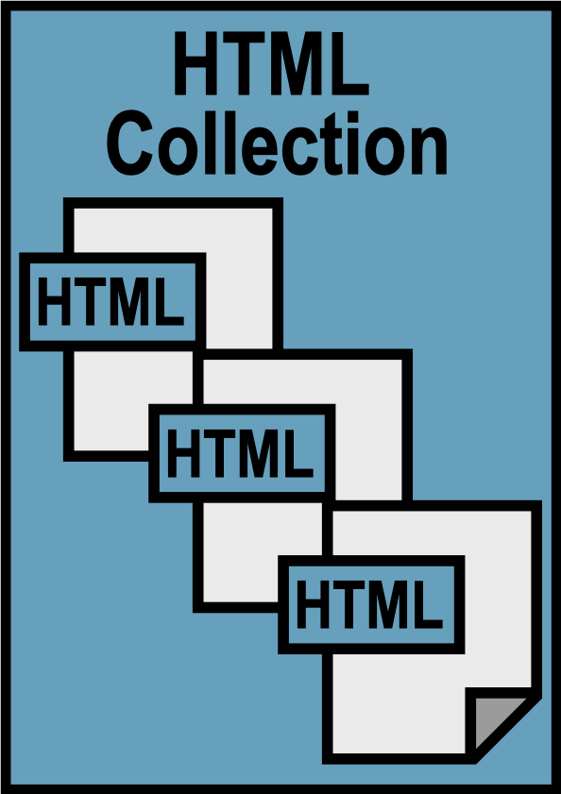
You have:
A collection of HTML files
All well-formed & valid XHTML
Notes:
We assume that your website consists of HTML5 documents which are all well-formed XML in the XHTML namespace. If they're not, then we can't process them.
So if your documents are HTML tag soup, you'll have to clean them up and fix them first. But that's a good thing anyway.

Slide 22

You add:
An HTML search page containing a special div:
<div id="staticSearch"></div>
Notes:
You need to add one new page to your site: the search page. We prefer that you add that page so that you can ensure that it matches the style of your site.
The only thing that must be in it is a single div element with the id "staticSearch". Our build process will put the search functionality into that div. If that div already has stuff in it, then it will be emptied first.

Slide 23
You add:
Some metadata elements to support search filters:
<meta name="Document type" class="staticSearch.desc" content="Poems" />
Notes:
If you only want a text search, then that's all you have to do. But if you also want some search filters, such as dates or document types, then you'll need to add the information required for those filters into the metadata of your HTML files.
Here you see a document type filter element, which specifies that the document containing it falls into the "Poems" category.

Slide 24
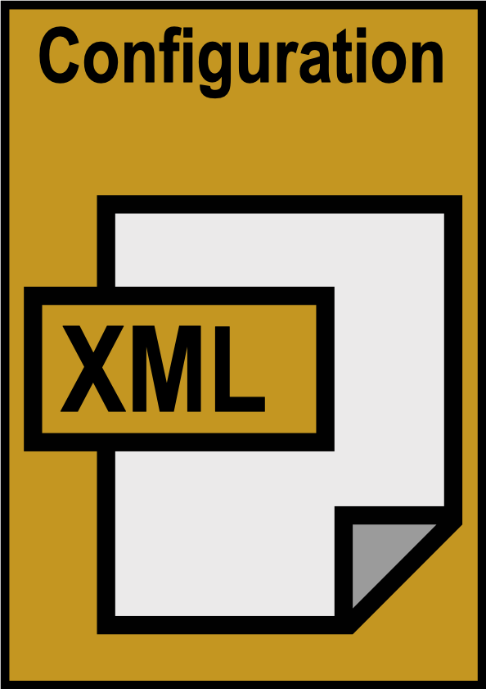
You create:
A configuration file (XML) to specify the features and constraints for your search engine
Notes:
Next, you need to create a simple XML file to specify the parameters you want to apply to your search. This is covered in our documentation, and there is a schema to validate it so that you know you've got it right.
That document tells the staticSearch build process where your HTML files are and where the search page is, and it also allows you to configure things like weighting, so you can specify for example that hits in headings count more heavily than hits inside paragraphs.

Slide 25
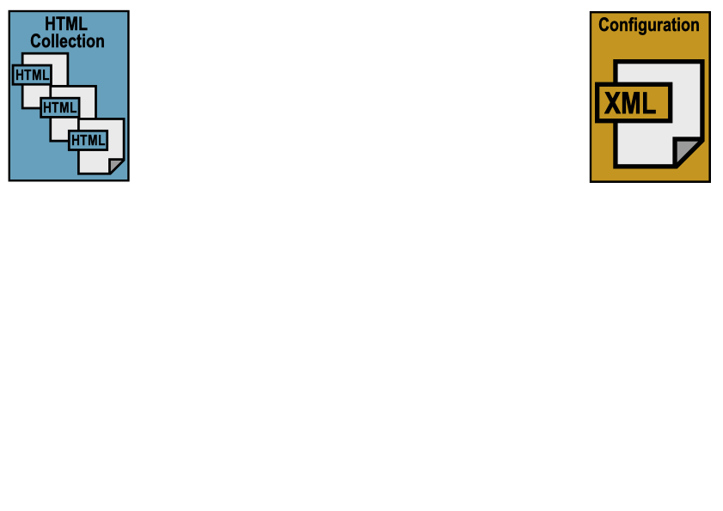
Notes:
So you have your HTML collection with its search page and your configuration file.
You run the staticSearch build process (which requires Ant). This is what happens:

Slide 26
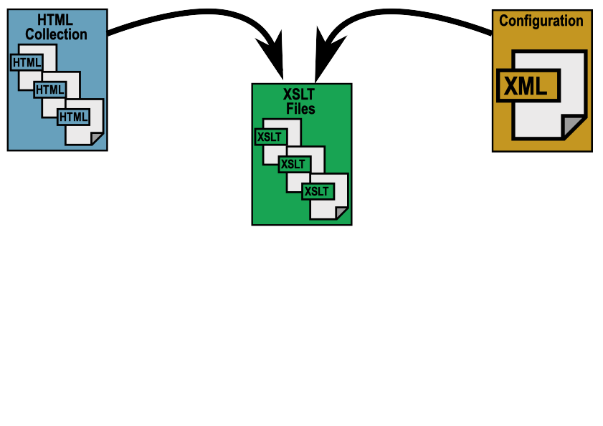
Notes:
Based on the configuration file, the XSLT processes your document collection. It doesn't modify the original documents (other than the search page); it creates temporary copies and manipulates those.

Slide 27
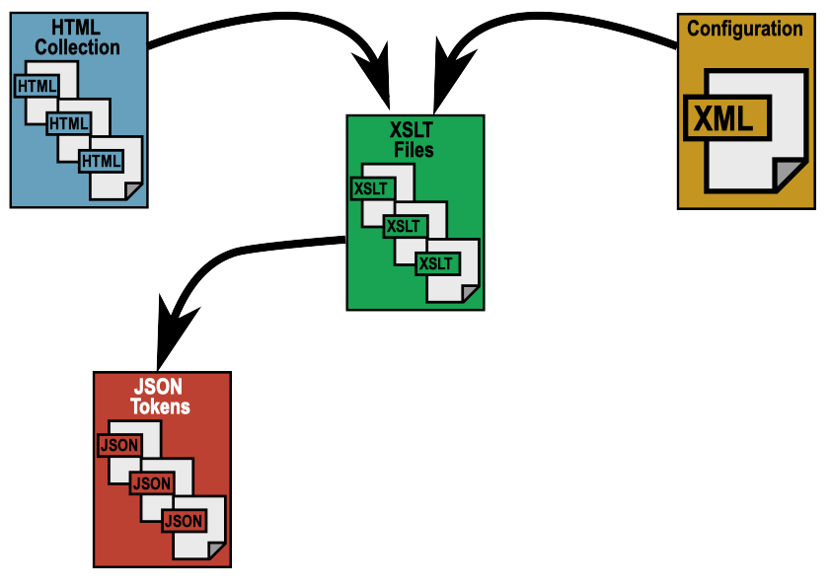
Notes:
It analyzes all the text in the documents, applies stemming to the words, and creates a large number of small JSON files.
Each JSON file contains information about one token – all the documents that contain that token, and keyword-in-context fragments for each instance.
The JSON file is named after the token it contains. This will be important later.

Slide 28
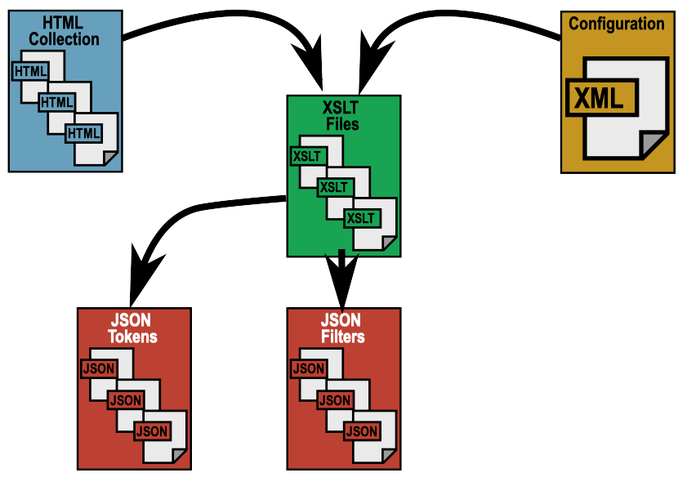
Notes:
The process also creates a JSON file for each of the filters found on the site, mapping documents to filter values.

Slide 29
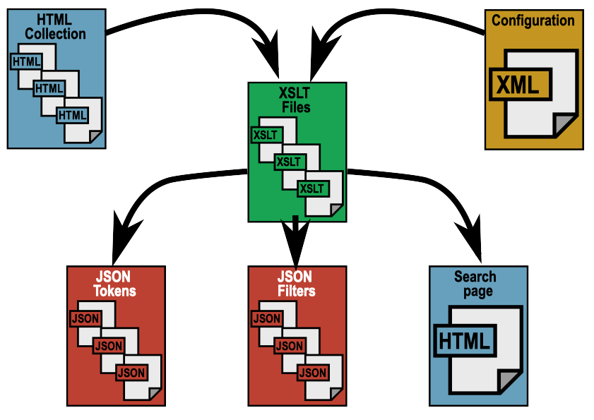
Notes:
Finally, the build process modifies the search page you created to insert the HTML, JavaScript and CSS it needs to do searches.

Slide 30
JSON token file
{"token": "unprofit",
"instances": [
{
"docId": "pom_2025_ithe_old_man_of_hoy",
"docUri": "poems/goodwords/1870/pom_2025_ithe_old_man_of_hoy.html",
"score": 1,
"contexts": [
{
"form": "unprofitably",
"context": "…whole that day was spent <mark>unprofitably<\/mark>.",
"weight": 1,
"pos": 400
}
]
},
{
"docId": "pom_8733_john_and_joan_canto_ii",
"docUri": "poems/blackwoods/1820/pom_8733_john_and_joan_canto_ii.html",
"score": 1,
"contexts": [
{
"form": "unprofitable",
"context": "…too much ap- propriated unto <mark>unprofitable<\/mark> jocularities and facetiousness. Craving licence,…",
"weight": 1,
"pos": 164 } ] } ] }
Notes:
This is what a JSON file for a single token looks like.
This token is for the stemmed form "unprofit".
It appears in two documents in the collection, once as "unprofitably" and once as "unprofitable".
A keyword-in-context fragment is stored for each instance.
Note that KWICs are optional; they take up more disk space, of course, so for a large collection you might turn them off or constrain their numbers in the configuration file.

Slide 31
Filter JSON
{
"filterId": "ssBool2",
"filterName": "Unsigned",
"ssBool2_1": {
"value": "true",
"docs": [
"poems/chambers_series/1867/pom_7594_the_husbands_request.html",
"poems/alltheyearround/1875/pom_4271_the_hourglass.html",
"poems/alltheyearround/1879/pom_4507_in_the_conservatory.html",
"poems/blackwoods/1843/pom_9963_jolly_father_joe.html",
"poems/blackwoods/1829/pom_10314_the_watchmans_lament.html"
]
}
}
Notes:
This is what a JSON filter file looks like.
This is for a boolean (true/false) filter called "Unsigned", meaning (in this case) that a poem appears in a publication without a signature.
It lists five poems which match this criterion. (This is a simplified version, of course; there are many poems in this particular collection which are unsigned.)

Slide 32
On the website...
...of the thousands of JSON files...
...the search page JS retrieves only the ones it needs for the search you do:
Notes:
All those JSON files are added into your website, along with the modified search page, and you can now use the search function.
If the search page had to retrieve all the thousands of little token files created by the build process, it would take forever. But it doesn't; it only needs to retrieve the ones that are needed for each specific search.

Slide 33
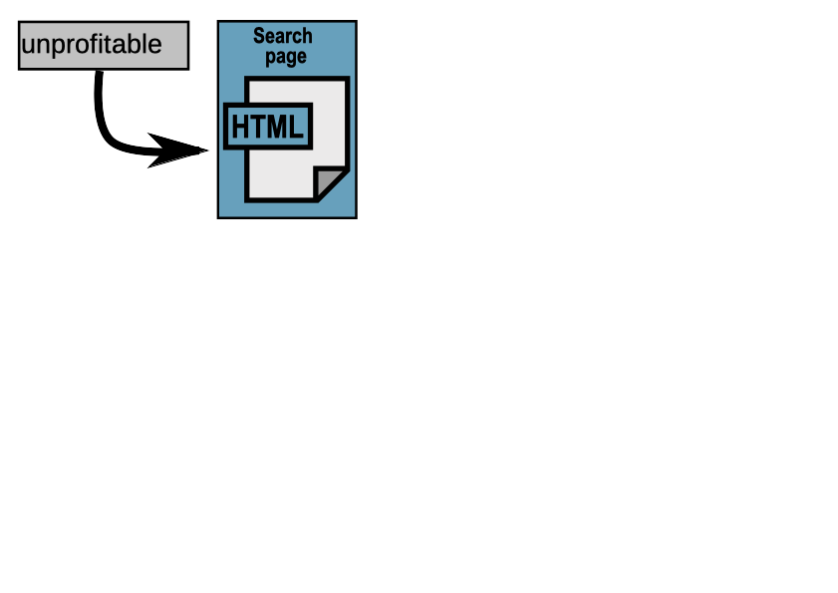
Notes:
So if you type the word "unprofitable" into the search page and initiate a search, this is what happens:

Slide 34
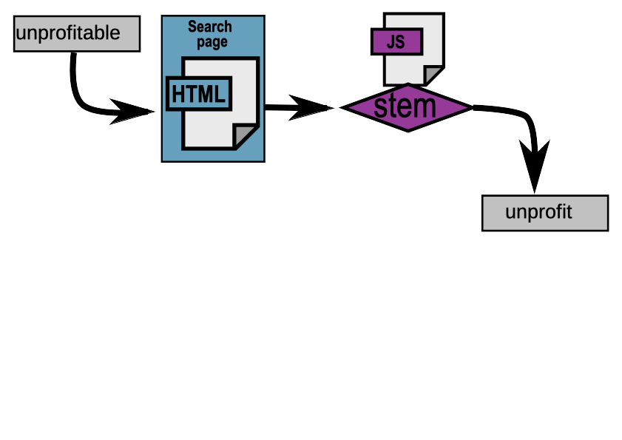
Notes:
First, that word is stemmed to get the token "unprofit" (there is a JavaScript implementation of the stemmer as well as the XSLT implementation that creates the token files).

Slide 35
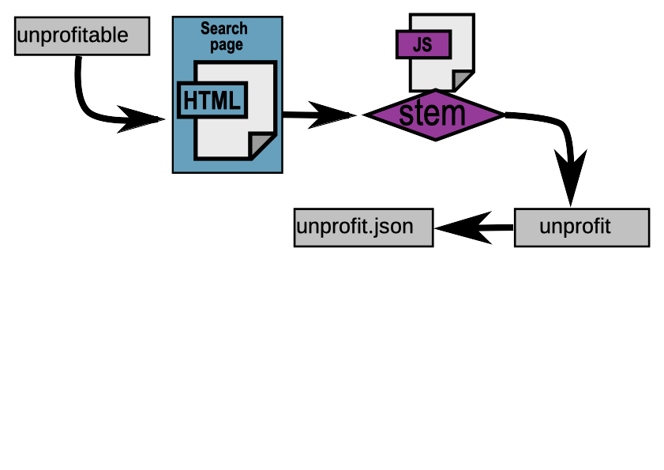
Notes:
From that token, it infers the name of the JSON token file that it needs to retrieve for this search.

Slide 36
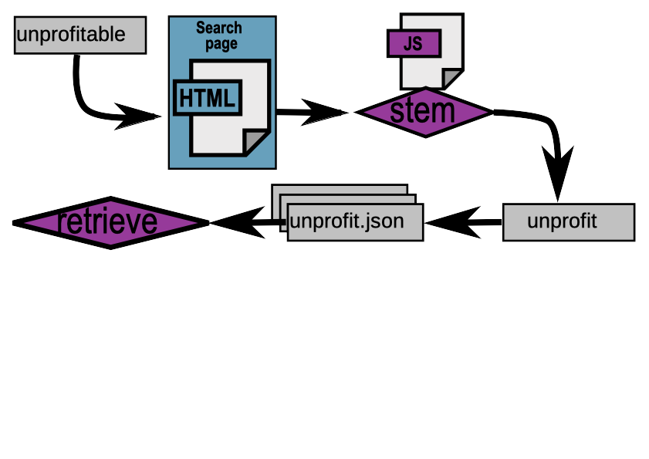
Notes:
It does the same for any other words typed into the search box, and also identifies any filters that have been applied to the search, so that it can retrieve the appropriate filter JSON files. Then it gets those files (assuming it doesn't have them already from a previous search).

Slide 37
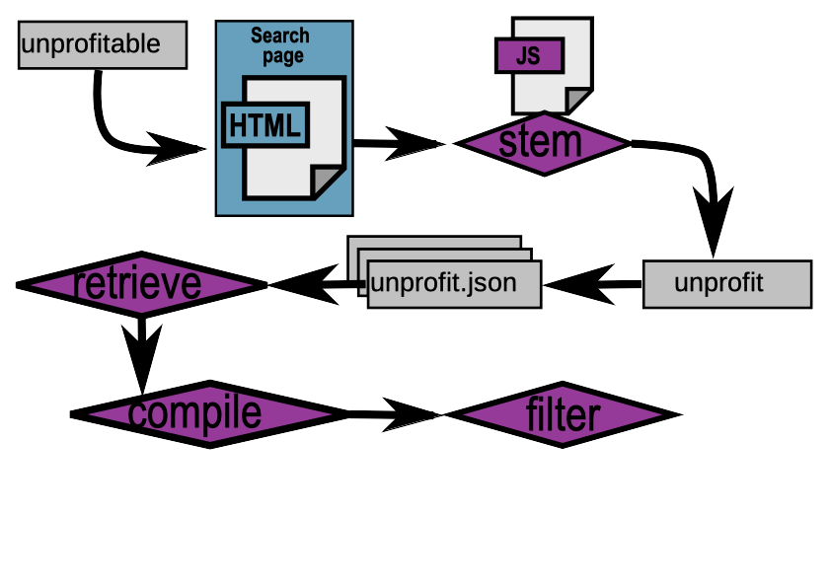
Notes:
Once the JSON is all retrieved, it compiles the hits from the tokens and filters the results...

Slide 38
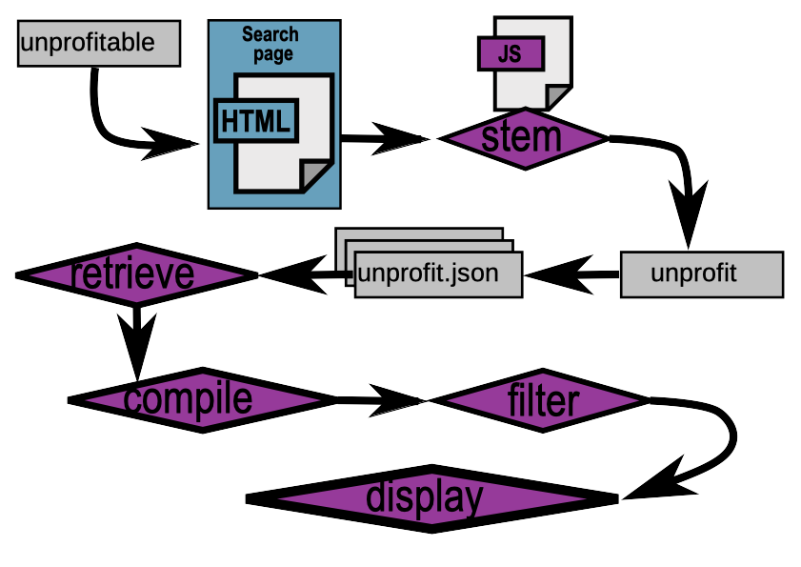
Notes:
...and it displays the results for the user, providing keyword-in-context matches if it's been configured to do that.

Slide 39
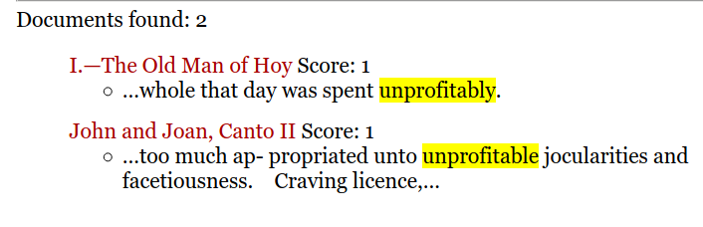

Slide 40
Endings Projects
☑ = live with staticSearch
☑ Robert Graves Diary (graves.uvic.ca)
☑ Map of Early Modern London (mapoflondon.uvic.ca)
☑ The Winnifred Eaton Archive (winnifredeatonarchive.org)
☑ Mapping Keats’s Progress (johnkeats.uvic.ca)
☑ My Norse Digital Image Repository (myndir.uvic.ca)
Le mariage sous L'Ancien Régime (mariage.uvic.ca)
Digital Victorian Periodical Poetry (dvpp.uvic.ca)
Landscapes of Injustice (loi.uvic.ca)
Linked Early Modern Drama Online (lemdo.uvic.ca)

Slide 41
Demonstration applications
https://johnkeats.uvic.ca/search.html
https://winnifredeatonarchive.org/search.html
https://dvpp.uvic.ca/search.html
Notes:
We currently have nine projects which use the staticSearch system, of which two are listed.
The first is a relatively simple site consisting of a few hundred articles, with a simple search engine that only has two filters.
The second is a medium sized archive of about 600 documents total, including about a dozen novels with 5 filters
The third is a much larger site (many thousands of documents), with a set of three different search configurations involving multiple filters.

Slide 42
Mappings Keats’s Progress
Notes:
Keats site screenshots needed:
empty search form
Search for walking (shows stemming and 82 docs)
Search for "walking" (exact phrase, 49 docs)
Add Poems filter (down to two docs)
Remove Poems filter, add 1820 From date (1 doc)

Slide 43
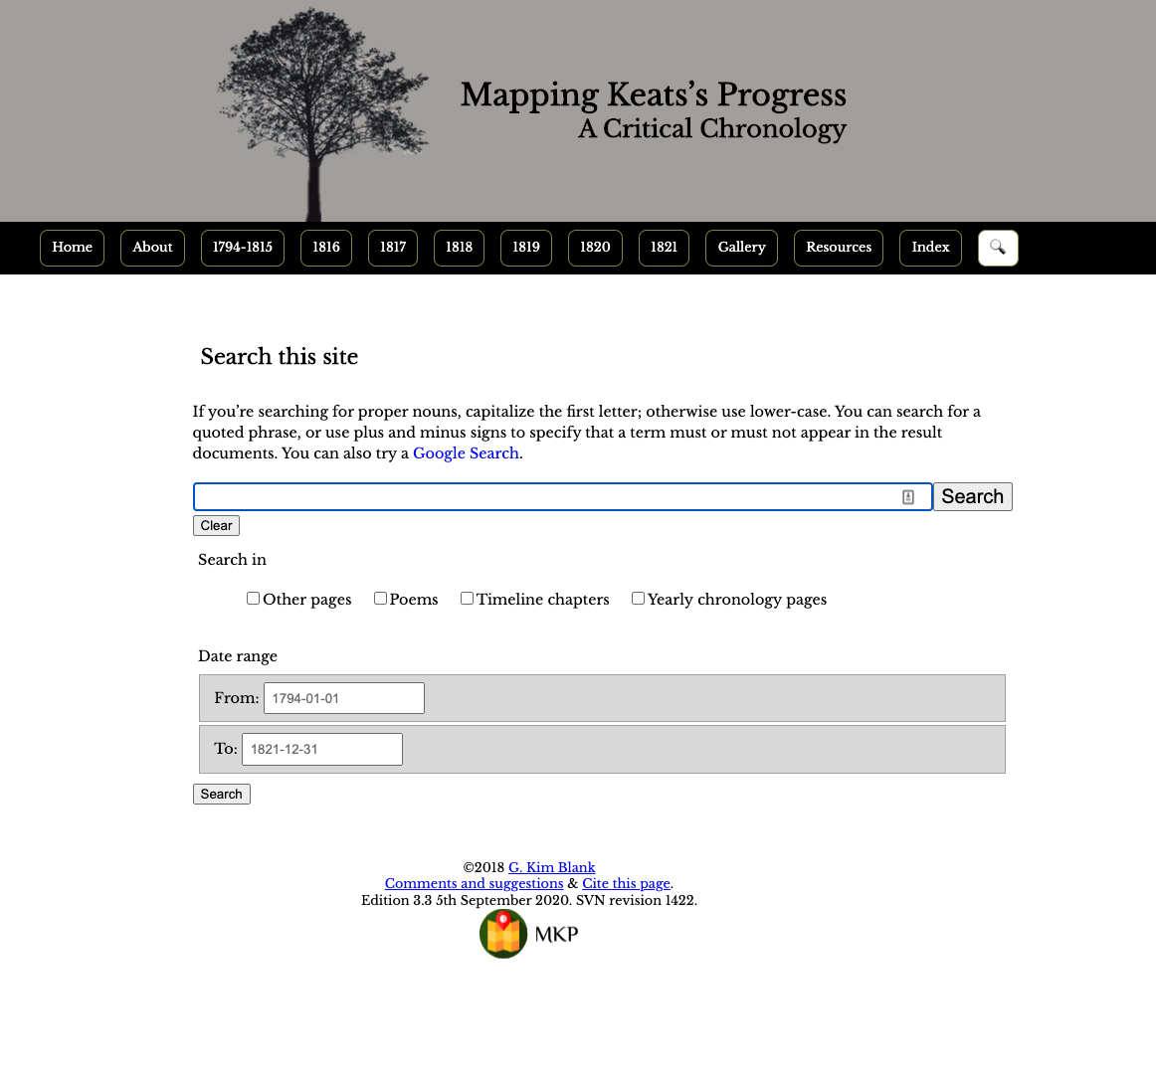
Notes:
empty search form

Slide 44
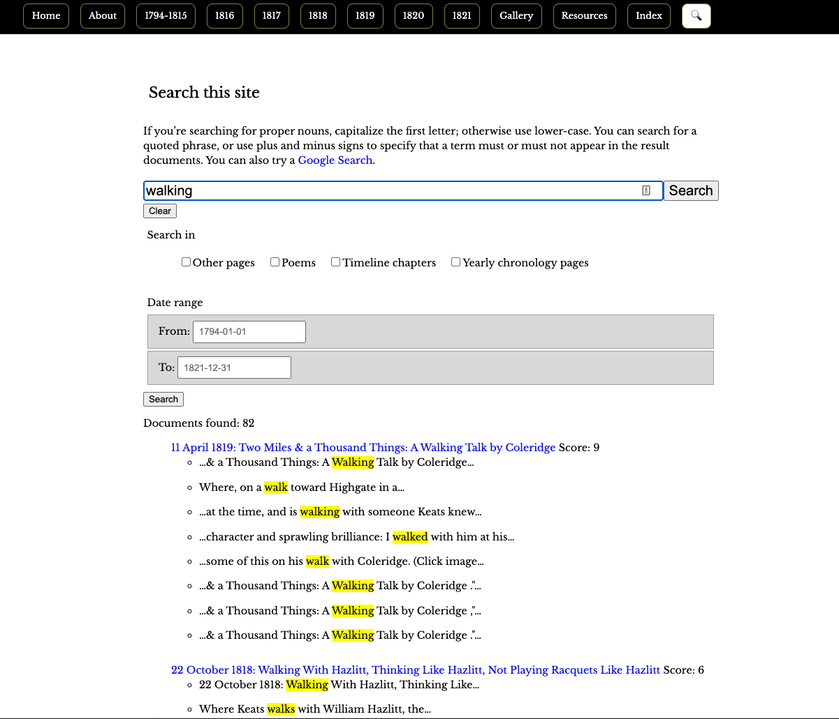
Notes:
Search for walking (shows stemming and 82 docs)

Slide 45
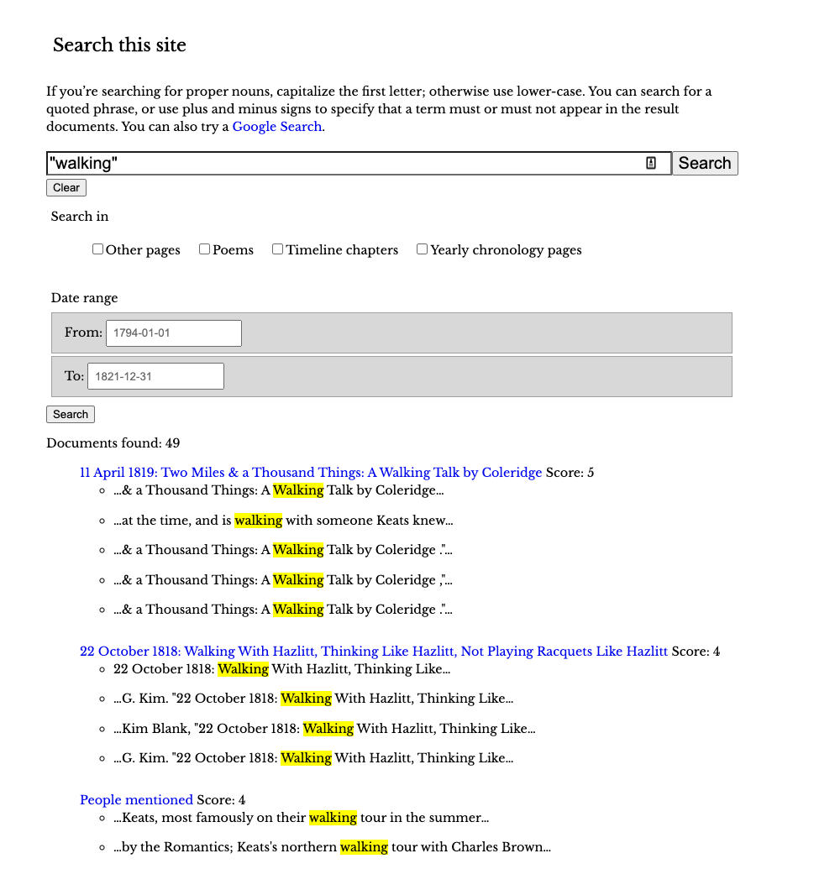
Notes:
Search for "walking" (exact phrase, 49 docs)

Slide 46
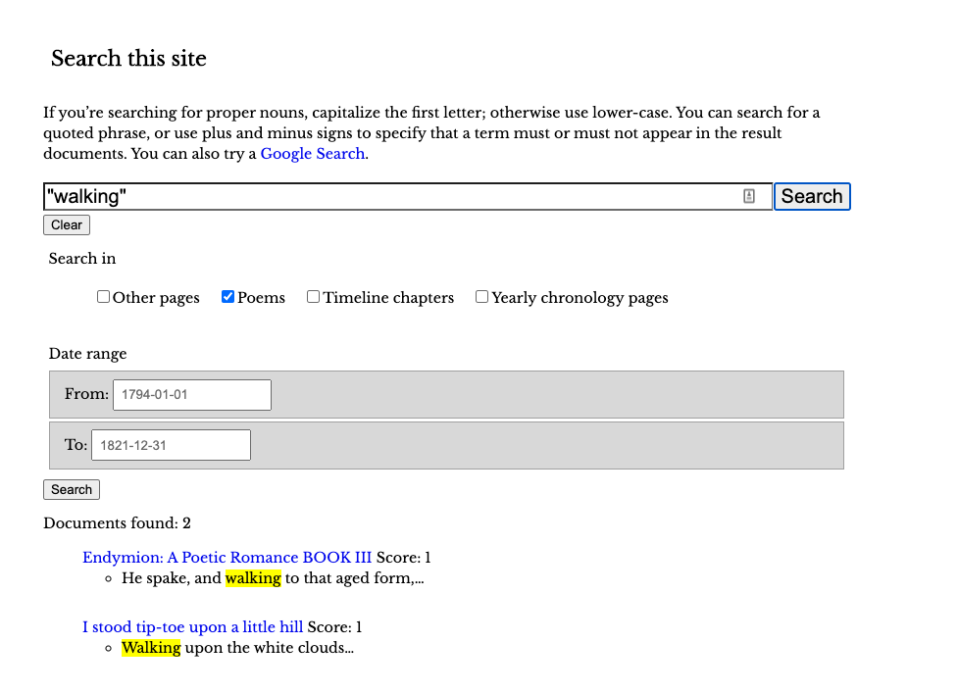
Notes:
Add Poems filter (down to two docs)

Slide 47
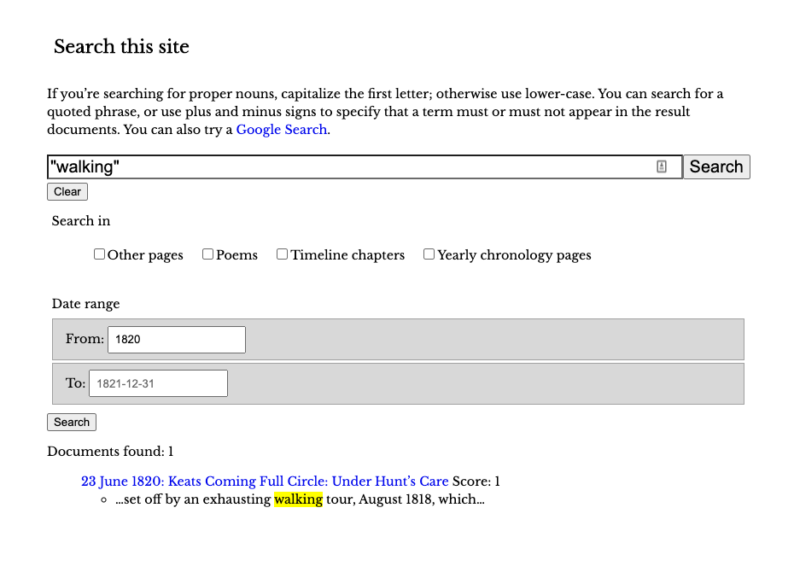
Notes:
Remove Poems filter, add 1820 From date (1 doc)

Slide 48
The Winnifred Eaton Archive

Slide 49
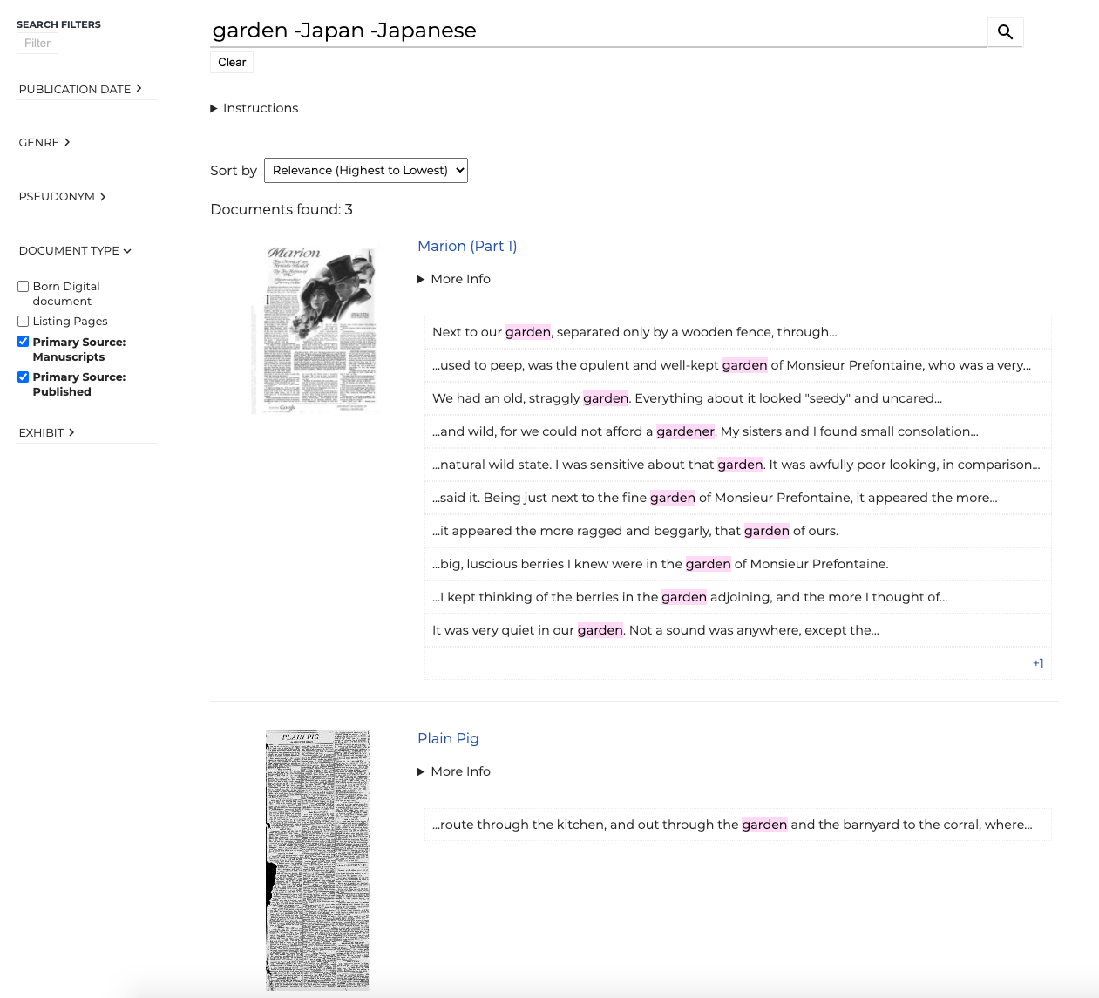

Slide 50
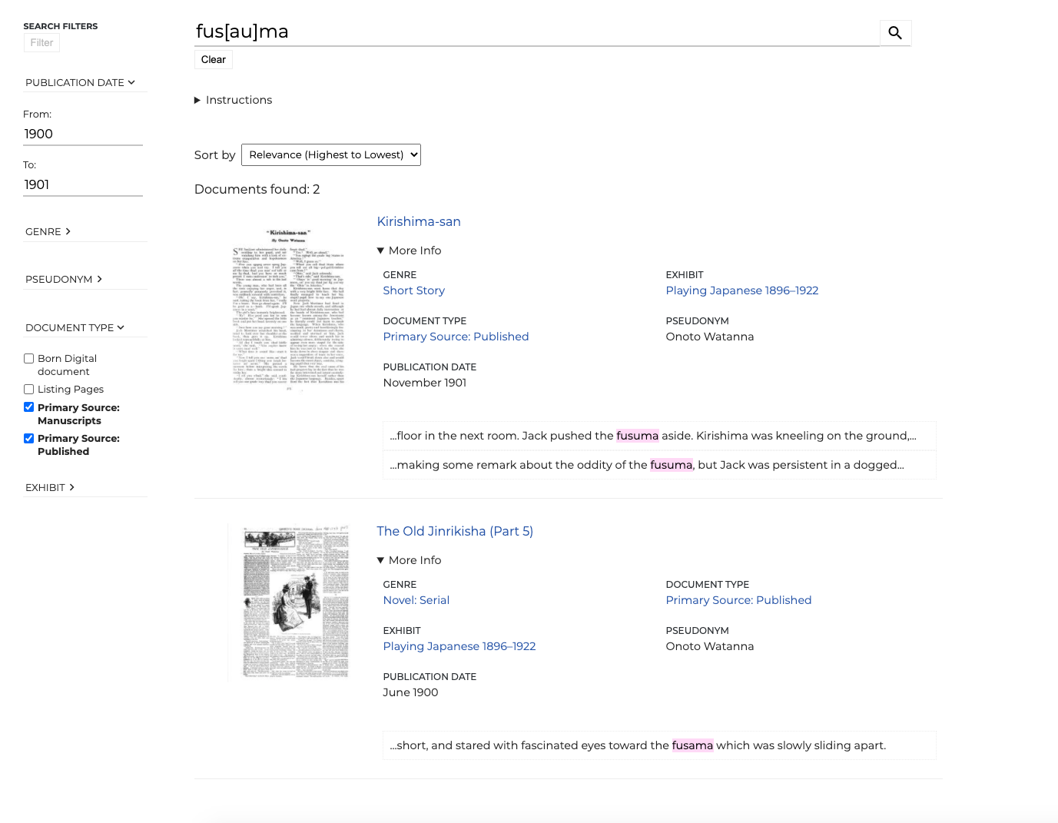

Slide 51
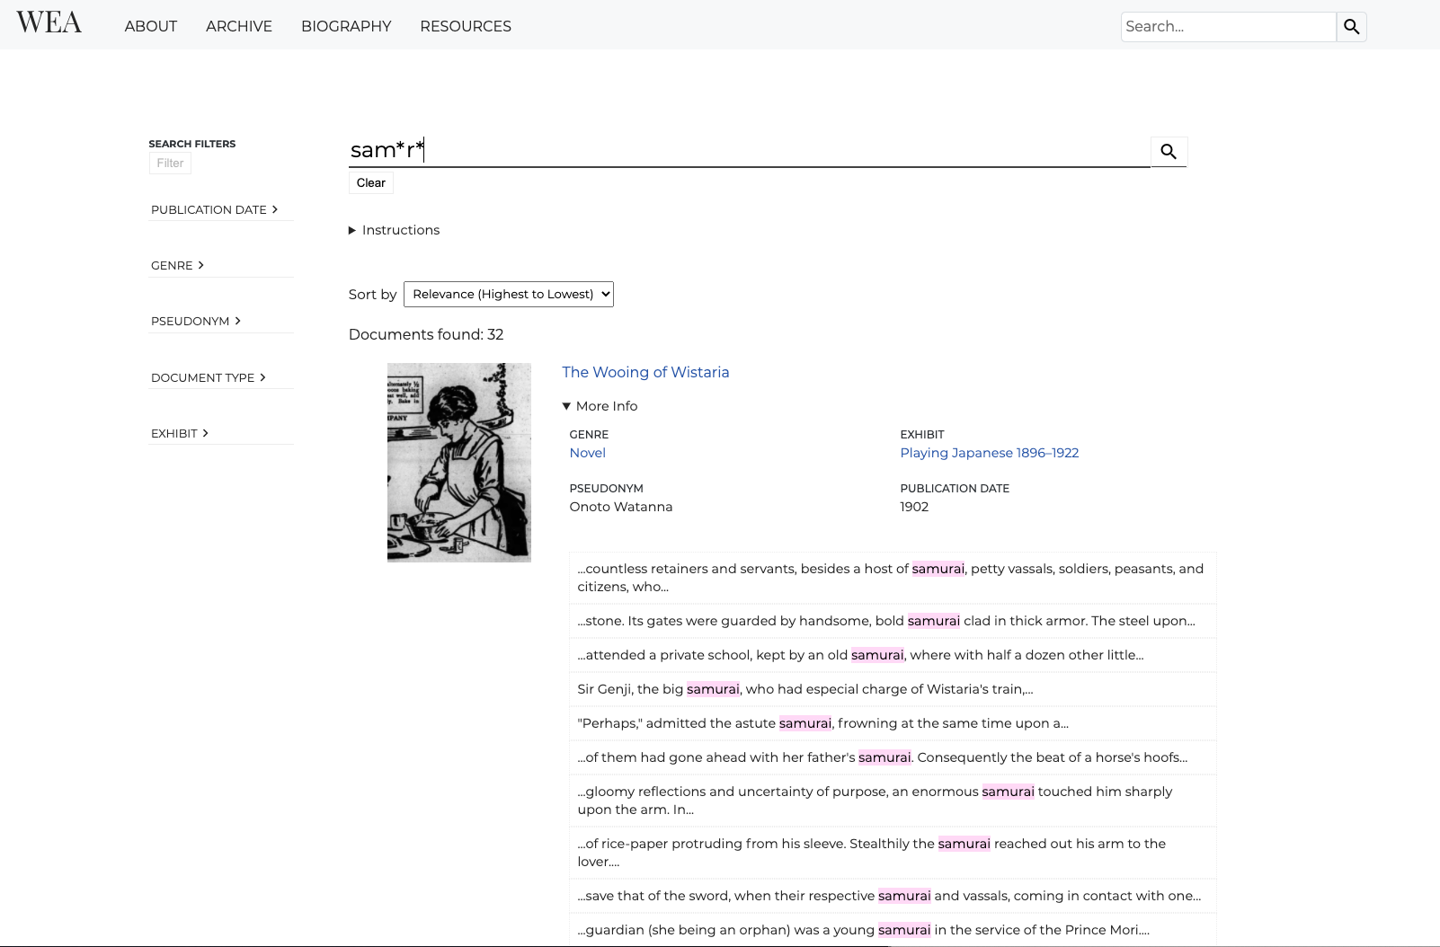

Slide 52
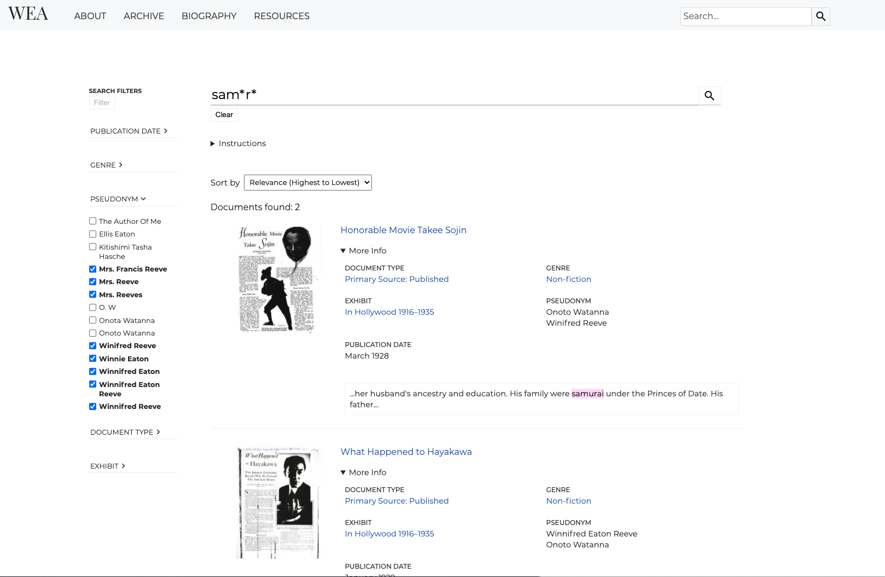

Slide 53
Digital Victorian Periodical Poetry
Multiple search pages/indexes
Different purposes
Different configurations and filters

Slide 54
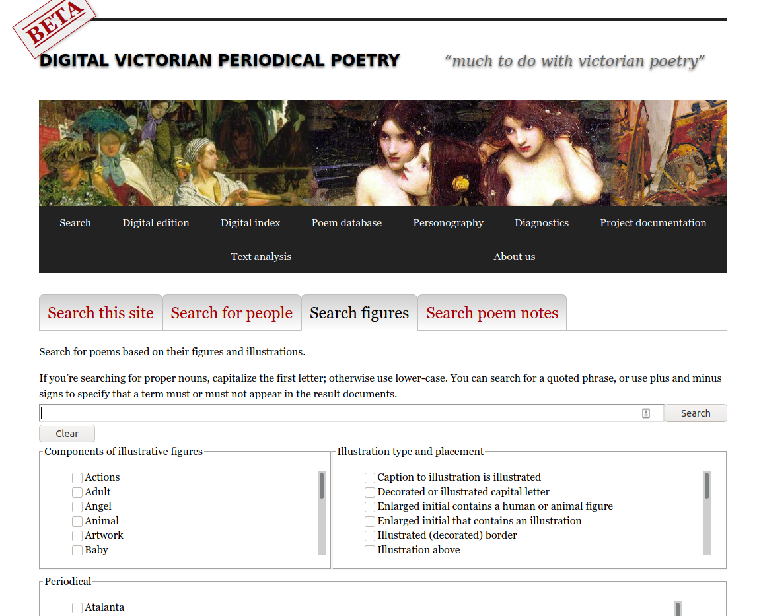

Slide 55
Other features
Pluggable stemmers (currently we have only Modern English and the “identity” stemmer).

Slide 56
Next steps
A Modern French stemmer
Enhanced English and French stemmers for Early Modern texts
Option to strip diacritics before stemming

Slide 57
Dev time amortization
1 year of work
2 contributors, 2 institutions
Approx 11,000 lines of code
Nine projects supported and counting
Value-for-money increases with every project
Notes:
Lines-of-code calculation:
git ls-files **.x* **.js **.odd **.css **.md | xargs wc -l

Slide 58
Takeaways
A DH Centre like HCMC massively multiplies the value of developer time
Developer collaborations between institutions add more value
Minimize custom project code, maximize reusable code

Slide 59
Resources
Get the code: https://github.com/projectEndings/staticSearch
Read the documentation:
https://endings.uvic.ca/staticSearch/docs/

Slide 60
Thanks!
HCMC, University of Victoria
DHIL, Simon Fraser University
Social Sciences and Humanities Research Council

