Slide 1

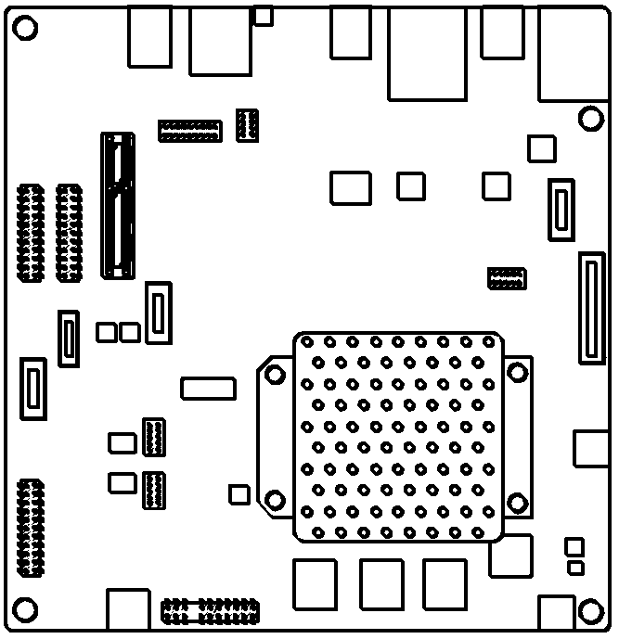
Images WIP
Development computer
Where you build ACRN
Target system
Where you run ACRN
Development computer
Where you build ACRN
Target system
Where you run ACRN
Serial connection
USB drive (recommended)

Slide 2







Images WIP
Step 1
Select Hardware and Scenario
Step 2 Prepare Development Computer
Step 3 Generate Board Configuration
Step 4 Generate Scenario Config & Launch Scripts
Step 5 Build ACRN
Step 6 Install and run ACRN
Ensure your hardware will work for your desired ACRN scenario
Install OS and prepare ACRN build environment
Install OS on target, use board inspector tool to generate board configuration file
Use configuration editor tool to generate scenario configuration file and launch scripts on development computer
Build ACRN hypervisor and kernel on development computer
Install ACRN hypervisor and kernel on target, run ACRN for the first time
Board configuration
Scenario configuration
Launch scripts
ACRN hypervisor
ACRN kernel

Slide 3
Images WIP
Pre-launched (launched before Service VM)
Post-launched (launched after Service VM)
Service VM
User VM
User VM
ACRN Hypervisor
Target Hardware

Slide 4
Images WIP
Service VM
User VM
Ubuntu
Ubuntu
ACRN Hypervisor
Target Hardware

Slide 5

Images WIP

