Slide 1
Getting Started With Open-Source Verification

Slide 2
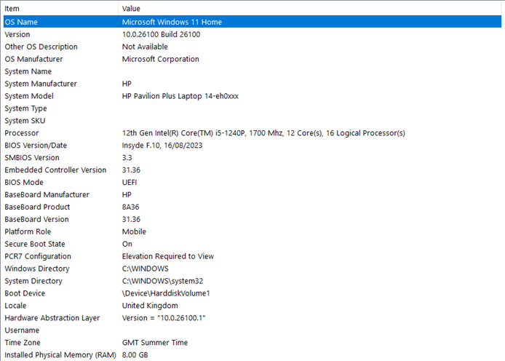
Setup and Prerequisites
Demos are designed to be fully Open-Source
They can be run on any mid-level PC

Slide 3
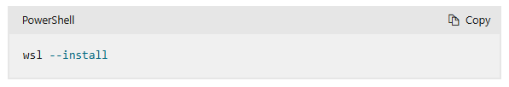
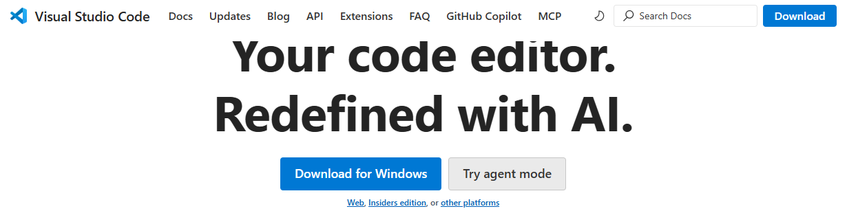
Setup
This tutorial has been developed on Ubuntu running on a windows laptop under WSL
The demos are run under VSCode

Slide 4
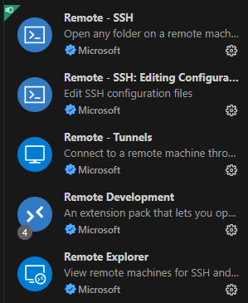
Setup
Using VSCode with WSL
https://code.visualstudio.com/docs/setup/windows
https://code.visualstudio.com/docs/remote/wsl
Using VSCode on MacOS
https://code.visualstudio.com/docs/setup/mac

Slide 5
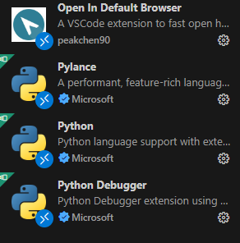

Setup
For a better editor experience Python, SystemVerilog and Browser extensions are added to VSCode

Slide 6
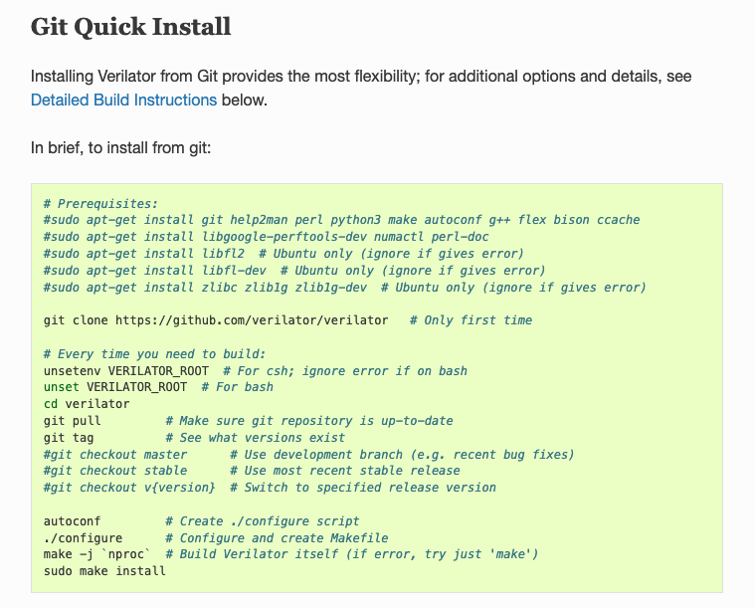
Setup
All examples are run using Verilator
AVL requires a new version installed directly from Git

Slide 7
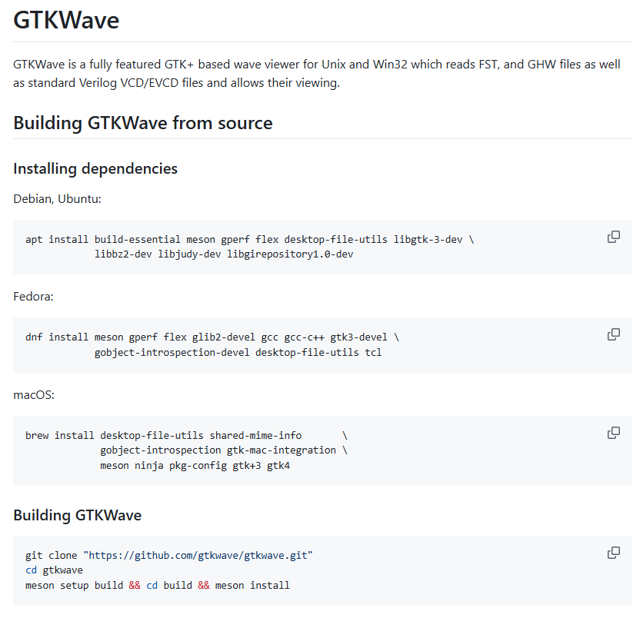
Setup
Waveforms can be viewed using GTKWave

Slide 8

Setup
However, Surfer is a preferred Waveform viewer with VSCode integration

Slide 9

Setup
Testbenches are designed using Cocotb

Slide 10
Setup
AVL is on GitHub
https://github.com/projectapheleia/avl
https://github.com/projectapheleia/avl-apb
https://github.com/projectapheleia/avl-axi
https://github.com/projectapheleia/avl-axi-stream
Full AVL documentation is available on ReadTheDocs
https://avl-core.readthedocs.io/en/latest/index.html

Slide 11
Setup
AVL Tutorials are on GitHub
https://github.com/projectapheleia/avl-tutorials
This will install all other AVL libraries required

Slide 12


