Slide 1
AVL Tutorials

Slide 2
Simple Tutorials
Tutorials are available in GitHub
https://github.com/projectapheleia/avl-tutorials

Slide 3
Simple Tutorials
Simple Tutorials are provided to get users familiar with the basic concepts
Tutorial 1: Clocks and Reset
Tutorial 2: Logic Variables
Tutorial 3: Structs
Tutorial 4: Logs
Tutorial 5: Simple Sequence

Slide 4
Simple Tutorials
All tutorials have the same structure
README.md explaining the steps required to complete the tutorial
exercise directory
Template containing TODO comments
solution directory
Finished tutorial for reference

Slide 5
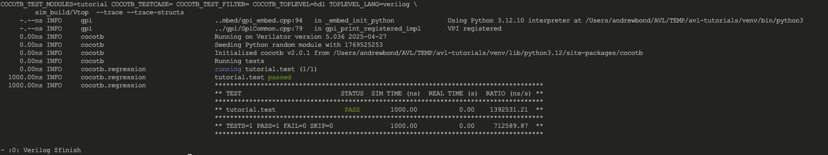
Simple Tutorials
All tutorials are run in the same way
cd exercise
make sim

Slide 6
Advanced Tutorials

Slide 7
Tutorial 1
Simple FIFO

Slide 8
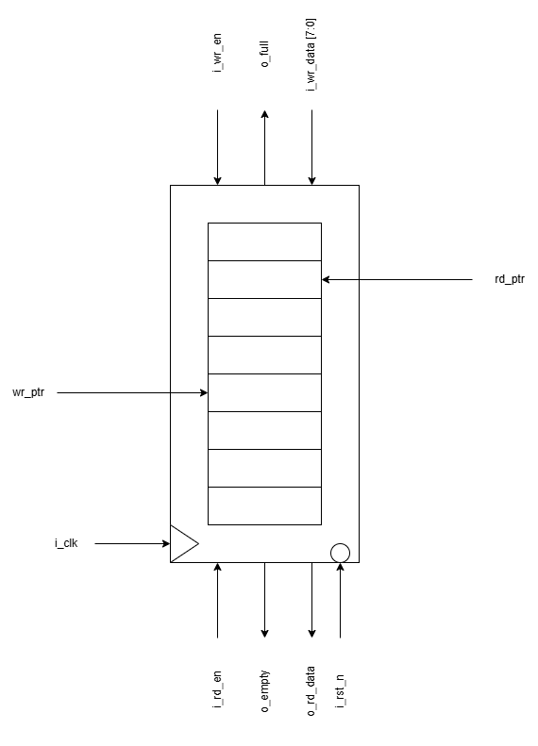
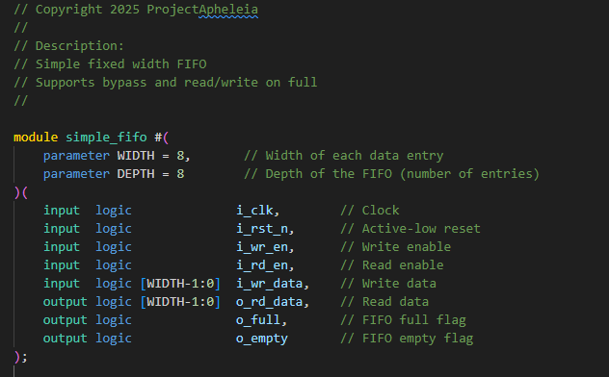
Design Under Test
The DUT is a simple FIFO
100MHz Clock
Async – active low reset
Width : 8 bits
Depth : 8 entries
Full / Empty indicators

Slide 9
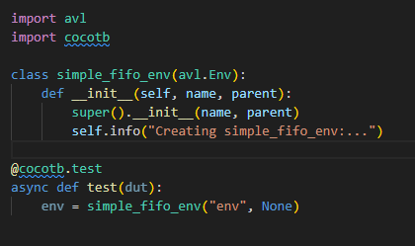
Phase 0
Extend the environment to drive the clock and reset signals
Add a timeout (1ms)
Confirm FIFO is empty after reset
https://avl-core.readthedocs.io/en/latest/methodology/env.html

Slide 10
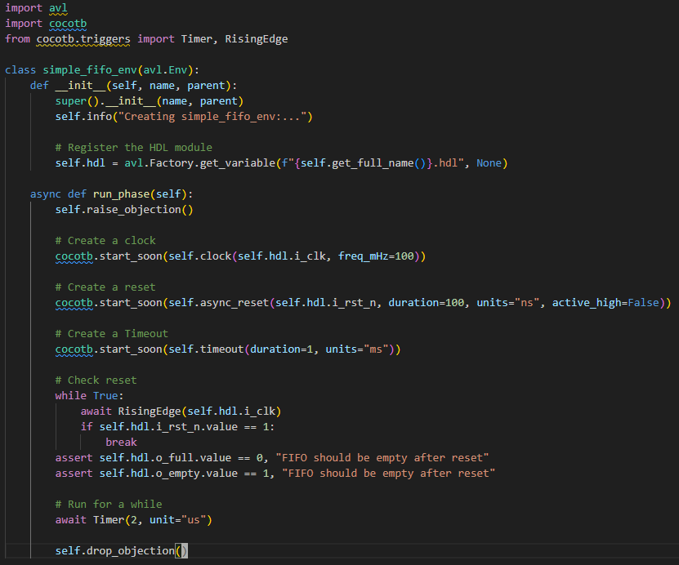
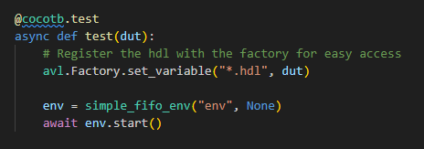
Phase 0
Register handle to DUT

Slide 11

Phase 0
Register handle to DUT
Create a run_phase
Create a clock

Slide 12
Phase 0
Register handle to DUT
Create a run_phase
Create a clock
Create a reset
Create a timeout

Slide 13
Phase 0
Register handle to DUT
Create a run_phase
Create a clock
Create a reset
Create a timeout
Add the reset check

Slide 14
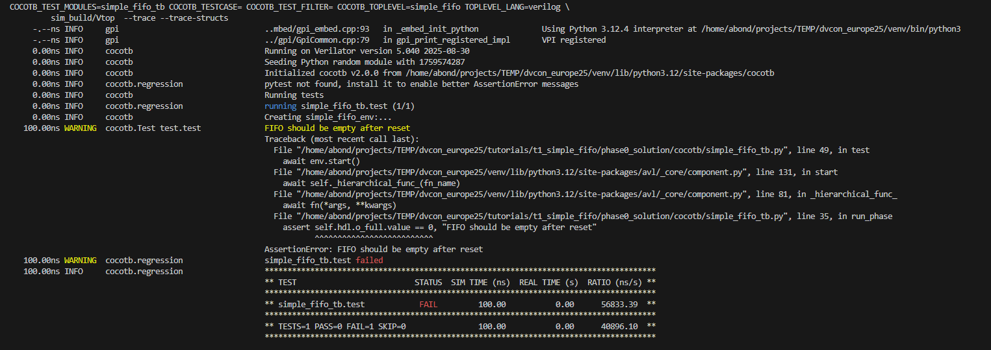


Phase 0
Run the test
make sim
Error on o_full due to width of variable

Slide 15
Phase 1
Create
Agent
Driver
Sequencer
Create a random sequence
Create a monitor with built in checks

Slide 16
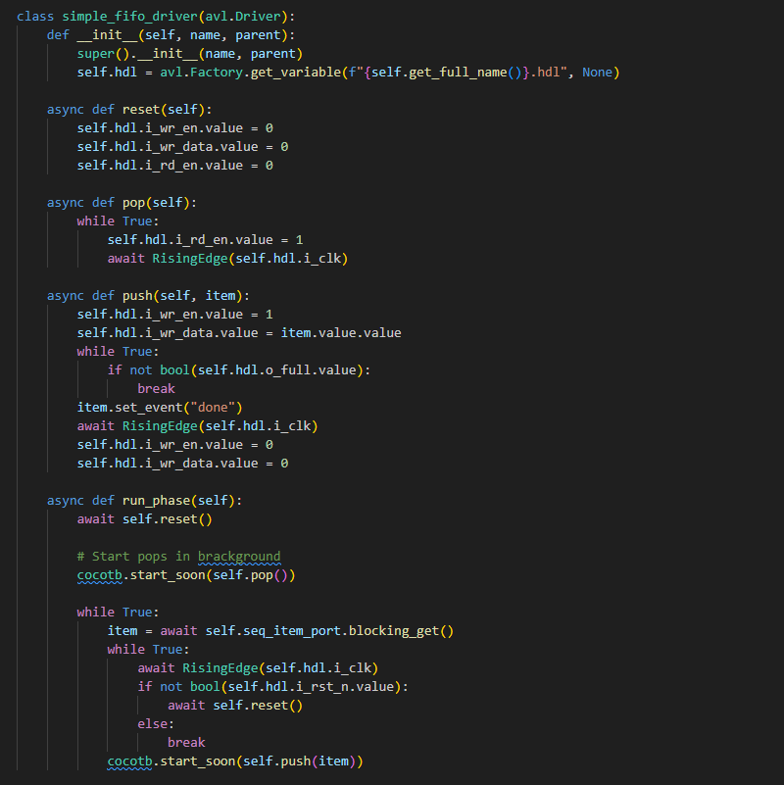
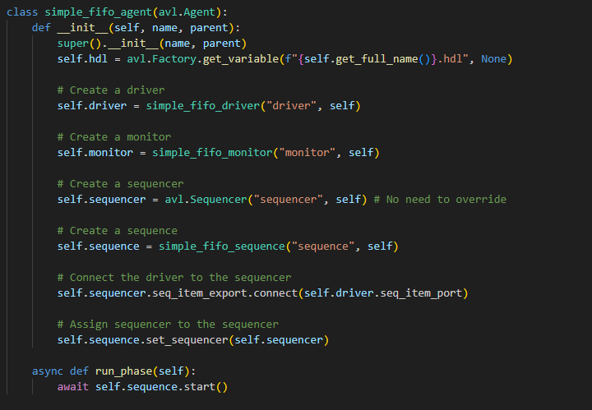
Phase 1
Create agent and driver

Slide 17
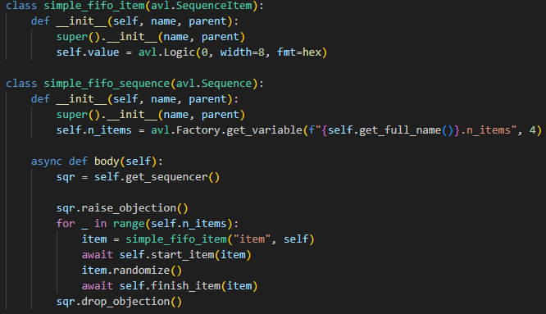
Phase 1
Create
Agent
Driver
Sequencer
Create a random sequence

Slide 18
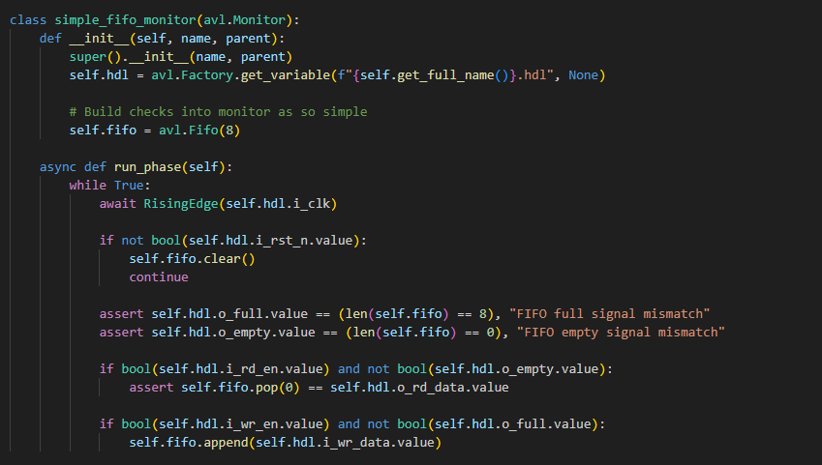
Phase 1
Create
Agent
Driver
Sequencer
Create a random sequence
Create a monitor with built in checks

Slide 19
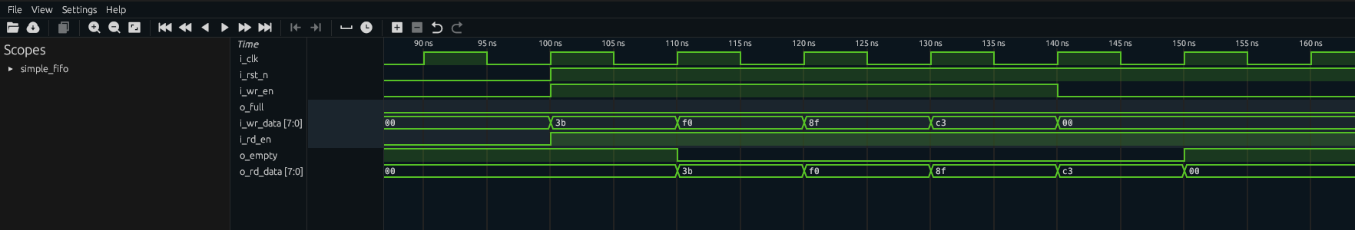
Phase 1
make sim
FIFO never fills as we pop immediately

Slide 20
Phase 2
Add rate limiters to driver
Increase number of items

Slide 21
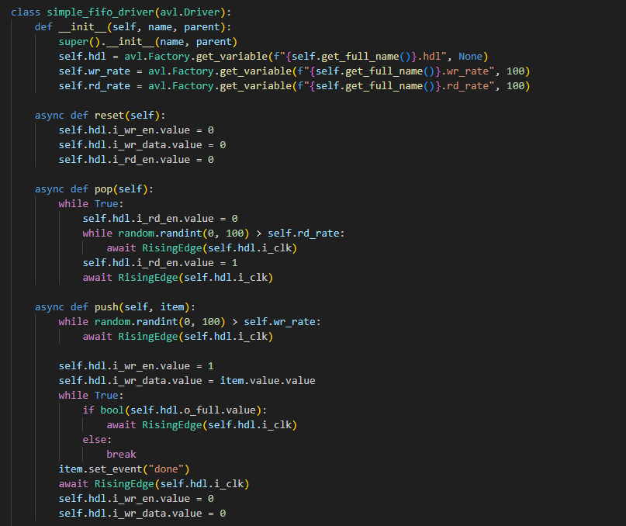
Phase 2
Add rate limiters to driver

Slide 22
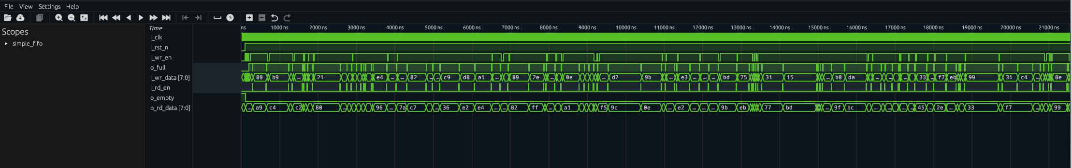
Phase 2

Slide 23
Tutorial 2
ALU

Slide 24
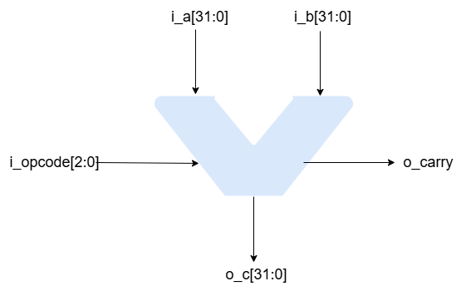
Design Under Test
Combinatorial ALU unit
Opcode | Description
3’b000 | NOP
3’b001 | ADD
3’b010 | SUB
3’b011 | AND
3’b100 | OR
3’b101 | XOR
3’b110 | COMP
3’b111 | ILLEGAL

Slide 25
Phase 0
Using a template create testbench with
Sequence / Sequence Item
Sequencer
Driver
Model
Scoreboard
Visualize
Tree
Diagram

Slide 26
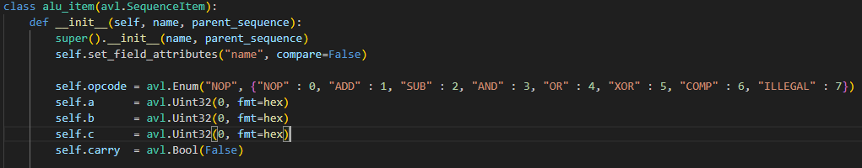
Phase 0
Using a template create testbench with
Sequence / Sequence Item
No need for sequence or sequencer – built into template

Slide 27
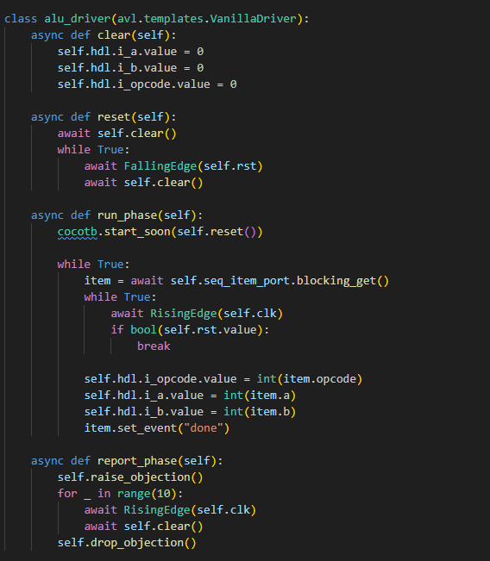
Phase 0
Using a template create testbench with
Driver

Slide 28
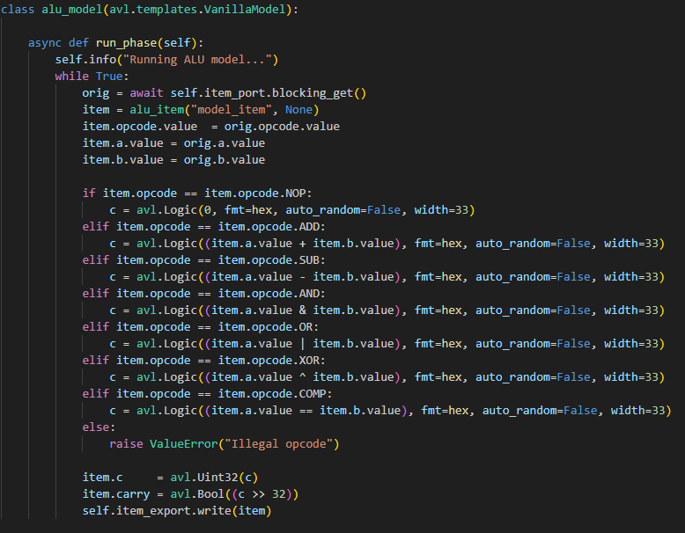
Phase 0
Using a template create testbench with
Model
Scoreboard
No need for scoreboard– built into template

Slide 29
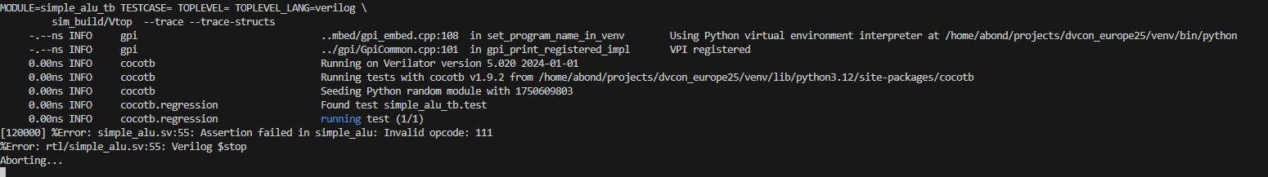
Phase 0
make run
$error – opcode[7] is illegal

Slide 30
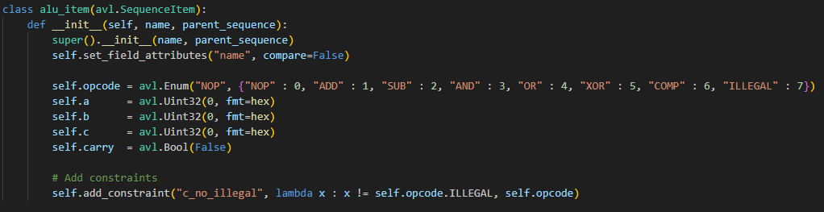
Phase 0
Add constraint to avoid illegal instructions

Slide 31

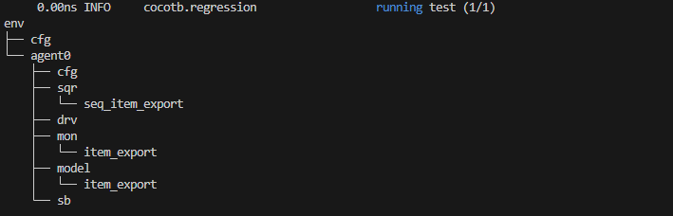
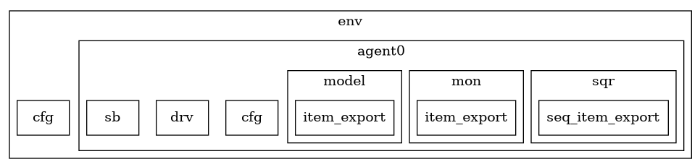
Phase 0
Visualize
True
Diagram

Slide 32
Phase 1
Add constraints to a and b to generate more interesting values

Slide 33
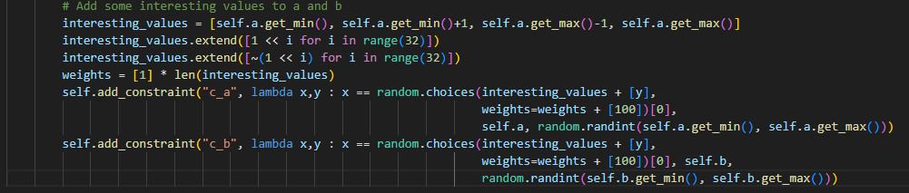
Phase 1
Add constraints to a and b to generate more interesting values

Slide 34
Phase 2
Add functional coverage
Generate coverage report

Slide 35
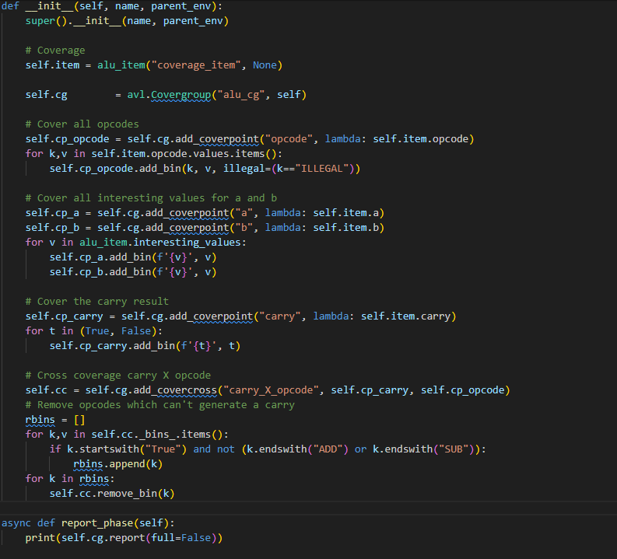
Phase 2
Add functional coverage

Slide 36
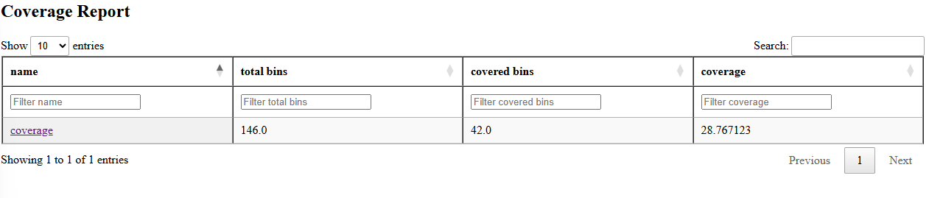
Phase 2
Add functional coverage
Generate coverage report
avl-coverage-analysis --path .

Slide 37
Questions and Answers

Slide 38
Thank You
https://github.com/projectapheleia/avl
https://avl-core.readthedocs.io/en/latest/index.html

