Slide 1


INTERNATIONAL INFORMATION TECHNOLOGY TRAINING SYSTEM
SOFTECH APTECH
AIR RESERVATION SYSTEM
BATCH137-138 – TEAM 1
Instructor Teacher: Student Perform:
Nguyen Ho Long Hai Doan Phuoc Trung
Le Xuan Hung
Nguyen Quoc Hung
1

Slide 2
CONTENT
Part 1: Team Target Audience
Analyze and understand the user requirements
Plan and maintain a schedule for the various activities to be done in this project
Part 2: Method and Utilities
Technology used:
HTML5, CSS, Bootrap, Javascript, AngularJS, ASP.NET MVC
Part 3: Result and Recommendations
Result – Air Reservation System
Recommendations for develop
2

Slide 3

Part 1: Team Target Audience
Analyze and understand the user requirements
Make the website for checking flight info and booking.
Interface compatible with all browsers, mobile (Mobile, Tablet, Laptop ...)
Integration of many functions:
Login-Logout,
Information of flights
Booking
Payment
3

Slide 4
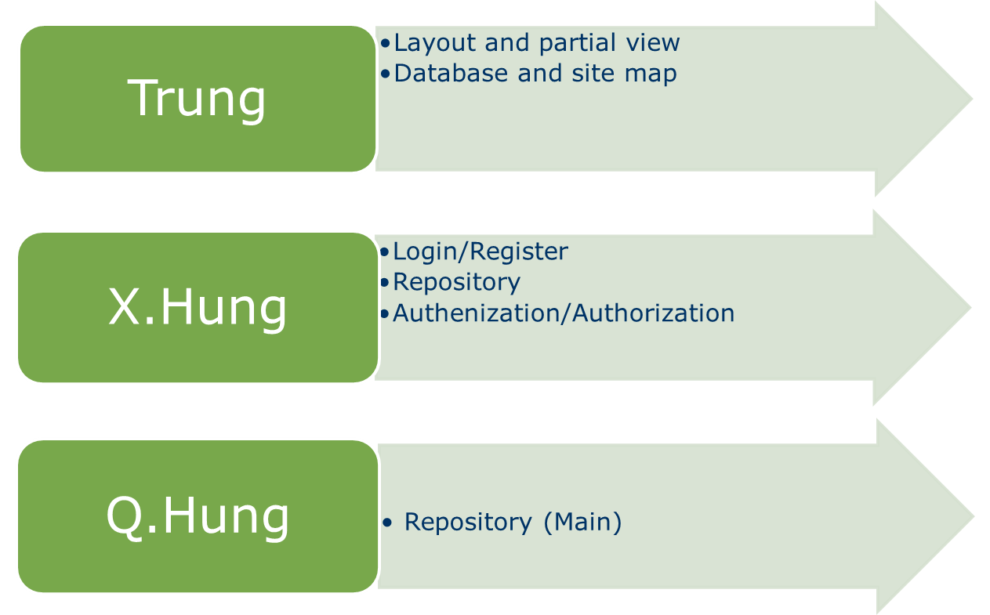
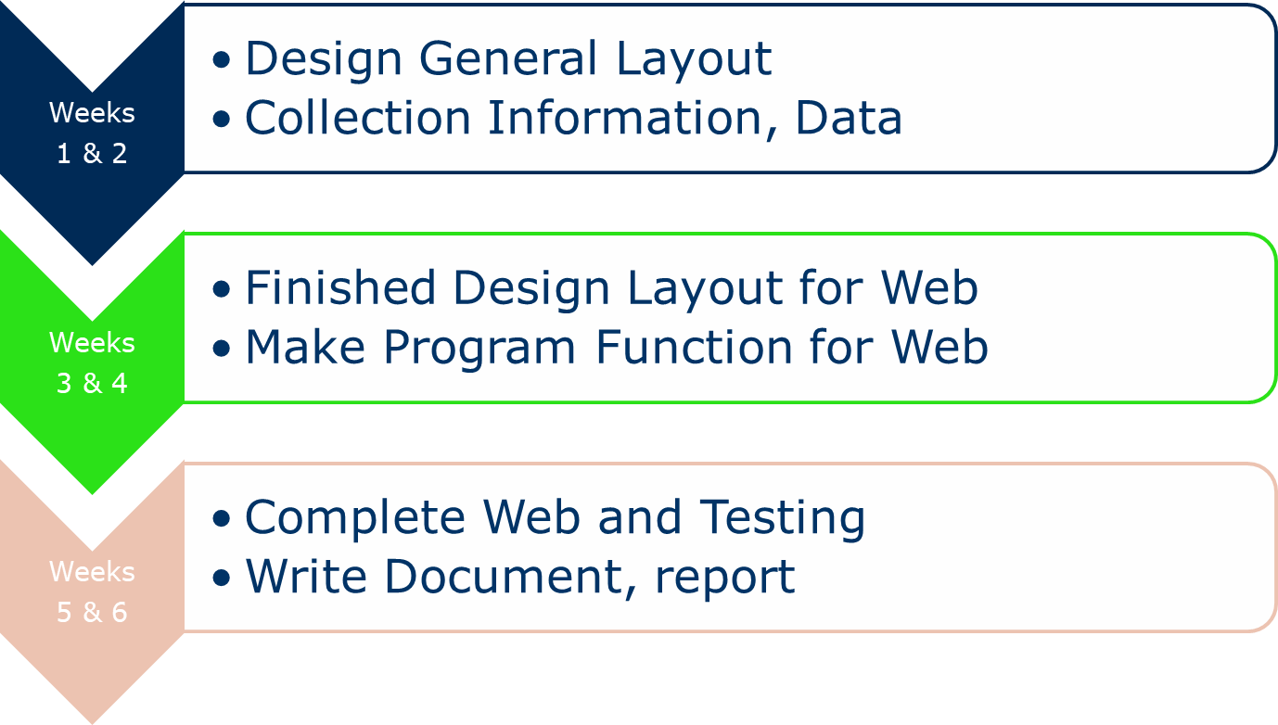
Part 1: Team Target Audience
Plan and maintain a schedule for the various activities to be done in this project
4

Slide 5

Part 2: Method and Utilities
Technology used: ASP.NET MVC
8

Slide 6

Part 2: Method and Utilities
Technology used: HTML5, CSS, Javascript
6

Slide 7



Part 2: Method and Utilities
Technology used: Boottrap, AngularJS, Github
7

Slide 8
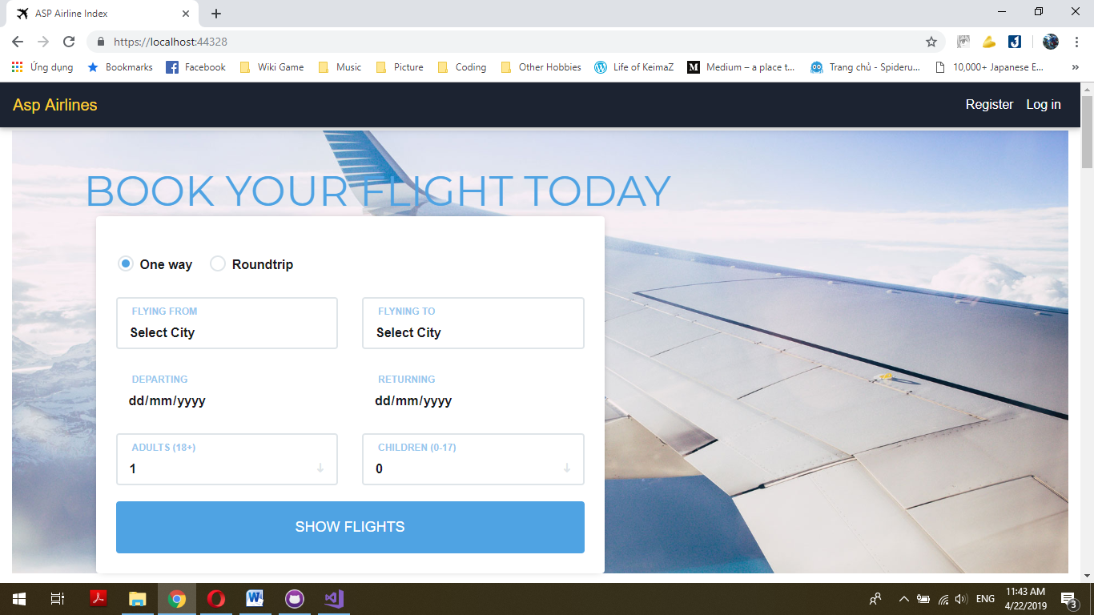
Part 3: Result and Recommendations
Result - DriverWithSmiles.com
9

Slide 9

Part 3: Result and Recommendations
Result - DriverWithSmiles.com
/HomePage
10

Slide 10
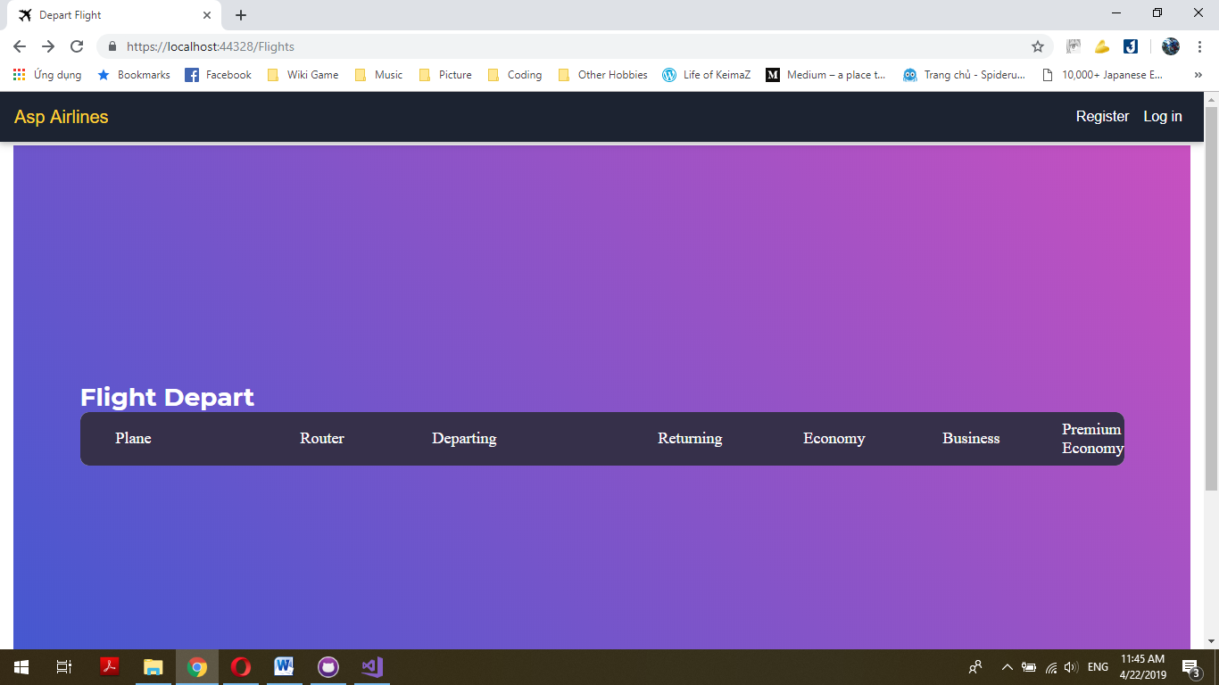
Part 3: Result and Recommendations
11

Slide 11
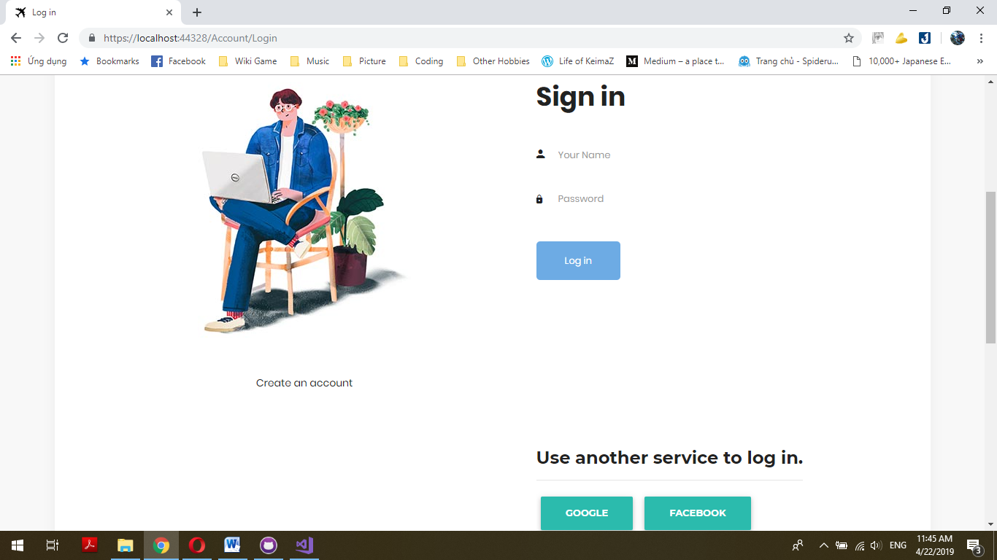
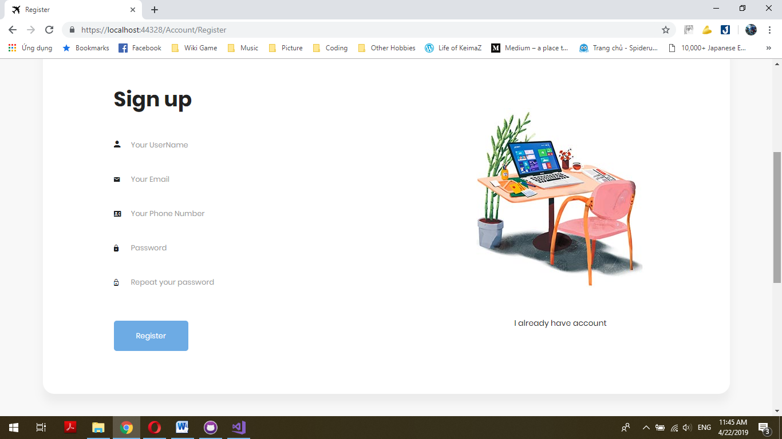
Part 3: Result and Recommendations
11

Slide 12
Part 3: Result and Recommendations
Recommendations
Need to be developed and upgraded
  Developed and upgraded sign up and login with authentication
  Build back-end (Manager/Administrastor)
  Upgrade static website to dynamic website by using Java, C#, P
33

Slide 13


34

