Slide 1

Cloud-Based CI/CD Pipeline for Microservices Deployment Architecture
Submitted in partial fulfillment of the requirements for the award of the degree of
Master of Computer Application (MCA)
By
Student Name: Saloni Kumari
Enrollment No: O24MCA110660
Under the guidance of
Guide/Mentor Name: Vasanthi Chandran

Slide 2
Abstract / Executive Summary
Project Topic Overview
Implements a microservices-based CI/CD deployment system using Azure Kubernetes Service (AKS)
Uses GitHub Actions for automated build, test, and multi-environment deployment (dev, stage, prod)
Utilizes Docker and Azure Container Registry (ACR) for containerization and image management
Incorporates Kubernetes features like services, ingress, and HPA for communication, access, and scaling
Integrates monitoring (Grafana, Prometheus) and RBAC (Azure AD) for observability and secure access

Slide 3
Introduction
Project Background
Problem Definition
Manual deployments are time-consuming and error-prone
Lack of automation and monitoringObjectives
Objectives
Automate build, test, and deployment using CI/CD
Deploy microservices on Azure Kubernetes Service (AKS)
Implement monitoring and secure access
Scope
Supports dev, stage, and production environments
Covers frontend and backend microservices
Technology Overview
AKS, Docker, GitHub Actions
Grafana, Prometheus, Azure SQL

Slide 4
System Study
Existing System
Limitations
Manual deployments are time-consuming and error-prone
No automated CI/CD or rollback mechanism
Limited monitoring and system visibility
Feasibility Study
Technically feasible using Azure cloud and AKS
Economically feasible with cloud free tiers
Operationally efficient due to automation
Requirement Gathering
CI/CD pipeline for automated deployment
Cloud infrastructure using AKS
Monitoring using Grafana & Prometheus
Secure access using RBAC (Azure AD)

Slide 5
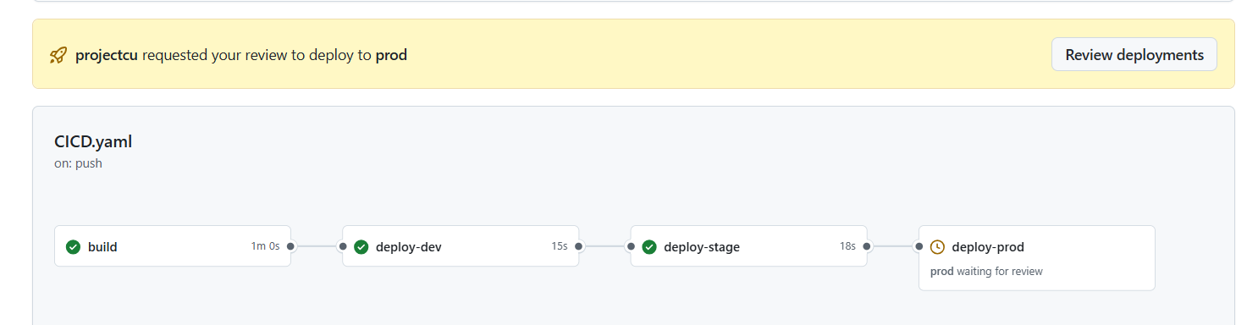
System Analysis
Requirement Analysis
Functional Requirements
Automated build, test, and deployment using CI/CD
Deployment of frontend and backend microservices on AKS
Monitoring dashboards for system and deployment status
Non-Functional Requirements
High availability and scalability
Secure access using RBAC (Azure AD)
Reliable and efficient system performance
DFD / Use Case Diagrams
Represents CI/CD workflow and deployment process
Actors: Developer, DevOps Engineer, System

Slide 6
System Design
System Architecture
CI/CD Pipeline
Implemented using GitHub Actions
Automated workflow: Build → Test → Docker → Deploy
Supports dev, stage, and production environments
Integrated with ACR and AKS for deployment
AKS Architecture
Microservices deployed on Azure Kubernetes Service
Separate namespaces: dev, stage, prod
Uses Ingress for external access
HPA configured for automatic scaling
Monitoring Architecture
Prometheus collects system and application metrics
Grafana provides dashboards for visualization
Integrated with Azure Monitor for logs

Slide 7
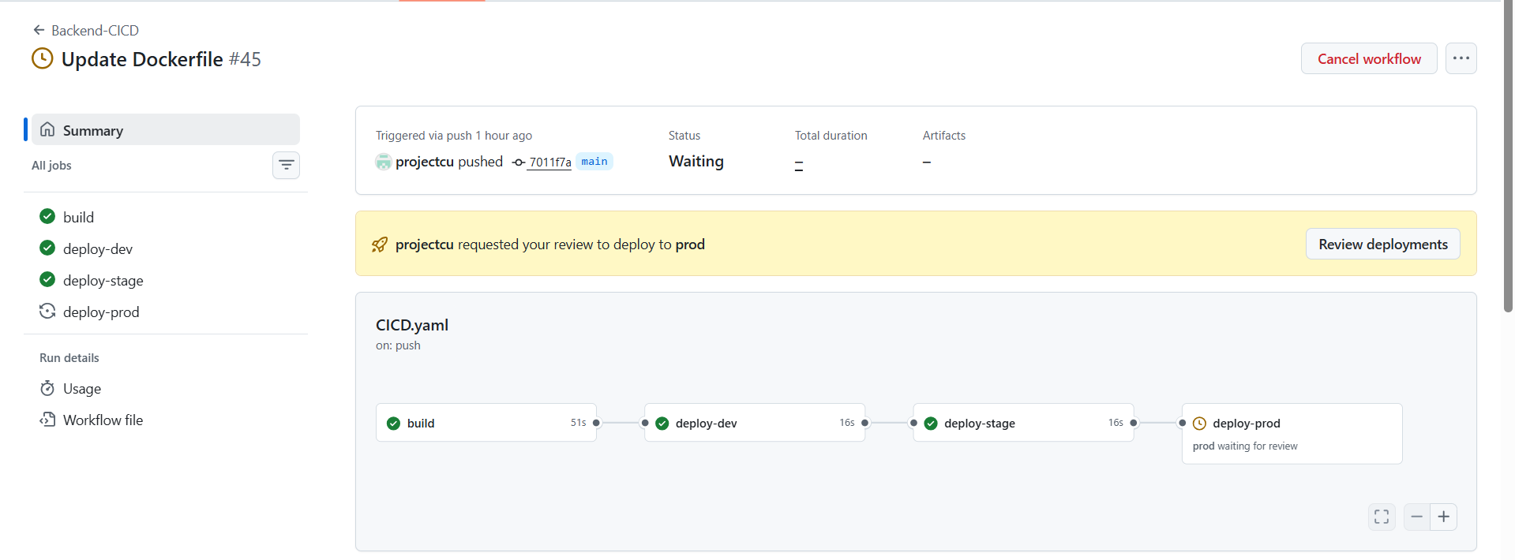
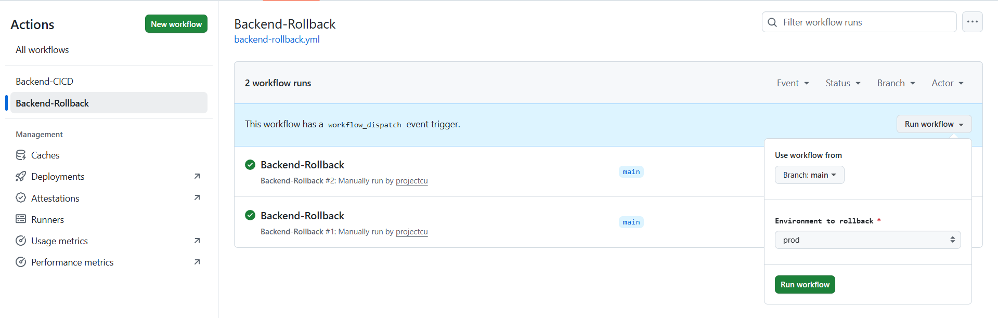
System Implementation
Technology Stack
Module Development
Frontend developed using React
Backend developed using Spring Boot APIs
CI/CD pipelines created using GitHub Actions
Separate workflows for deployment and rollback

Slide 8
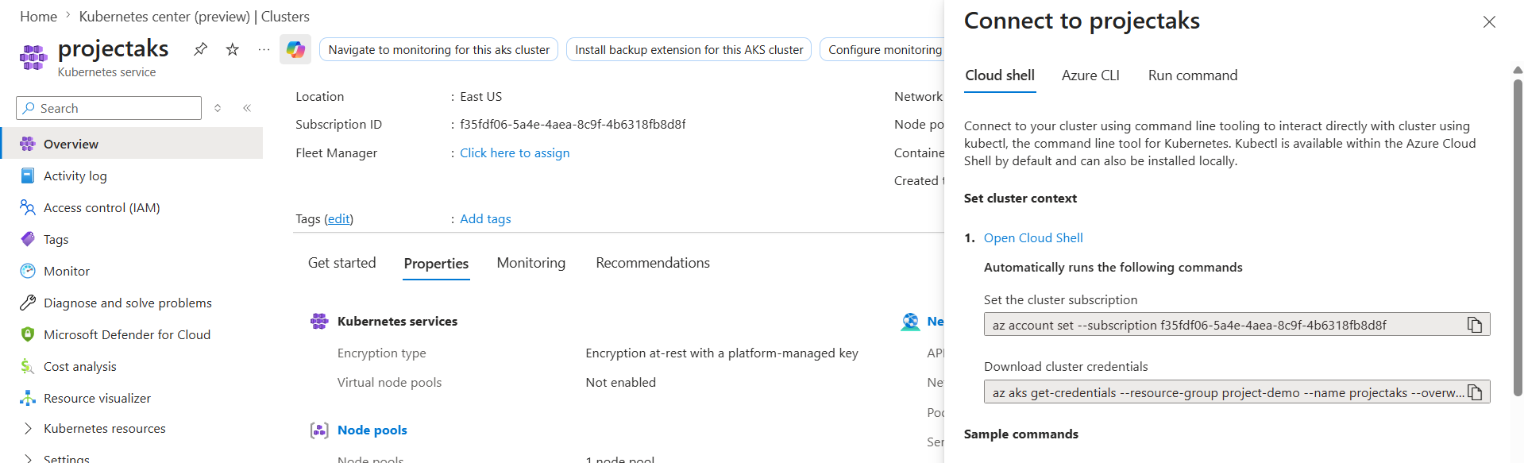
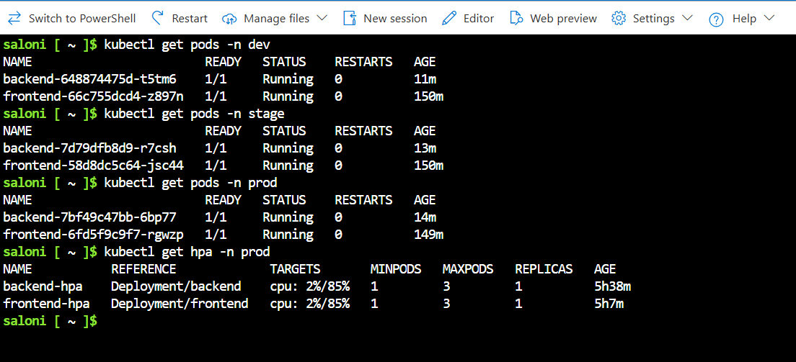
System Implementation
Azure / AKS Integration
Application deployed on Azure Kubernetes Service (AKS)
Container images stored in Azure Container Registry (ACR)
Multi-environment setup (dev, stage, prod)

Slide 9
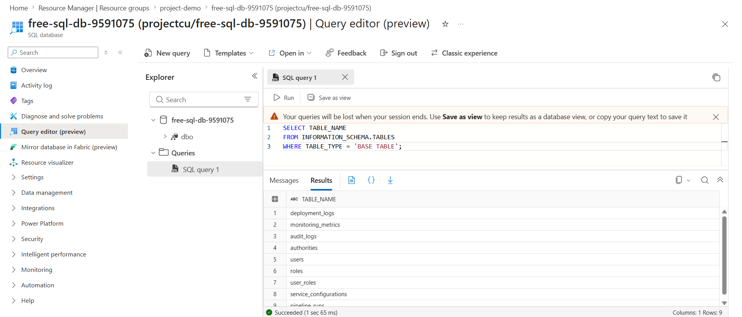
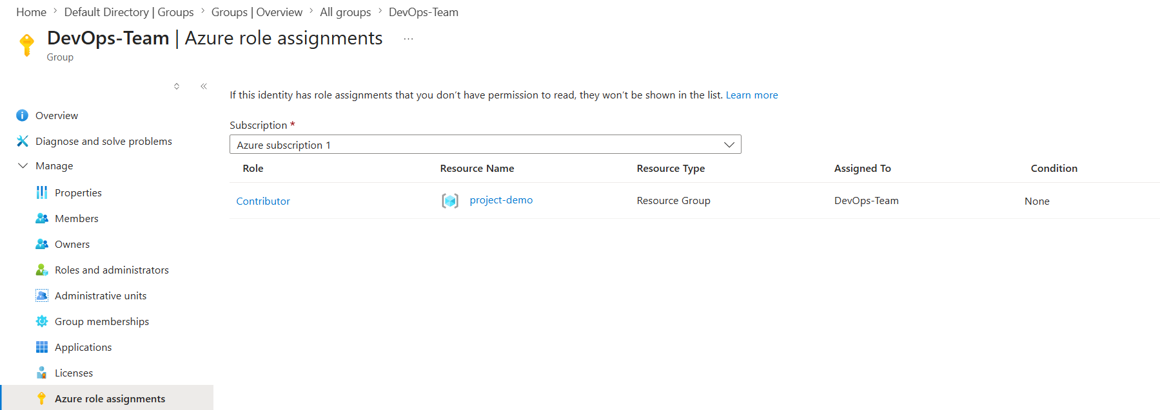
System Implementation
SQL Integration
Integrated with Azure SQL for data storage
Uses Azure AD for role-based access control (RBAC)

Slide 10
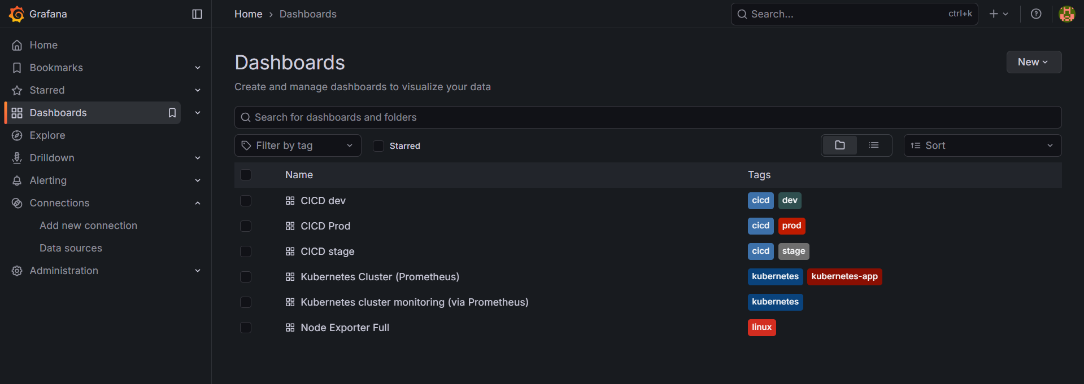
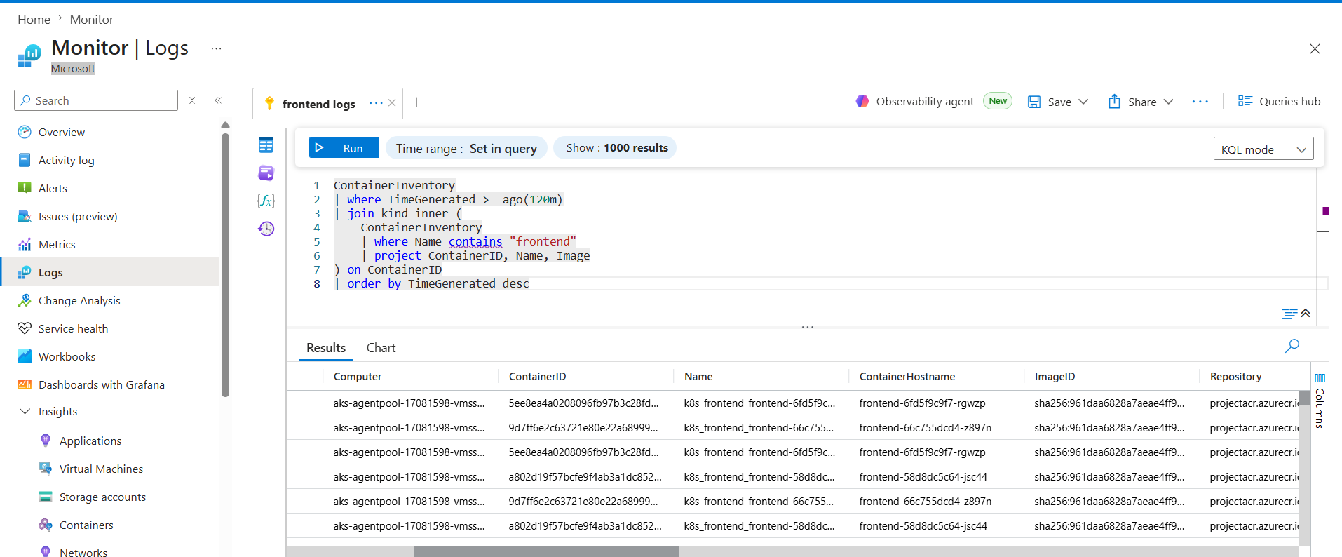
System Implementation
Deployment & Monitoring
Automated deployment using CI/CD pipelines
Monitoring using Prometheus and Grafana dashboards
Logging and insights using Azure Monitor

Slide 11
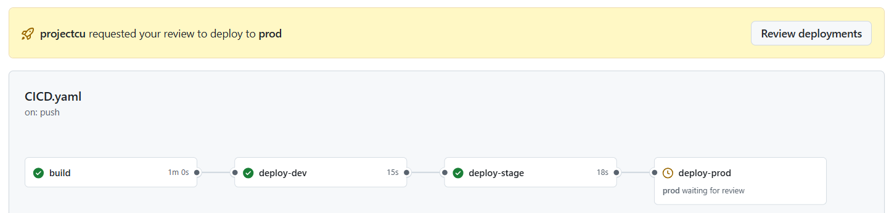
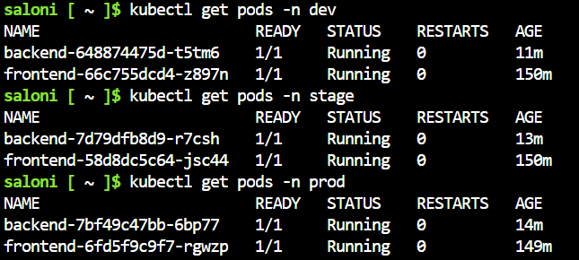
Testing
Test Cases
CI/CD pipeline execution validation (build, test, deploy stages)
Deployment success verification across dev, stage, and prod environments

Slide 12



Testing
Application accessibility via Ingress URLs

Slide 13
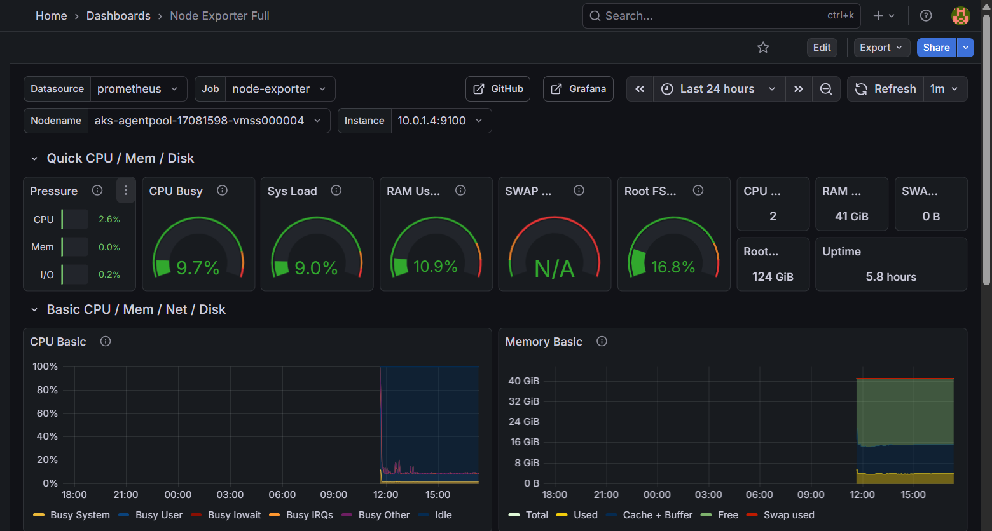
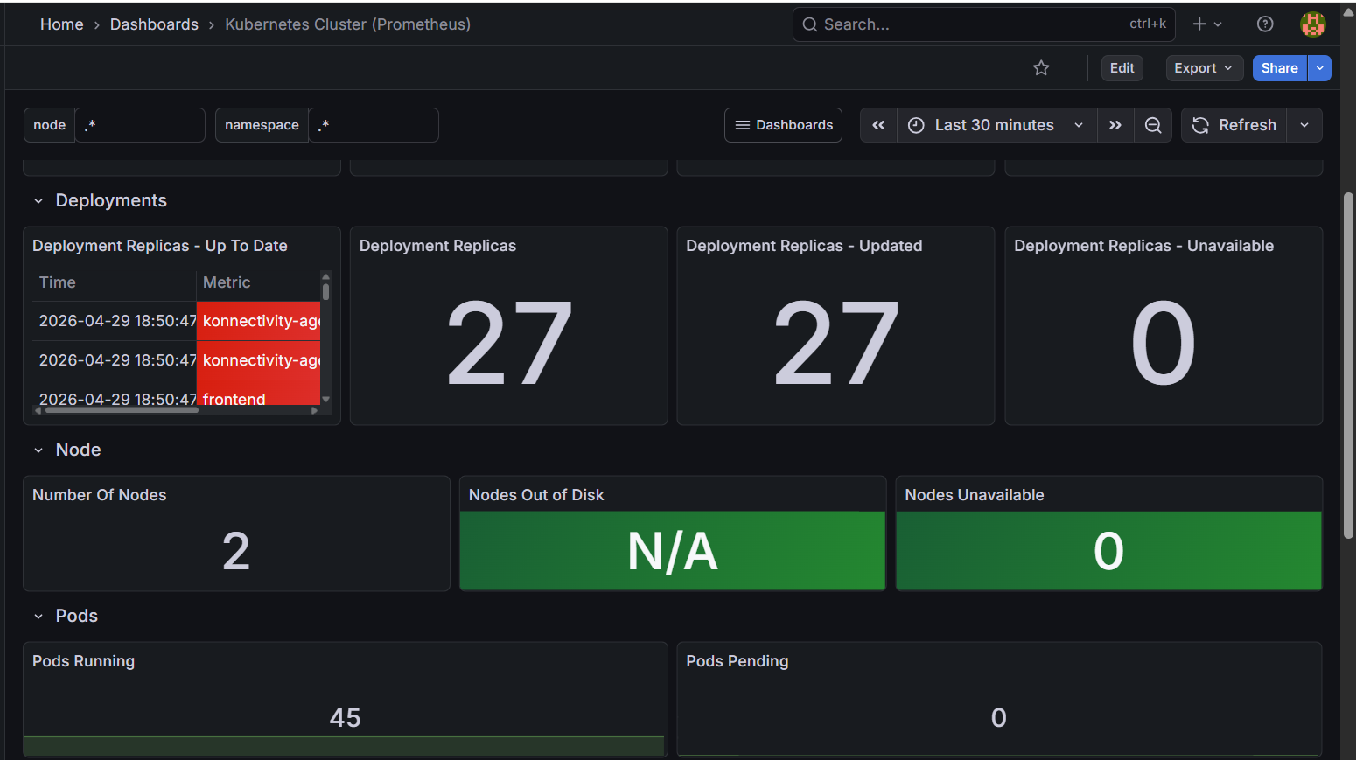
Testing
Monitoring validation using Grafana dashboards and Azure log storage

Slide 14
Results & Discussion
System Output
Performance Analysis
Faster deployments using automated CI/CD pipelines
Efficient resource usage with Kubernetes HPA scaling
Improved reliability through monitoring and logging
Advantages
Reduced manual effort and deployment errors
Scalable and highly available system
Real-time monitoring using Grafana dashboards
Quick recovery using rollback pipelines
Comparison
Traditional system: manual, slow, error-prone deployments
Proposed system: automated, scalable, and reliable

Slide 15
Conclusion & Future Scope
Project Summary
Objectives Achieved
Implemented automated CI/CD pipelines for deployment
Successfully deployed microservices on Azure Kubernetes Service (AKS)
Integrated monitoring using Grafana and Prometheus
Benefits
Reduced manual effort and deployment errors
Scalable and highly available system
Real-time monitoring and improved reliability
Secure access using RBAC (Azure AD)
Future Enhancements
Implement auto-scaling based on advanced metrics
Add auto-healing and self-recovery mechanisms
Enhance monitoring with AI-based alerts
Extend support for multi-cloud deploymen

Slide 16
Thank you….

