Slide 1
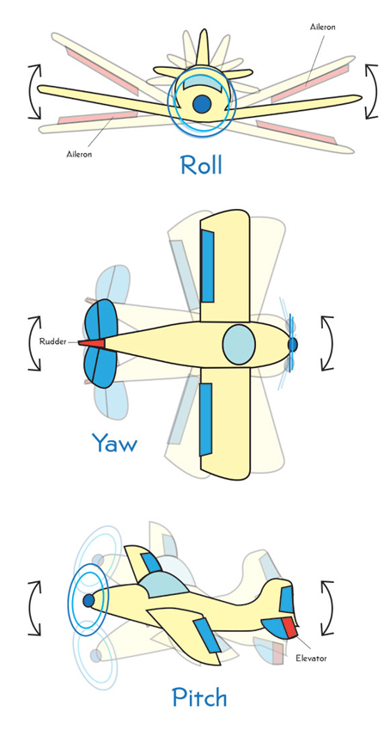

TOP VIEW
Pin 11
ESC 4
ESC 1
Pin 5
FL
CCW
CW
FR
Nose Up - +ve Pitch
Nose right (CW) - +ve Yaw
Right Wing Down - +ve Roll
FL – Front Left
RL
CW
CCW
RR
RL – Rear Left
Pin 10
ESC 3
ESC 2
Pin 6
FR – Rear Right
FR – Front Right

