Slide 1

MULTIMODAL AI HACKATHON 2026 · TRACK B
Mapping Flood Damage from Space
Where did the flood hit? What is damaged? Who is cut off?
Any area · any date · free Sentinel satellite data
Notes:
On 26 August 2026 a glacier collapse sent a flood down the Bhote Koshi–Trishuli valley. Rescuers need three answers: where did it hit, what is damaged, who is cut off. We built a system that answers them from free satellite data.

Slide 2



Three answers rescuers need
Where did it hit?
What is damaged?
Who is cut off?
Flood water and mud / debris, mapped from radar and optical satellites.
Buildings, roads and bridges from OpenStreetMap, checked one by one.
Road network rebuilt before and after; villages ranked by urgency.
Notes:
Three questions: where, what, who.

Slide 3



Pick any area and any flood date
Nothing is hard-coded for Nepal. The system finds and downloads everything itself:
Sentinel-1 radar
Sentinel-2 optical
Copernicus DEM
OpenStreetMap
Same orbit, before and after the flood
Used when the sky is clear
Elevation and terrain masks
As it was before the event
Not used as input: Copernicus EMS, UNOSAT or any published damage map — only for checking results.
Notes:
Pick any area and any flood date — nothing is hard-coded for Nepal. The system finds and downloads Sentinel-1 radar from the same orbit before and after, optical images if clear, elevation, and OpenStreetMap as it was before the flood.

Slide 4







End to end on a laptop CPU
1
2
3
4
5
6
7
›
›
›
›
›
›
Download
Preprocess
AI flood model
Debris step
Damage
Road network
Report
~9 km window: 2–7 minutes · ~2,000 km²: about 24 minutes
Notes:
It runs end to end on a laptop CPU: download, preprocessing, AI flood model, debris step, damage, road network, report.

Slide 5


The AI: two detectors, one verdict
Flood water
Mud and debris
U-Net segmentation model trained on Kuro Siwo and Sen1Floods11, tested on events it never saw.
Debris does not look like water in radar, so a separate change test finds it — each polygon comes with a confidence level and an evidence sentence.
0.79
F1 on Kuro Siwo test
(paper best: 0.80)
Data-quality panel shows what the satellites could actually see.
Notes:
Flood water comes from a U-Net trained on Kuro Siwo and Sen1Floods11. Mud and debris come from a separate change test with a confidence level. F1 = balance of precision and recall.

Slide 6
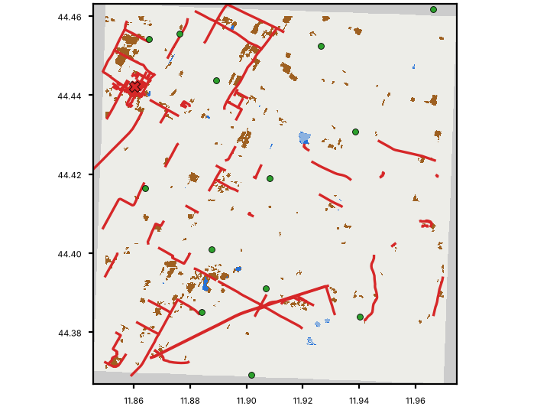



What is damaged, who is cut off
Buildings
Checked one by one against the flood and debris layers
Roads
Blocked sections found by rebuilding the road graph
Bridges
Over flooded water → marked suspect, never "destroyed"
Villages
Green, orange, red — ranked by urgency with repair order
Example situation map (sample run)
Notes:
Buildings, roads and bridges from OpenStreetMap before the event are checked one by one. We show ranges. Who is cut off? Red villages have no road to a town or hospital; the system ranks them by urgency and shows which road section to repair first. Bonus: click a point to trace the flood path downstream; one-page situation report.

Slide 7
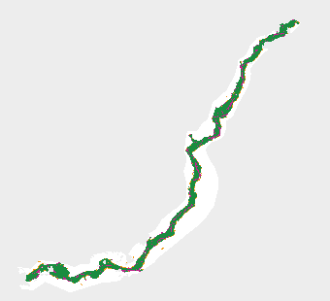
Trishuli vs the official EMS map
0.92
0.79
precision
recall
90%
93%
destroyed / damaged buildings inside our area
damaged bridges flagged blocked or suspect
European Union, Copernicus Emergency Management Service data (comparison only, never an input)
Affected area, 26 Aug 2026 · overall confidence is low (steep valley, radar shadow) — we say so.
Notes:
Trishuli compared with EMSR927: precision 0.92, recall 0.79, F1 0.85. 90% of destroyed or damaged buildings fall inside our affected area; 93% of damaged bridges matched were flagged blocked or suspect.

Slide 8
We report weak spots honestly
0.81
0.20
0.45
mean F1, 12 independent floods
without a "before" image — it is a change detector
radar-only, unseen Himalayan scenes
Mountain flash floods: recall is low
Narrow rivers are invisible to radar
Satellites revisit every few days — no warning of a sudden collapse
Educational prototype, not an operational tool
Notes:
We report weak spots honestly: the model is a change detector, mountain recall is low, narrow rivers are invisible to radar, satellites revisit every few days and cannot warn ahead of a sudden collapse. This is an educational prototype.

Slide 9

Data and credits
Contains modified Copernicus Sentinel data 2026.
Produced using Copernicus WorldDEM-30 © DLR e.V. 2010–2014 and © Airbus Defence and Space GmbH 2014–2018 provided under COPERNICUS by the European Union and ESA; all rights reserved.
© OpenStreetMap contributors.
Training data: Kuro Siwo (Bountos et al., 2024) · Sen1Floods11 (Bonafilia et al., 2020).
Built with Claude Code
Notes:
Contains modified Copernicus Sentinel data 2026; © OpenStreetMap contributors; Copernicus DEM; Kuro Siwo, Sen1Floods11. Built with Claude Code.

