Slide 1
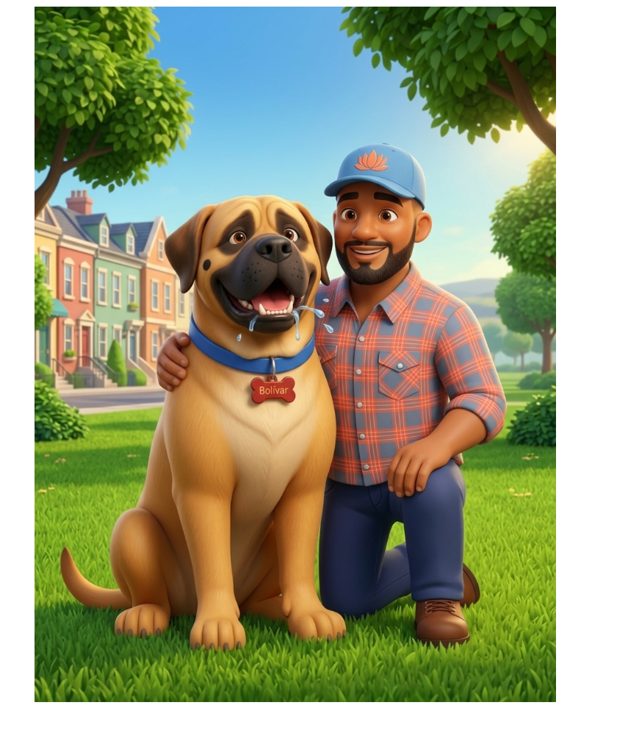
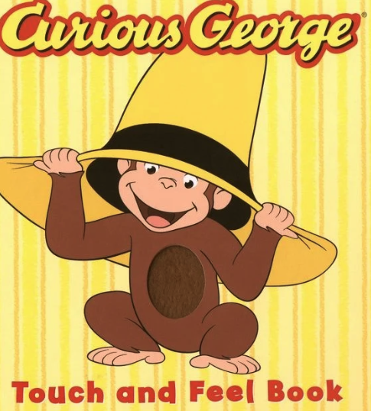
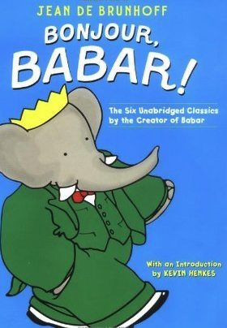
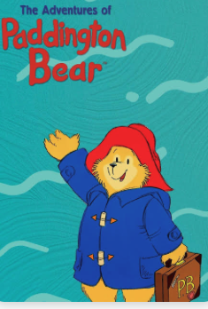
Book Cover
Remove Big Papa
Keep the page simple with yellow or light blue background color
Bolívar prominent in the center
A large circle around Bolívar may be a good cover page
Below are sample arts to draw inspiration for cover page with Cover Title

Slide 2
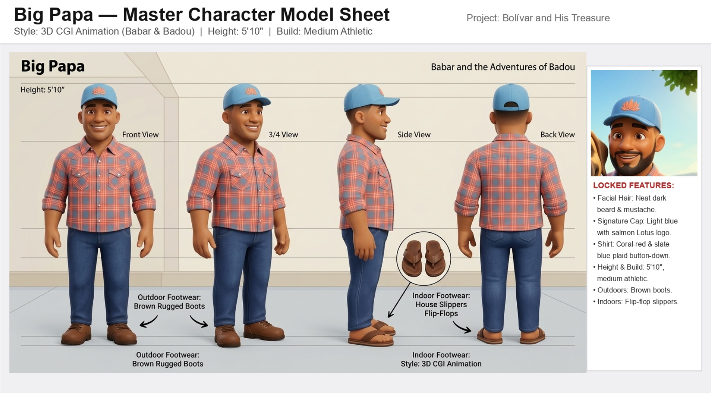
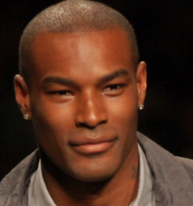
Big Papa Character
Thinner body (normal)
Skin color a shade lighter
No facial hair (remove any beard, goutee, mustache)
Eyes should be slightly smaller see below for context:

Slide 3
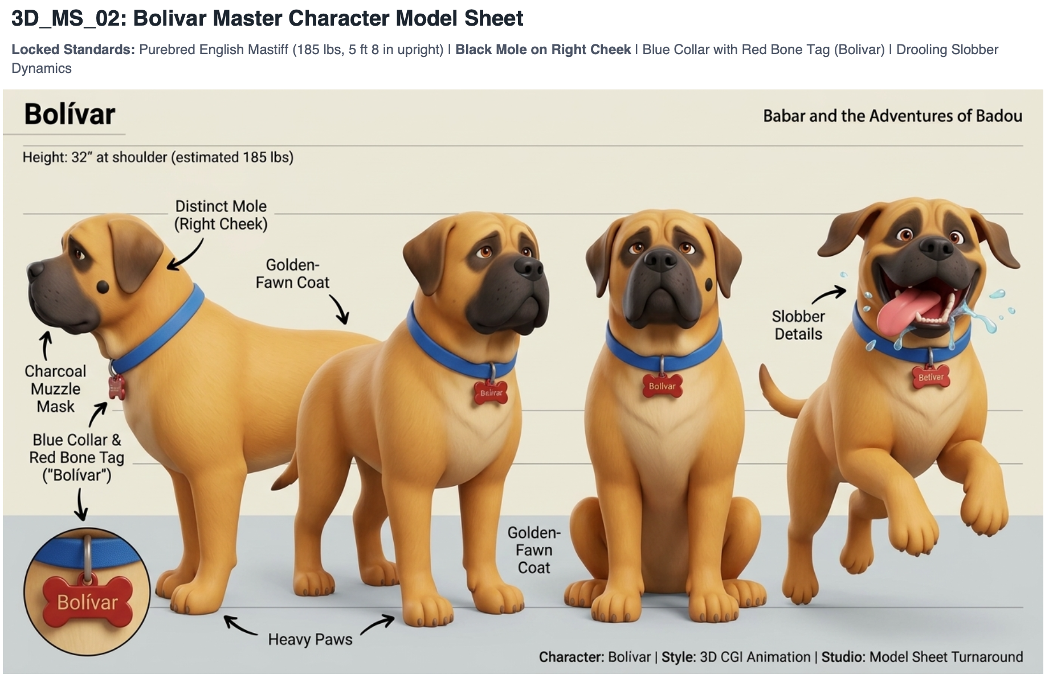
Bolívar
Images to the right indicate his mole is on his left cheek: it should be on his right
Please make the mole a bit smaller.

Slide 4
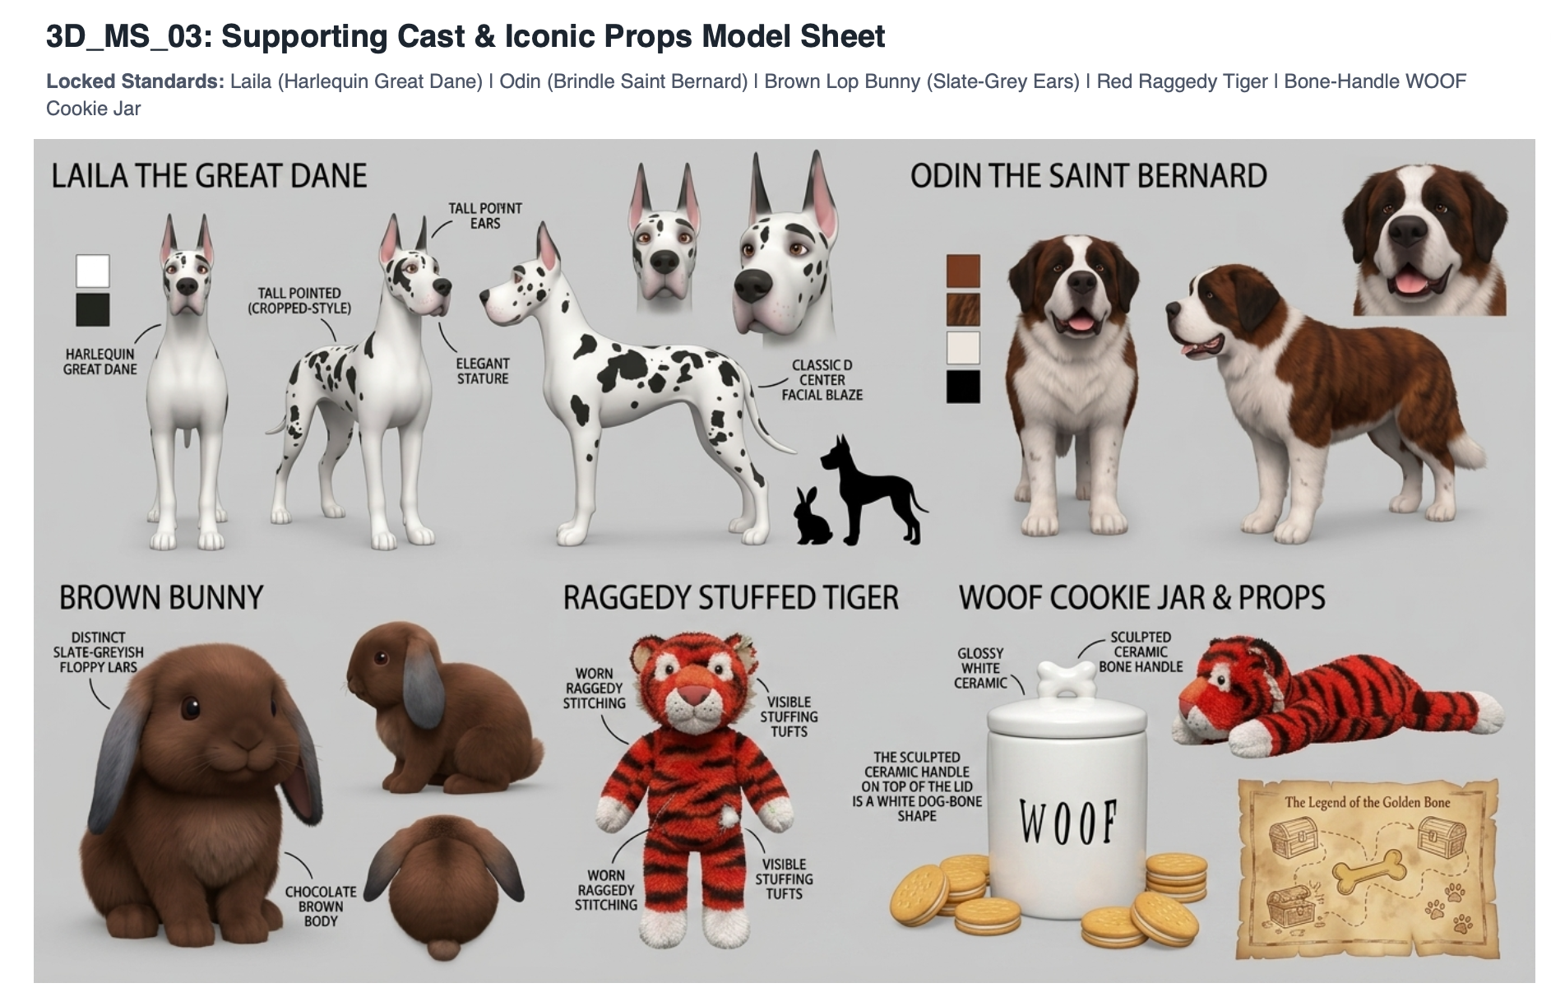
Laila, Odin, and Brown Bunny, etc.
Brown Bunny make a shade lighter.

