Slide 1

Book Cover Title
“Bolívar and His Treasure” –letters all in yellow font
Use a Baloo 2 Extra Bold font
  > See sample to the right

Slide 2
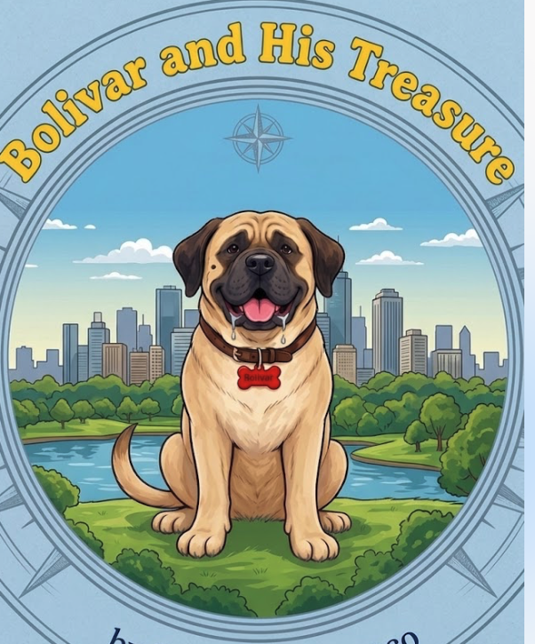
Book Cover Design
See change requests for Bolívar’s appearance on Slide 5
Use image on the right as inspiration for cover >
  Bolívar in the middle (no white space) (Bolivar’s name is misspelled in the image)
  The outer/exterior circle should be fully visible on the cover.
Remember, title of the book to be in yellow color and Baloo 2 Extra Bold font
Light or powder blue used as background colors outside of the inner circle (inner circle is where Bolívar is located in a park with a city skyline as a backdrop)
Author name should be placed horizontally on the middle center of the bottom of the page.
Author name should appear only as “Benjamin Kiamco” (no “by”)

Slide 3
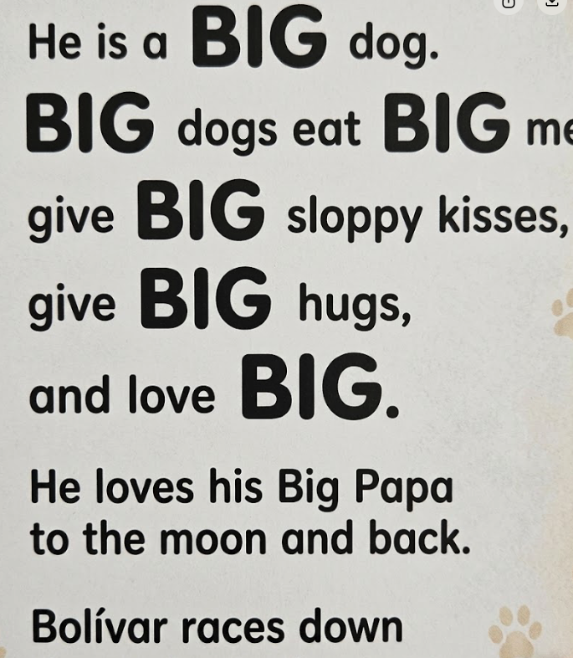
Type of Font for letters in the book
All words in the book narration use –Quicksand Bold font > See sample to right
Font size is all the same including when italicization is used in a sentence such as :

Slide 4
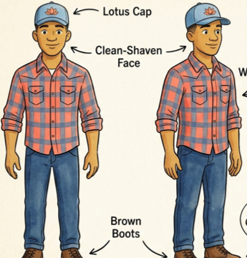
Big Papa
Remove white undershirt

Slide 5
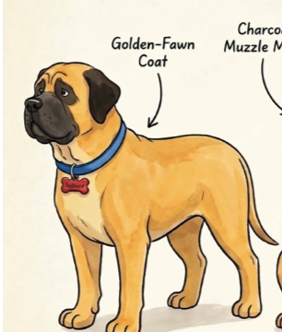
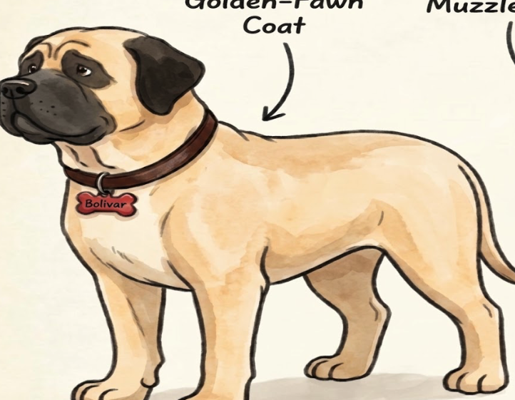
Bolívar
Replace golden fawn coat a tint lighter.
Replace the blue collar of the collar to chocolate brown collar.
See bottom right image with the change >

Slide 6
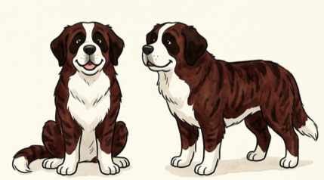
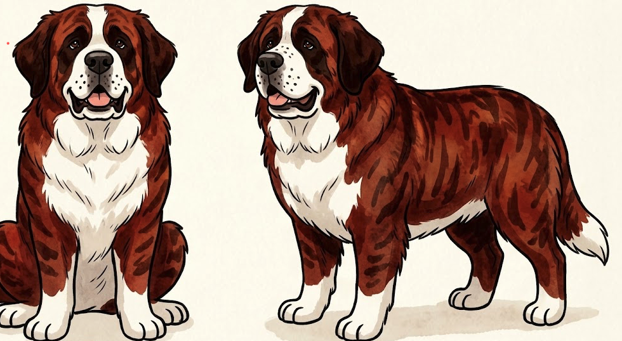
Supporting Friends and Props
Odin the Saint Bernard
Add 30lbs to his weight
Hair coat a reddish-brown
Add freckles
See image at bottom right for reference >

