Slide 1

Dissertation on “INTRUSION DETECTION SYSTEM FOR NETWORK DATA SECURITY” Submitted By “Mr. Bhushan Talan” (M.E 2nd Year ) To Prof. Harsha Vyawahare (Guide)
Department of Computer Science & Engineering
SIPNA COLLEGE OF ENGINEERING AND TECHNOLOGY AMRAVATI

Slide 2
Contents
Introduction
Aim
Literature Survey / Previous Work Done
Proposed System
Implementation Tools / Language Used
Advantages
Disadvantages
Future Work
Conclusion
References

Slide 3
Introduction
An intrusion detection system (IDS) monitors network traffic and monitors for suspicious activity and alerts the system or network administrator.
In some cases the IDS may also respond to anomalous or malicious traffic by taking action such as blocking the user or source IP address from accessing the network.
An intrusion detection system can be a great tool for proactively monitoring and protecting your network from malicious activity, however they are also prone to false alarms.

Slide 4
Some systems may attempt to stop an intrusion attempt but this is neither required nor expected of a monitoring system.
Network security and security analysis level using Intrusion detection system are primarily focused on identifying possible incidents, logging information about them, and reporting attempts.
In addition, organizations use. Intrusion detection system for security and security analysis level for other purposes, such as identifying problems with security policies, documenting existing threats and deterring individuals from violating security policies.

Slide 5
Aim
The main aim of this project is to develop an intrusion detection system that helps to prevent the system from any intrusion attack and increase the security of the system.

Slide 6
Literature Survey
Elhadj Benkhelifa et al. [2018] has proposed a paper that is concerned with advancements in intrusion detection practices in IoT. It provides a comprehensive review of current Intrusion Detection Systems (IDS) for IoT technologies, focusing upon architecture types.
Preeti Aggarwal et al. [2015] has presented the analysis of KDD data set with respect to four classes which are Basic, Content, Traffic and Host in which all data attributes can be categorized. The analysis is done with respect to two prominent evaluation metrics, Detection Rate (DR) and False Alarm Rate (FAR) for an Intrusion Detection System (IDS) [3].

Slide 7
Nabila Farnaaz et al. [2016] has built a model for intrusion detection system using random forest classifier. Random Forest (RF) is an ensemble classifier and performs well compared to other traditional classifiers for effective classification of attacks [4].
Hichem Sedjelmaci et al. [2017] has designed and implemented a novel intrusion detection and response scheme, which operates at the UAV and ground station levels, to detect malicious anomalies that threaten the network. In this scheme, a set of detection and response techniques are proposed to monitor the UAV behaviors and categorized them into the appropriate list (normal, abnormal, suspect, and malicious) according to the detected cyber-attack [7].

Slide 8
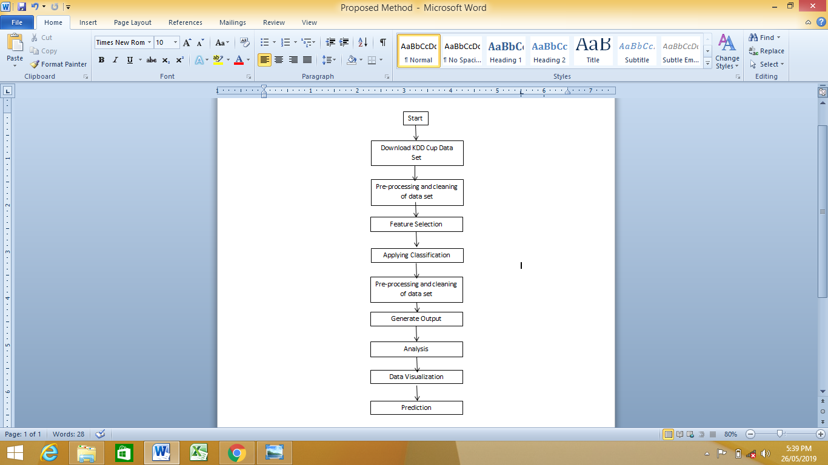
Proposed System

Slide 9
Tools
SOFTWARE REQUIREMENTS
Operating System : Ubuntu
Programming Language : Python
Database : MySQL , MongoDB etc.
IDE : PyCharm
Web development tool : Flash Framework

Slide 10
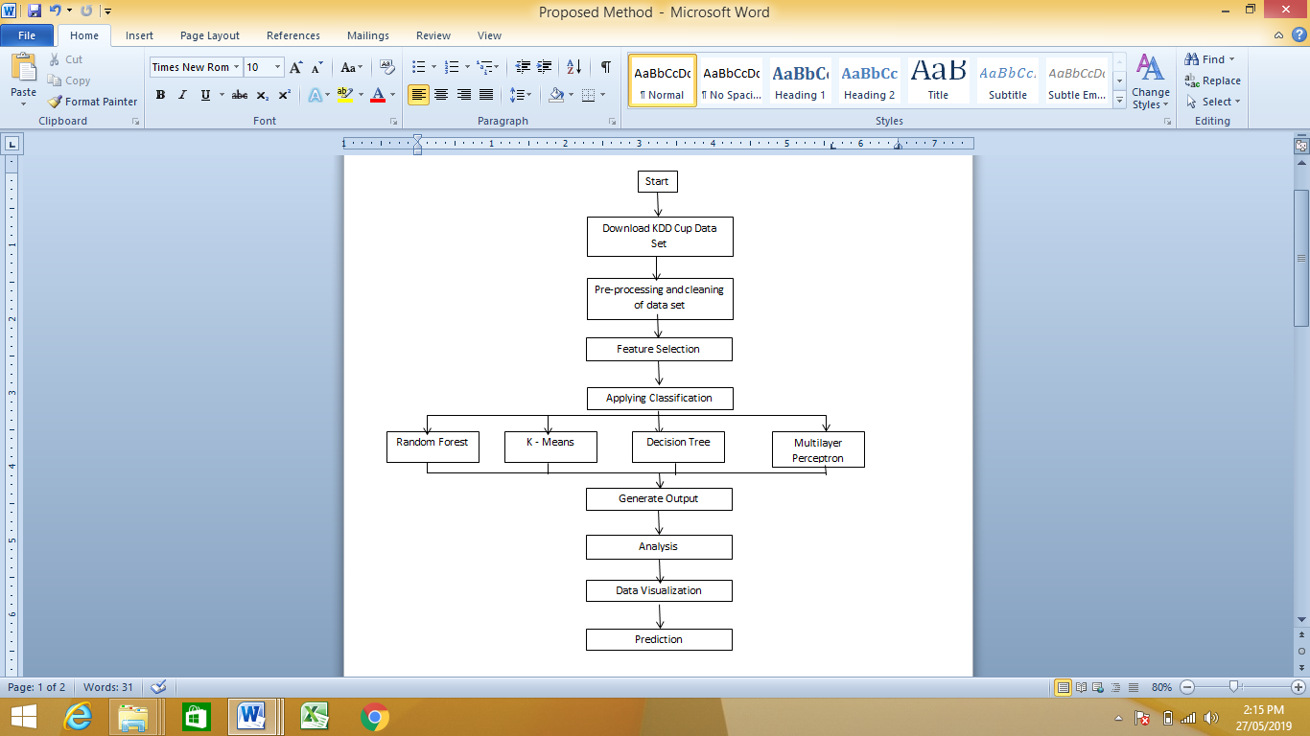
* Implementation *

Slide 11
Advantages
The proposed system is effective in preventing the system from intrusion attack.
The system uses 4 classifiers and all of them work efficiently.
System should be work on resultant parameters which help to used best suitable methodology for specific data-set.

Slide 12
Disadvantages
The proposed method is carried on readily available data set so the system is not tested in real time.
System working on offline dataset, where logs will be generates real time.

Slide 13
Future Work
The future work of this project includes testing of this system on real time captured packets and in real time.
This will help to understand the working of the system more efficiently and also the modifications that are required to make the system reliable.

Slide 14
Conclusion
From the Classifiers used in this project for evaluations, it is found out that the K – Means Classifier is most effective when compared against Time Complexity and Space.

Slide 15
References
[1] Elhadj Benkhelifa, Thomas Welsh, Walaa Hamouda, “A Critical Review of Practices and Challenges in Intrusion Detection Systems for IoT: Towards Universal and Resilient Systems” IEEE Communications Surveys & Tutorials, 2018.
[2] John E. Dickerson, Julie A. Dickerson, “Fuzzy Network Profiling for Intrusion Detection”, IEEE, 2000.
[3] Preeti Aggarwal, Sudhir Kumar Sharma, “Analysis of KDD Dataset Attributes - Class wise For Intrusion Detection”, Procedia Computer Science, 2015.
[4] Nabila Farnaaz, M. A. Jabbar, “Random Forest Modeling for Network Intrusion Detection System”, Procedia Computer Science, 2016.
[5] F.Sabahi, A.Movaghar, “Intrusion Detection: A Survey”, IEEE, 2008.

Slide 16
[6] Fadi Salo, Mohammad Noor Injadat, Ali Bou Nassif, Abdalla Shami, Aleksandar Essex, “Data Mining Techniques in Intrusion Detection Systems: A Systematic Literature Review”, IEEE Access, 2016.
[7] Hichem Sedjelmaci, Sidi Mohammed Senouci, Nirwan Ansari, “A Hierarchical Detection and Response System to Enhance Security Against Lethal Cyber-Attacks in UAV Networks”, IEEE TRANSACTIONS ON SYSTEMS, MAN, AND CYBERNETICS: SYSTEMS, 2017.
[8] Alex Shenfield, David Day, Aladdin Ayesh, “Intelligent intrusion detection systems using artificial neural networks”, The Korean Institute of Communications and Information Sciences (KICS) (Science Direct), 2018.
[9] Kehe Wu, Zuge Chen, Wei Li, “A Novel Intrusion Detection Model for a Massive Network Using Convolutional Neural Networks”, IEEE Access, 2017.
[10] Zhihua Zhang, Hongliang Zhu, Shoushan Luo, Yang Xin, Xiaoming Liu, “Intrusion Detection Based on State Context and Hierarchical Trust in Wireless Sensor Networks”, IEEE Access, 2016.

Slide 17
Thank You

