Slide 1

Design of the Driving System of the Engine of Electrical Vehicle
Presented By
Md. Ohiduzzaman Sajol (2003043)
Amit Kumar Das (2003056)
Md. Washim Molla (2003058)
S.M. Fahim Shahriar (2003059)
Md. Mustafijur Rahman (2003057)
Sadman Shamyo (2003060)
Presented To
Dr. Md. Habibullah
Professor, Dept. of EEE, KUET
Md. Sajjad Hossain
Lecturer, Dept. of EEE, KUET
Presented On
November 10, 2025
Department of Elecctrical & Electronic Engineering
Khulna University of Engineering & Technology
EE 4110 – Sessional on Power Electronics & Industrial Drives

Slide 2
Outline
Abstract
Introduction
Methodology
List of Apparatus
Model Description
Results
Conclusion
EE 4110 – Sessional on Power Electronics & Industrial Drives

Slide 3
Abstract
PECs replace engine parts, driving the green energy shift.
EVs use DC-AC inverters and DC-DC converters for power control.
An H-bridge converter model controls motor speed and torque.
Novel diode placement ensures current continuity and energy recovery.
MATLAB® GUI enables remote monitoring and control.
EE 4110 – Sessional on Power Electronics & Industrial Drives

Slide 4
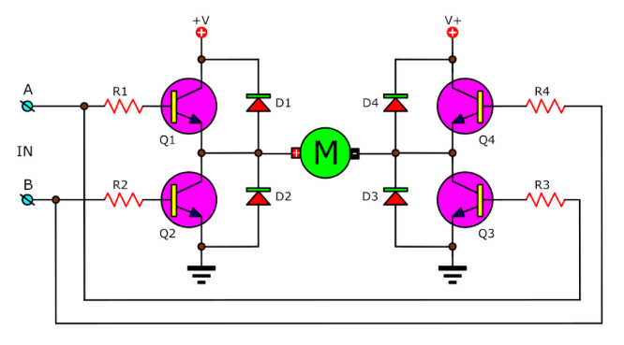
Introduction: H-Bridge
Figure 1 shows the MOSFET-based H-bridge motor drive.
Four switches (Q1–Q4) control motor direction and speed.
Flyback diodes (D1–D4) protect against voltage spikes.
Diodes provide a path for current when switches are off.
Stored energy can feed back to supply or dissipate through a resistor.
Figure 1: H-bridge DC motor drive [3]
EE 4110 – Sessional on Power Electronics & Industrial Drives

Slide 5
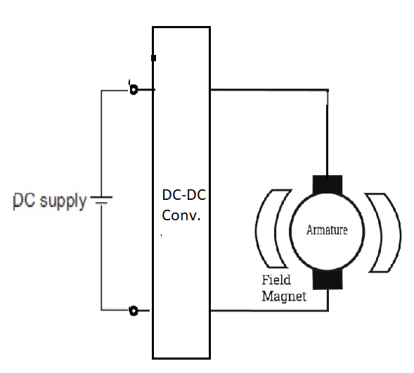
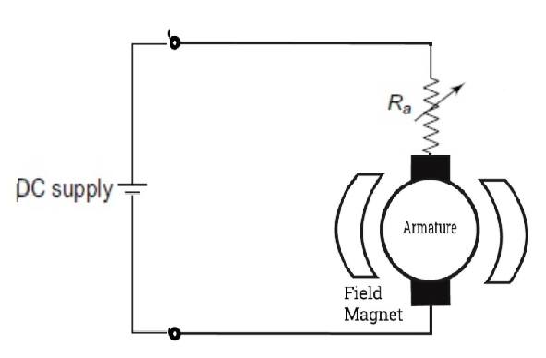
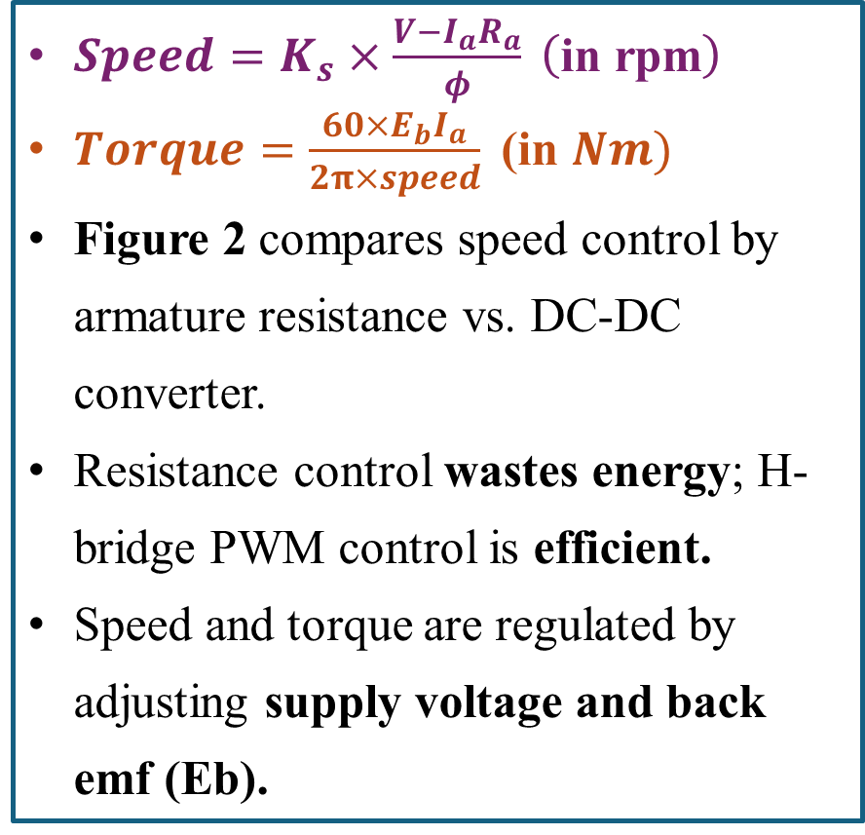
Introduction: Motor Speed & Torque Control
$Speed=K_{s}×\frac{V−I_{a}R_{a}}{φ} \left(\text{in} \text{rpm}\right)$
$Torque=\frac{60×E_{b}I_{a}}{2π×speed}\text{ (}\text{in} Nm)$
Figure 2 compares speed control by armature resistance vs. DC-DC converter.
Resistance control wastes energy; H-bridge PWM control is efficient.
Speed and torque are regulated by adjusting supply voltage and back emf (Eb).
(a)
(b)
Figure 2: (a) DC motor speed control by varying armature resististance and (b) by using a DC-DC converter
EE 4110 – Sessional on Power Electronics & Industrial Drives

Slide 6
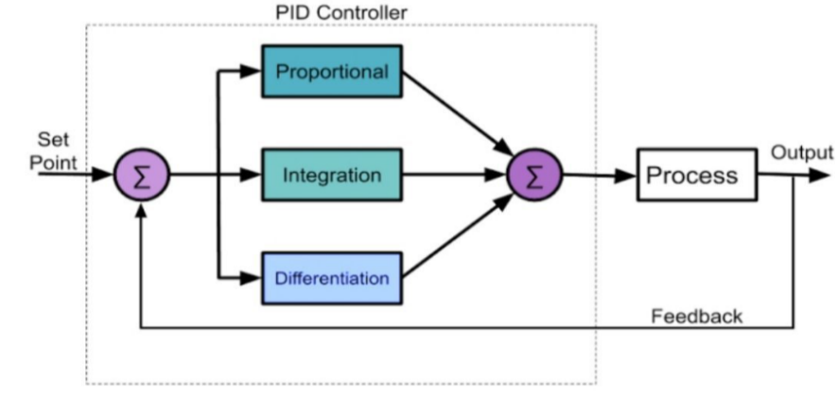
Introduction: PID Controller in Closed Loop Operation
Figure 3 illustrates the motor speed control using a PID feedback loop.
The PID controller compares actual speed with the set point.
It adjusts the motor input to minimize speed error and maintain stability.
Figure 3: Block diagram of PID controller [5]
EE 4110 – Sessional on Power Electronics & Industrial Drives

Slide 7
Methodology: Project Flow Chart
Gathering Apparatus
Apparatus Validity Test
Installation
GUI development
PWM Generation
PID Tuning
Running the Motor Driver
Observation and Justification
Conclusion
EE 4110 – Sessional on Power Electronics & Industrial Drives

Slide 8
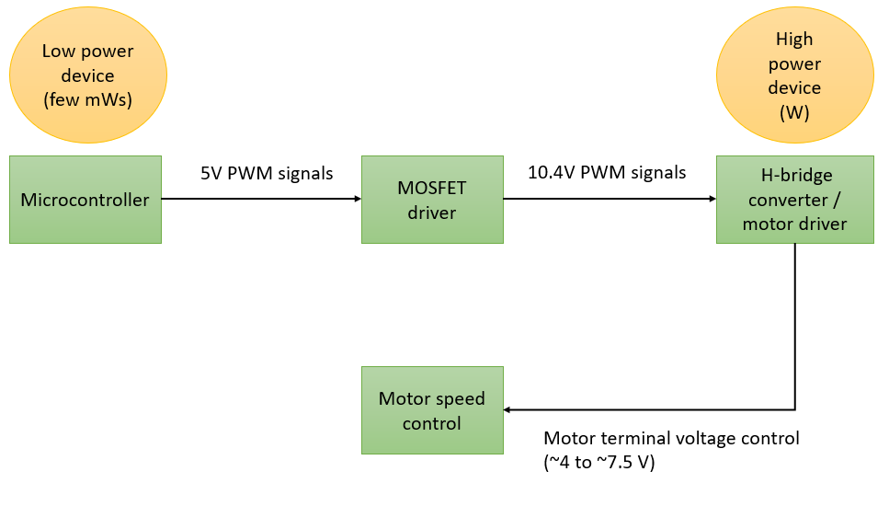
Methodology: Executation Steps
Figure 4: Execution steps to motor drive modelled for EV
EE 4110 – Sessional on Power Electronics & Industrial Drives

Slide 9
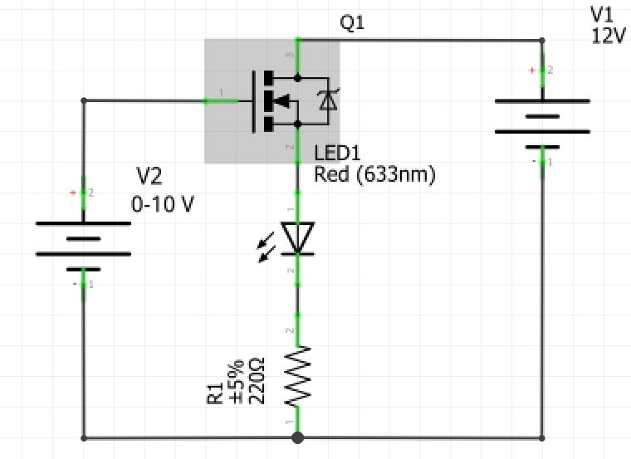
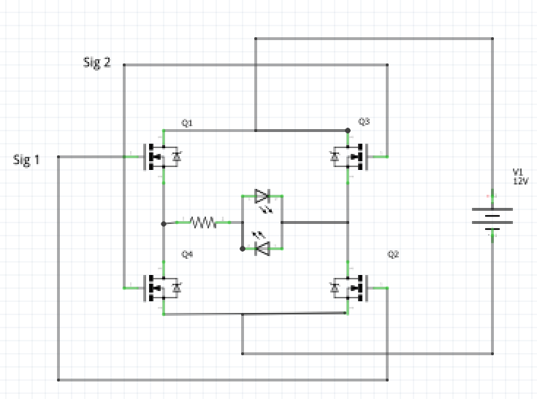
Methodology: Pretesting Apparatus
(a)
(b)
Figure 5: (a) MOSFET operability test — LED turns on at V_{GS}=10 V; off at lower V_{GS}. (b) Driver and H-bridge validity test — LEDs indicate correct operation based on Sig 1 and Sig 2 logic states.
EE 4110 – Sessional on Power Electronics & Industrial Drives

Slide 10
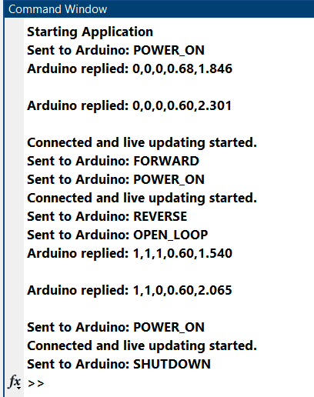
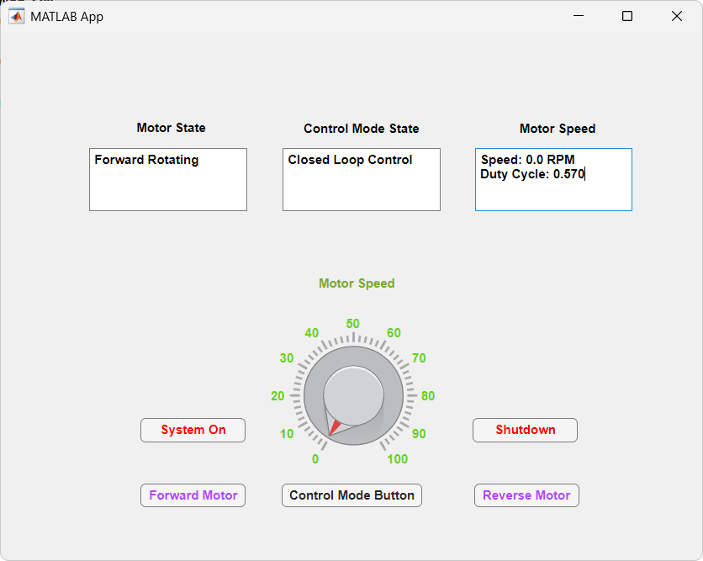
Methodology: GUI Development
Figure 6: Acknowledgement from Arduino
Figure 7: GUI window
EE 4110 – Sessional on Power Electronics & Industrial Drives

Slide 11
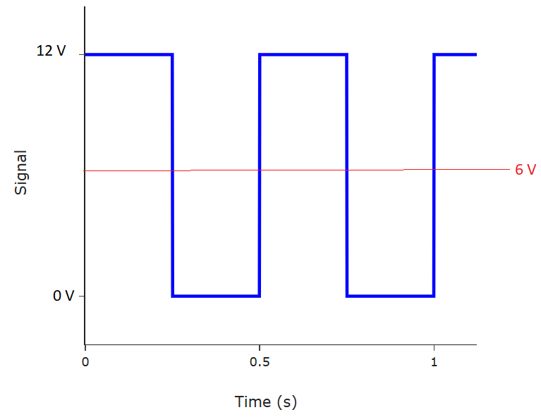
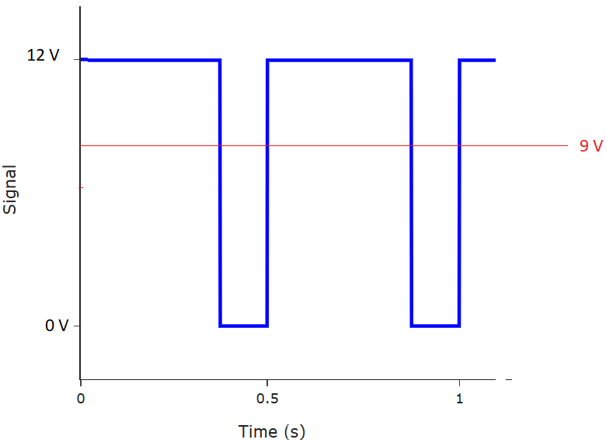
Methodology: PWM Generation
(a)
(b)
Figure 8: (a) 50% duty cycle that can produce an average voltage of 6V across motor terminals. (b) 75% duty cycle that can produce an average of 9V across motor terminals.
EE 4110 – Sessional on Power Electronics & Industrial Drives

Slide 12
Methodology: PWM Generation
Arduino pins 2 and 3 generated PWM signals for motor control.
A potentiometer adjusted the PWM duty cycle.
Pin 3 controlled forward and pin 2 controlled reverse rotation.
MOSFET driver translated logic signals to 12 V or 0 V at motor terminals.
Figure 8 shows 50% (≈6 V) and 75% (≈9 V) duty cycles controlling motor speed.
EE 4110 – Sessional on Power Electronics & Industrial Drives

Slide 13
Methodology: PID Parameter Tuning
PID controller parameters: Kp = 0.1, Ki = 0.4 and Kd = 0.01
Tuned for fast response and minimal speed oscillation.
Ensures motor speed quickly settles to the user-set reference.
EE 4110 – Sessional on Power Electronics & Industrial Drives

Slide 14
List of Apparatus
Table 1: List of apparatus used in project
S.L No. | Name of Apparatus | Ratings / Specification | Quantity
1 | DC power supply | 11.5 V, 2 A | 1
2 | LM2596 DC-DC buck converter | Vin = 11.5 V, Vout = 10.4 V | 1
3 | Arduino UNO | - | 1
4 | PC817 optocoupler | IF = 50 mA, IC = 50 mA, VCEO = 35 V | 2
5 | IRFZ44N MOSFET | - | 4
6 | 1N4007 diode | VPIV = 1000 V, VF = 0.7 V | 1
7 | DC motor (dynamo) | 4–12 V, 4500 rpm | 1
8 | DC generator (dynamo) | 4–12 V, 4500 rpm | 1
EE 4110 – Sessional on Power Electronics & Industrial Drives

Slide 15
List of Apparatus
S.L No. | Name of Apparatus | Ratings / Specification | Quantity
9 | Resistor | 220 Ω, 2.2 kΩ, 10 kΩ, 100 kΩ (0.25 W) – 5 each; 15 Ω, 18 Ω (10 W) – 1 each | -
10 | Potentiometer | 1 kΩ, 100 kΩ, 1 W | 1 each
11 | Relay switch | Vtrigg = 5 V | 3
12 | Rocker switch | 3 A | 1
13 | Push buttons | 0.5 mA | 3
14 | Fuse | 10 A | 1
15 | Multimeter | 0–50 V DC | 1
16 | Breadboard | - | 3
17 | Jumper wires and probes | - | As needed
EE 4110 – Sessional on Power Electronics & Industrial Drives

Slide 16
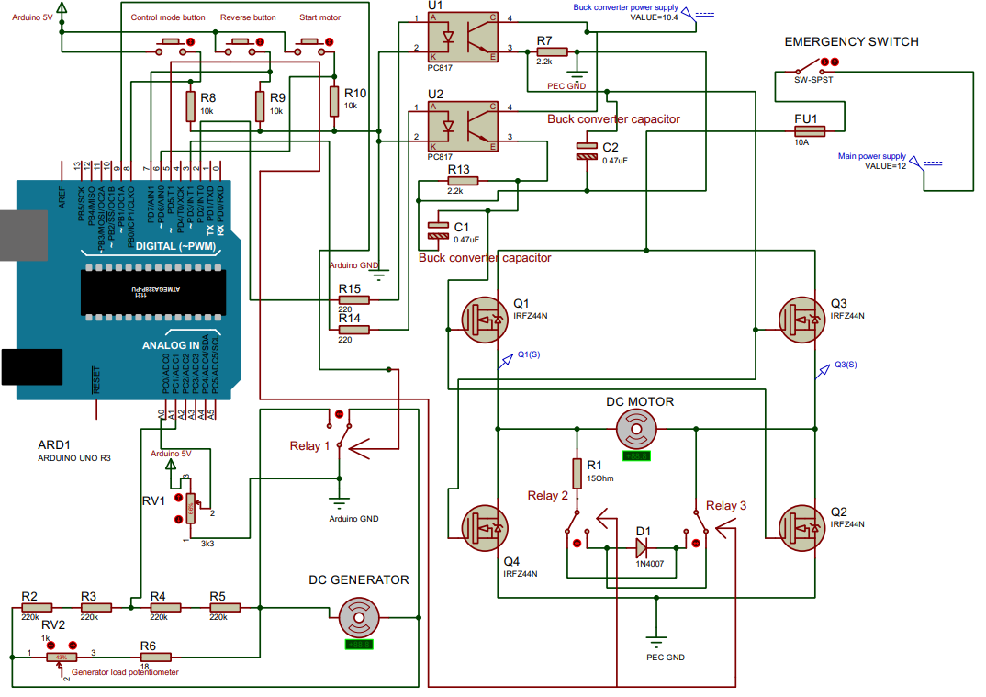
Model Description: Proteus Blueprint
Figure 9: Circuit diagram of the whole prototype
EE 4110 – Sessional on Power Electronics & Industrial Drives

Slide 17
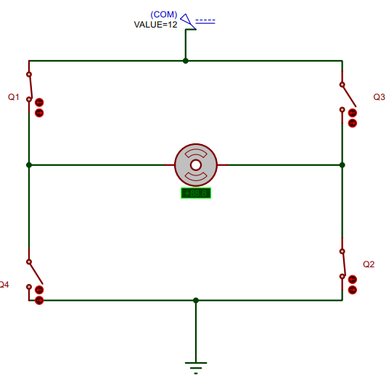
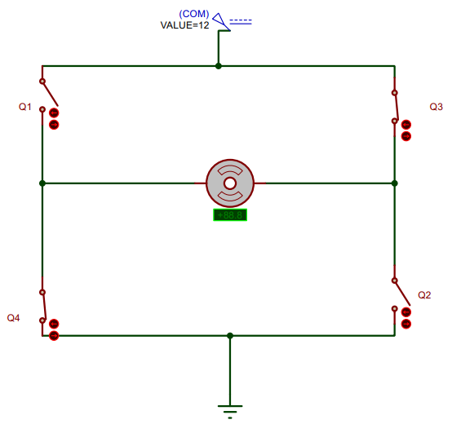
Model Operation: Motor Rotation
(a)
(b)
Figure 10: Equivalent single pole single throw (SPDT) switch circuit of H-bridge converter motor drive for the case of (a) Forward motoring and (b) reverse motoring. Blue arrows show current flow.
EE 4110 – Sessional on Power Electronics & Industrial Drives

Slide 18
Model Operation: Monitoring
Potentiometer on analog pin A0 acts as both accelerator and brake
Motor speed increases or decreases based on potentiometer rotation direction
50% duty cycle (minimum) ensures smooth running and prevents shutdown below 4 V
100% duty cycle gives maximum motor speed
Reverse motion is controlled via a dedicated reverse gear button in the GUI.
EE 4110 – Sessional on Power Electronics & Industrial Drives

Slide 19
Model Operation: Control Modes
Motor control mode can be toggled between open and closed loop via a control mode button
In open loop mode, speed varies with load changes since no feedback is used
Increased load slows the motor and reduced load speeds it up even at fixed input
This behavior mirrors real EV acceleration on uneven terrain; hence, feedback control is essential for stable motor speed under varying load.
EE 4110 – Sessional on Power Electronics & Industrial Drives

Slide 20
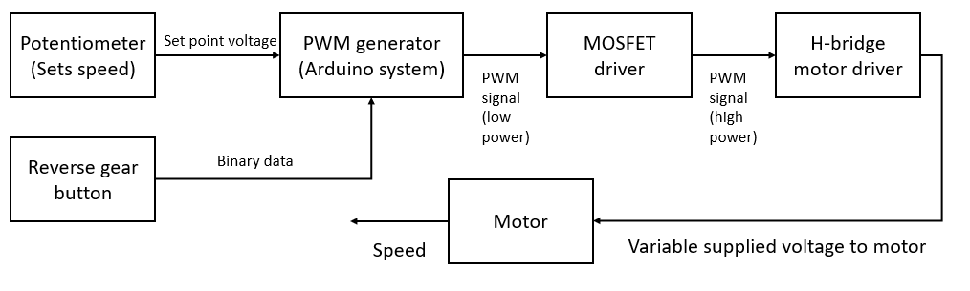
Model Operation: Open Loop Action
Figure 11: Open loop control of motor speed.
EE 4110 – Sessional on Power Electronics & Industrial Drives

Slide 21
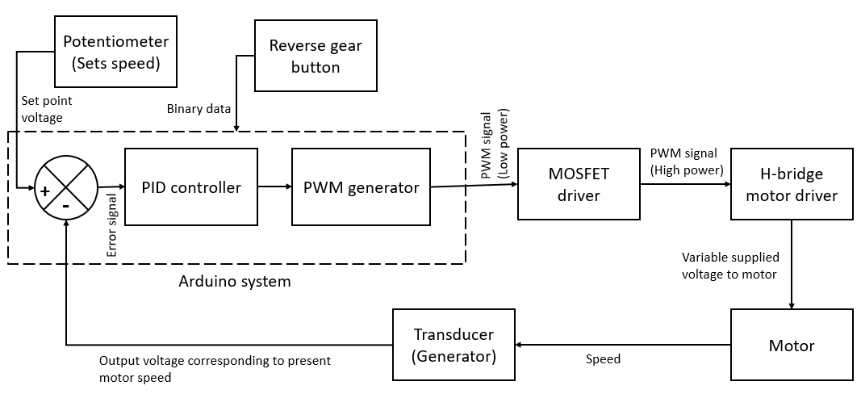
Model Operation: Closed Loop Action
Figure 12: Closed loop control of motor speed
EE 4110 – Sessional on Power Electronics & Industrial Drives

Slide 22
Results: Overview
Table 2: Overview of prefixed data
S.L. no. | Name of data | Value
1 | Time period of PWM signal | 30ms
2 | Frequency of PWM signal | 33.33 Hz
3 | Buck converter output | 10.4 (approx.)
4 | Duty cycle of PWM for lowest motor speed | 50 % (regular operation), 0% (open loop test), 50% (closed loop test)
5 | Duty cycle of PWM for highest motor speed | 100 %
EE 4110 – Sessional on Power Electronics & Industrial Drives

Slide 23
Results: Open Loop Test
Table 3: Summary of open loop test
S.L no. | Parameter name | Value
1 | Maximum motor terminal voltage | 7.35V (approx.)
2 | Minimum motor terminal voltage just before motor stops (for 40% duty cycle) | 4V (approx.)
3 | Maximum voltage across generator terminal (this corresponds to maximum motor speed) | 5.5 V (approx.)
4 | Minimum voltage across generator terminal just before motor stops (this corresponds to minimum motor speed at 40% duty cycle) | 2.06 V (approx.)
EE 4110 – Sessional on Power Electronics & Industrial Drives

Slide 24
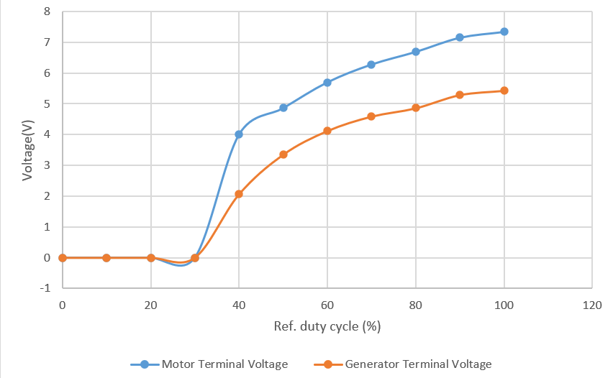
Results: Motor-Generator Terminal Voltage Comparison
Figure 13: Motor–generator voltage comparison showing lower generator voltage, indicating frictional losses from coupling faults.
EE 4110 – Sessional on Power Electronics & Industrial Drives

Slide 25
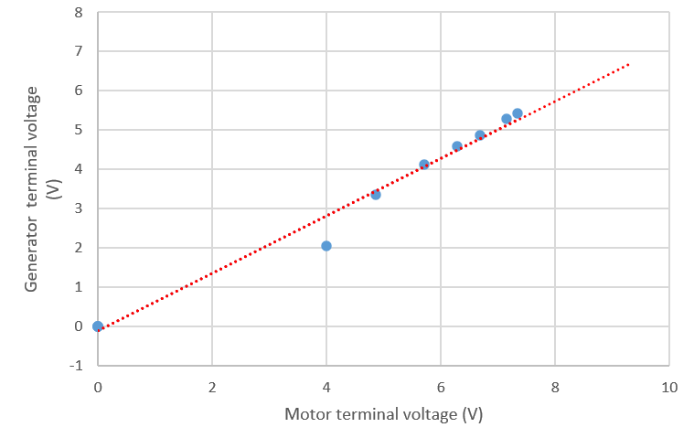
Results: Motor-Generator Terminal Voltage Comparison
Figure 14: Linear trend relation between motor and generator terminal voltage. To measure motor speed correctly, the generator voltage should have a linear link with motor speed which in turns is expressed by motor terminal voltage.
EE 4110 – Sessional on Power Electronics & Industrial Drives

Slide 26
Results: Closed Loop Test
Table 4: Summary of closed loop test
S.L no. | Parameter name | Value
1 | Maximum voltage across generator terminal (this corresponds to maximum motor speed) | 4.8 V (approx.)
2 | Minimum voltage across generator terminal (this corresponds to minimum motor speed at 50 % duty cycle) | 3.3 V (approx.)
EE 4110 – Sessional on Power Electronics & Industrial Drives

Slide 27
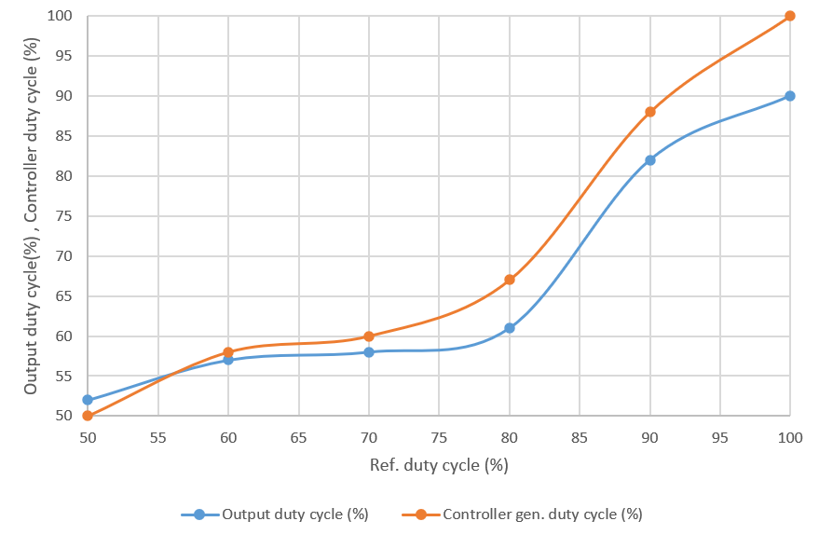
Results: Variations of Duty Cycle
Figure 15: Variation of output and controller gen. duty cycle with ref. duty cycle
EE 4110 – Sessional on Power Electronics & Industrial Drives

Slide 28
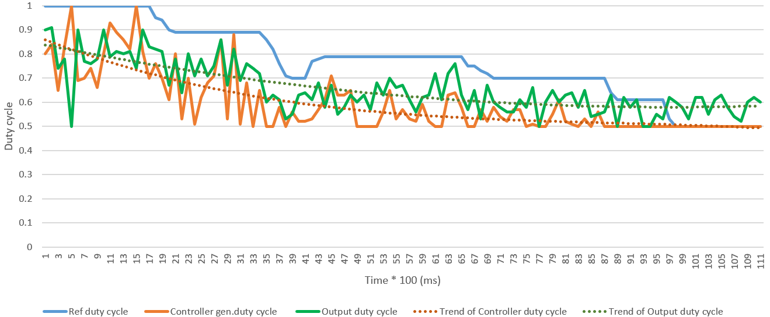
Results: PID Response Characteristics
Figure 16: Real time data of PID response
EE 4110 – Sessional on Power Electronics & Industrial Drives

Slide 29
Results: Calibration of Parameters
Table 5: List of calibrated Data
S.L no. | Name of Data | Calibrated value
1 | Microcontroller ADC output for maximum generator output voltage | 640
2 | Proportional gain of PID controller, K_{p} | 0.1
3 | Integral gain of PID controller, K_{i­} | 0.4
4 | Derivative gain of PID controller, K_{d} | 0.01
EE 4110 – Sessional on Power Electronics & Industrial Drives

Slide 30
Conclusion
H-bridge driver prototype successfully drives DC motors for Evs
It can operate in both open and closed loop control modes
The design allows excess inductive power to be transferred to an auxiliary low power source
Performance is satisfactory but design improvements are possible
Using a non-invasive speed sensor instead of a generator could reduce energy loss from coupling faults.
EE 4110 – Sessional on Power Electronics & Industrial Drives

Slide 31
Thank You
Any Questions?
Department of Elecctrical & Electronic Engineering
Khulna University of Engineering & Technology
EE 4110 – Sessional on Power Electronics & Industrial Drives

