Slide 1

Bridging Signal and Intelligence: A DSP-Driven EEG Feature Pipeline for Neural Network Seizure Detection
Presented By
Md. Ohiduzzaman Sajol (2003043)
Durjoy Sarkar Dhrubo (2003026)
Presented To
Dr. Monira Islam
Associate Professor, Dept. of EEE, KUET
Presented On
November 2, 2025
Department of Elecctrical & Electronic Engineering
Khulna University of Engineering & Technology
EE 4142 – Sessional on Digital Signal Processing

Slide 2
Outline
Abstract
Introduction
Background
Methodology
Results
Discussion
Conclusion
Future Work
References
EE 4142 – Sessional on Digital Signal Processing

Slide 3
Abstract
DSP-based EEG pipeline for seizure detection
CHB-MIT dataset with notch & bandpass filters
Extracted spectral & statistical EEG features
Visualized raw vs. filtered & frequency spectra
Features ready for ML seizure classification
EE 4142 – Sessional on Digital Signal Processing

Slide 4
Introduction
EEG is a non-invasive method to measure brain activity.
Automated EEG-based seizure detection is a key biomedical DSP task.
EEG’s non-stationary nature demands strong preprocessing & feature extraction.
DSP provides tools for time–frequency domain analysis (e.g., convolution, DFT, filtering).
EEG data (CHB-MIT) is preprocessed, features extracted, and prepared for ML seizure classification.
EE 4142 – Sessional on Digital Signal Processing

Slide 5
Background: EEG and Seizure Activity
EEG records brain’s electrical signals via scalp electrodes.
Typical EEG range: 0.5–70 Hz, divided into standard bands:
  Δ (0.5–4 Hz) – Deep sleep
  θ (4–8 Hz) – Drowsiness/meditation
  α (8–13 Hz) – Relaxed wakefulness
  β (13–30 Hz) – Active focus
  γ (30–70 Hz) – Cognitive processing
Seizures: sudden, synchronized bursts of activity
  visible as amplitude spikes & spectral power changes
EE 4142 – Sessional on Digital Signal Processing

Slide 6
Methodology: Data Acquisition
Dataset: CHB-MIT Scalp EEG Database (pediatric epilepsy patients)
Format: EDF files with multi-channel EEG recordings
Loaded via mne.io.read_raw_edf()
Includes both seizure and non-seizure intervals
EE 4142 – Sessional on Digital Signal Processing

Slide 7
Methodology: Preprocessing Pipeline
Notch Filter (60 Hz): remove power-line noise (IIR notch)
Bandpass FIR Filter (0.5–70 Hz): isolate standard EEG range
Segmentation: 10-s overlapping epochs for temporal analysis
Normalization: z-score (zero mean, unit variance) for consistency
EE 4142 – Sessional on Digital Signal Processing

Slide 8
Methodology: DSP Operations
Correlation: inter-channel Pearson correlation matrices
Convolution: moving-average smoothing to reduce fluctuations
Spectral Analysis: FFT + Welch PSD for frequency and band-power estimation
EE 4142 – Sessional on Digital Signal Processing

Slide 9
Methodology: Feature Extraction
Band Powers: mean, std, median in δ, θ, α, β, γ bands
Statistical: energy, variance, skewness, kurtosis
Spectral Entropy: Shannon entropy of normalized PSD
Correlation Metrics: mean, std, max of inter-channel correlations
Band Ratios: e.g., α / β for cognitive state insight
EE 4142 – Sessional on Digital Signal Processing

Slide 10
Methodology: Implementation
Tools: Python 3.10, MNE, SciPy, NumPy, pandas, Matplotlib
Interactive workflow via Jupyter Notebook
Features aggregated into chb_features.csv
Repository: github.com/projectohid/4142-project
EE 4142 – Sessional on Digital Signal Processing

Slide 11
Results: Spectrogram Analysis (Normal vs. Seizure)
Normal EEG (Fig. 1) : Broad spectral power (10–30 Hz, α & β bands)
Seizure EEG (Fig. 2) : Dominant low-frequency power (<10 Hz, δ & θ)
Confirms effective filtering and distinct physiological vs. pathological patterns
EE 4142 – Sessional on Digital Signal Processing

Slide 12
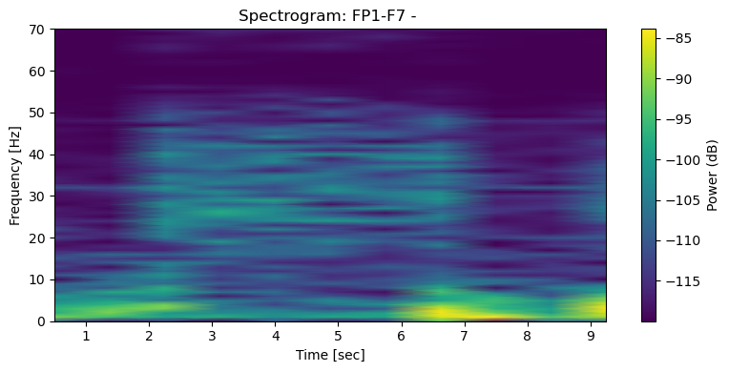
Results: Spectrogram Analysis (Normal vs. Seizure)
Fig. 1: Spectrogram for Chb01_01.edf (non-seizure).
EE 4142 – Sessional on Digital Signal Processing

Slide 13
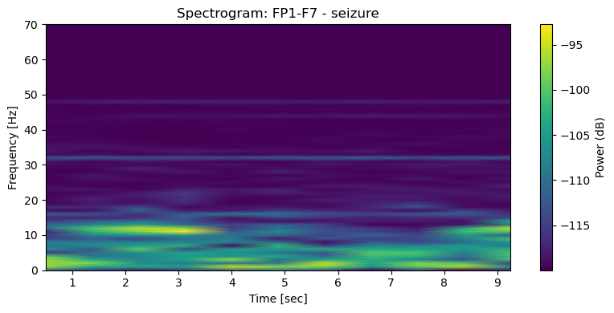
Results: Spectrogram Analysis (Normal vs. Seizure)
Fig. 2: Spectrogram for Chb01_03.edf (seizure).
EE 4142 – Sessional on Digital Signal Processing

Slide 14
Results: Raw Vs. Filtered Signal
Time-domain (Fig. 3): Filtered signal smoother; reduced drift & 60 Hz noise
Frequency-domain (Fig. 3): 60 Hz peak suppressed; spectrum confined to 0.5–70 Hz
Verifies notch + FIR bandpass filters effectiveness
EE 4142 – Sessional on Digital Signal Processing

Slide 15
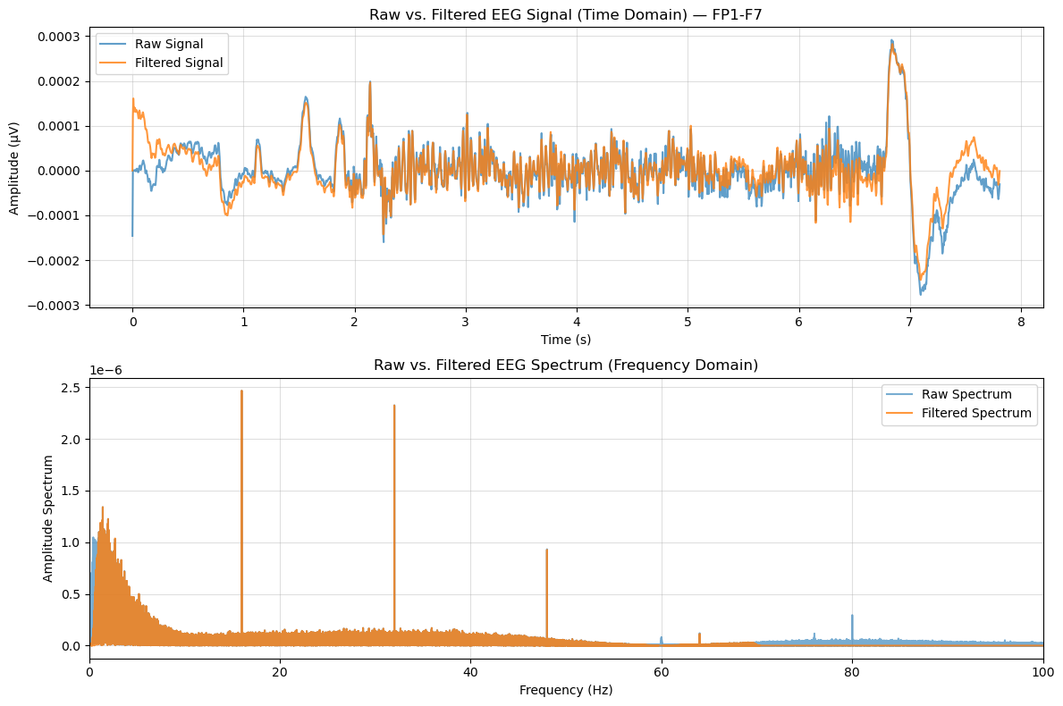
Results: Raw Vs. Filtered Signal
Fig. 3: Raw and filtered Signals and their Spectrums for Chb01_01.edf .
EE 4142 – Sessional on Digital Signal Processing

Slide 16
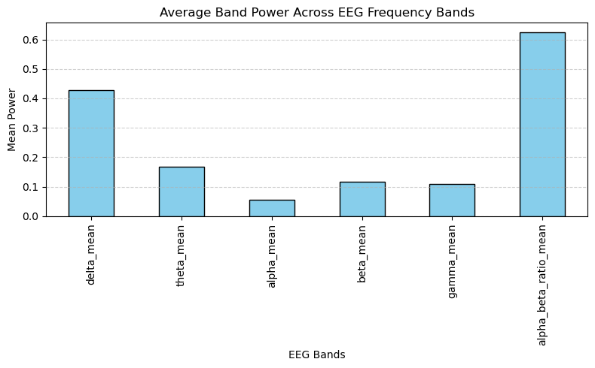
Results: EEG Band Power Distribution
Power hierarchy:
Δ > θ > β > γ > α
Low-frequency dominance → seizure or drowsy state indicator
Confirms spectral accuracy of feature extraction
Fig. 4: Average Band Power Across EEG Frequency Bands for Chb01_01.edf .
EE 4142 – Sessional on Digital Signal Processing

Slide 17
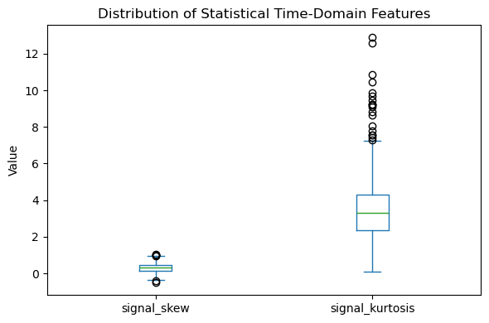
Results: Time-Domain Statistical Features
High kurtosis: sharp, transient seizure spikes
Low skewness: symmetric yet with frequent outliers
Confirms impulsive, non-Gaussian EEG patterns in seizures
Fig. 5: Distribution of Statistical Time-Domain Features for Chb01_01.edf .
EE 4142 – Sessional on Digital Signal Processing

Slide 18
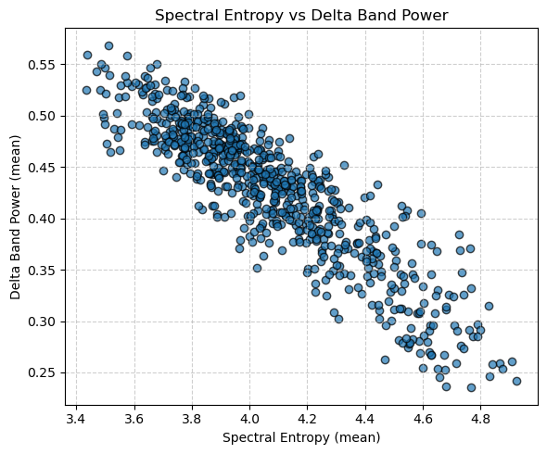
Results: Spectral Entropy vs. Delta Power
Negative correlation → higher δ power = lower entropy
Indicates reduced complexity during seizure activity
Validates entropy as nonlinear brain state marker
Fig. 6: Spectral Entropy vs. Delta Band Power for Chb01_01.edf .
EE 4142 – Sessional on Digital Signal Processing

Slide 19
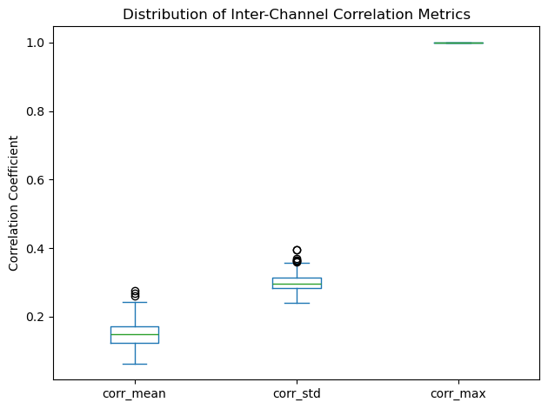
Results: Inter-Channel Correlation
Max correlation ≈ 1.0: strong cross-channel synchronization
Consistent mean correlation = stable phase coupling
Demonstrates spatial coherence in seizure EEG
Fig. 7: Distribution of Inter-Channel Correlation Metrics for Chb01_01.edf .
EE 4142 – Sessional on Digital Signal Processing

Slide 20
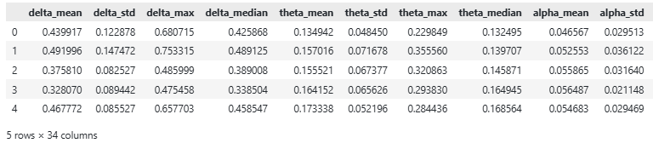
Results: Feature Matrix & ML Readiness
Table I: Part of the extracted Feature Matrix for Chb01_01.edf .
Each 10 s epoch → 30+ DSP-based features
Seizure/non-seizure epochs clearly separable in feature space
Confirms pipeline suitability for neural network models
EE 4142 – Sessional on Digital Signal Processing

Slide 21
Results: Summary
Domain | Key Observation | DSP Technique
Spectrograms | Low-frequency dominance | STFT / Spectrogram
Filtering | Removed 60 Hz & artifacts | Notch + FIR
Band Power | High δ, θ; low α, β, γ | FFT + PSD
Statistics | High kurtosis, low skewness | Time-domain
Entropy | −ve correlation with δ power | Entropy calc.
Correlation | Strong inter-channel sync | Pearson corr.
Feature Set | Clear seizure separation | DSP feature extraction
EE 4142 – Sessional on Digital Signal Processing

Slide 22
Discussion
Spectral Behavior
  Normal EEG: broad power (10–30 Hz, α–β bands)
  Seizure EEG: strong low-freq. dominance (<10 Hz, δ–θ)
  Confirms shift from desynchronized → synchronized neuronal activity
  Filtering (notch + bandpass) effectively removed 60 Hz noise & drift while preserving core EEG content
Band Power Trends
  Hierarchy: Δ > θ > β > γ > α
  High α/β ratio & reduced high-freq. power → decreased cortical processing during seizures
EE 4142 – Sessional on Digital Signal Processing

Slide 23
Discussion
Time-Domain Statistics
  High kurtosis: sharp epileptic transients
  Low skewness: symmetric but heavy-tailed amplitude distribution
  Indicates impulsive, non-Gaussian seizure morphology
Entropy & Complexity
  Entropy ↓ as Δ-power ↑ → reduced signal complexity during seizures
  Captures transition to predictable, synchronized brain dynamics
  Entropy = nonlinear complement to power-based metrics
EE 4142 – Sessional on Digital Signal Processing

Slide 24
Discussion
Inter-Channel Correlation
  High cross-channel correlation (≈1.0) → strong spatial coherence
  Reflects widespread cortical synchronization in seizure states
Integrated DSP Takeways
  Filtering: ensures clean, physiologically valid signals
  FFT / PSD: reveal spectral composition
  Statistics + Entropy: quantify morphology & complexity
  Correlation: captures spatial coupling → Together, classical DSP techniques uncover physiological + pathological EEG patterns, producing interpretable features for intelligent seizure detection.
EE 4142 – Sessional on Digital Signal Processing

Slide 25
Conclusion
DSP methods effectively applied for EEG seizure analysis.
Filtering + spectral + statistical tools made EEG interpretable.
Key Points:
  Preprocessing: Notch & FIR filters removed noise, kept key signals.
  Spectral: Clear normal–seizure separation (low-freq dominance).
  Stats: High kurtosis, low entropy → synchronized seizure waves.
  Correlation: Strong inter-channel coupling during seizures.
  Features: Compact, ML-ready dataset for classification.
Takeaway:
→ DSP bridges theory & application, enabling explainable EEG systems.
EE 4142 – Sessional on Digital Signal Processing

Slide 26
Future Work
Wavelet Filters: Handle dynamic, non-stationary EEG noise.
ICA Cleaning: Remove eye/muscle artifacts.
Deep Learning: Train models on DSP-derived features.
Automation: Streamline preprocessing & feature selection.
EE 4142 – Sessional on Digital Signal Processing

Slide 27
References
[1] L. Tan and J. Jiang, Digital Signal Processing: Fundamentals and Applications, 3rd ed. Elsevier Science, 2018.
[2] M. Teplan, “Fundamentals of EEG measurement,” Measurement Science Review, vol. 2, no. 2, pp. 1–11, 2002.
[3] H. Adeli, Z. Zhou, and N. Dadmehr, “Analysis of EEG records in an epileptic patient using wavelet transform,” Journal of Neuroscience Methods, vol. 123, no. 1, pp. 69–87, 2003.
[4] U. R. Acharya, S. V. Sree, G. Swapna, R. J. Martis, and J. S. Suri, “Automated EEG analysis of epilepsy: A review,” Knowledge-Based Systems, vol. 45, pp. 147–165, 2013.
[5] A. Aarabi, R. Fazel-Rezai, and Y. Aghakhani, “EEG seizure prediction: Measures and challenges,” Computers in Biology and Medicine, vol. 42, no. 4, pp. 376–390, 2012.
EE 4142 – Sessional on Digital Signal Processing

Slide 28
Thank You
Any Questions?
Department of Elecctrical & Electronic Engineering
Khulna University of Engineering & Technology
EE 4142 – Sessional on Digital Signal Processing

