Slide 1
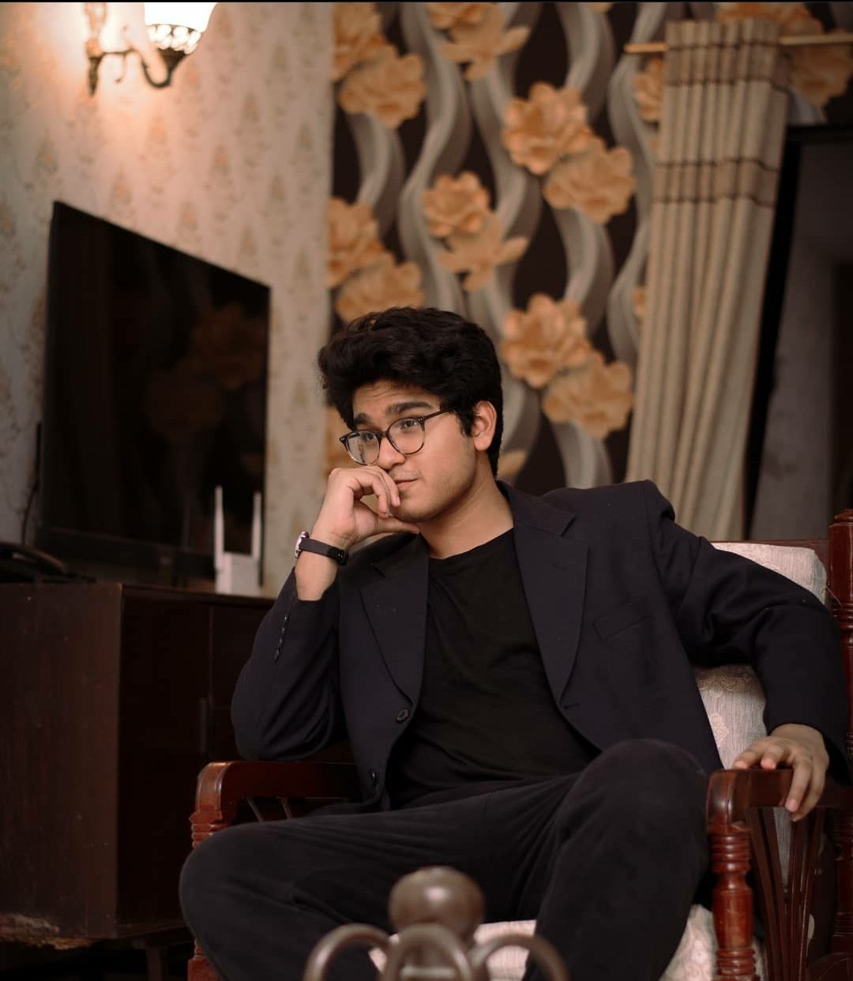
Adil Ali Khan
A Presentation by that same guy - 24586

Slide 2
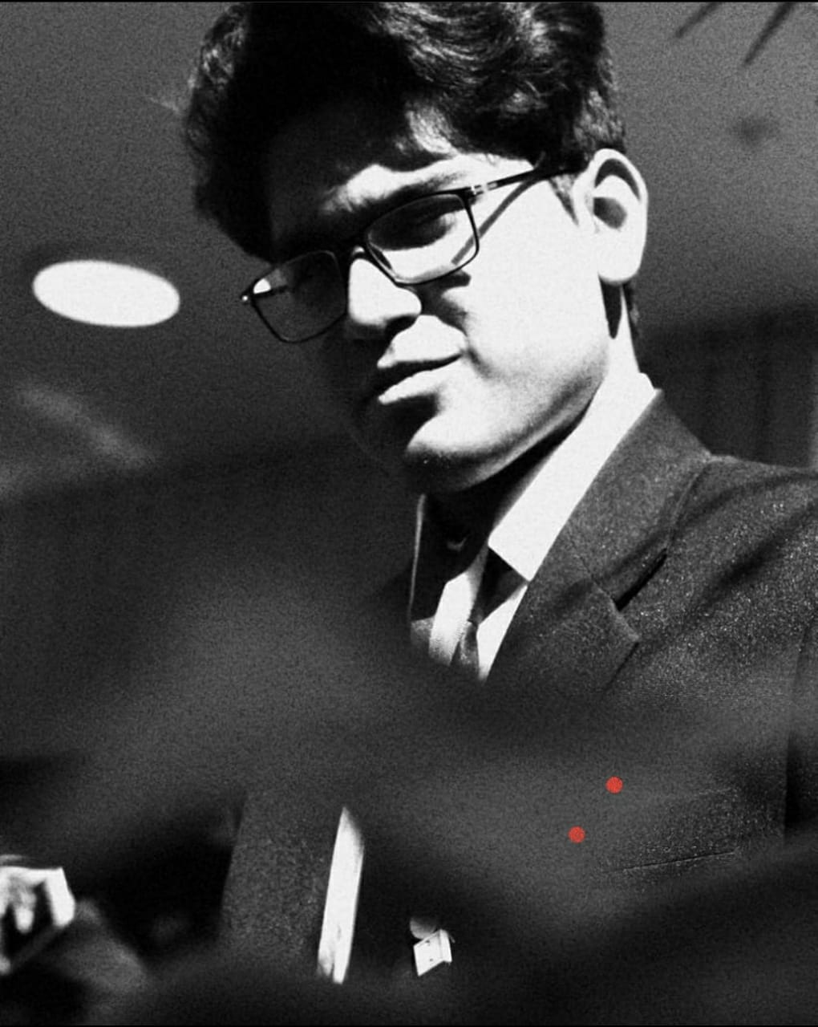
Career Ambitions
So, who am I? Let's first discuss some formals. I am a 19-year-old student studying Business Administration in IBA. I am currently enrolled in an undergraduate program, but I do plan to pursue a post graduate study on the subject. Business administration had always appealed to me. Having looked up to the Business models of Apple, Youtube, Instagram, Facebook, Google, AirBnB, etc. in great awe.
Although there is no real set path of where I want my career to be headed after my studies, I know that I will always be operating as an Entrepreneur, even if I have a permanent job, because of obvious reasons. I am especially motivated to work in Marketing and Business Development. Added to this, I would also like to see myself commit to working directly for the state to fulfill my patriotic ambitions, working in a capacity I would have specialized in. I have always been more learned than most of my peers in matters pertaining to Economics, Current and Geopolitical affairs.
Alongside these few firm plans, I have plans to build a public profile on Social Media as well, as an influencer because I feel that a public profile for passionate students of this era is really important as it helps them document and share their professional journey in a relatively more appealing way.

Slide 3
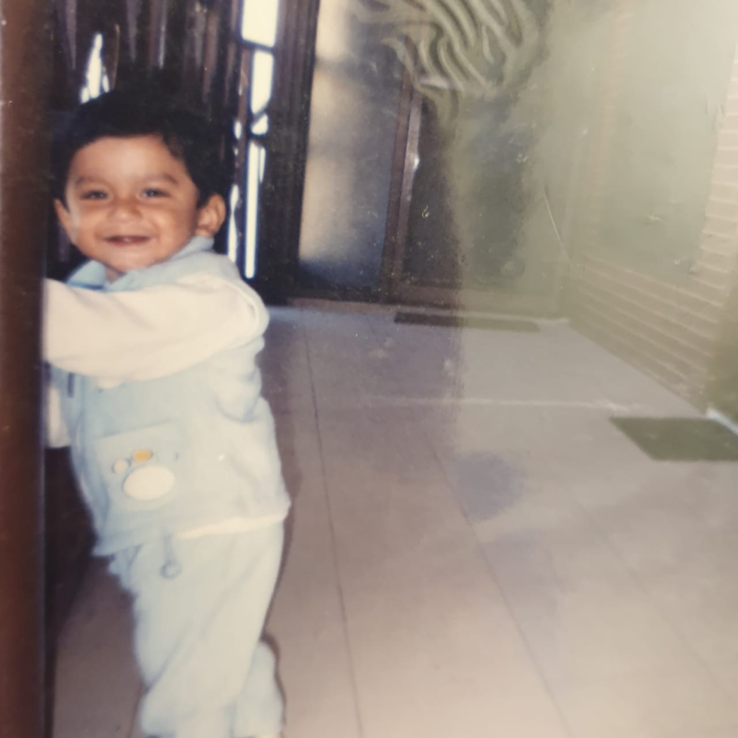
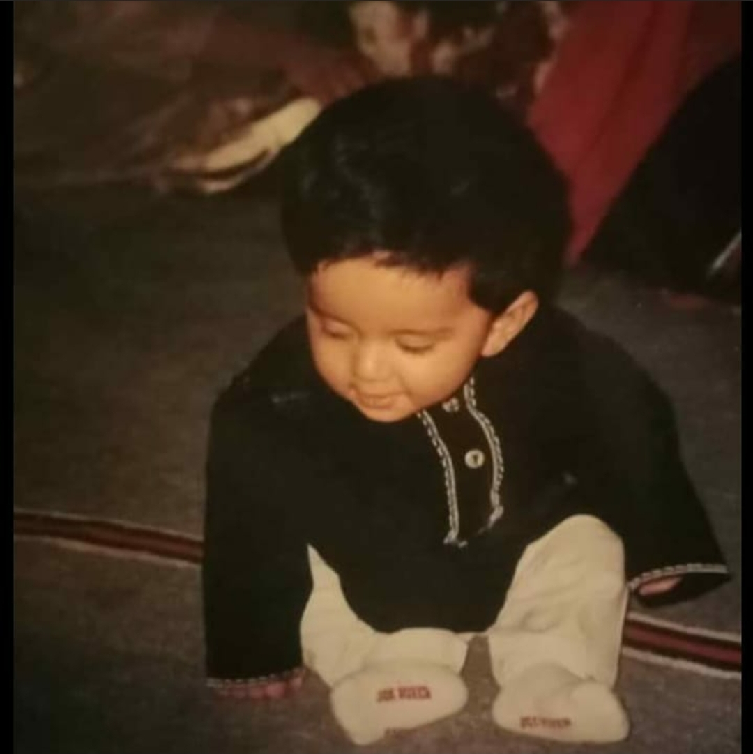
Childhood
19-07-2002.
Having spent my life as an only child of two very loving and devoted parents, it would be very easy for one to assume that I am a spoilt brat and am used to having things done my way with little or no regard for someone else’s conflicting wishes. I believe that could not be further from the truth, I think I was raised well enough by two very exceptional people. Their chemistry, teamwork ensured that I do not turn out to be a typical “Only-Kid”. Obviously, that does not mean at all that they did not provide me with everything that they felt I should be provided with, but rather they were careful enough to make sure that the unfailing provision of everything I ask for was avoided. As much as a difficult childhood and a challenged early life is an attractive narrative to adopt if you are to present a protagonist. I had an easy one.
I think my favorite toy would either be my Motorbike or my Green remote-controlled Jeep. My wrestling action figures could also be given an Honorable Mention.

Slide 4
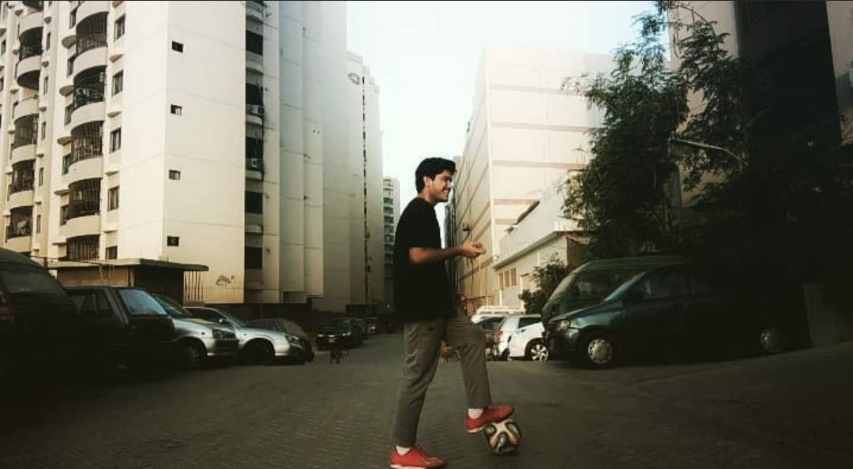
Hobbies
I think this is the part of this presentation that I can write the most about, simply because there is a lot to talk about.
Sports: I am someone who takes a lot of pride in the level of Physical Excursion I undertake. In an age when most people my age have already become couch potatoes and do not pride themselves over the level of involvement, they have in sporting activities. I can proudly say that I have explored a great number of sports and explored them to an extent that I can safely call myself an Amateur-Semi Pro in them.
Cricket: Now this is the sport that I have been playing for the longest time. It was the first sport I dived in, as a kid and I still love the feeling of timing a straight drive down the pitch against a worthy fast bowler, or the wristy in-swinging delivery that sends the stumps flying. Starting out as a competitive bowler playing inter-school tournaments, I went on to become more of a batsman, perfecting my bat swing and my timing against hard bowl opponents. Although there have been a lot of Professional players that I have looked up to and learnt this and that from. I think my love

Slide 5
Continuing:
for how Shoaib Malik has played throughout his career can not be left undiscussed. His evolution as an off-spinner to a full-blown anchor in the deep batting lineup is something I am never going to get tired of talking about. His recent performances in the t20 Cricket World Cup 2021 are a statement in themselves. It’s a pity that Pakistan could not win the World Cup despite being arguably the best team in the tournament.
Football: I think much like most people that became absolute fans of Football; I am also a convert. Now being a convert does not mean that my love for Cricket has subsided. It just means that now I have something that competes with the monopolistic nature that Cricket had in my heart. Although, the story of National Football is very different from National Cricket, that does not mean that Pakistanis have not been able to make some football teams and some footballers their life and soul. For me, the team that I gave my heart to, would be FC Barcelona. The Blue and Red striped team from Catalunya, Spain. And If it isn’t already obvious, the player that I would readily give my life for would be Lionel Andres Messi. I think that If I get going on my love for Messi and Barcelona, I will easily exhaust the slide limit for this assignment. So, with a heavy heart I will chose to succumb to the walls that my rational sense is putting up. But, if I can say one thing, I think I would just say that I watch every game that FC Barcelona plays and has watched every game they have played, give or take, since 2017. And yes, much like everyone else, I had my heart stabbed too when Messi left FC Barcelona for PSG.

Slide 6
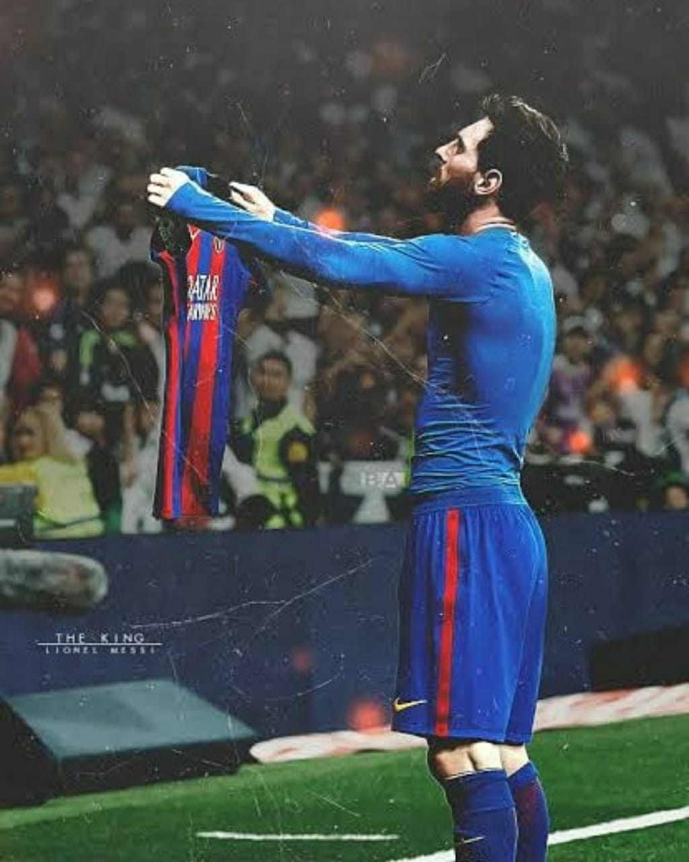
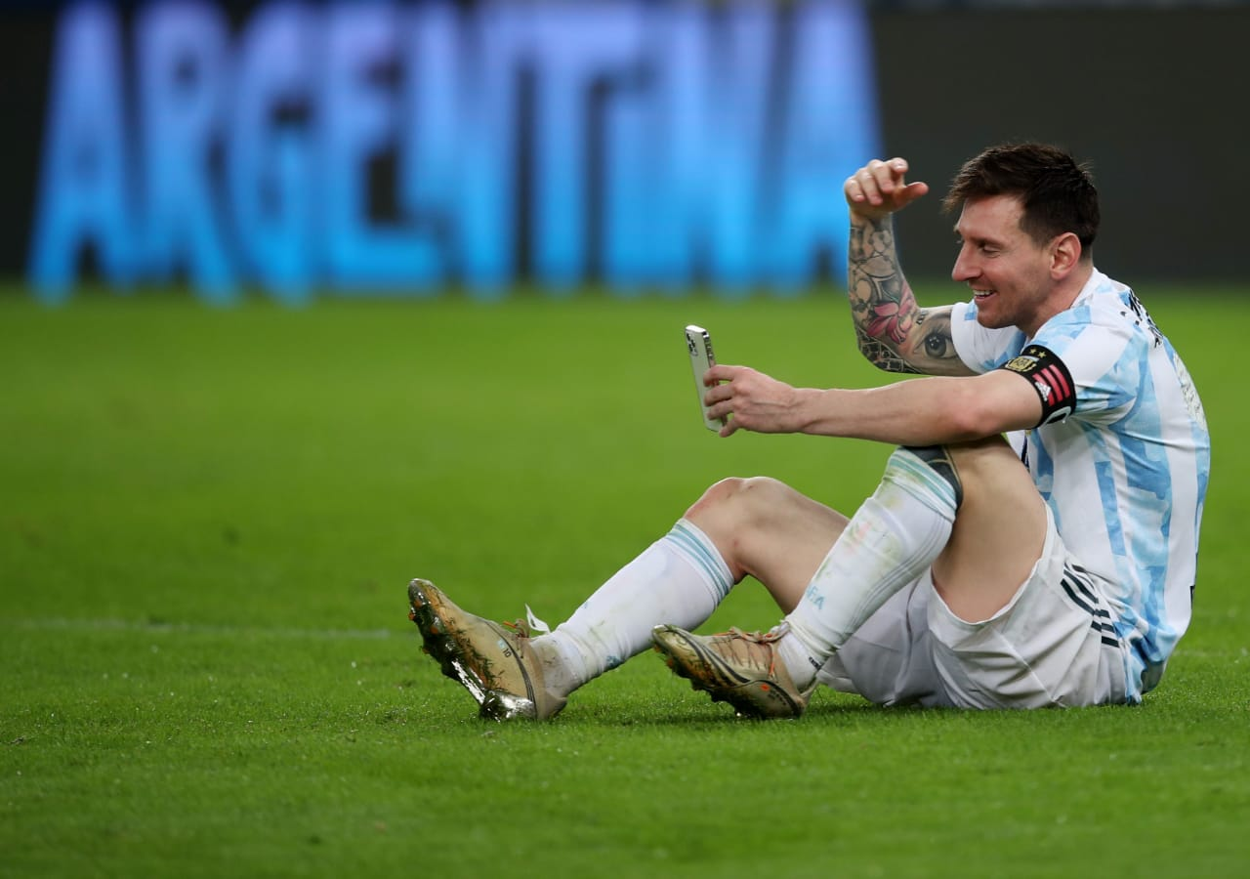

Slide 7

I certainly do not feel any shame in dedicating two entire slides to my dream team and my favorite Footballer. I could go on and on about the histories of this club and the achievements they have bagged and everything else that I am interested in but I don’t think it will be fair to bore you with the details.
Badminton: Now this is a sport that is relatively more recent, I was informally introduced to it in my A Levels. Didn’t have much of a history with it before A Levels. But it did pique my interest pretty quickly and so the effort to become better and better at it made me a regular player, and it didn’t take a lot of time for me to make myself a self-proclaimed “Amateur” of the sport. I play this pretty regularly in IBA and outside IBA on the weekends. I feel that the sport does a good job of making sure that I get a good cardio done and plus it is a very interesting sport in itself and maybe that’s why I was able to accommodate it to the other two sports I have much more of an emotional connection with.

Slide 8
Table Tennis: I think that Table Tennis is the sport I have had the most professional development in. I started playing it in 7th grade, got incorporated into the Inter-School circuit till 9th grade and at the peak of my time, defeated the under-19 Sindh champion a few times. Partly because he was from my own school, and I got to practice against him whenever preparing for a major tournament. It is a difficult sport and does demand some time in getting thoroughly used to it. You can play well without being used to it, but if critiqued by a professional, he/she is going to diagnose a lot of fundamental flaws in your gameplay. Maybe that’s why it took me the longest amount of time to call myself a Semi-Pro at the game.

Slide 9
Other less-Physical Hobbies
Reading: I think its criminal to be a content writer and not be a reader. Its also criminal to not be a reader in the modern age where there is so much content being generated on the daily and for sure, it is a very taxing practice, but it does develop a routine of constantly burying yourself with information which will always allow you to have an informed or less-informed opinion at least, on most of the things that are making the norm.
Gaming: Something I have been doing ever since the age of 9. I started out with competitively playing First-Person Shooter games such as IGI, Counter-Strike, Call Of Duty, Fortnite, then more recently, switching to PUBG, then now most recently, switching to Valorant. I play Valorant for atleast two hours daily on a competitive level. Although, it is a great past time, it could easily have been something way more had Pakistan encouraged the gaming community through incentives like regular tournaments or leagues. But that kind of setup is difficult to find and so much like me, most other gamers find themselves at a difficult position.

