Slide 1
Lavender.

Slide 2
The color Lavender is a one-word description of who I, Areeba Elham, am.
This beautiful color is soft, calming and peaceful – all the things that I consider myself to be.

Slide 3
A university student who has seen the world in her 18 years of existence through a very unique lens of optimism.
A firm believer in small things matter more than the bigger ones. It’s the smallest, most mundane moments in life that add up to create a bigger picture of happiness.

Slide 4
If I had to describe myself through my personality type, I am an introverted individual and I don’t like to socialize with just anyone and it is beyond my understanding how people can sit with someone for a while and become friends.
I wouldn’t talk much in a group setting which is both a good thing and a bad one, in my opinion, however, with the ones I am very comfortable around, I will be super chatty and cheerful.

Slide 5
Another one of the traits that I possess is that I am driven by feeling. I focus more on what my heart says than what my mind tells. Sometimes it comes in handy, other times it lands me in trouble.
I am sensitive and emotionally expressive. I consider myself an empath and my friends and family would most definitely agree with it.

Slide 6
My volunteer work in welfare societies at school, college and university, all showcase my concern for the well being of others around me.
I have been to Beach cleanups, have helped organize fundraisers and ration/winter drives, have volunteered in blood donation events etc.

Slide 7
I am also an intuitive person which basically describes how I am open minded and creative.
Being someone who is naturally curious about things, I exercise my imagination as I seek new ideas and possibilities.

Slide 8
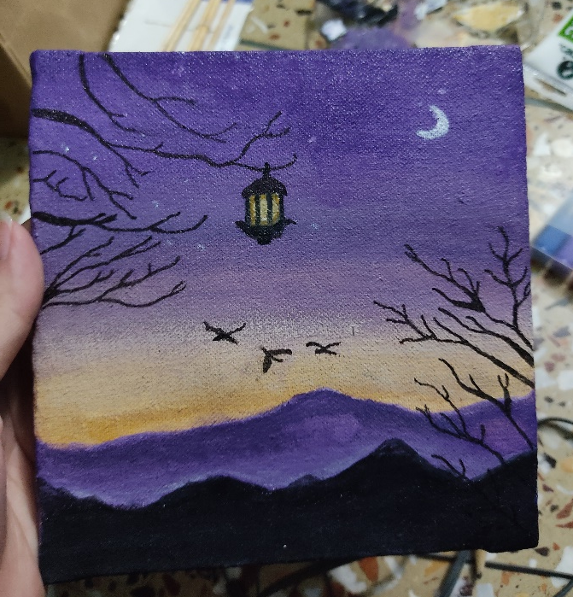
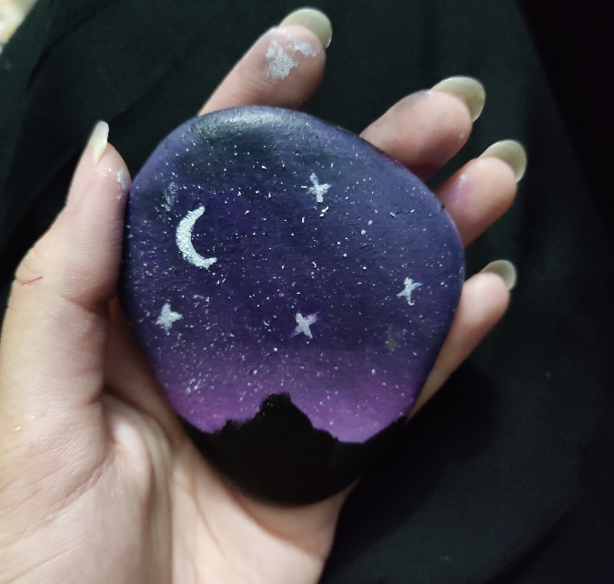
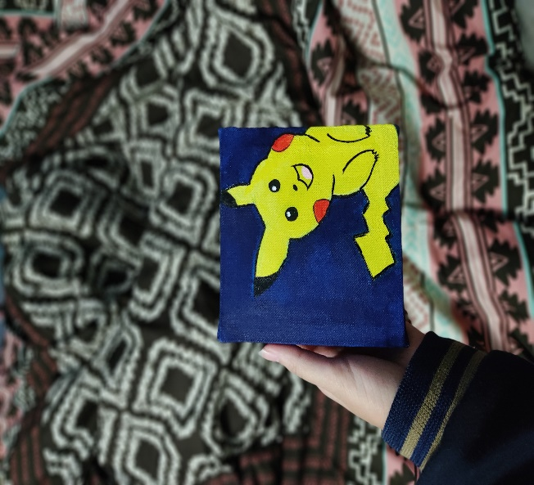
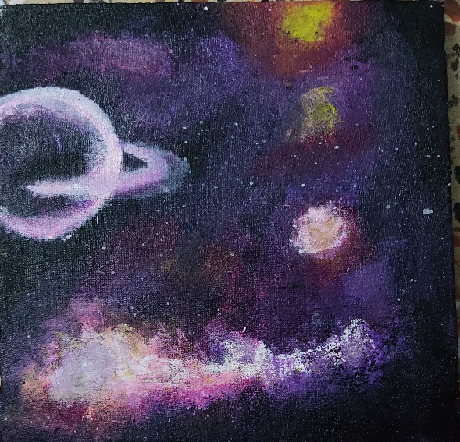
Talking about creativity, I like to paint. Here’s a few of the first few paintings I ever made.

Slide 9
While we’re talking about hobbies, I love to read, too.
Unpopular opinion: reading online/on phone is better. And I say that ONLY because it allows me in the dark as well.
My favorite genres are romance, fantasy. I absolutely love the Percy Jackson series and Keeper of the Lost Cities series from the fantasy genre.

Slide 10
If I talk about my zodiac sign, I am an Aries and one could go as far to consider me a “typical Aries”. I am ambitious and full of energy.
Honesty stands first for an Aries and so does it, for me. A very hardworking and passionate individual however, being a Fire sign I do hold a temper.

Slide 11
I am also an animal lover and my favorite ever animal has to be a red panda after kittens. I have noticed that not a lot of people are familiar with Red Pandas and they often question “a red what?” when I mention it. So, here’s a link to a video of Red Pandas : https://www.youtube.com/watch?v=Qu59cLEA4HQ

Slide 12
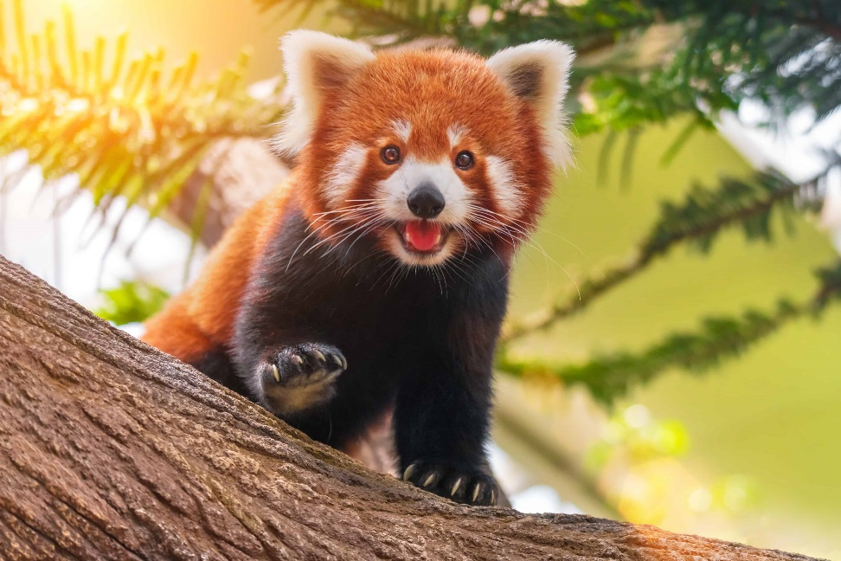
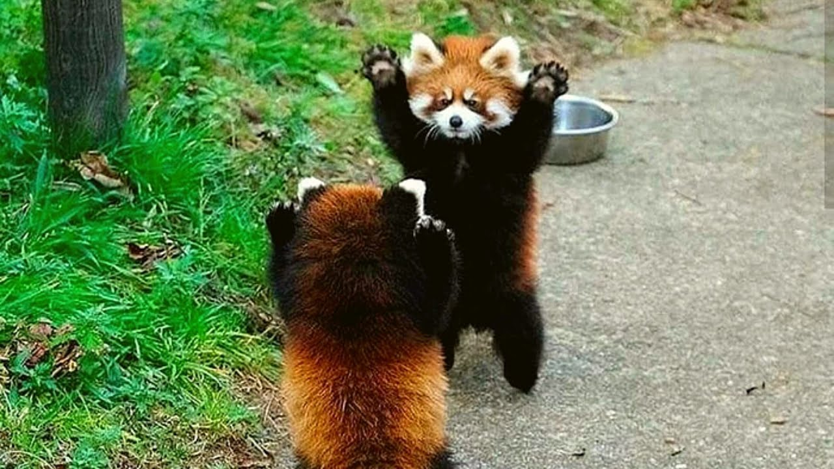
Fun fact: Red Pandas raise their hands above their heads to appear more “intimidating” to others.
Here’s a Red Panda.

Slide 13
This presentation was a part of the course that I am taking in university and through this I aimed to portray my knowledge about Ms PowerPoint and I hope I fulfilled the aim. Hope you weren’t bored out of your mind through the entirety of this presentation. Have a great day!

