Slide 1


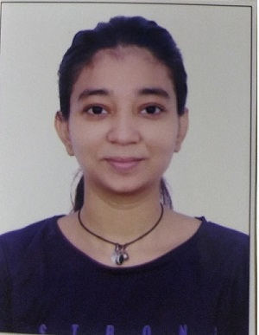






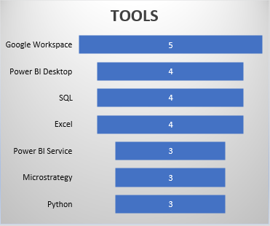
AKSHAYA NAIK
EDUCATION
(2021) Electronics Engineer
CODEBASICS Virtual Internship
PORTFOLIO
Use Data to showcase Real Picture in creative way
This Photo by Unknown Author is licensed under CC BY-NC

