Slide 1

STUDENT DATABASE
example of students database using sorted linked list and random files

Slide 2
Members
1-nagy nabil Mohamed
2-osama Mohamed fattoh
3- Mahmoud ahmed hegazy
4- abdelrahman Mohamed Elmahdy
5- afaf abdelwahab abdelkader

Slide 3
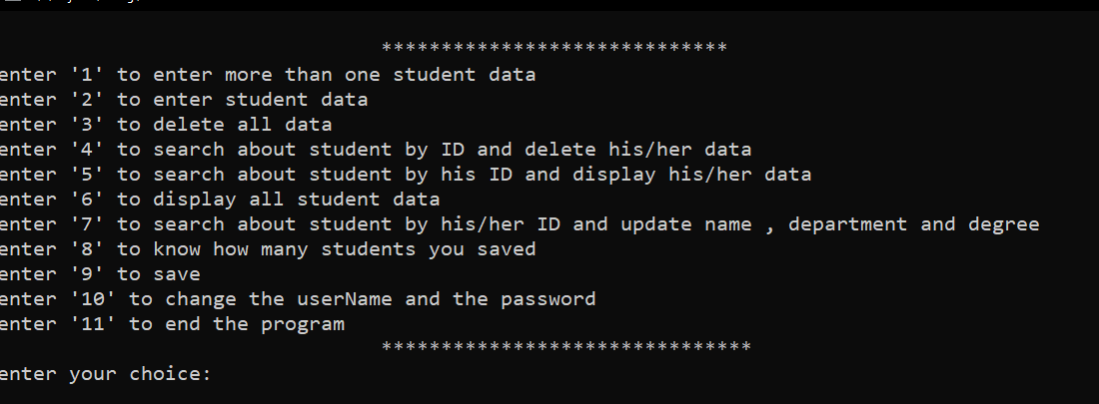
What our program can do?

Slide 4
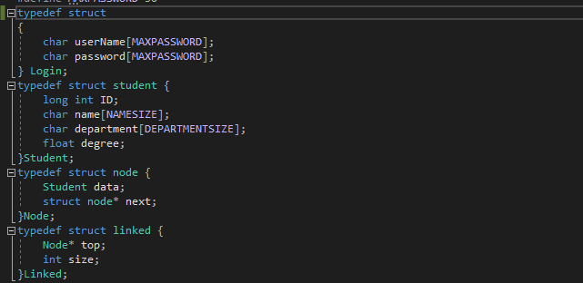

Basic structures

Slide 5
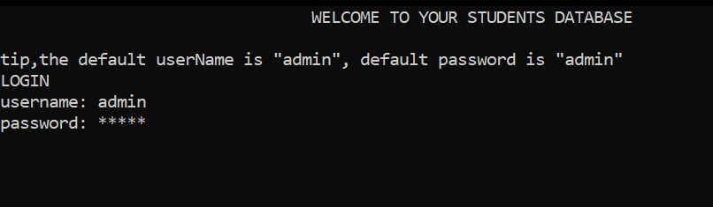
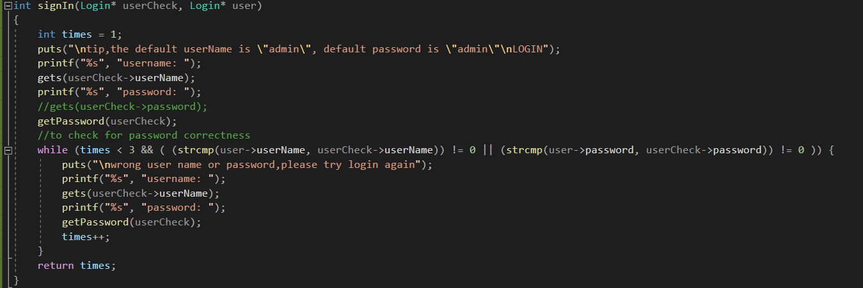
You will not be able to enter the program without enter the password

Slide 6
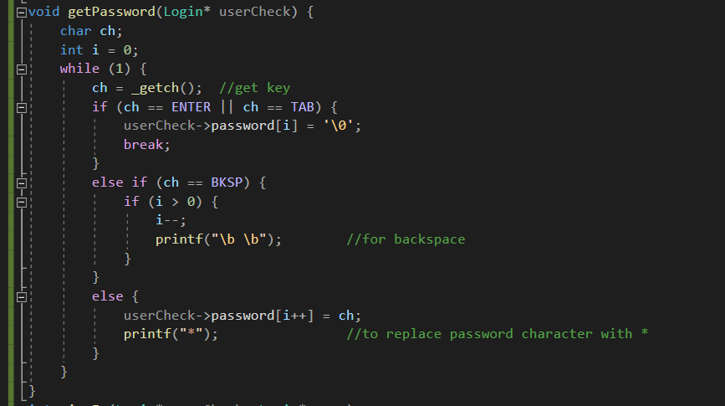
To change passwords as ‘*’

Slide 7

Create(initialize) Linked list

Slide 8
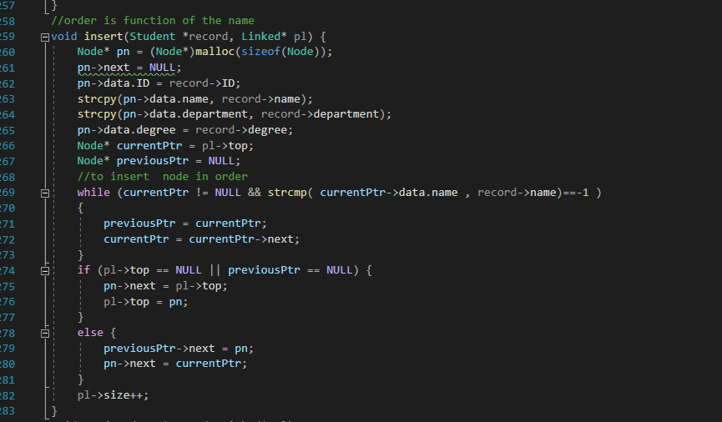
Insert is function using sorted linked list to add students by order of their names

Slide 9
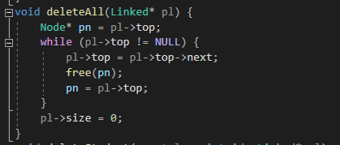
Function deleteAll to free all the list

Slide 10
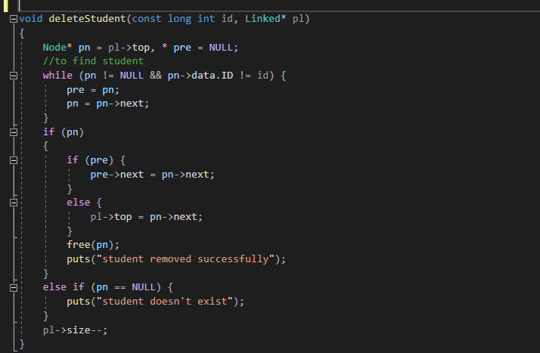
deleteStudent used to delete certain student by his ID

Slide 11
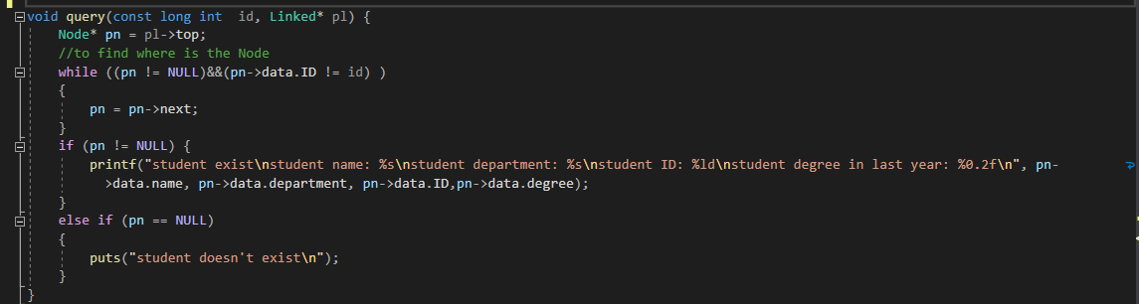
Query is function to search about student by his ID and display data

Slide 12
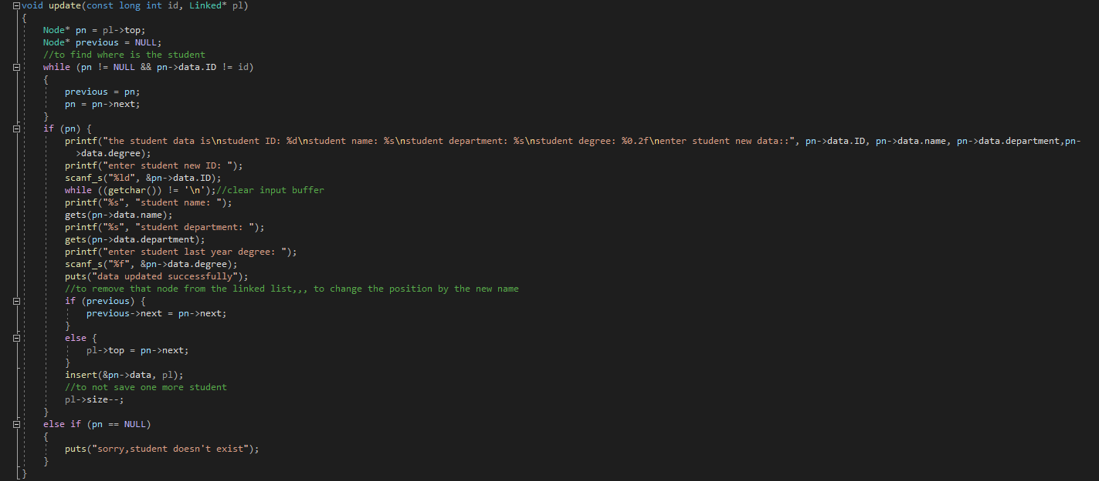
Update function used to edit student data

Slide 13
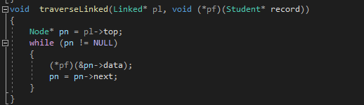
traverseLinked used to pass all the list data to another function

Slide 14
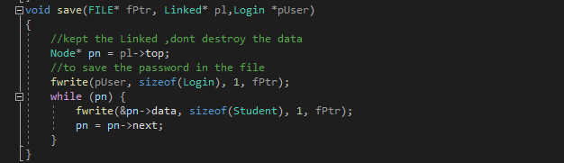
Save function used to save list data in files

Slide 15
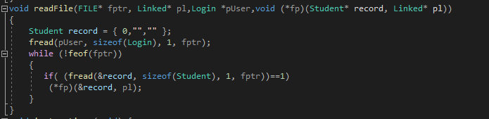
readFile function used to read the data from file to the list

Slide 16
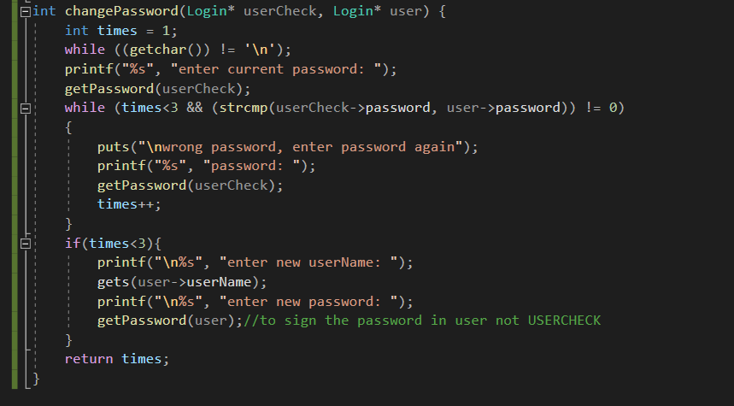
changPassword Is function used to change program password

Slide 17
Instructions function to display program choices

Slide 18
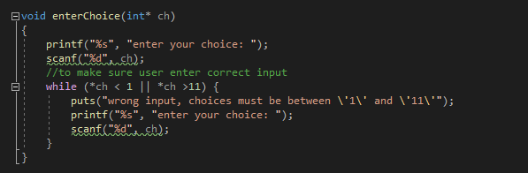
enterChoice function to take user choice

Slide 19
Thanks

