Slide 1

Ultra‑Precision Current and Voltage Measurement System
Compact, low‑loading measurement module for 1 V–12 V and 1 µA–100 mA ranges. Designed around STM32 control, ADS1115 16‑bit conversion, OLED UI and UART logging with emphasis on minimal DUT loading and robust low‑current accuracy.

Slide 2
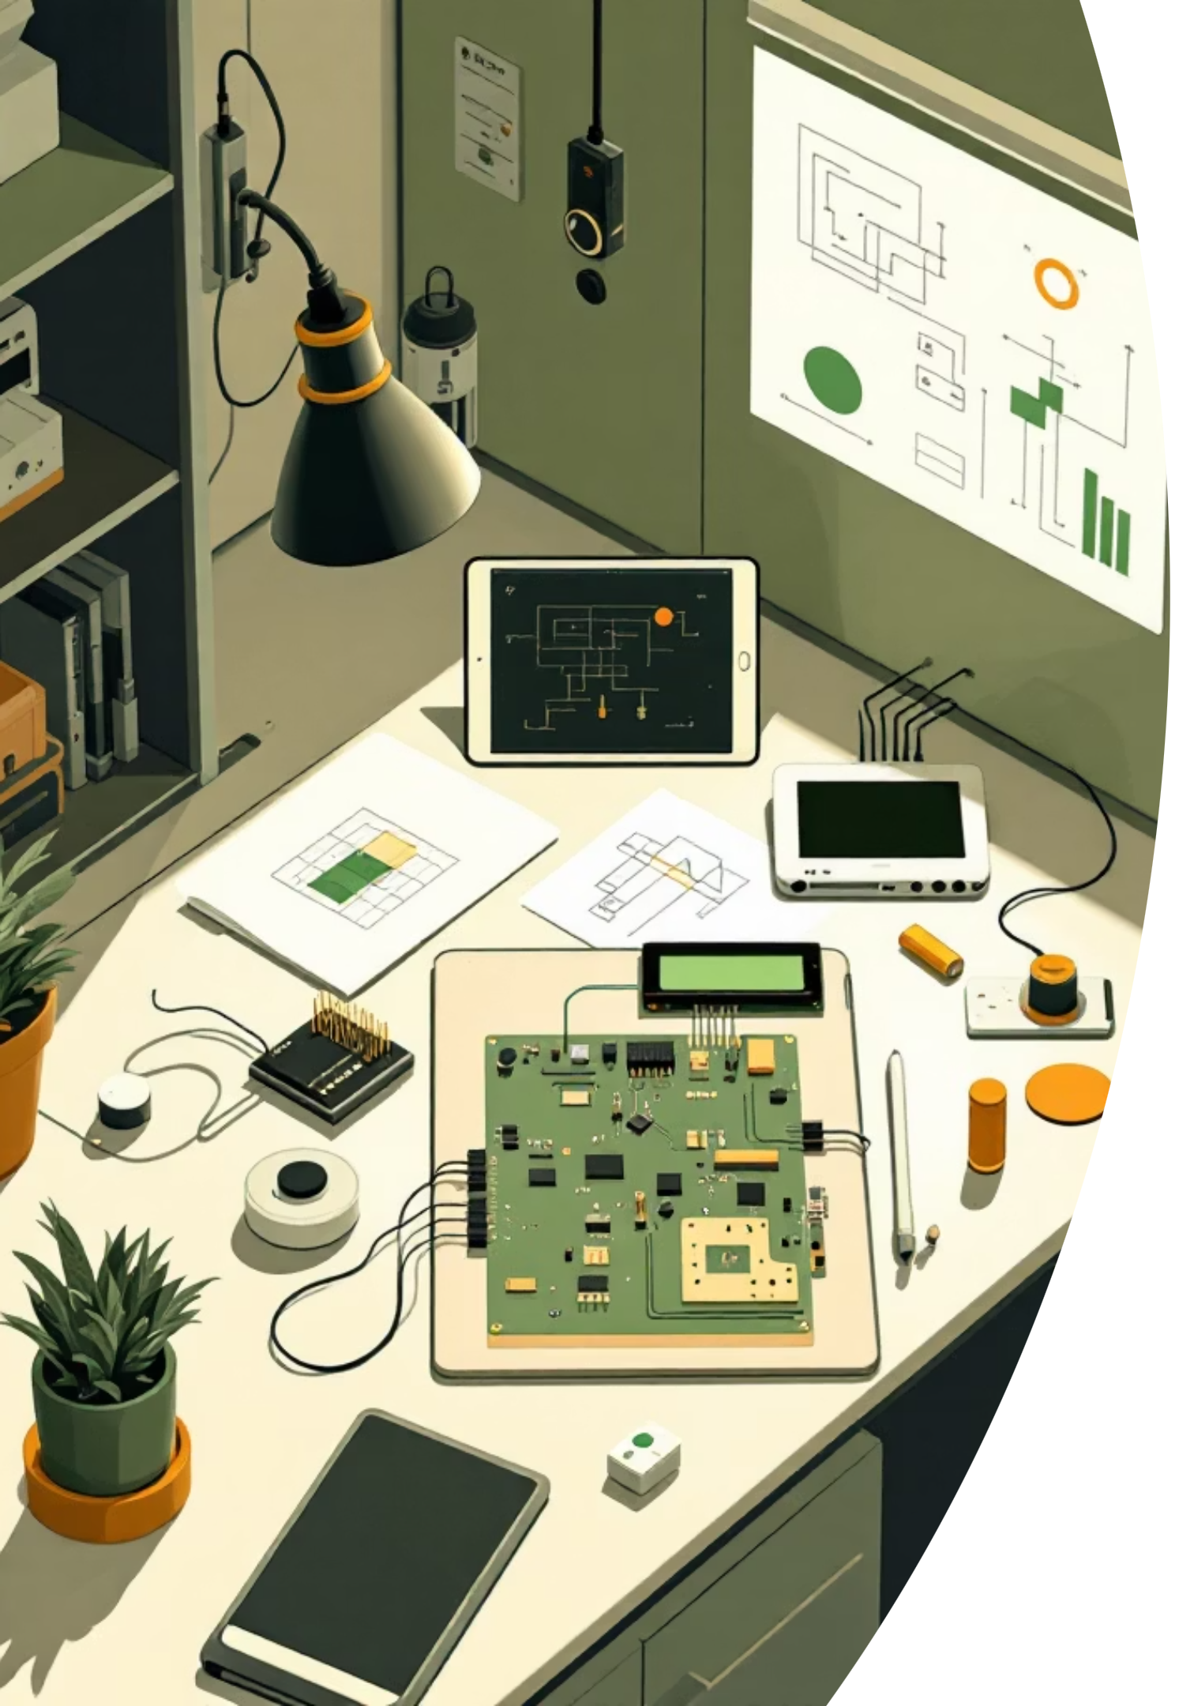
Project Overview
Objectives
Core Components
Measure voltage 1–12 V at 0.001 V steps; measure current 1 µA–100 mA across 3 ranges; sample ≥2 kS/s; present on OLED and stream CSV over UART; keep DUT loading minimal.
STM32F411CEU6 (Blackpill)
ADS1115 16‑bit ADC (I²C)
SH1107 128×128 OLED (SPI)
3P4T rotary range switch
LM2596 buck + 2× Li‑ion batteries
Key Requirement
Minimal impact on DUT: reduce divider and sensing loading to sub‑100s µA levels where possible.

Slide 3
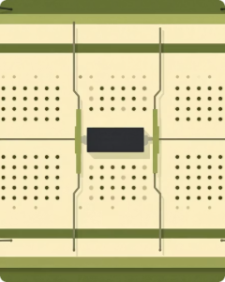
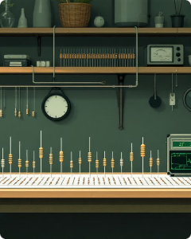
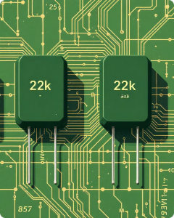
Voltage Measurement — Divider Design Evolution
4 × 330 Ω
4 × 10 kΩ
4 × 22 kΩ (Final)
Loading ~9.1 mA at 12 V — too heavy. High DUT loading and power loss; rejected.
Loading ~0.3 mA — improved but not optimal for µA‑level sensitivity.
Division 4:1 → 12 V → 3 V to ADC. Loading 136 µA at 12 V. 0.1 µF ADC input capacitor for filtering.
Lesson: Increasing divider resistance reduces DUT loading; pair with input capacitor to reject noise without significant RC slowdown at target sampling rate.

Slide 4
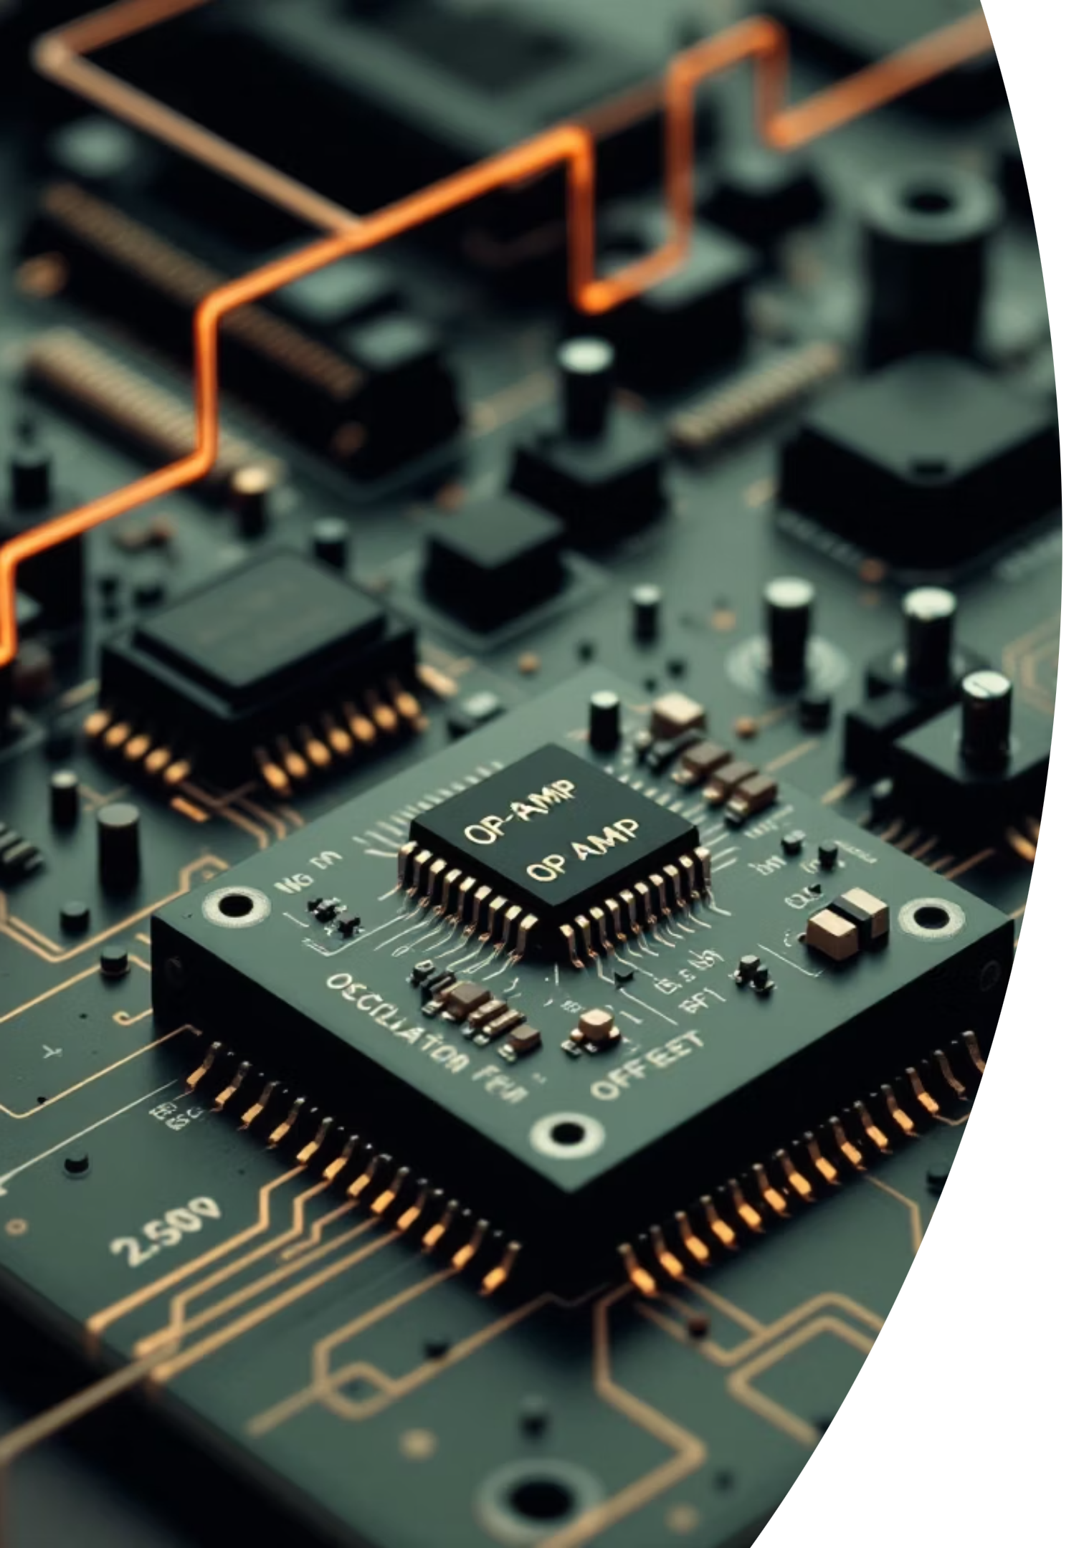
Current Measurement — Op‑Amp Attempts
Attempted Op‑Amp Approaches
LM358 and MCP6002 amplifiers were tried on breadboard for low‑side shunt amplification. Observed large offset, bias, instability and oscillations at low currents.
LM358
High offset ±3 mV and bias currents; produced severe fluctuations at µA currents.
MCP6002
Improved bias but still unstable below 100 µA; sensitive to wiring and breadboard capacitance.
Root Causes
Dynamic range 1 µA → 100 mA (100k:1) too large for single op‑amp stage.
Offset dominates at low currents (1.5 mV ≈ 150% error at 1 mV signals).
Breadboard wiring introduced noise and oscillation.

Slide 5
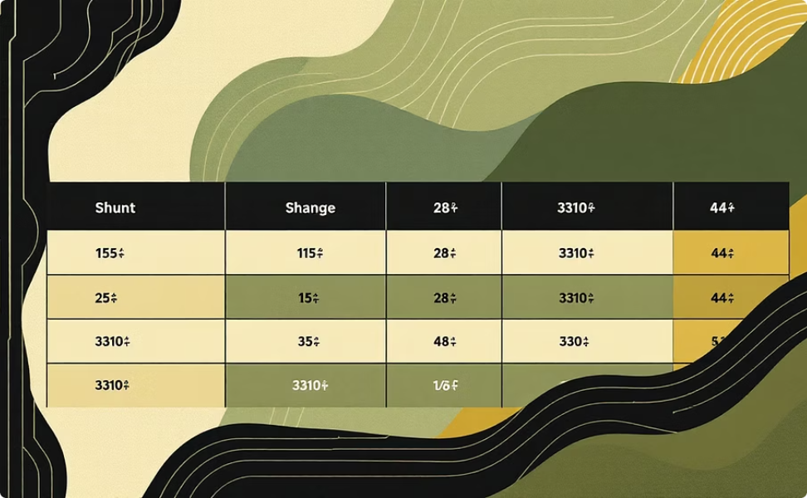

Current Measurement — Successful ADC Method
Switched passive shunt resistors with appropriate ADC PGA gains provide wide dynamic range with linear, stable results and no op‑amp offset calibration.
Range Table (selected positions)
Advantages
Pos 1: 5 Ω → 100–20 mA → Vdrop 500–100 mV (PGA tuned)
Pos 2: 8 Ω → 20–2 mA → 160–16 mV
Pos 3: 10 Ω → 200 µA–1 µA → 2 mV–10 µV
Passive and inherently linear (Ohm's Law).
No op‑amp offset errors to correct.
Robust across temperature and wiring conditions.

Slide 6
Capacitor Filtering — ADC Input Stability
Placed 0.1 µF ceramic caps at ADS1115 inputs to suppress high‑frequency noise. Empirical cutoff frequencies depend on source resistance (R): fc = 1/(2πRC).
Channel / Source R
Cutoff frequency (approx)
Voltage (A0) — 88 kΩ
≈ 18 Hz
Range 1 (A1/A2) — 5 Ω
≈ 318 kHz
Range 2 — 8 Ω
≈ 199 kHz
Range 3 — 10 Ω
≈ 159 kHz
Measured improvements: voltage noise reduced from ±15 mV → ±2 mV (≈87%); current noise from ±5 mV → ±0.5 mV (90%). ADC stability improved to ±1 LSB. Critical: always include input caps for reliable low‑level readings.

Slide 7
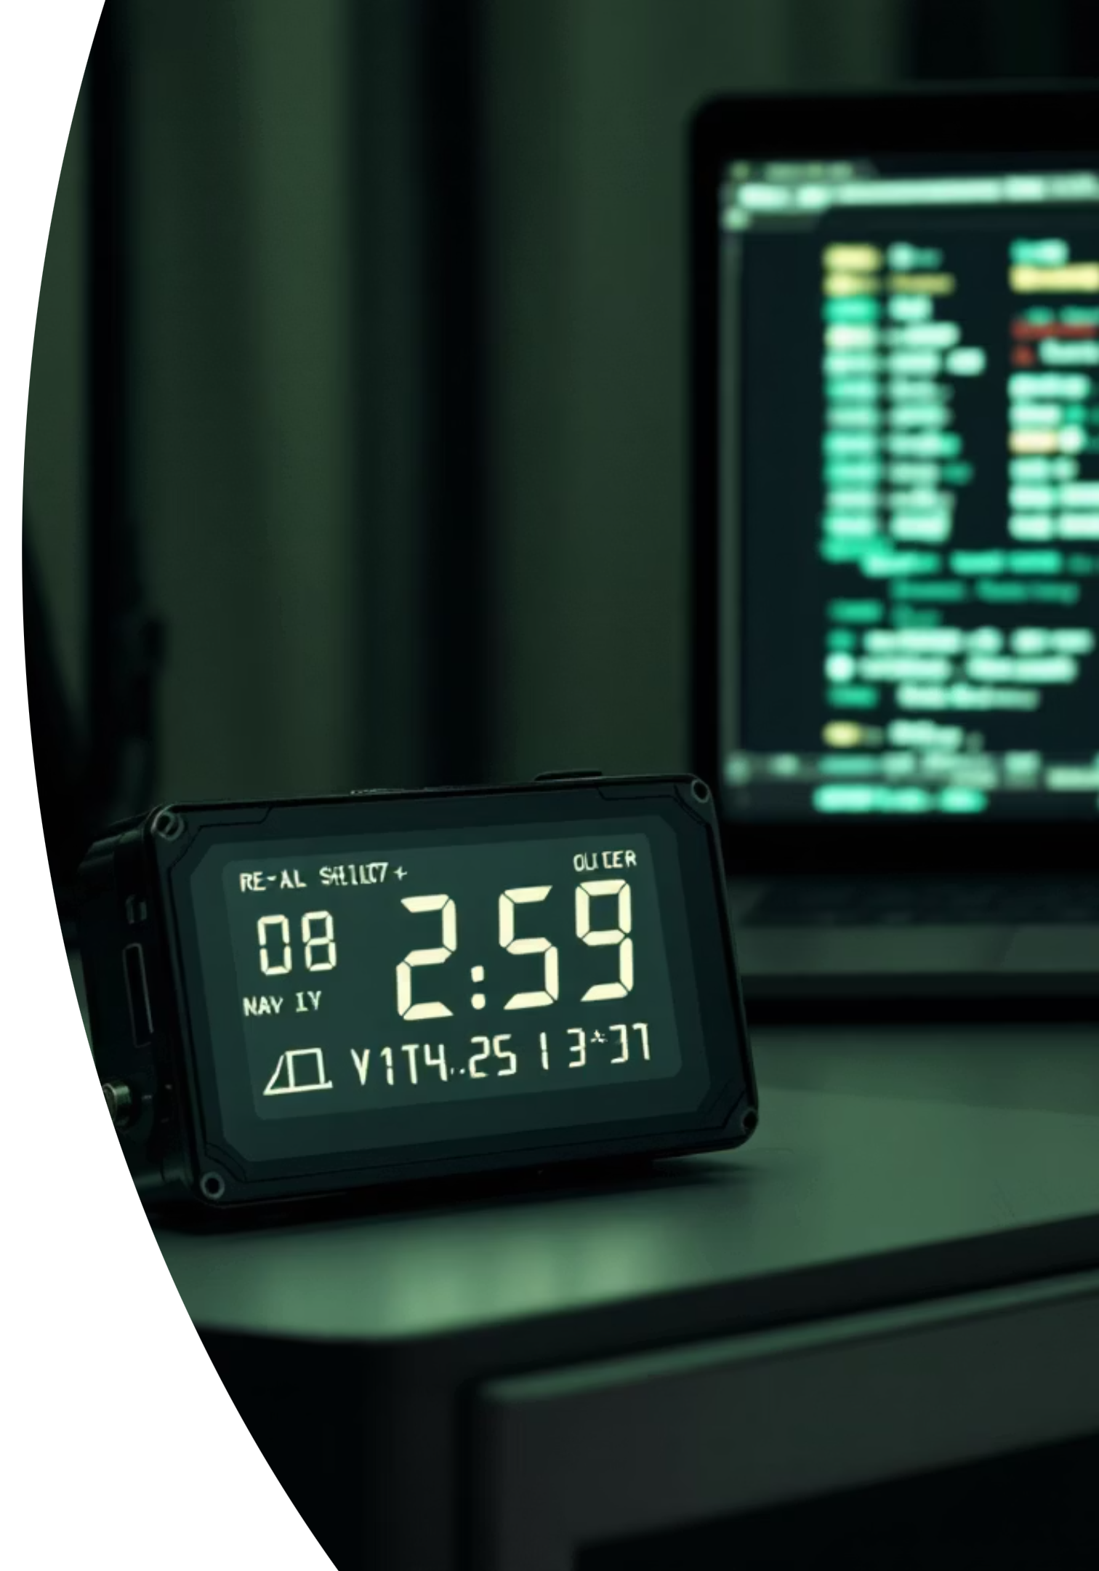
Data Output — Display & Logging
OLED (SH1107)
UART to PC
SPI pins: PB8, PB9, PB10, PC3. Real‑time display: voltage, current, active range, status. Stable and low‑latency for operator feedback.
USART2 (PA2 TX) at 115200 baud. CSV format: "Voltage(V),Current(mA),Range" — compatible with PuTTY, Python scripts or serial monitors for logging and post‑processing.
Failed Extras
Backup Strategy
SD Card via SPI — library & level‑shift problems under 3.3 V constraints.
ESP32 WebSocket — timing and power complications; introduced instability.
Maintain reliable UART logging and local OLED UI as primary operational paths — these saved the project.

Slide 8

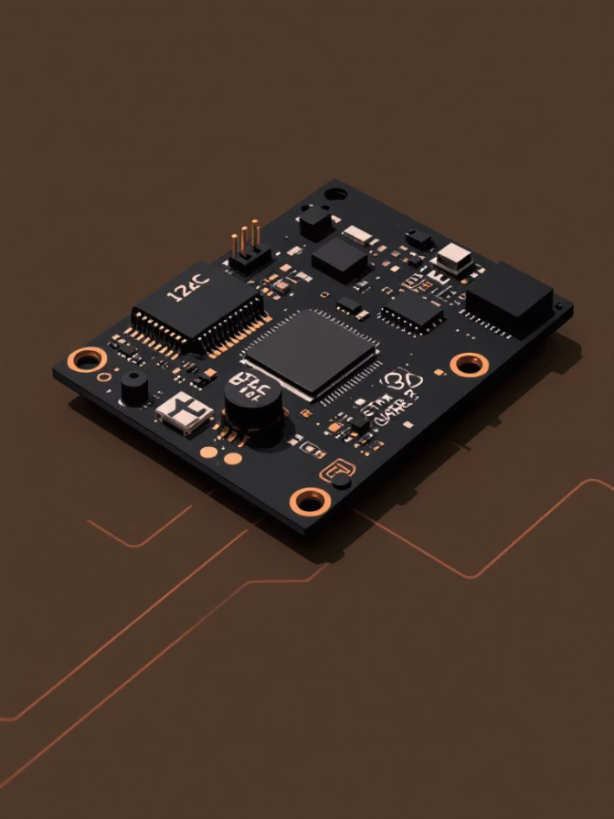
System Architecture
Power and signal flow designed for isolation, low noise and reliable conversion.
DUT interface
Battery pack
Rotary switch to divider or shunt
2× Li‑ion (7.4 V)
ADC & Display
Power & Data Flow
Master switch
ADS1115 (I²C) and SH1107 (SPI)
ON/OFF control
STM32 core
5 V regulator
3.3 V regulator powered
LM2596 buck converter
Pin Summary
PB6, PB7 — ADS1115 (I²C)
PA2 — USART2 TX for PC logging
PB8, PB9, PB10, PC3 — SH1107 OLED (SPI)
Various GPIO — rotary switch and range select

Slide 9
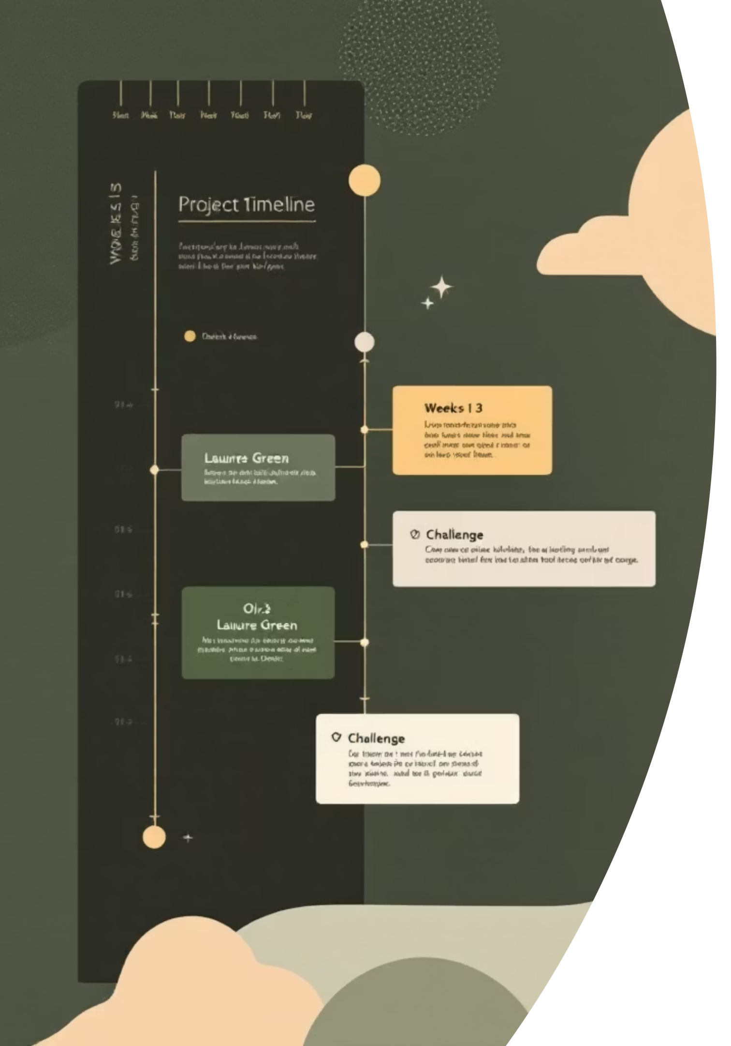

Project Timeline & Milestones
1
Week 1 — Voltage & OLED
Implemented 4×22 kΩ divider and OLED UI. Op‑amp current sensing failed on breadboard.
2
Week 2 — Current Ranges
Validated 3‑range shunt method and rotary switching. SD card & ESP32 approaches failed; retained UART.
3
Week 3 — Calibration & Finalize
Calibrated ranges, tuned PGA gains, reduced noise ~90% with input caps. System validated end‑to‑end. The enclosure was finalized.
PROJECT STATUS: Completed — measurement specs and logging targets met. Final verification passed.

Slide 10
Conclusion, Lessons & Next Steps
Specifications Achieved
Key Lessons
Future Improvements
Voltage: 1–12 V @ 0.1 V resolution. Current ranges: 100 mA–20 mA, 20 mA–2 mA, 200 µA–1 µA. OLED and UART logging functional. Maximum DUT loading ≈ 136 µA.
High‑value voltage dividers reduce DUT loading.
Shunt resistors with range switching outperform op‑amp front ends for 100k:1 dynamic range.
0.1 µF input capacitors drastically reduce ADC noise and stabilize readings.
Maintain simple, reliable backup outputs (UART) when advanced logging fails.
Auto‑ranging with analog switches or MCU‑controlled relays for seamless transitions.
Custom PCB and careful ground routing to reduce parasitic noise and eliminate breadboard effects.
Proper level‑shifters and power domain design for reliable SD card logging.

