Slide 1
Git & Github
A quick session
by
Manivannan.C

Slide 2
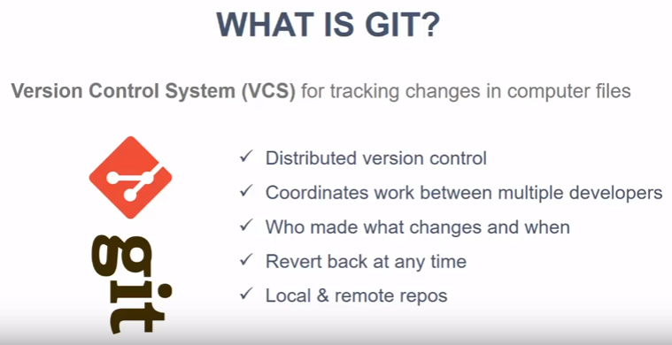

Slide 3
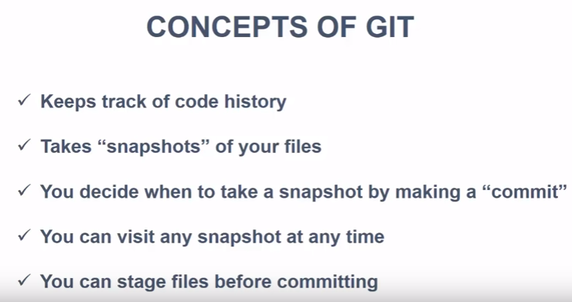

Slide 4
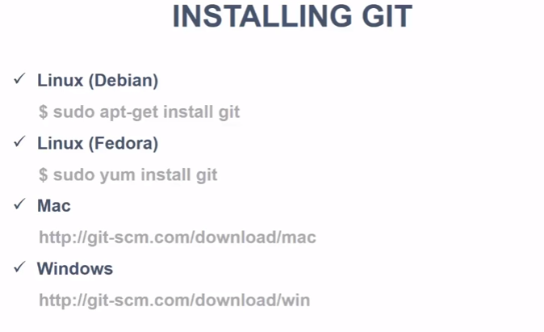

Slide 5
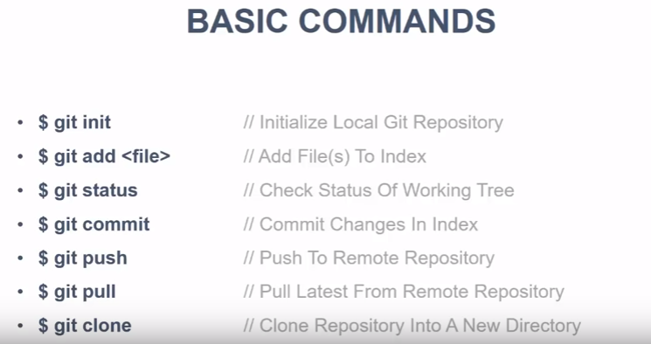

Slide 6
Initial Checks
Go to Windows→All Programs→Git
Git Bash
Git CMD
Git GUI
Open Bash or CMD and type git –version
Configure Username and Email
Create Remote Github Repositories.

Slide 7
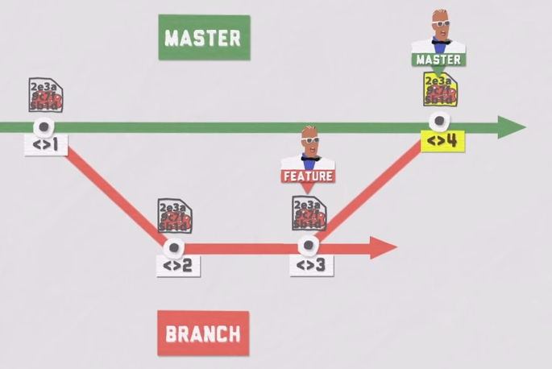
Merge works like this

Slide 8
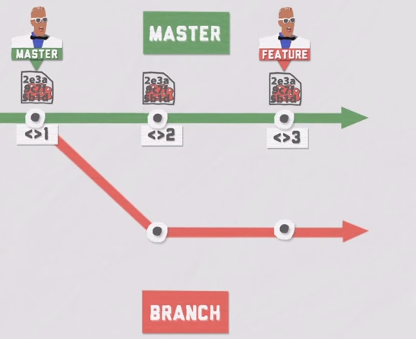
Rebase works like this

Slide 9
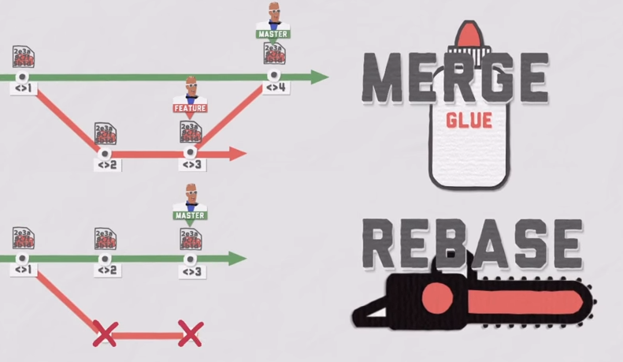
Merge & Rebase

Slide 10
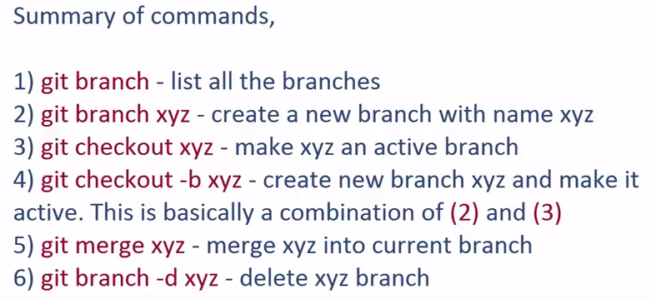

Slide 11
Additional Commands
git branch –r
git remote –v
git remote add origin “Git URL”
git fetch
git merge/origin
git pull( short command of short git fetch;git merge)
git tag
git tag b1.0
git push --tags

Slide 12
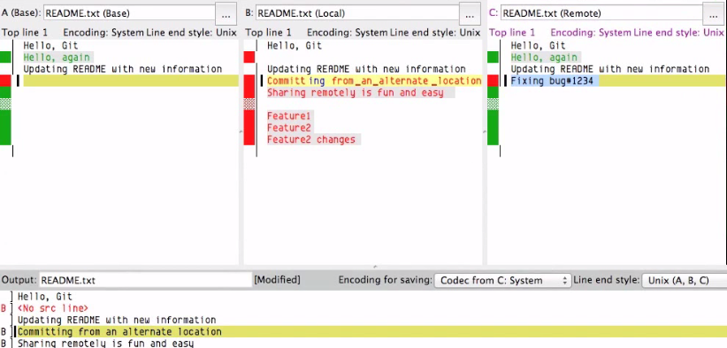
Merge Conflicts
git mergetool (opendiff kdiff3)

