Slide 1
CS619 · FINAL YEAR PROJECT · PROTOTYPE PHASE
AQDesk
Answer Question Community, Learning and Knowledge Platform
A working prototype — six modules, live database, real workflows.
Laravel 12
MySQL 8
Bootstrap 5
6 / 6
PHP 8.2
11 tables
32 views
modules built
Titania Melody · BC220203981
Supervisor: Mr. Abdullah Qamar · Virtual University of Pakistan
Notes:
AQDesk is a community and knowledge platform for emerging technologies. This deck covers what the prototype implements, what it deliberately defers, and how it is built.

Slide 2
THE PROBLEM
One platform, six services, one community
Students, instructors, researchers and technology professionals currently scatter across a different tool for every need — one site to ask a technical question, another to find an internship, a third to run an event.
AQDesk brings those services into a single digital ecosystem for the emerging-technologies domain, so knowledge, collaboration and opportunity live in the same place.
WHO IT SERVES
1
Students
ask, learn, apply
2
Instructors & researchers
share expertise
3
Technology professionals
The Main Requirement File specifies seven functional areas. The Prototype Assignment narrows the current phase to six mandatory modules.
answer, mentor, hire
4
Organisations
post opportunities
Notes:
The core idea: a single ecosystem instead of four separate tools.

Slide 3
SCOPE
What we committed to build — and what we did not
Every module below is traced to its source document, so scope decisions are auditable rather than assumed.
IMPLEMENTED IN THE PROTOTYPE
DEFERRED TO THE FINAL PROJECT
1
User Authentication
2
Role-Based Access
Project Collaboration
FR1
FR1
FR3
Dashboard
User Profile
Events & Podcasts
3
4
FR4
Prototype file
FR1
Consulting Management
Community Q&A
Jobs & Opportunities
FR6
5
6
FR2
FR5
Newsletter & Announcements
FR7
Deferred modules still ship as labelled placeholder pages in the running application — the full scope stays visible, and the architecture already accommodates them.
Notes:
Point out that Dashboard has no FR in the main file — it appears only in the Prototype Assignment, so we designed its content ourselves.

Slide 4
THE BUILD
Six modules, working end to end
1
Authentication
2
Role-Based Access
3
Dashboard
Register · bcrypt login · sessions · CSRF · deactivation guard
Admin · Expert · Member. Middleware, ownership checks, conditional UI
Role-aware statistics and quick actions — three roles, three pages
4
User Profile
5
Community Q&A
6
Jobs & Opportunities
Public profile · avatar upload · skills · password change
Ask · answer · vote · tag · 4 categories · search · accept answer
Post · filter · apply with CV · applicant pipeline
All six run against a live MySQL database — no mock data, no static screens.
Notes:
Each card is a working module. Offer to demo any of them live.

Slide 5
MODULES 1 & 2
Authorisation as a design, not a pile of if-statements
Administrator
THREE LEVELS OF ENFORCEMENT
Manage users and roles · activate and deactivate accounts · moderate all content
1
Route middleware
EnsureUserHasRole guards whole route groups — role:admin, role:admin,expert
Expert / Professional
Publish jobs and internships · review applicants · set application status
2
Ownership checks
Member
Only the author or an admin may edit a record — a decision middleware cannot make
Ask · answer · vote · edit own content · maintain profile · apply
3
Conditional interface
Roles live in a normalised table with a foreign key on users — not a string column — so the schema itself documents them.
Blade renders only the actions the current role can actually perform
Notes:
Separating coarse access (middleware) from fine access (ownership) is the key design idea here.

Slide 6
MODULES 3 & 4
The same page, three different answers
The dashboard is the clearest single demonstration of role-based access: three users sign in one after another and see three visibly different pages.
Administrator
Expert
Member
USER PROFILE
Total users
Questions
Answers
Open opportunities
My answers
My questions
Jobs I posted
Applicants received
My questions
My answers
My applications
Open jobs
Public profile page
Avatar upload, 2 MB cap
Bio, skills, organisation
Social links
Password change
Every role also sees recent community questions, the latest opportunities, their own contributions, and the Phase 2 roadmap — so the dashboard doubles as a map of the whole platform.
Notes:
Demo tip: sign in as member, then expert, then admin, back to back.

Slide 7
MODULE 5 · FR2
A full question-and-answer workflow
Ask
Browse
DESIGN NOTE
Title, category, up to five tags, auto-generated unique slug
Search, category filter, tag filter, newest / most viewed / unanswered
One votes table,
two kinds of content
Answer
Vote
Voting applies to questions and to answers. Two vote tables would have meant two sets of near-identical logic.
A single polymorphic table — votable_type plus votable_id — serves both, and any future module inherits voting at no cost.
Any signed-in user answers any open question
Up and down on questions and answers; click again to undo; never on your own post
Accept
Moderate
The author pins one answer as accepted
An administrator closes, re-opens or deletes
Categories, exactly as named in FR2: EdTech · Artificial Intelligence · Web Development · Internet Governance
Notes:
The polymorphic votes table is a good answer if asked "what would you do differently at scale".

Slide 8
MODULE 6 · FR5
From posting to hiring decision
FR5 asks for job postings, internship listings and application submission. We implemented all three plus the employer-side workflow that makes an application mean something.
1
2
3
4
5
Post
Discover
Apply
Review
Decide
Expert or Admin publishes a job or internship
Filters by type, work mode and keyword
Cover letter plus optional CV (PDF/DOC, 4 MB)
Employer reads letters and downloads CVs
pending → reviewed → shortlisted → accepted
Publishing is role-gated
No duplicate applications
Withdrawal deletes the CV
Only Administrators and Experts reach the posting routes
Enforced by a unique database index, not just by application code
Storage is cleaned up when an applicant withdraws
Notes:
Emphasise the unique index — correctness enforced at the database level, not only in PHP.

Slide 9
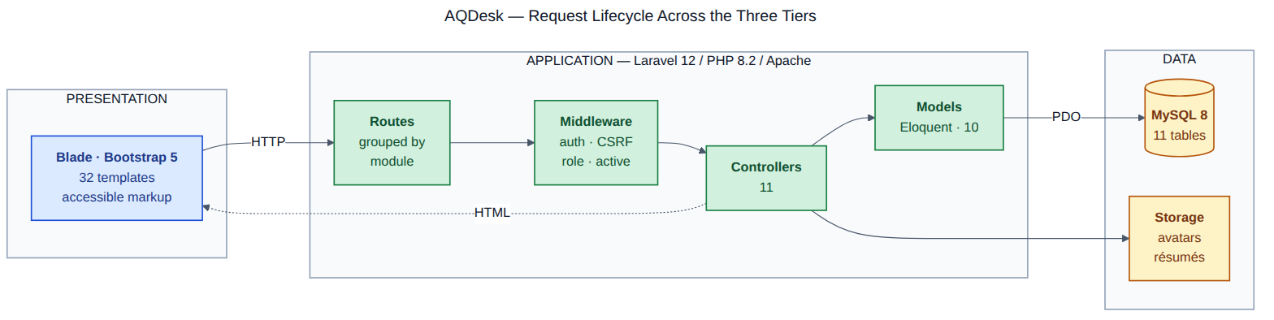
ARCHITECTURE
Three tiers, one request path
Routes grouped by module
Middleware before controllers
Models own the data
routes/web.php reads as a map of the six modules
Session, CSRF, role and account-status checks run first
Eloquent relationships express the domain; no raw SQL in controllers
Notes:
This modular separation is what allows the four deferred modules to be added without touching existing code.

Slide 10
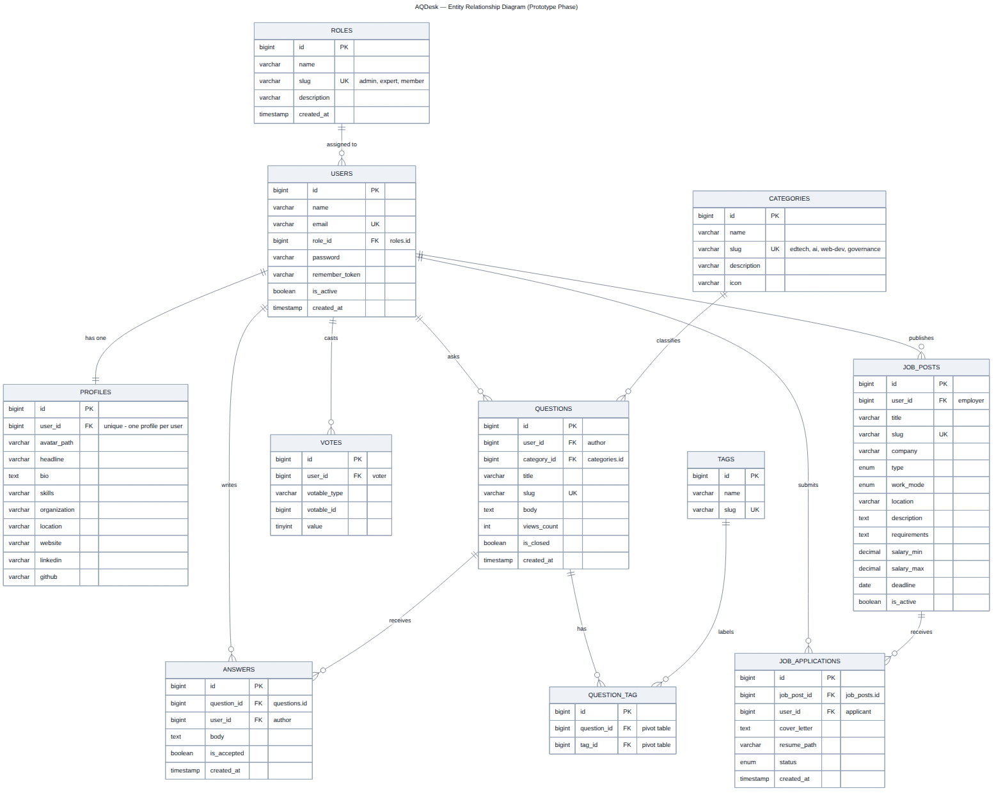
DATABASE DESIGN
Eleven tables, integrity enforced in the schema
CONSTRAINTS THAT MATTER
Cascade deletes
Removing a question removes its answers, tags and votes — no orphan rows
One vote per user per item
Unique index on user, votable id and votable type
One application per opportunity
Unique index on job post and user
Roles set null, never cascade
Deleting a role can never destroy accounts
Unique slugs
Readable, stable URLs on questions and opportunities
Full-resolution ERD: /docs/diagrams/01-erd.png · DDL: /schema/aqdesk_schema.sql
Notes:
The full DDL is in /schema/aqdesk_schema.sql; migrations build the same structure.

Slide 11
EVIDENCE
Measured against the stated quality requirement
6 / 6
11
32
0
mandatory modules
fully functional
application tables
with full CRUD
Blade templates
npm dependencies
70–80% functional frontend
All six mandatory modules work end to end. Only the four deferred modules are static.
Basic backend integration
Full CRUD across eleven tables, session authentication, validated file uploads.
Database connectivity
MySQL 8 through Eloquent over PDO, with migrations and seeders.
Clear system architecture
Three-tier MVC, documented, with routes grouped by module.
Notes:
These four requirements come verbatim from the Prototype Assignment.

Slide 12
ENGINEERING
Two decisions we can defend
CDN OVER VITE
AVOIDING A FRAMEWORK COLLISION
No Node.js, no build step
The table is job_posts, not jobs
Bootstrap loads from a CDN and our own styles are one plain CSS file. The alternative adds Node, an npm install and a build to the setup instructions.
For a deliverable an evaluator runs on an unfamiliar machine, removing a toolchain removes a whole class of setup failure. The project installs with composer install and nothing else.
Laravel reserves the jobs table for its queue worker, and the default migration creates it.
Naming our opportunities table jobs would have collided with the framework. The table and its model are job_posts and JobPost — a small detail that would have cost hours to diagnose later.
Both are trade-offs, not shortcuts — and being able to explain the trade-off is the point.
Notes:
Expect a question on the CDN choice. The answer is reproducibility for the evaluator, with a build pipeline planned for production.

Slide 13
PHASE 2
What comes next
The four remaining functional requirements already have placeholder pages in the running application. Each lists its planned features and cites its FR number.
Project Collaboration
FR3
Events & Podcasts
FR4
Project spaces · collaborator invitations · file sharing with versions · threaded feedback
Event CRUD and registration · webinar API integration · podcast upload and RSS
Consulting Management
FR6
Newsletter & Announcements
FR7
Client records · availability calendar · booking · proposal tracking
Subscriptions · campaign composer · queued mail delivery · announcement feed
Notes:
Also planned: social login to complete FR1, a formal WCAG audit, a PHPUnit suite, and cloud deployment.

Slide 14
REFLECTION
What building it actually taught us
1
Requirements are rarely complete
2
Authorisation is a design problem
The two source documents disagree on the technology stack, number the FRs inconsistently, never name the roles, and make Dashboard mandatory with no FR behind it. Reading them closely was real work — we documented every assumption rather than pretending the specification was unambiguous.
Checking the role inside every controller method grew unmanageable fast. Separating coarse access from per-record ownership made the whole system easier to reason about — and much easier to explain.
3
Small framework details bite quietly
4
Fewer dependencies, fewer failures
Naming a table jobs would have collided with Laravel's queue. Passing created_at to updateOrCreate silently did nothing because the column was guarded. Neither failed loudly; both were caught by reading carefully.
Choosing a CDN over a build step felt like a compromise at first. For something an evaluator has to run on an unfamiliar machine, it is the more defensible decision.
Notes:
Answer honestly if asked what was hardest: getting authorisation right without duplicating checks everywhere.

Slide 15
READY TO DEMONSTRATE
Let us show you
the running system.
Sign in as a Member, then an Expert, then an Administrator — the same six modules answer differently for each.
Source code · /src
Database schema · /schema
Documentation · /docs
Private GitHub repository
Titania Melody · BC220203981 · CS619 Prototype Phase · Supervisor: Mr. Abdullah Qamar
Notes:
Close by offering the live walkthrough. Demo accounts all use the password "password".

