Slide 1

a Projectional Editor written by Levente Mészáros

Slide 2
Goals I.
Make it General Purpose
support editing arbitrary data structures, provide generic notations and operations that work with any kind of data structure
Provide Different Notations
varying from textual to graphics, varying from generic to domain specific, allow mixing notations freely with nesting and layouting
Make it Domain Cognizant
provide natural domain specific notations and operations that are well known from currently used tools

Slide 3
Goals II.
Integrate Well
across different problem domains and different projections, allow unforeseen combinations of documents and projections
Be on Par with Text Editors
provide domain specific textual notations that are as usable as those provided by current text editors, allow falling back to the standard text domain nested anywhere as a last resort

Slide 4
Generic Feature Examples
styling text with colors and fonts anywhere
word wrapping for problem domains other than text
nested automatic line numbering
annotating anything with comments, discussions, etc.
sorting to make navigation and understanding easier
grouping parts to make navigation and understanding easier
filtering to allow removing certain unimportant parts
focusing on only a part of the document
editing arbitrary parts of the document collected by the user

Slide 5
Features for Programming Languages
free renaming, multiple names, automatic naming schemes, naming preferences, type annotation, etc.
automatic syntax highlighting, automatic indentation, code formatting preferences, inlining mathematical notations, inlining decision tables, etc.
literate programming, mixing styled documentation with code, styling code with colors and fonts, etc.
inlining function calls, editing function call sites, editing references, cross cutting code views, selective code views, etc.
mixing tests with code, continuous testing, evaluation tracing, partially evaluating code, etc.
semantic versioning, semantic conflict resolution, etc.

Slide 6
Main Concepts
Read Evaluate Print Loop
a simple yet powerful algorithm, the core of the editor
Document
a piece of data that is being edited, the state of the editor
Projection
a bidirectional transformation between domain specific data structures, the way data is presented and edited
Backend
a means of communication with input and output devices

Slide 7
Means of
Primitives
small and reusable atomic document data structures and projections
Combinations
nesting document data structures and using higher order projections and recursion
Abstractions
creating new document data structures along with projections to existing document data structures

Slide 8
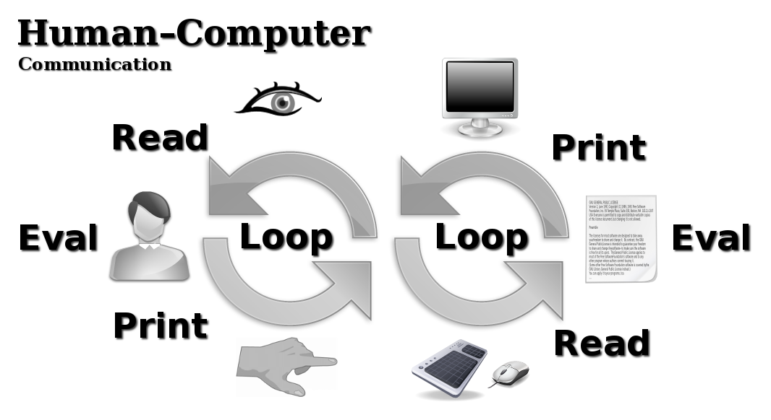
Human Computer Communication

Slide 9
Read Evaluate Print Loop
Generalizing the REPL
the original REPL reads from a character stream and prints to a character stream
the generalized REPL supports different kinds of input and output devices
Output Devices
character stream, graphics display, speaker, etc.
Input Devices
character stream, keyboard, mouse, etc.

Slide 10
Document Examples I
Primitive (boolean, number, string, sequence, etc.)
Graphics (text, image, line, rectangle, circle, etc.)
Text (character, newline, spacing, etc.)
Book (book, chapter, paragraph, listing, etc.)
Tree (node, leaf, delimiters, separators, indentation, etc.)
Table (table, row, column, cell, alignment, etc.)
Graph (vertex, edge, etc.)

Slide 11
Document Examples II
XML (element, attribute, text, etc.)
JSON (null, boolean, number, string, array, object, etc.)
State Machine (state, event, transition, etc.)
Java (constant, local variable, class definition, method definition, conditional, for loop, return, etc.)
Common Lisp (constant, conditional, variable binding, function application, function definition, etc.)
File System (file, directory, etc.)

Slide 12
Projection
Projection
a bidirectional (two distinct algorithms: printer and reader) transformation between domain specific data structures
Printer
prints the document to all output devices simultaneously, a purely functional and highly recursive algorithm that is lazy and incremental (utilizes functional reactive programming)
Reader
reads an operation from all input devices simultaneously, also a purely functional and highly recursive algorithm

Slide 13
Printer
Input
a document data structure including selections using the input problem domain
Output
a document data structure including selections using the output problem domain
IO map
a data structure that effectively describes the mapping between the printer's input and output

Slide 14
Reader
Input
a mapping from a gesture to an operation using the output problem domain of the printer
Output
a mapping from a gesture to an operation that uses the input problem domain of the printer
IO map
produced by the printer to allow the reader to efficiently identify corresponding parts of the printer's input and output

Slide 15
Projection Kinds
Domain to Domain Projections
Domain Preserving Projections
Sequence Projections
Generic Projections
Higher Order Projections
Compound Projections

Slide 16
Domain to Domain Projection Examples
Text ⇒ Graphics Canvas
Text ⇒ String, String ⇒ Text
Tree Leaf ⇒ Text
Tree Node ⇒ Text
Table Cell ⇒ Text
Table Row ⇒ Text
Table ⇒ Text

Slide 17
Domain to Domain Projection Examples
JSON String ⇒ Tree Leaf
XML Attribute ⇒ Tree Node
Book Chapter ⇒ Tree Node
Common Lisp Conditional ⇒ S-Expr. List
S-Expression List ⇒ Tree Node
Java Method ⇒ Tree Node
Tabbed Pane Widget ⇒ Graphics Canvas

Slide 18
Domain Preserving Projection Examples
Text Word Wrapping Projection
the printer inserts line breaks into long lines to fit the requested width, the reader offsets references according to the inserted newlines
Text Line Numbering Projection
the printer inserts line number prefixes before each line, the reader offsets references according to the inserted prefix
Common Lisp Inlining Projection
the printer replaces a function call with the variable bindings along with the body of the function that is being called, the reader produces operations that apply to the called function

Slide 19
Sequence Projection Examples
Reversing Projection
the printer reverses its input, the reader reverses the appropriate level of references in operations
Sorting Projection
the printer sorts its input according to the provided criteria, the reader sorts the appropriate level of references in operations
Filtering Projection
the printer removes elements from its input according to the provided criteria, the reader offsets the appropriate level of references in operations

Slide 20
Generic Projections
Identity Projection
the printer just returns its input, the reader also returns its input
Copy Projection
the printer produces a fresh shallow copy of its input, the reader transforms operations so that they apply to the origin of the shallow copy created by the printer
Focus Projection
the printer returns a part of its input referenced by a path parameter, the reader transforms operations so that they apply to the referenced part of the printer's input

Slide 21
Higher Order Projections I.
Recursive Projection
parameterized by a projection, both the reader and the printer applies it recursively
Sequential Projection
parameterized by a sequence of projections, the printer applies them one after the other, the reader applies them the same way but in the reverse direction
Parallel Projection
parameterized by a sequence of projections, the printer applies them simultaneously producing a sequence of their outputs

Slide 22
Higher Order Projections II.
Type Dispatching
parameterized by a sequence of type and projection pairs, both the reader and the printer applies the appropriate projection to its input based on the type of the printer's input
Reference Dispatching
parameterized by a sequence of reference and projection pairs, both the reader and the printer applies the appropriate projection to its input based on the place of the printer's input in the document that is being edited
Predicate Dispatching

Slide 23
Compound Projections I.
Anything ⇒ String
Anything ⇒ Tree
Anything ⇒ Table
Widget ⇒ Graphics
Tree ⇒ Text, Tree ⇒ Graphics
Table ⇒ Text, Table ⇒ Graphics

Slide 24
Compound Projections II.
Graph ⇒ Tree
Book ⇒ Tree
XML ⇒ Tree
JSON ⇒ Tree
Common Lisp ⇒ S-Expression
S-Expression ⇒ Tree
File System ⇒ Tree

Slide 25
Online Resources
Home Page
  http://projectured.org/
Demonstration Videos
  http://www.youtube.com/user/projectured
Source Code
  https://github.com/projectured/projectured
Community
  mailto:projectured@gmail.com

