Slide 1
Day Reminders
Reminders, where you already work.
v1.4.6 · Kation Technologies · June 2026

Slide 2
Stop forgetting things in five different apps.
Day Reminders is a tab + bot inside Teams.
You add things; the bot pings you in chat before each one's due.
Day Reminders v1.4.6

Slide 3
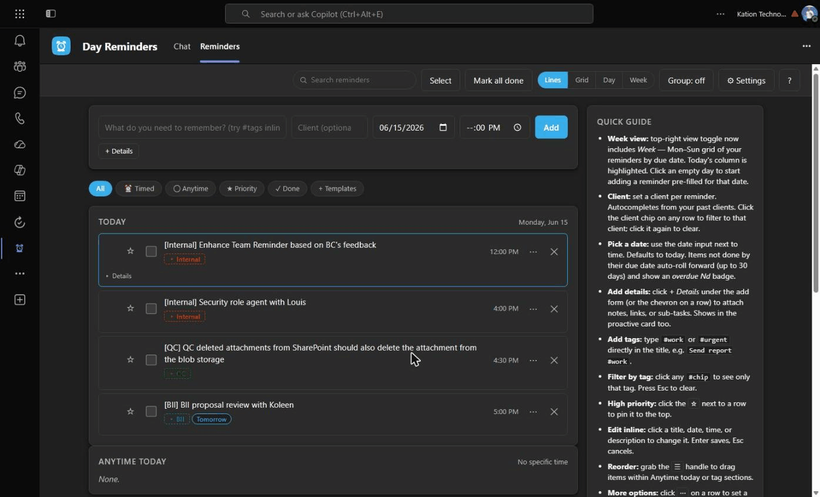
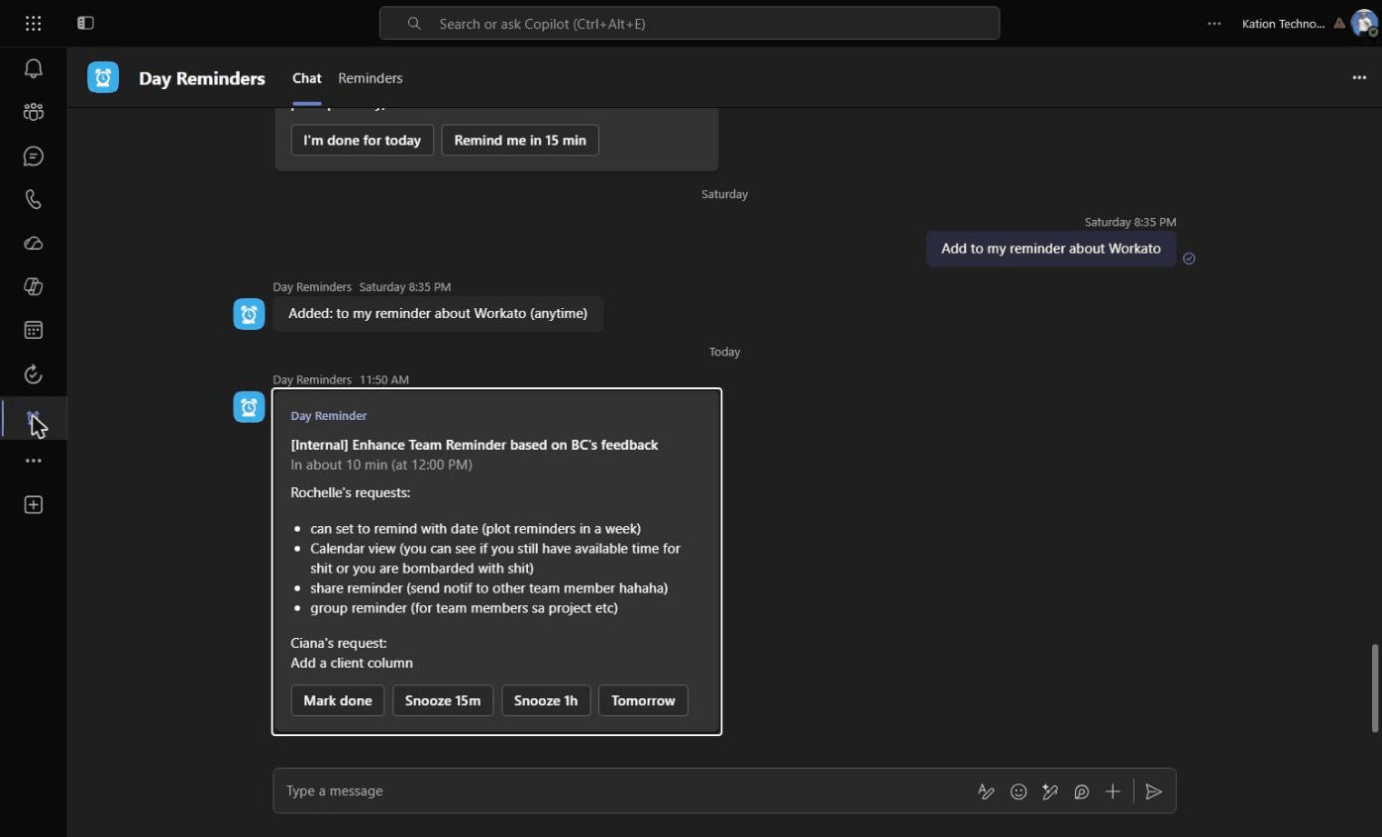
Find it in your Teams left rail.
Alarm-clock icon in the rail. → Two top tabs: Reminders (the UI) and Chat (where the bot pings you).
Day Reminders v1.4.6

Slide 4
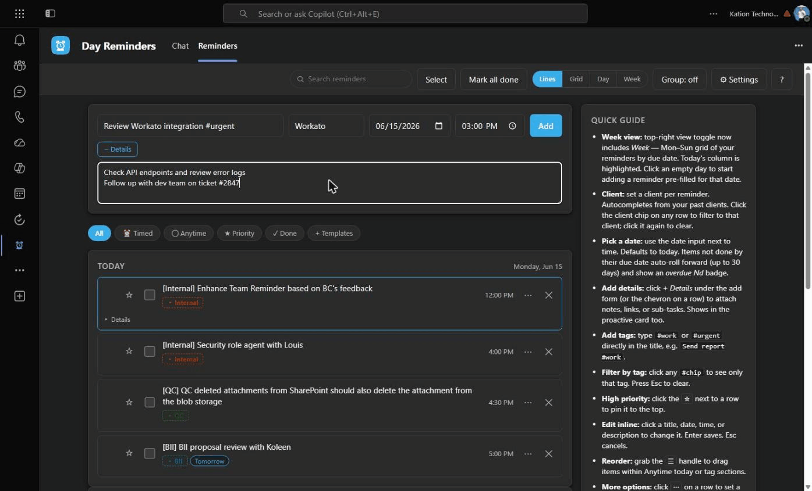
Adding a reminder.
Title · Client (autocompletes from your past) · Date (defaults to today) · Time (optional) · + Details for notes / links / sub-tasks
Day Reminders v1.4.6

Slide 5
Three ways to add one.
1
In the tab
2
Mid-conversation
3
In the bot chat
for thoughtful adding
for when you remember while replying
for typing-fast moments
Fill the form at the top of the Reminders tab — title, client, date, time, details. Hit Add.
Click the · · · under any Teams message box → Day Reminders → Quick add reminder. Type, submit, back to your reply.
/add 5pm tomorrow #qc Review batch 14
Dates can be tomorrow, mon, fri, 6/20, or a full YYYY-MM-DD.
Day Reminders v1.4.6

Slide 6
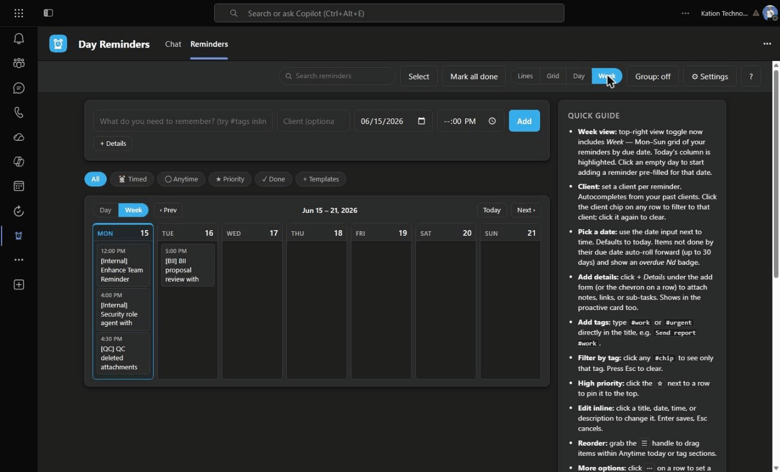
Am I bombarded this week, or free?
Mon–Sun grid by due date. Today's column highlighted. Click any empty day to add for that date.
Day Reminders v1.4.6

Slide 7
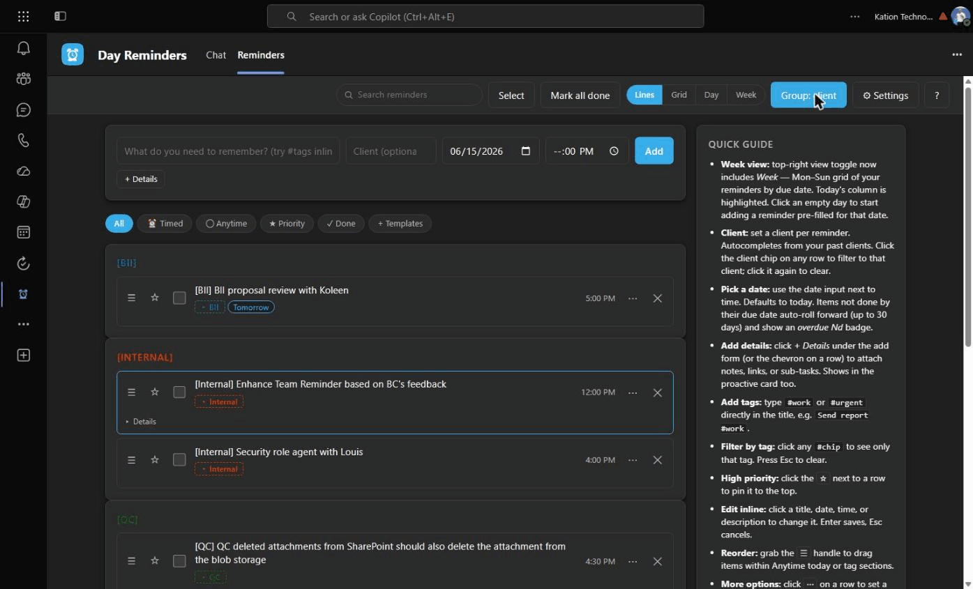
Group by client. Or tag. Or just leave it flat.
The Group toggle cycles off → tag → client. Sections per group, each header colored to match. Click any chip to filter to just that one.
Day Reminders v1.4.6

Slide 8
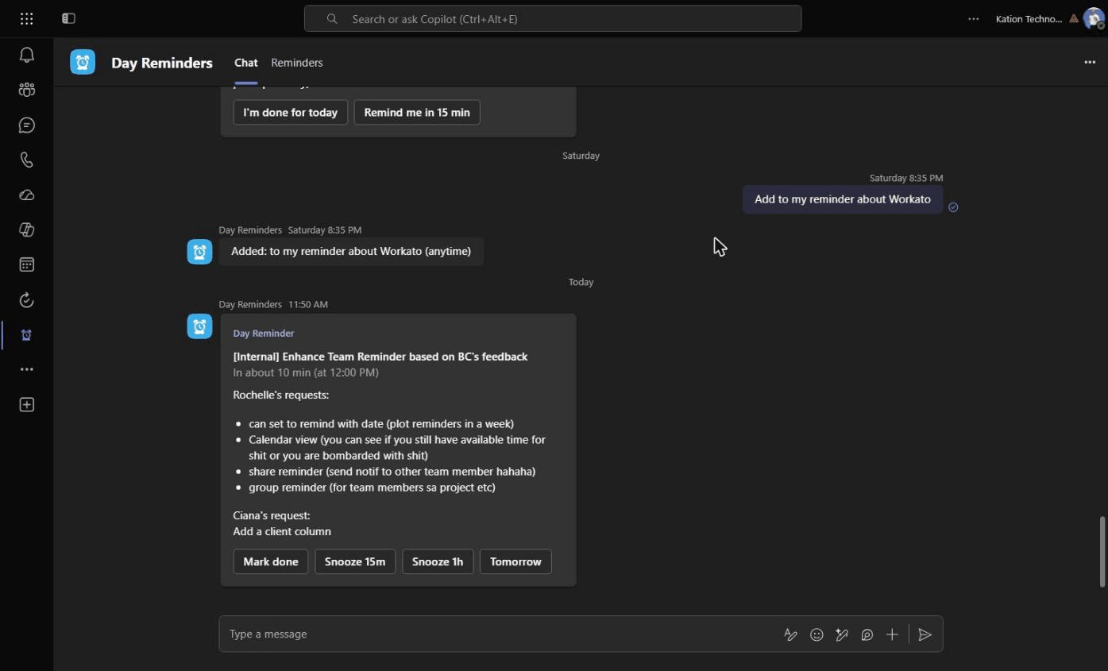
When it's due, a card pops in your chat.
Mark done. Or snooze 15m, 1h, Tomorrow. End-of-day check-in lists anything still open.
Day Reminders v1.4.6

Slide 9
Try it now.
Alarm-clock icon in your Teams left rail.
COMING NEXT
v1.5 · Sharing.
Assign reminders to teammates. Set per-tag default share lists so #QC auto-shares with the QC team without picking recipients each time.
Bugs, requests, 'this is annoying' → ping Josh, or drop them in the team channel.

