Slide 1
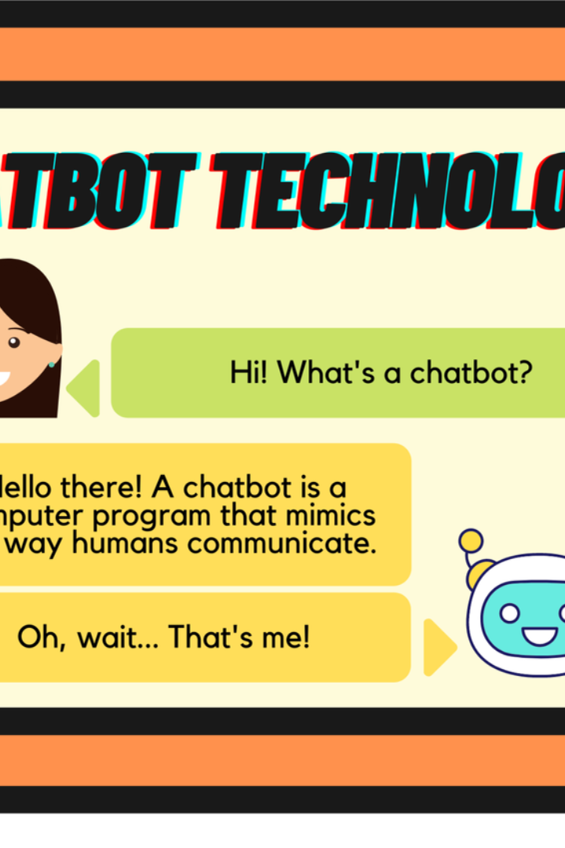


AI-Legal Assistant using Rasa Chatbot
The AI-Legal Assistant using Rasa Chatbot is an innovative application that integrates natural language processing (NLP) and machine learning to offer legal support through conversational language. Developed to enhance accessibility, it aims to streamline the process of obtaining legal information and assisting with legal issues.
by 015-Roshan Mundekar

Slide 2

Enhancing Legal Services
User Interaction
Intuitive Technology
Users can interact with a virtual assistant through conversational language for legal support and guidance.
The technology utilizes advanced language understanding capabilities to comprehend user queries related to legal issues.
Access to Legal Resources
Empowers individuals with a user-friendly tool to navigate the complexities of the legal landscape.

Slide 3

Transformative Impact
1
Democratizing Legal Resources
2
Bridging the Gap
It offers an innovative solution to bridge the gap between individuals and legal knowledge through the seamless integration of Rasa chatbot technology.
The project aims to democratize access to legal resources and information, making legal assistance more readily available to a broader audience.

Slide 4
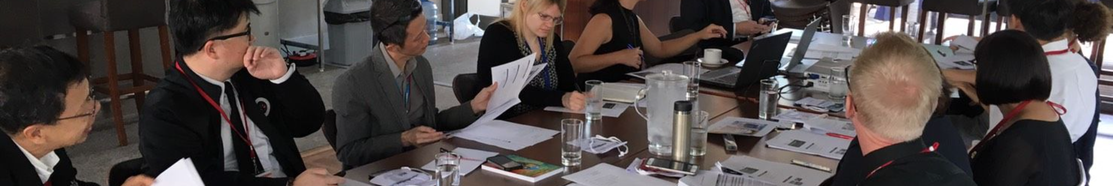
Empowering Legal Professionals
1
Language Processing
Utilizes natural language processing and machine learning technologies.
2
Advanced Understanding
Comprehends user queries related to legal issues.
3
Accessibility
Enhances accessibility and efficiency of legal services.

Slide 5
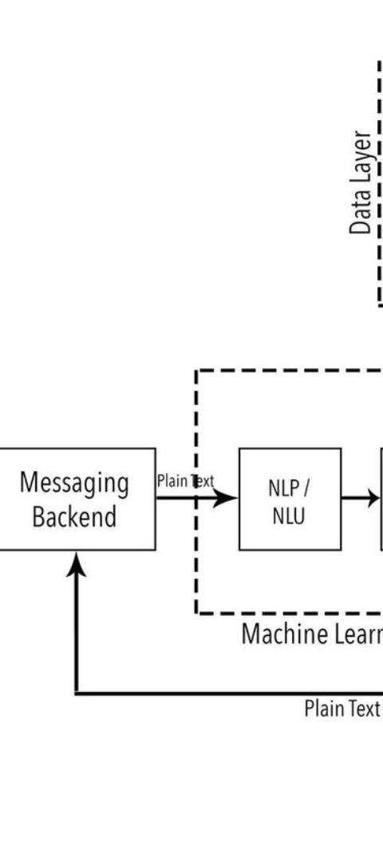
User-Friendly Interface
Conversational Interaction
Instant Assistance
Allows users to interact with a virtual assistant using conversational language.
Provides relevant information and even preliminary legal advice.

Slide 6
Artificial Intelligence in the Legal Field
24x7
Efficient
24/7 Accessibility
Efficient Services
The AI-Legal Assistant offers round-the-clock access to legal support and assistance.
Streamlines the process of obtaining legal information.

Slide 7
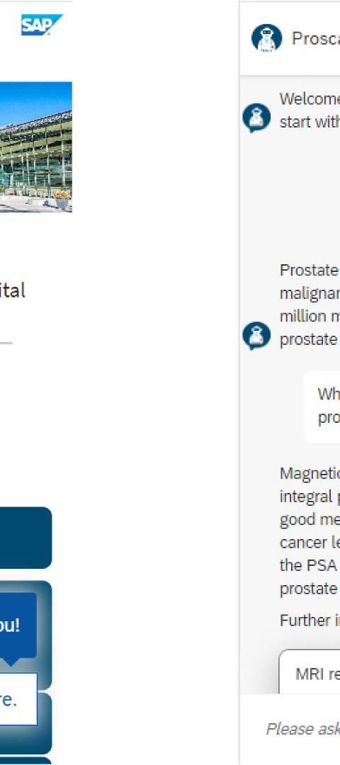



Seamless Integration
Virtual Assistant
Users can interact seamlessly with a virtual assistant for legal guidance.
Legal Knowledge
The system bridges the gap between individuals and legal knowledge.
Accessibility
Offers accessibility to legal resources and information for a broader audience.

Slide 8
Expert Legal Guidance
Comprehensive Support
Empowers individuals with enhanced access to comprehensive legal support.
Efficiency
Streamlines the process of obtaining legal information and advice.
Accessibility
Makes legal assistance accessible to a wider audience.

