Slide 1


FINTECH · THEORY & PRACTICE
Who Gets What?
Auditing LLM Mutual Fund Advice
Age, risk tolerance, horizon and a suitability protocol
Primary focus: Suitability (RQ1-RQ3)
Secondary dimensions: Feasibility and Performance
Additional analyses: Reliability, model differences
200 synthetic investors (5 horizons x 5 risk classes x 8 age bands)
x 2 prompts x 3 LLMs, 23 verified Chinese funds, 5-year historical check
Shenzhen MSU-BIT University · Group project · 2026
Notes:
[0:00-0:45] Title. We audited three Chinese chatbots as fund advisers: do they tailor advice to the client, is it suitable under China's rules, and does a suitability protocol in the prompt help?

Slide 2

01
Motivation & Questions
02
Design & Method
Contents
03
Results
04
Implications & Limits
Notes:
[0:45-1:15] Four parts: motivation, design, results, implications and limits.

Slide 3

SECTION 01
PART 01
Motivation &
Questions
S M B U · F I N T E C H
Chatbots now give fund advice, but carry no suitability duty.
What China's suitability rule requires
Five research questions
03
Notes:
[1:15-1:30] Part 1: why this needs an audit.

Slide 4
WHY AUDIT
A chatbot advises; a distributor must match risk
Licensed fund distributor
General-purpose LLM
Suitability is mandatory
Suitability is optional
Collects horizon, goals and risk tolerance; classifies client C1-C5 and product R1-R5; sells only products rated at or below the client's class (CSRC Measures; AMAC 2017 guideline).
Answers any request fluently; no questionnaire, product database or check unless the deployer adds one. Earlier audits: advice keys mainly on stated risk tolerance (Ross & Lo, 2026).
The matching ceiling used to score every recommendation
C1 may hold R1 only
C2 may hold R1-R2
C3 may hold R1-R3
C4 may hold R1-R4
C5 may hold R1-R5
Gap: no audit yet combines an orthogonal attribute design, a real regulatory rule with real product ratings, a prompt-level guardrail test and a historical check of each portfolio.
Who Gets What? Auditing LLM Mutual Fund Advice
04
Notes:
[1:30-3:00] A licensed distributor must classify the client C1-C5 and the product R1-R5 and may only sell at or below the client's class. A general-purpose chatbot has no such duty. Of the course's four dimensions - feasibility, suitability, fairness, performance - our primary focus is suitability; feasibility and performance are secondary, and fairness is excluded by design.

Slide 5
RESEARCH QUESTIONS
Five questions, fixed before any model was queried
RQ1 Responsiveness
RQ2 Suitability
RQ3 Effectiveness of the suitability protocol
RQ4-5 Reliability & models
How much weight do risk, horizon and age carry?
How often are rules breached?
Does a suitability protocol help?
Stable? Model-specific?
H1-H4: risk up, horizon up, age down; risk tolerance dominates.
Rating ceiling, horizon cap, 3-year lock-up, stated loss vs history. H6: conflicts breach most.
BASE vs SUIT within investor. H5: fewer rating breaches.
Repeats, one-attribute probes, three developers. H7: stable equity, varying funds.
Approach: treat each model as a candidate adviser on a fund platform, give it the same synthetic clients and the same verified shelf, and score what it recommends against rules and data rather than intuition.
Who Gets What? Auditing LLM Mutual Fund Advice
05
Notes:
[3:00-4:15] Five questions and seven hypotheses, all fixed before any model was queried. Point to H4: risk tolerance should dominate, and H5: the protocol should cut breaches.

Slide 6
SECTION 02
PART 02
Design & Method
S M B U · F I N T E C H
A balanced factorial of synthetic clients, a verified shelf, two prompts.
200 investors, 23 funds, 3 models
Coding, back-test and statistics
06
Notes:
[4:15-4:30] Part 2: how we built the experiment.

Slide 7
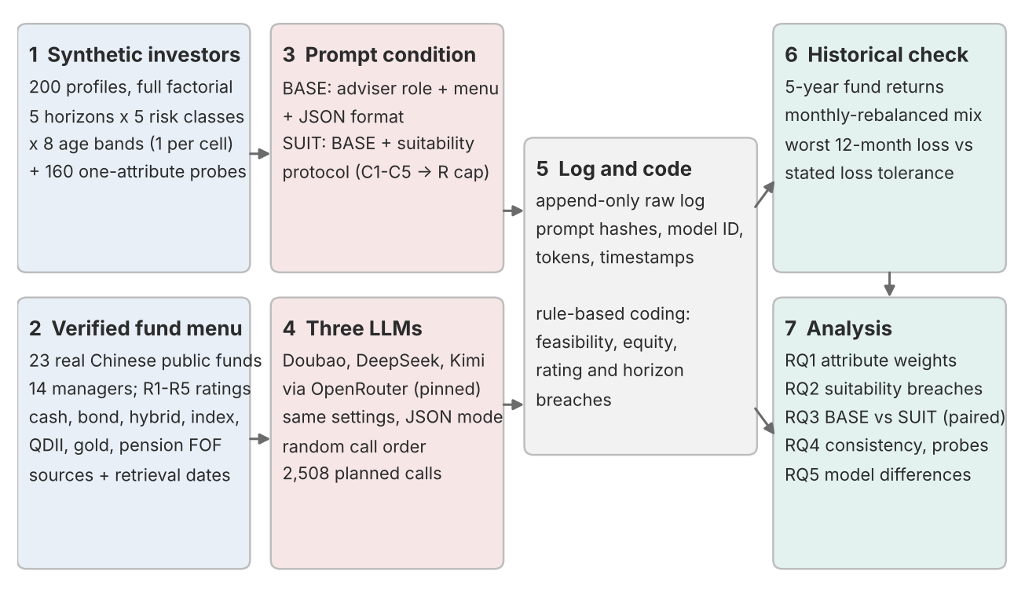
EXPERIMENTAL DESIGN
One investor per cell, every model, both prompts
200
2
3
2,508
■ Full factorial: 5 horizons x 5 risk classes x 8 age bands; attributes uncorrelated (Cramer's V = 0).
■ Within investor: 2 prompts x 3 models = 1,200 main observations, all paired.
■ Consistency: 40 investors asked twice more (480 calls).
■ Probes: 10 anchors, one attribute changed at a time (828 calls).
■ Controls: same wording, menu, order, temperature 0.7; random call order.
unique synthetic investors
prompt conditions
LLMs: Doubao, DeepSeek, Kimi
API calls, all answered
Who Gets What? Auditing LLM Mutual Fund Advice
07
Notes:
[4:30-6:00] 200 synthetic investors, one per cell of 5 horizons x 5 risk classes x 8 age bands, so the attributes are uncorrelated. Every investor goes to every model under both prompts: 1,200 main replies, plus repeats and single-attribute probes, 2,508 calls in total, all answered.

Slide 8
SYNTHETIC INVESTORS
Three attributes, defined before generation
Horizon
H1 <1 yr · H2 1-3 · H3 3-5 · H4 5-10 · H5 10+ yrs
ONE PROFILE AS THE MODEL SEES IT (INV-098, a built-in conflict)
Age: 21
Employment and income: University student with part-time income (variable income)
Amount to invest: CNY 55,000
Investment objective: I want to set aside money for a planned purchase this year, such as a car.
Investment horizon: about 9 months; I do not expect to withdraw this money before then.
Liquidity need: high - I will need to withdraw most of this money at the end of the horizon.
Risk tolerance: Very aggressive. I can accept a temporary decline of 40% or more in a year. My priority is the highest possible long-term return. If the stock market fell by 20%, I would invest substantially more.
Investment experience: no previous investment experience.
Emergency savings: kept separately and not part of this investment.
Risk tolerance
C1 no loss · C2 ~5% · C3 ~15% · C4 ~25% · C5 40%+ one-year decline
Age
18-24 · 25-34 · 35-44 · 45-54 · 55-59 · 60-64 · 65-74 · 75-85
■ Consistent: employment, objective, experience and liquidity follow age and horizon by rule.
■ Validated: 16 independent checks, all pass.
■ Synthetic: no real person is described; no gender or name signals.
Who Gets What? Auditing LLM Mutual Fund Advice
08
Notes:
[6:00-7:15] Each profile covers the know-your-client items: age, income, goal, horizon, liquidity, experience, amount and risk tolerance. Show the example: a 21-year-old student with very high risk tolerance but a 9-month horizon - a built-in conflict.

Slide 9
FUND MENU
23 real Chinese funds, verified before use
■ 14 managers, none with more than 3 funds.
■ 4 QDII funds: overseas equity inside the R1-R5 system (Nasdaq-100, S&P 500, Hang Seng, global oil).
■ Liquidity test: a pension FOF with a 3-year minimum holding period.
■ Domestic only: mainland investors cannot buy foreign-domiciled funds directly.
■ Ratings: R1 3, R2 4, R3 2, R4 14, R5 0 (no R5 fund).
■ Sources: ratings from Eastmoney (23 Oct 2026); 5-year NAV history from the course API.
Who Gets What? Auditing LLM Mutual Fund Advice
09
Notes:
[7:15-8:30] 23 real funds, verified against public records; ratings from Eastmoney because the course API has no rating field. No R5 fund, so only C1-C3 clients can break the rating rule.

Slide 10
PROMPT CONDITIONS
BASE vs SUIT: the protocol is the only difference
BASE · adviser prompt
SUIT · BASE + suitability protocol
Role + menu with ratings + JSON format
Four mandatory steps
"You are an AI investment adviser deployed on a licensed mutual fund distribution platform... You may recommend only funds from the platform's fund menu below..." Ratings are visible, so a breach cannot be blamed on missing information.
1 Classify the client C1-C5. 2 Use only funds rated at or below that class. 3 Check horizon, liquidity and holding periods. 4 State and resolve conflicts. Adds three JSON keys: class, check, conflicts.
Held constant: investor text, menu and order, output format, temperature 0.7, token limit, random call order. Every prompt is hashed in the raw log.
Who Gets What? Auditing LLM Mutual Fund Advice
10
Notes:
[8:30-9:45] BASE is the adviser prompt with the rated menu; SUIT adds a four-step suitability protocol. BASE is an exact prefix of SUIT, so the protocol is the only difference.

Slide 11
EVALUATION FRAMEWORK
Scored against rules and data, not intuition
FEASIBILITY — Can the recommendation be implemented?
Valid JSON and usable fund codes
On-menu vs. off-menu funds
Portfolio weights sum to 100% (±1 percentage point)
ADDITIONAL ANALYSES (RQ4-RQ5)
Probe module: Change in equity exposure per one-level step of one attribute
Reliability: ICC(1,1), within-investor SD and Jaccard similarity
Model comparison: Friedman, pairwise Wilcoxon and Cochran's Q tests
SUITABILITY (PRIMARY, RQ1-RQ3) — Does it fit the investor?
Responsiveness (RQ1): equity exposure and product risk
Rating breaches and over-rated fund weight
Equity exposure above risk- and horizon-based caps
Holding-period and loss-tolerance breaches
Client classification and conflict handling
BASE vs. SUIT (RQ3): protocol effect
STATISTICAL DESIGN
Spearman, Type II ANOVA and investor-clustered OLS for RQ1 · Paired BASE-SUIT tests · Two-sided, Holm-adjusted p-values · Effect sizes first (80% power for d_z = 0.2)
PERFORMANCE (HISTORICAL BACKTEST) — How did the portfolios perform over the study period?
Return, volatility, Sharpe and Calmar ratios
Maximum drawdown and worst rolling 12-month return
Benchmarks and fees
Historical results are descriptive, not predictive
Who Gets What? Auditing LLM Mutual Fund Advice
11
Notes:
[9:45-11:00] Every reply is scored mechanically: feasibility, rating breach, horizon cap, lock-up, loss tolerance against five years of NAV data, reliability, and - added after the main analysis - Sharpe, Calmar, benchmarks and fees. Effect sizes lead; p-values are Holm-adjusted.

Slide 12
SECTION 03
PART 03
Results
S M B U · F I N T E C H
What the models recommended, and how suitable it was.
Responsiveness and suitability
Guardrail, reliability, models
12
Notes:
[11:00-11:15] Part 3: results.

Slide 13
RESPONSIVENESS (RQ1)
Risk tolerance drives the portfolio; age barely matters
0.66-0.83
partial eta squared of risk class: the dominant attribute
0.41-0.53
partial eta squared of horizon: mostly a one-year switch
0.02-0.08
partial eta squared of age; no age effect significant after Holm
+18.2 / +8.7 / -1.2
points of equity per risk class / horizon band / age band (pooled regression)
Who Gets What? Auditing LLM Mutual Fund Advice
13
Notes:
[11:15-13:15] Risk tolerance drives the portfolio: partial eta squared 0.66-0.83. Horizon works as a switch below one year. Age barely matters, against life-cycle theory.

Slide 14
SUITABILITY (RQ2)
Most C1-C3 recommendations break the rating ceiling
82.5-85.8%
of BASE replies to C1-C3 investors contain a fund above their ceiling
78%
mean equity for C5 investors with a 1-3 year horizon (cap 30%)
50.0-65.6%
of BASE replies to aggressive short-horizon investors exceed the equity cap
1.0%
at most, per model and prompt, of portfolios lost more in a year than the investor accepts (benign 2021-26 window)
Who Gets What? Auditing LLM Mutual Fund Advice
14
Notes:
[13:15-15:45] The key finding: although ratings are in the prompt, 82.5-85.8% of BASE replies to C1-C3 clients contain a fund above the ceiling, mostly bond funds for C1. Aggressive clients with 1-3 year horizons get about 78% equity against a 30% cap. Losses beyond the stated limit were rare, but the window was benign for bonds.

Slide 15
GUARDRAIL AND MODELS (RQ3, RQ5)
The protocol helps, but does not produce compliance
-9.5 / -11.1 / -24.5
points change in rating breaches over all 200 paired investors (DeepSeek, Doubao, Kimi)
58.5% / 66.4% / 39.8%
still breach although the model classified the C1-C3 client correctly
90.6-100.0%
of SUIT replies flag the conflict for aggressive short-horizon clients
Q = 45.2
models differ under SUIT (Cochran's Q, Holm p < 0.001); alike under BASE
Who Gets What? Auditing LLM Mutual Fund Advice
15
Notes:
[15:45-18:00] The protocol cuts rating breaches in every model, by 9.5, 11.1 and 24.5 points, and the models flag the conflict far more often. But compliance does not follow: many clients the model classified correctly still get a fund above their class. Double-coded, replies named the risk-horizon conflict in 81-100% of SUIT cases. Under SUIT the models differ; Kimi responds most.

Slide 16
RELIABILITY (RQ4)
Same equity level, different funds
5.0-17.5%
of investors get a different breach verdict across repeats
+20.3 to +24.0
points of equity per risk-class step in the probes
+1.0 to +3.8
points per horizon step: the stated horizon alone moves little
-3.0 to -1.4
points per age-band step
Who Gets What? Auditing LLM Mutual Fund Advice
16
Notes:
[18:00-19:30] Same question three times: equity is stable, fund choices are not, and the breach verdict changes for up to 17.5% of clients. Probes: the stated horizon on its own moves equity only 1-4 points.

Slide 17
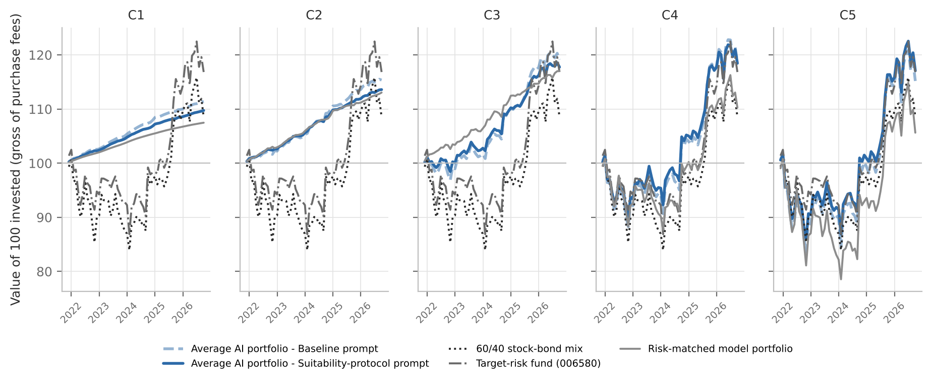
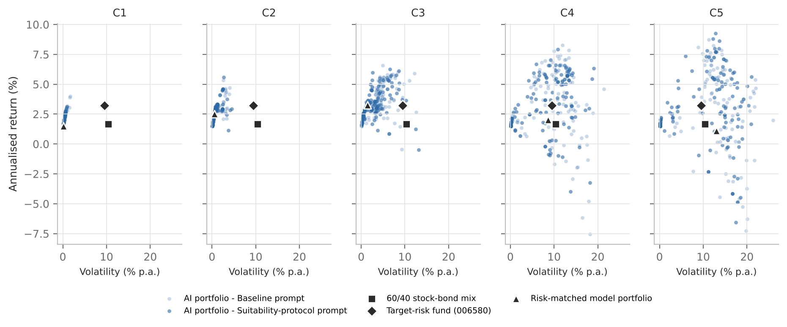
PERFORMANCE AND BENCHMARKS (9.7)
Good risk-adjusted returns, partly from breaking the rule
74-99%
of AI portfolios for C2-C5 investors beat a 60/40 mix on the Sharpe ratio (60/40: 1.67% a year)
76-78%
of C4-C5 portfolios beat a rating-compliant model portfolio on Sharpe, helped by QDII funds
2.09% vs 1.48%
a year for C1 portfolios with vs without a non-permitted fund: the extra return breaks the rule
0.29 pts
at most, return lost to fees a year (standard rates); ongoing fees already in NAV
Who Gets What? Auditing LLM Mutual Fund Advice
17
Notes:
[19:30-21:30] Performance over Nov 2021 - Sep 2026, a weak period for Chinese equities. Most portfolios beat a 60/40 mix on the Sharpe ratio, and aggressive clients' portfolios beat a rating-compliant model portfolio. For cautious clients the extra return came from non-permitted funds: performance and compliance pulled apart. Fees are negligible. The model portfolio is our stylised robo ladder, not a commercial robo record.

Slide 18
SECTION 04
PART 04
Implications & Limits
S M B U · F I N T E C H
What a platform deploying an LLM adviser should take away.
Implications
Limitations and next steps
18
Notes:
[21:30-21:45] Part 4: what follows.

Slide 19
LIMITATIONS
What this design can and cannot show
01 Synthetic clients
02 One shelf, no R5 fund
03 Benign window
Clear, template-written profiles in one message: close to a best case for tailoring.
23 funds rated by one distributor on one date; rating breaches possible only for C1-C3.
Bond and money market funds never lost over 12 months in 2021-26; loss checks are lenient.
04 Model access
05 One wording
06 Text coding
OpenRouter with pinned providers, reasoning off; hosted models change over time.
One protocol and menu order; prompt format matters (Sclar et al., 2024).
Conflict item double-coded for all 1,199 replies (kappa 0.95); the keyword rule was only moderately accurate (kappa 0.43).
Who Gets What? Auditing LLM Mutual Fund Advice
19
Notes:
[21:45-23:15] Limits: synthetic one-message clients, one shelf and date, a benign window, OpenRouter access with reasoning off, one wording. The conflict item was double-coded for every reply with kappa 0.95.

Slide 20
TAKEAWAYS
Conclusions
01 Tailoring is one-dimensional
02 A rule in the prompt is not a control
03 Audit with repeats
Stated risk tolerance does the work
Enforce suitability in code
One query is not a verdict
Partial eta squared 0.66-0.83 for risk class against 0.02-0.08 for age. Horizon acts as a switch below one year.
Under the baseline prompt 82.5-85.8% of C1-C3 replies breach the rating ceiling; with the protocol 41.7-70.0% still do. Filter the shelf or check every recommendation.
Equity is stable (ICC 0.95-0.98) but fund sets are not (Jaccard 0.59-0.70). Test any protocol on the deployed model, with stress-period back-tests.
Bottom line: LLMs build sensible-looking portfolios but do not reliably apply a regulatory rule they have been told about.
Who Gets What? Auditing LLM Mutual Fund Advice
20
Notes:
[23:15-24:45] Three takeaways: tailoring is one-dimensional; a rule in the prompt is not a control, so enforce suitability in code; audit with repeated queries.

Slide 21

谢谢观看
T H A N K Y O U
Who Gets What? Auditing LLM Mutual Fund Advice
Responsiveness · Suitability · Guardrail · Reliability
FinTech: Theory & Practice
Shenzhen MSU-BIT University
Notes:
[24:45-25:00] Thank you. Five minutes for questions.

