Slide 1
How can creativity be impacted by binaural beats Saurabh Rao,Avinash Bobba Department of Computer Sciences,Institute of Technology. Gandhi Institute of technology and management, Visakhapatnam, India.

Slide 2
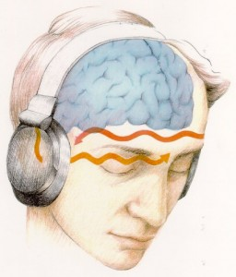
What are binaural beats
The sensation of auditory binaural beats occurs when two coherent sounds of nearly similar frequencies are presented one to each ear with stereo headphones or speakers.

Slide 3
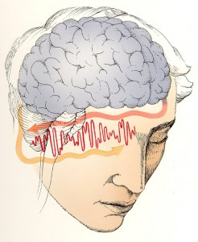
The brain integrates the two signals, producing a sensation of a third sound called the binaural beat.
For example, if a frequency of 100 Hz is played in one ear and 107 Hz is played in the other ear, a binaural beat of 7 Hz is created by the brain.
Brain waves match or “follow” the binaural beat. If the binaural beat is 7 Hz, an increase in brain waves of 7 Hz occurs.

Slide 4
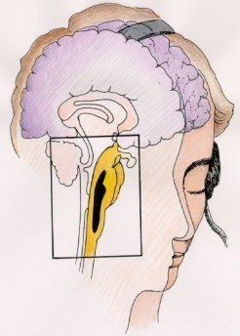
Binaural beats originate in the brainstem's superior olivary nucleus, the site of contralateral integration of auditory input.

Slide 5
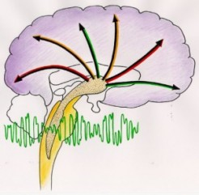
The binaural beat is neurologically conveyed to the reticular formation which uses neurotransmitters to initiate changes in brainwave activity.

Slide 6
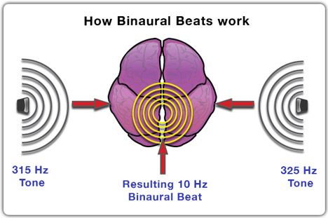
Brain Waves & Consciousness Beta (13-56 Hz) Alert concentration and problem-solving Alpha (8-13 Hz) Alert relaxation Theta (4-7 Hz) Deep relaxation and increased learning Delta (1-3 Hz) Deep sleep

Slide 7
Details about the subjects

Slide 8
Twenty one students belonging to the Computer sciences department of Gandhi Institute of Technology and management were considered for this study as subjects( 16 male, 5 female ). All of the subjects had eyesight that was normal or was corrected to normal. The subjects had no history of hearing loss of any kind. The subjects were explicitly asked if they had ever experienced any issues with regard to their neurological or psychological health, to which all the subjects replied in the negative. All the participants were tested between 1 PM and 4 PM on the same day, to ensure a lesser variation in the fluctuating mood patterns,neural pathway interaction and other variables.

Slide 9
The participants were exposed to two kinds of auditory stimuli. The first one was the stimuli for the adaptation of the subject’s ears to the auditory stimuli, which consisted of a binaural beat of frequency 350 Hz. After the subject had demonstrated the ability to listen to the 350 Hz stimulus, the gamma frequency (44 Hz) binaural beat stimuli was introduced. The order in which the subjects answered the questions was determined to be constant. In the session, the participant would complete the same tasks in the same order. The items chosen by the subjects was left to their descretion, to ensure results for questions that the subjects were most comfortable with.

Slide 10
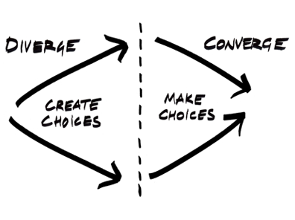
Convergent and divergent thinking

Slide 11
Question one
What you have to do in this activity is simple . A picture has been given to you below . Extend the picture in whatever manner you feel is creative. You can transform these lines into a drawing of your choice . Feel free to get as creative as possible !
Divergent thinking

Slide 13
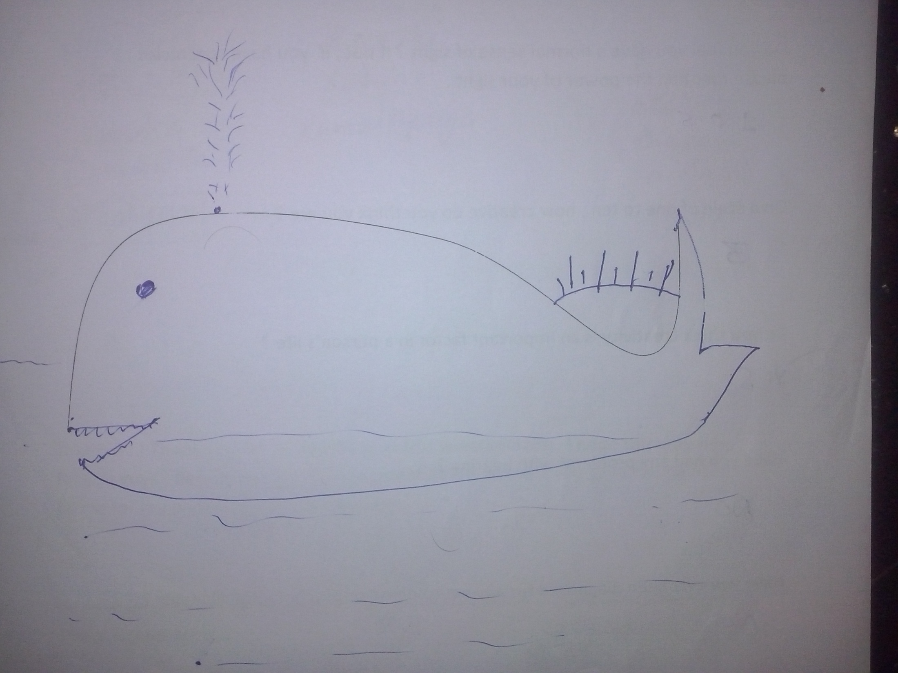

Slide 14
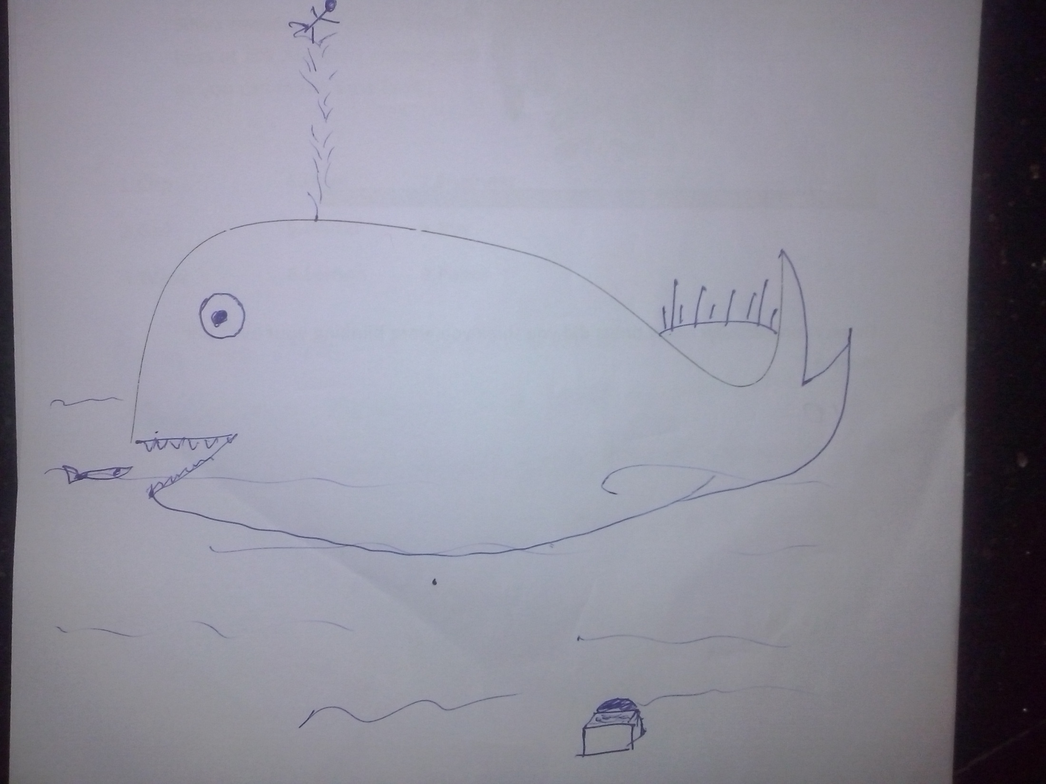

Slide 15
Question two
In this exercise , you will be given a random set of words . What you have to do is this :
Select ONE word of your choice .
Think of as many associations as you can . For example , if the word “phone” is given , this is how your thought process might work – Okay so we can CALL from a phone . We can do this because it has a SIM. Hmm , what does a sim card have in it ? ALUMINIUM ? is that SILVER in color ? Silver reminds me , is that what JEWELLERY is made of ? My mom bought hers at JOY ALLUKAS ... so on and so forth . Think and write about as much as you can in the time limit .
Divergent thinking

Slide 16
Question three
As you have noticed , I have mentioned a group of words . The idea here is to form a paragraph with these given set of words . Try to use as many of the words as you can to form a paragraph \ story that is meaningful !
fly,arrest,scan,bus,loan,bullet,island,bal,lphoto,feel,romance , seven,village,listen,wheel,simple,win,steel,man , biology,peace,paper, exercising.
Convergent thinking

Slide 17
Question four
Look at this picture for a minute or two . During this time ,concentrate on the picture . At the same time , try to focus on the number of times you are blinking your eyes .
Impact of auditory stimuli on thinking

Slide 18


Slide 19
Results

Slide 20
5.8 2, 5.35

Slide 21
14.61,14.90

Slide 22
10.42 , 10.61

Slide 23
11.90,9.90

Slide 24
Thank you !

Slide 25
Questions ?

