Slide 1
Variables used
NAME | TYPE
Song Name | String
Album Name | String
Position on Album | Integer
In Hot 100 Billboard | Categorical
Position | Integer
Year | Integer
Song length in seconds | Integer
BPM Value | Integer
Key | String
Sentiment | Integer
Category | Categorical
Word Count | Integer
Lyrics | String

Slide 2
Data gathering - Sources and Methods
VARIABLE | TOOL/LANGUAGE USED | PROCESS
Song Name, Album Name, Position on Album | Import.io | Wikipedia each album ; extract using import.io
In Top 100 Billboard , Position | Microsoft Excel | Import using import.io ; Position in Top 100 if in list.
Song Length | Python | Extract using urllib2 & lxml, convert from min to sec .
BPM Values | Import.io , Manual | Used import.io for 3 albums , rest manually.
Key | None | Manually
Sentiment | R | Compared lyrics with a set of +,- words
Lyrics | Import.io | Lyrics from princelyrics.co.uk . Scraped using import.io

Slide 3
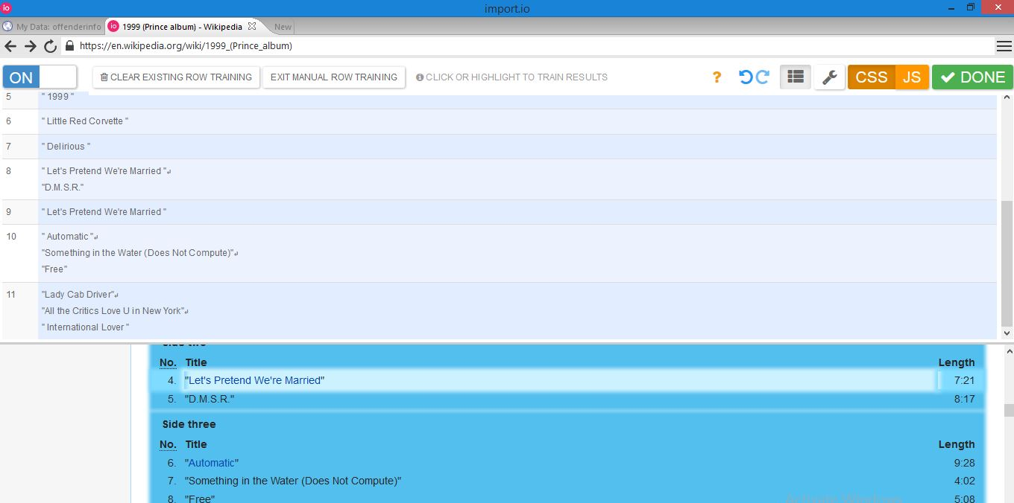

Slide 4
 | Predicted No | Predicted Yes
Actual No | 16 | 8 | 24
Actual Yes | 1 | 2 | 3
 | 17 | 10
Name | Value
Accuracy | 0.6666667
Misclassification Rate | 0.3333333
True Positive Rate | 0.6666667
False Positive Rate | 0.3333333
Specificity | 0.6666667
Precision | 0.2
Prevalence | 0.1111111

Slide 5
"Purple Rain"
I never meant to cause you any sorrow I never meant to cause you any pain I only wanted one time to see you laughing I only want to see you laughing in the purple rain Purple rain Purple rain Purple rain Purple rain Purple rain Purple rain I only want to see you bathing in the purple rain I never wanted to be your weekend lover I only wanted to be some kind of friend Baby I could never steal you from another It's such a shame our friendship had to end Purple rain Purple rain Purple rain Purple rain Purple rain Purple rain I only want to see you underneath the purple rain Honey I know, I know, I know times are changing It's time we all reach out for something new That means you too You say you want a leader But you can't seem to make up your mind I think you better close it And let me guide you to the purple rain Purple rain Purple rain Purple rain Purple rain If you know what I'm singing about up here C'mon raise your hand Purple rain Purple rain I only want to see you, only want to see you In the purple rain

