Slide 1
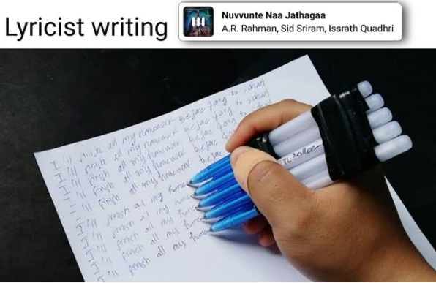
Ground truthing a meme – the average Sid Sriram song

Slide 2
Why : I saw a meme
Assumption : Sid Sriram’s songs have repeated words/lines
Questions :
Descriptive –composer/language/chronology preferences.
Quantitative – lyrical lexical richness (or lack of)
Qualitative – generating an average Sid Sriram song.

Slide 3
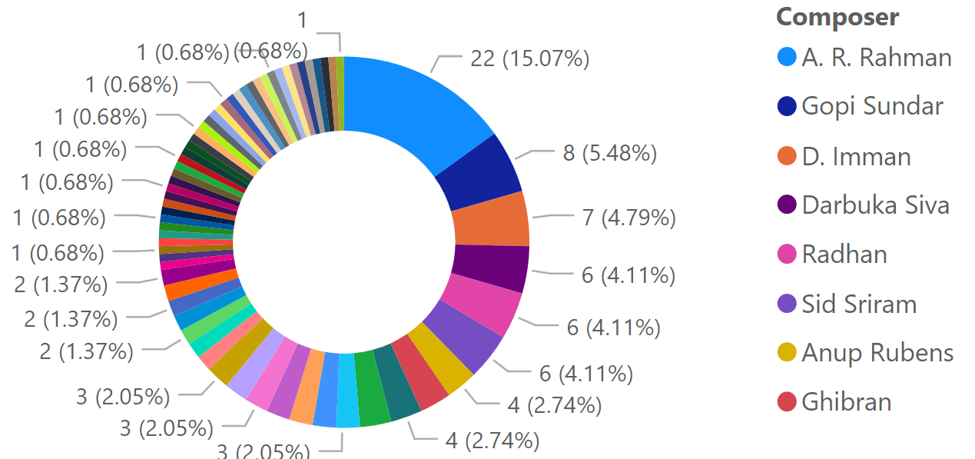
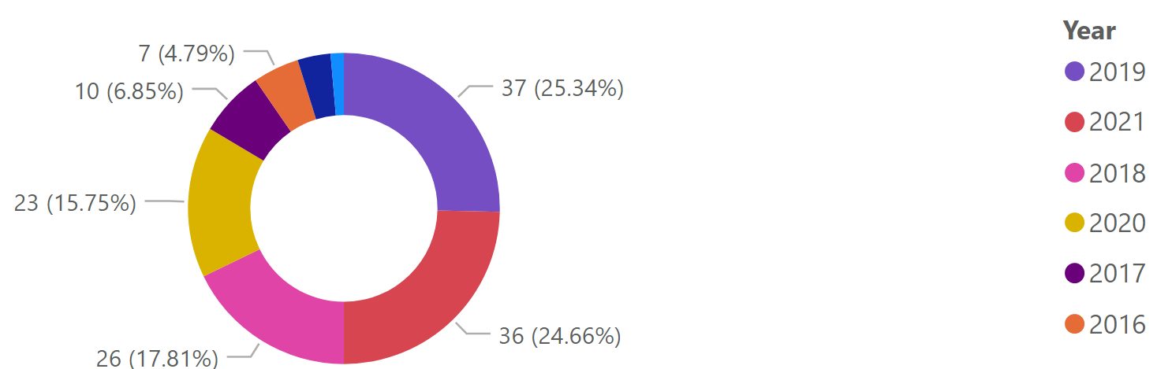
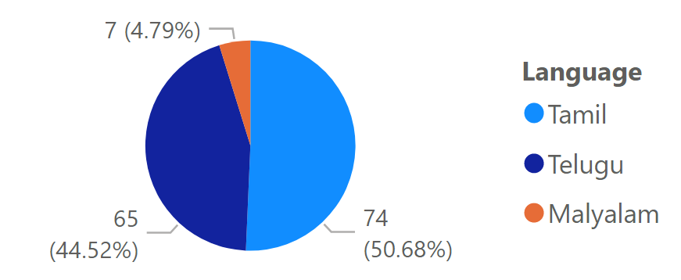

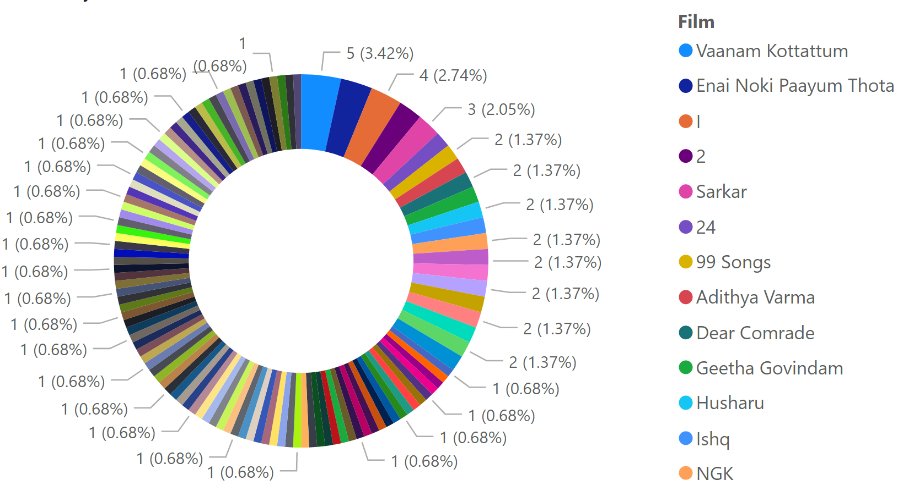
Obvious composer bias (heavy –ve skew) and mild movie bias (slight –ve skew)
YoY song count
Preference : Tamil > Telugu > Malyalam

Slide 4

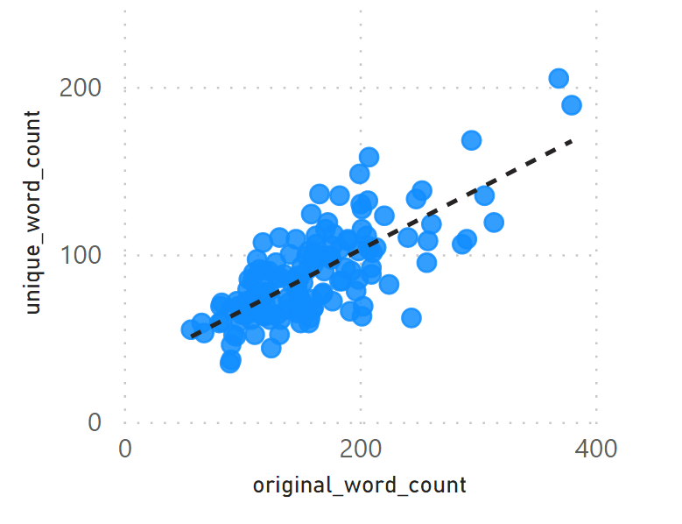
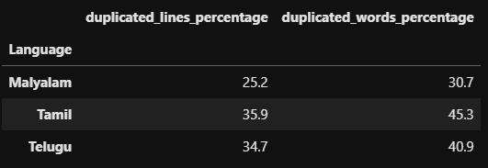
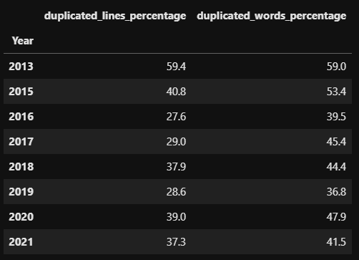
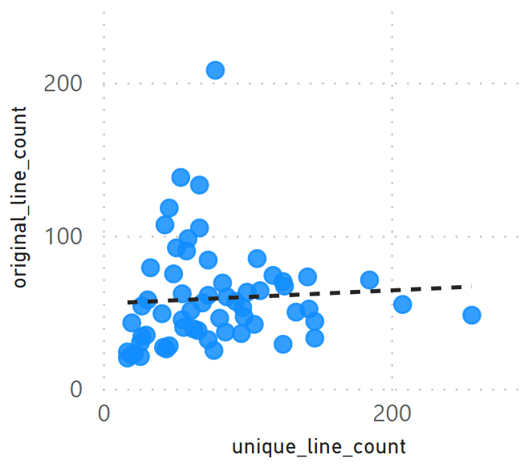

Slide 5
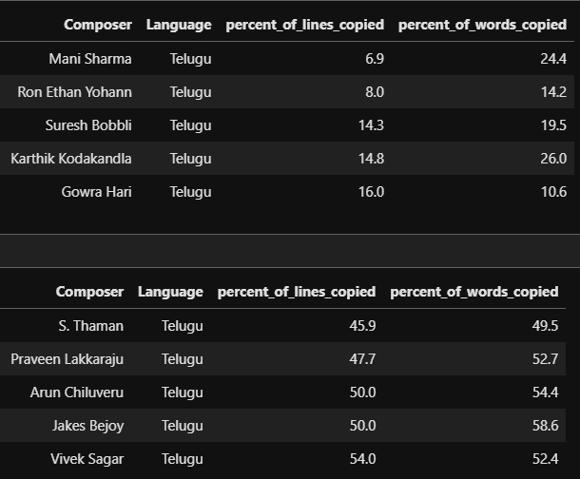
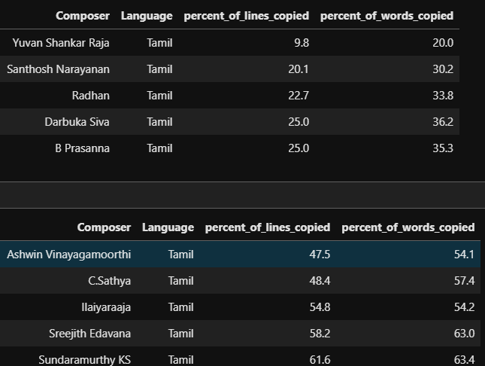
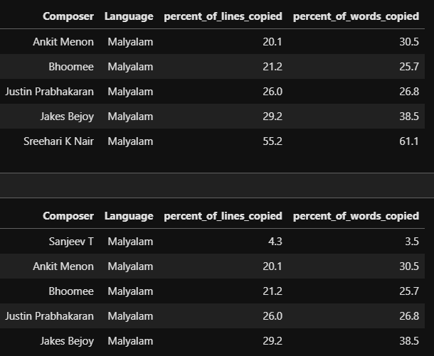

Slide 6
Plagiarism preference : Tamil > Telugu > Malyalam
~61% unique lines and ~55% unique words per song on average.
Plagiarism on a downtrend from 2013 to 2019,but ramps up from there on.
Most original Tamil composers : Yuvan Shankar, Santhosh Narayanan
Least original Tamil composers :Sundaramurthy KS , Sreejith Edavana
Least original Telugu composers :Vivek Sagar , Jakes Bejoy
Most original Telugu composers : Mani Sharma , Ron Ethan Yohann

Slide 7
An average statistically significant Sid Sriram song
(Telugu only, sorry)

Slide 8
Yadike yadike o chinani manasu
Jhum tanatana jhum tananana
Theeskelathaav neethopaate mellaga nanne
Maate vinaduga vinaduga vinaduga
Ee maya prememito emito
Nee valla ta ta thapum vegam
Nuvve ee maayo emo
Ne tadigina takajanu
Nuvvunte naa jataga nenunta oopiriga
Amma amma nee vennela
Nithyaam napai undaalilaa
Naa priyamau priyamau batteryve vidici vellipodde

