Slide 1
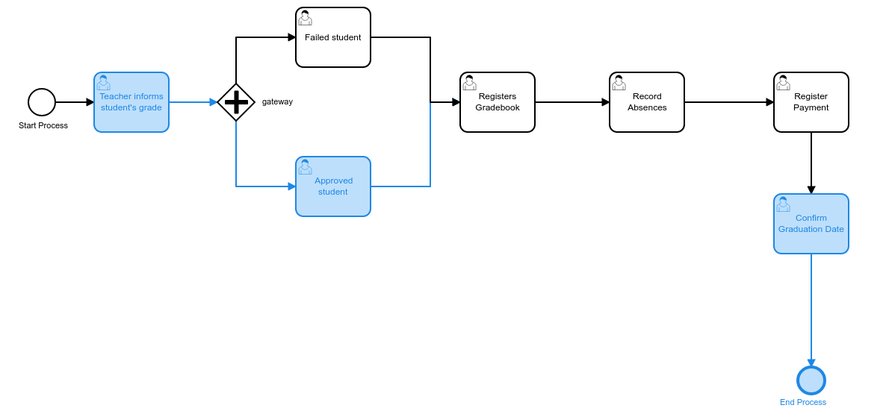
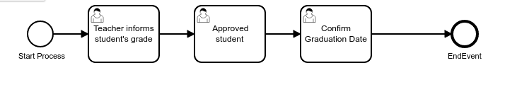
Sample
“Complex”
“Simple”

Slide 2
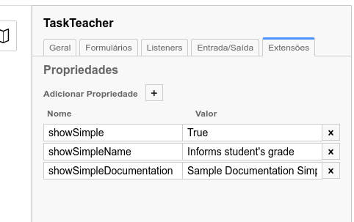
Sample
* New feature properties custom for modeler

Slide 3


Architecture Generate Simple BPMN
Camunda BPM Plataform
Deploy Class
Extension
(tomcat/lib)
Complex BPMN Deploy
Simple BPMN Deploy
Camunda Modeler
Extension
properties
Generate-simple-bpmn
class

Slide 4
Architecture Generate Simple BPMN
Camunda BPM Plataform
Complex BPMN Deploy
Simple BPMN Deploy
Faz Manual
java -jar gera-simples.jar
complex.bpmn simple.bpmn
Camunda Modeler
Extension
properties
Faz manual
Generate-simple-bpmn
class

Slide 5

Preview – Cidadão - SEI
Imprimir tarefas de MyProcess e também em
“Simple_MyProcess”

Slide 6
Obrigado
Fontes: https://github.com/ambientelivre/reverse-engineering-camunda-fluent
Contatos:
Marcio Junior Vieira
marcio@ambientelivre.com.br
https://www.linkedin.com/in/mvieira1/

