Slide 1
5- Rendering
Ordu, 12.05 – 16.05 2025

Slide 2
Render in Blender
Rendering is the process of generating a photorealistic or non-photorealistic image from input data such as 3D models.
Blender render engines = EEVEE, Cycles, Workbench
Freestyle

Slide 3
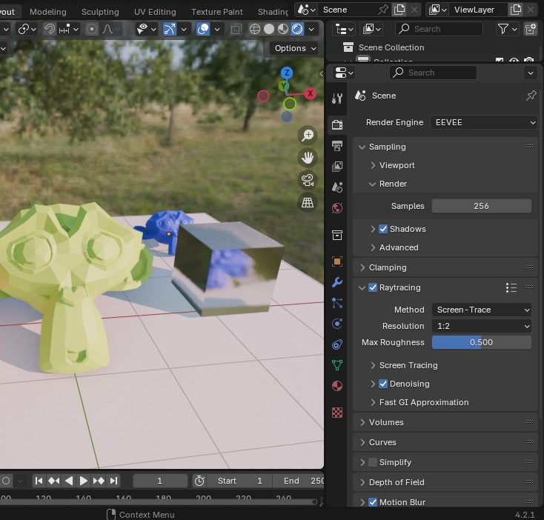
EEVEE tips
Light scene with HDRI
Increase samples
Check Raytracing
Check Motion Blur

Slide 4
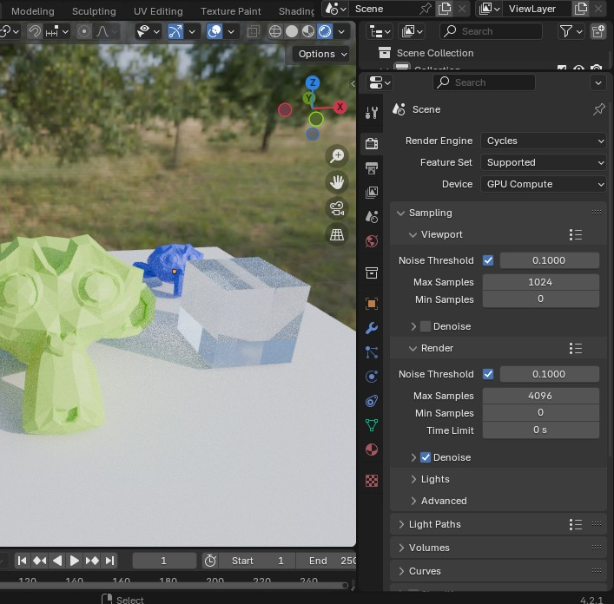
Cycles tips
Light scene with HDRI

Slide 5
Cycles tips
Light scene with HDRI
Enable GPU
Increase Noise (render) Threshold

Slide 6
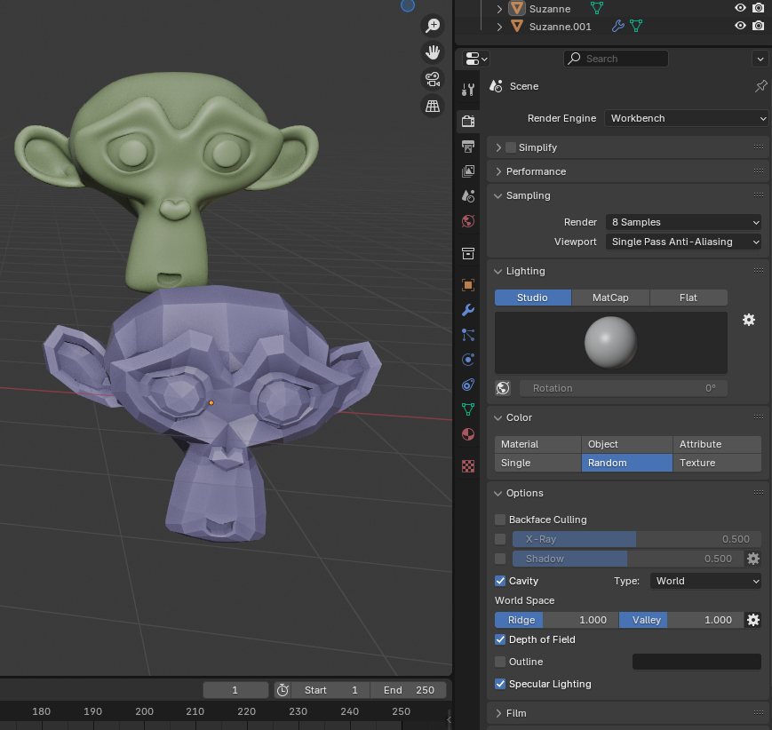
Workbench
Choose a Studio or MatCap lighting setup
Choose Material (need to set material settings) or Random
Check Cavity
Check Depth of Field (onfigure on camera settings)

