Slide 1
0- Introduction
Ordu, 12.05 – 16.05 2025

Slide 2
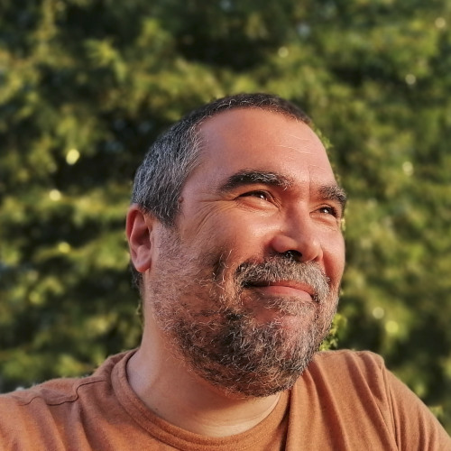
Me?
nafergo@gmail.com
https://nafergo.github.io

Slide 3
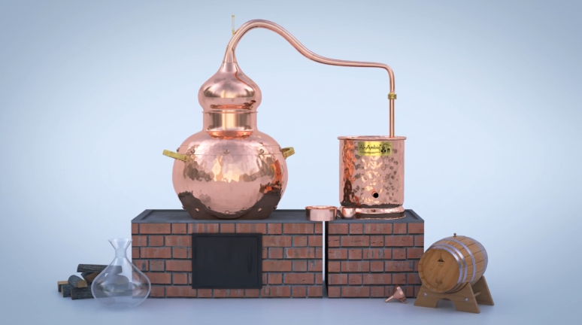
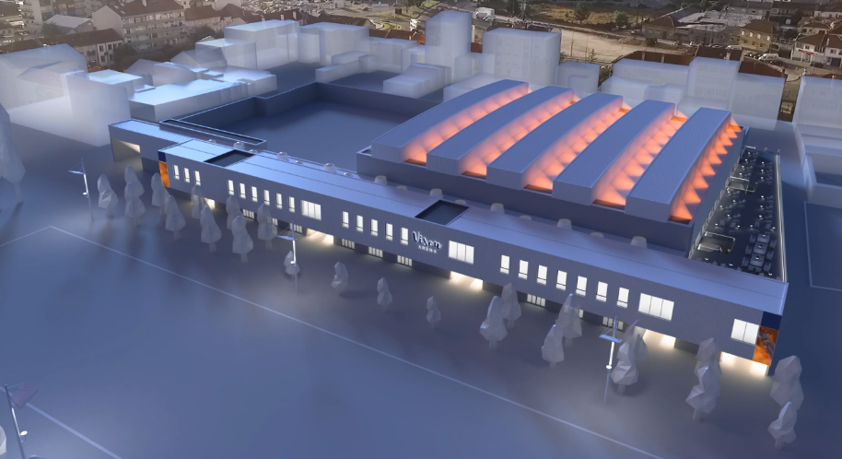
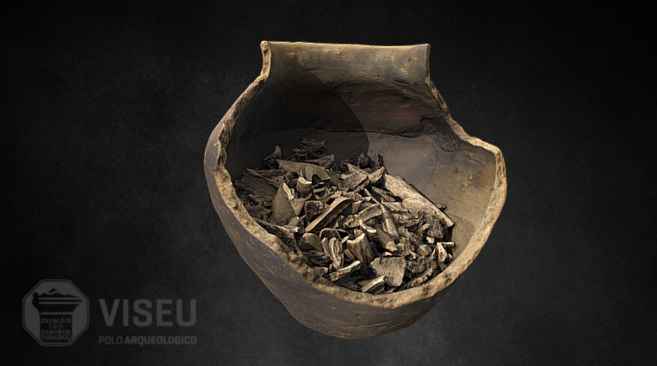
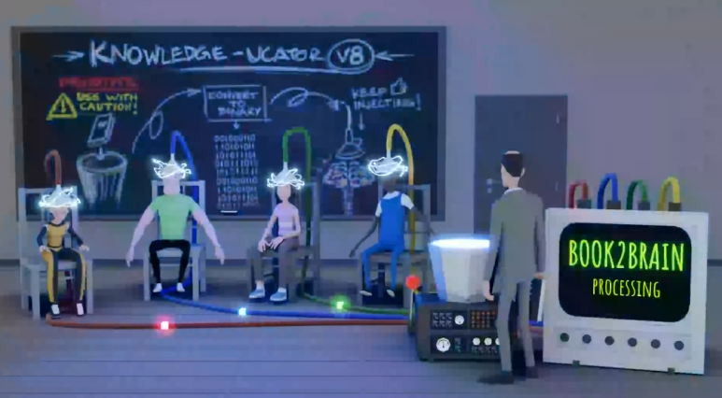
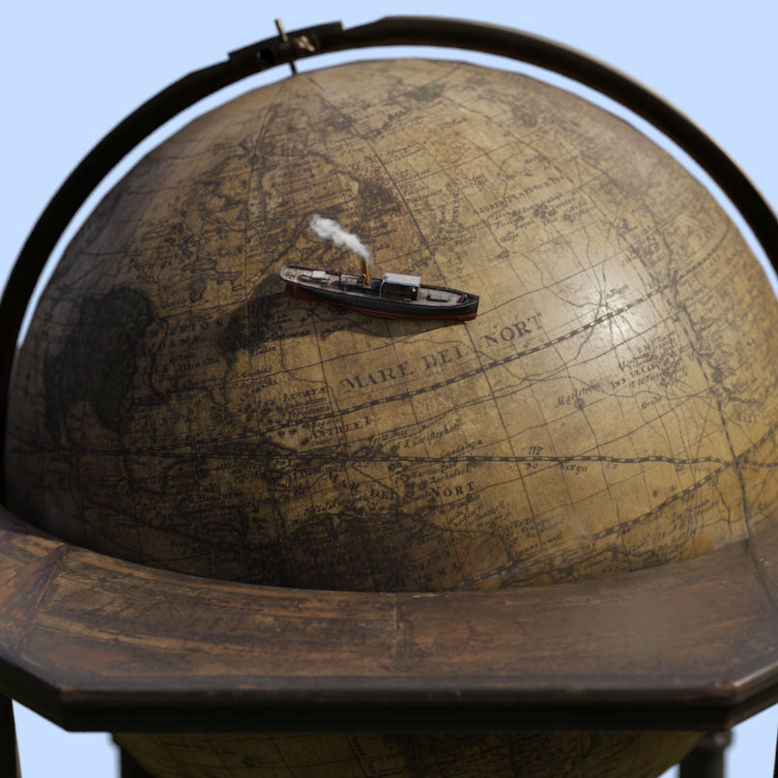
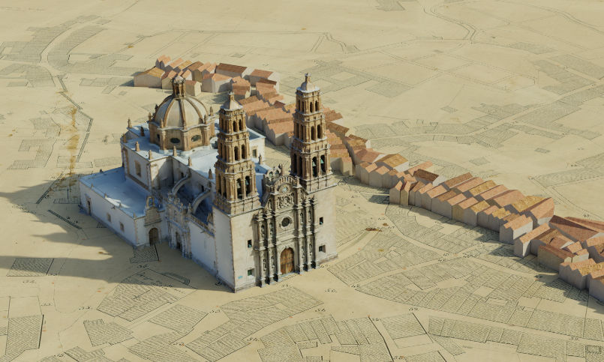
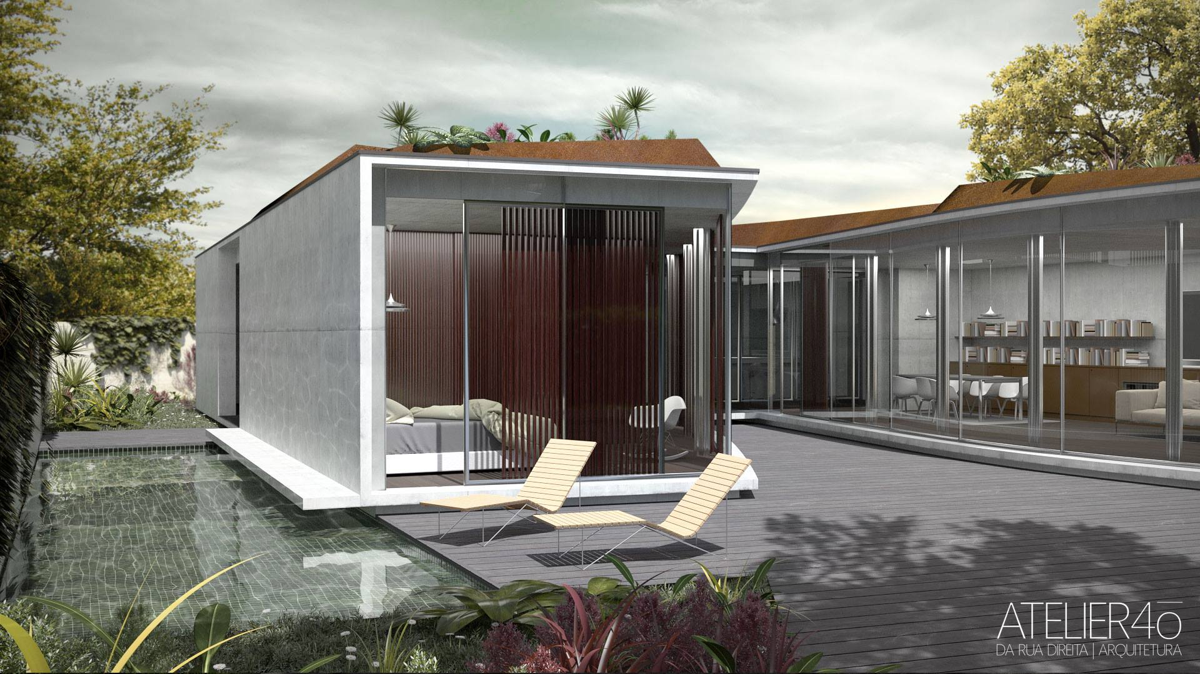
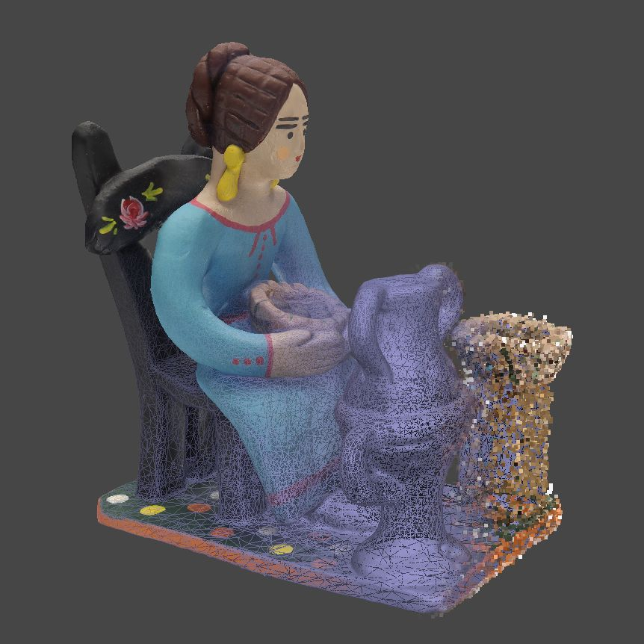

Slide 4
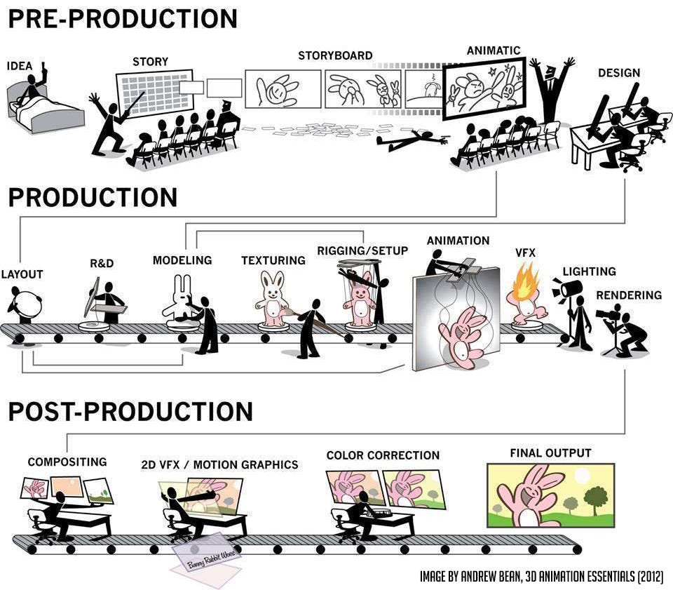

Slide 5

1
4
4.1
2
3
3
5

Slide 6




Group project = Group Demo Reel!!!
Lowpoly
Diorama
Character
Moving

Slide 7
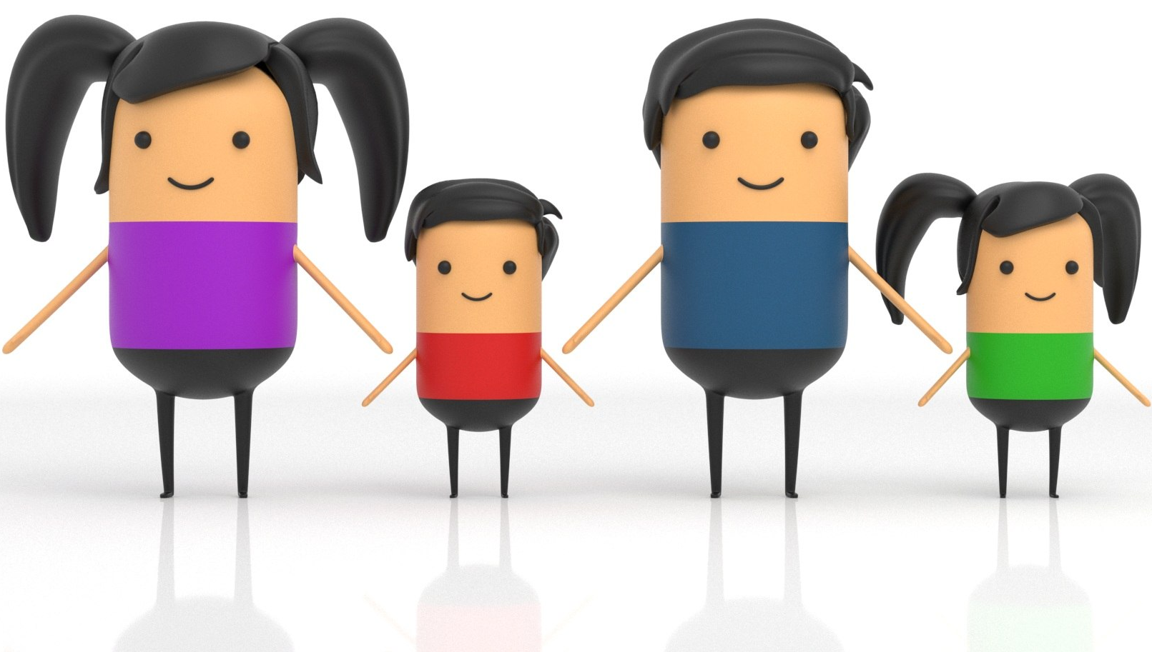
Ideas and inspiration for characters

Slide 8
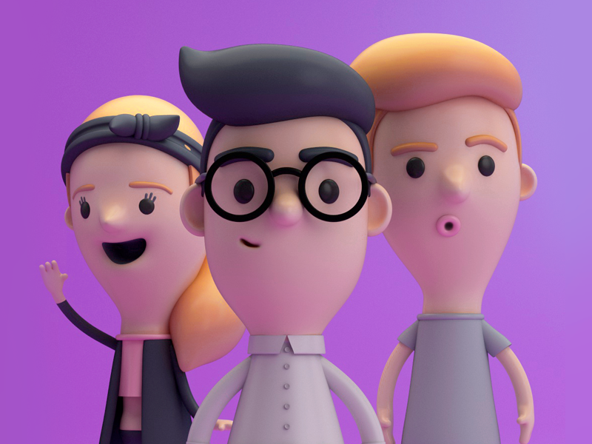
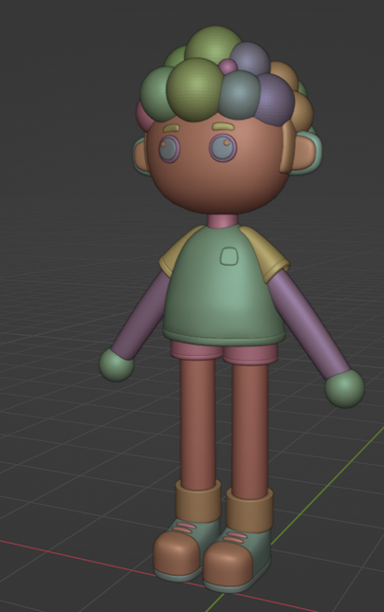
Ideas and inspiration for characters

Slide 9
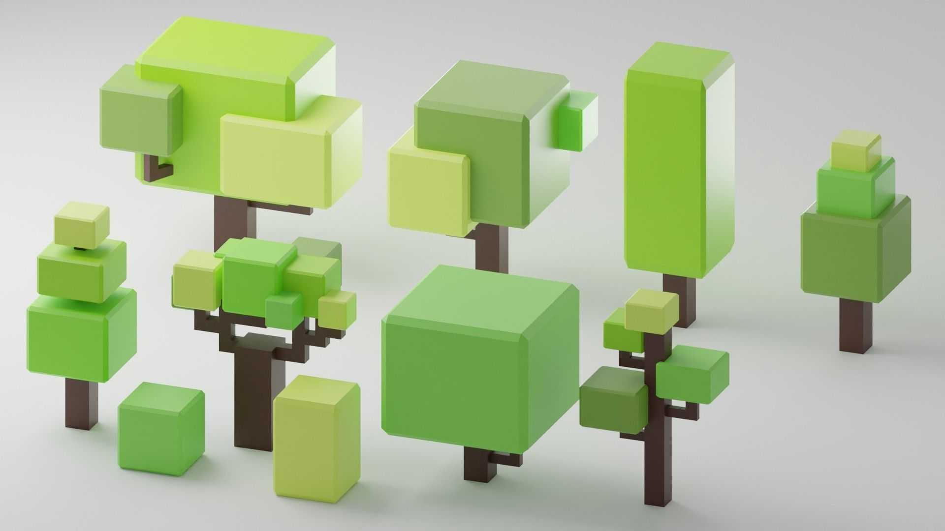
Ideas and inspiration for vegetation

Slide 10
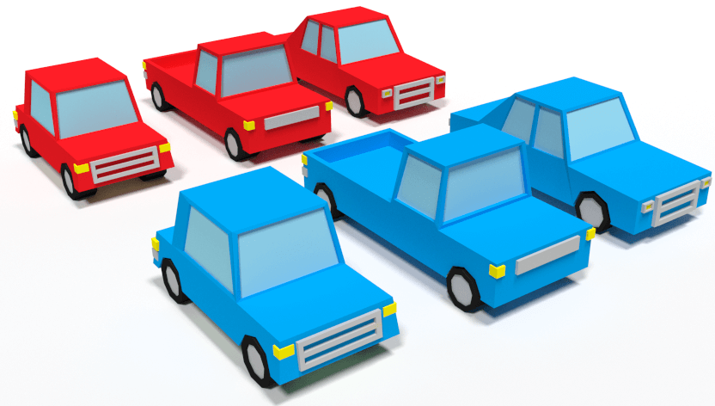
Ideas and inspiration for cars

Slide 11
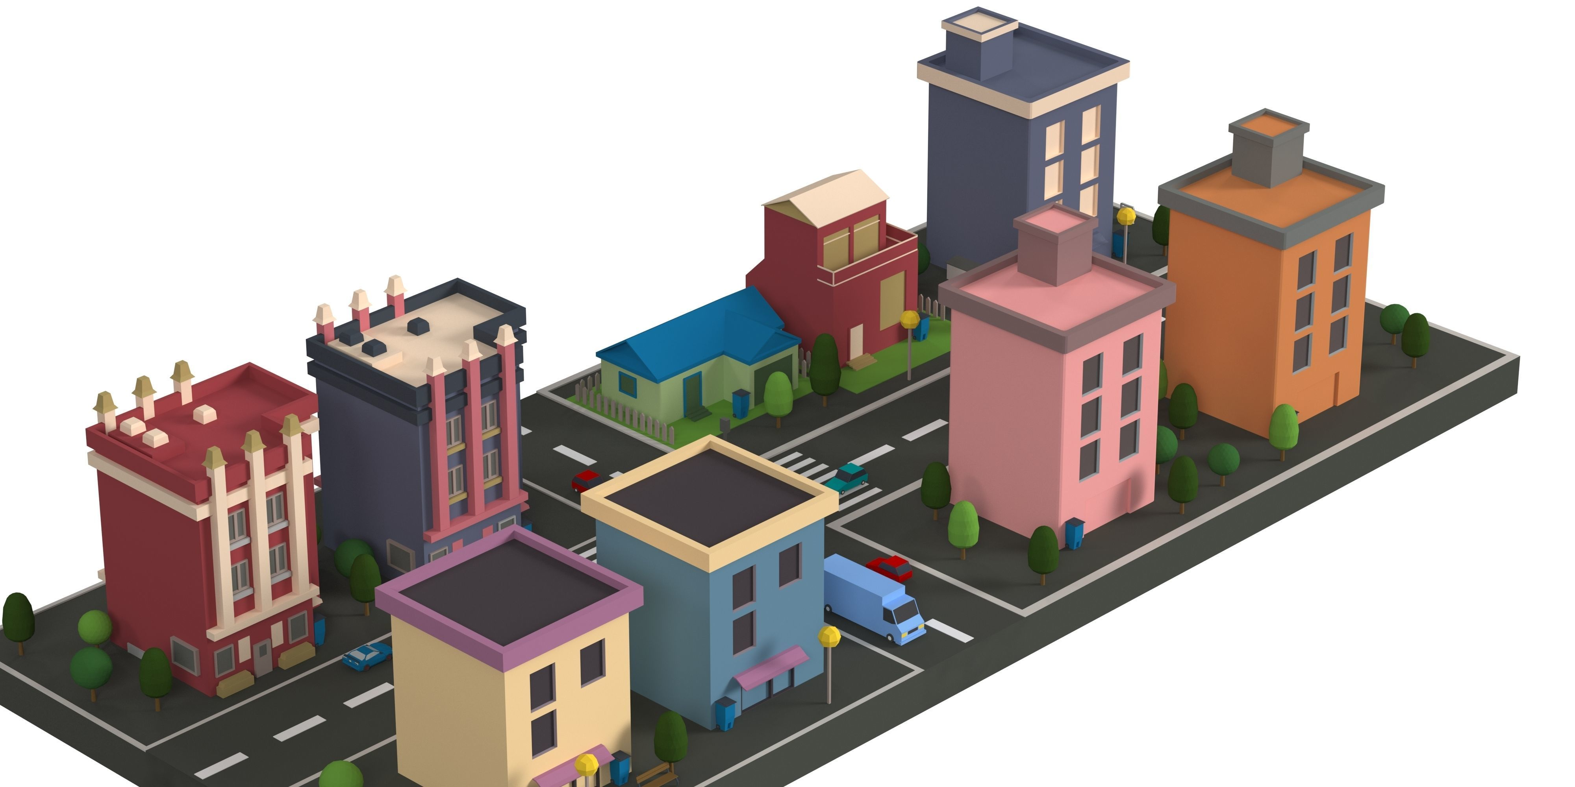
Ideas and inspiration for buildings

Slide 12
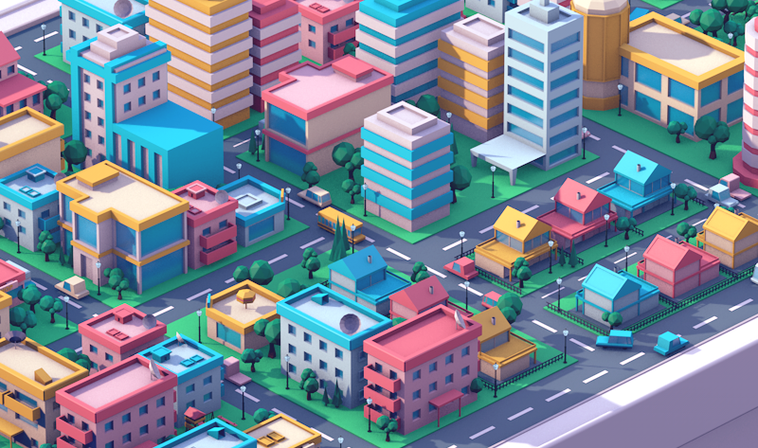
Ideas and inspiration for buildings

Slide 13
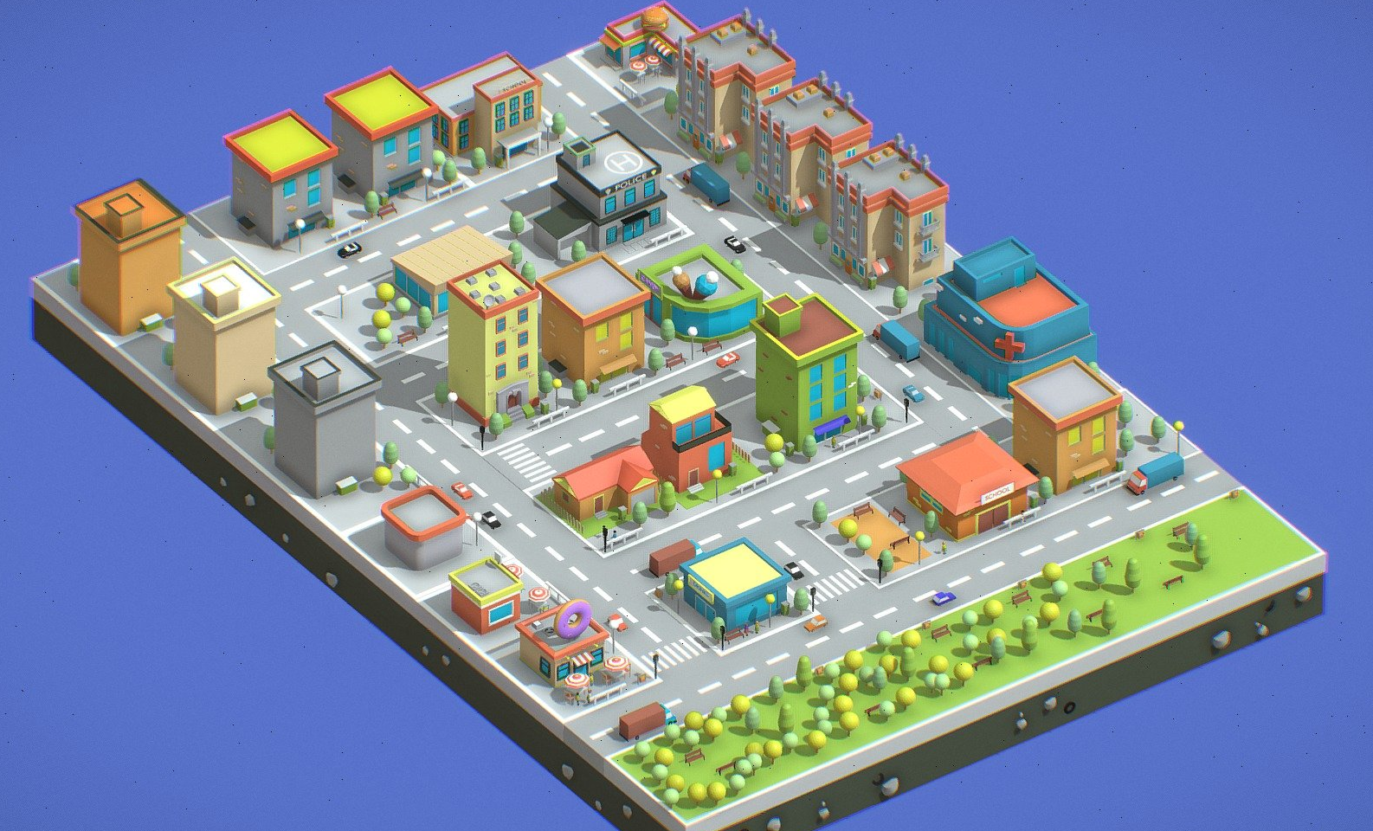
Ideas and inspiration for buildings

Slide 14
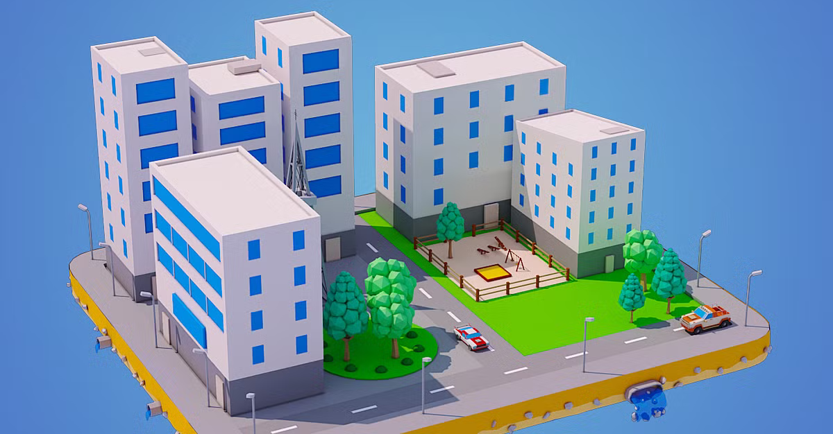
Ideas and inspiration for buildings

Slide 15
Let’s start!
https://github.com/projetoalfobre/Ordu-2025-3d-training

