Slide 1
1- Interface and settings
Ordu, 12.05 – 16.05 2025

Slide 2
Outline
Overview of User Interface
Blender preferences
Useful tips

Slide 3
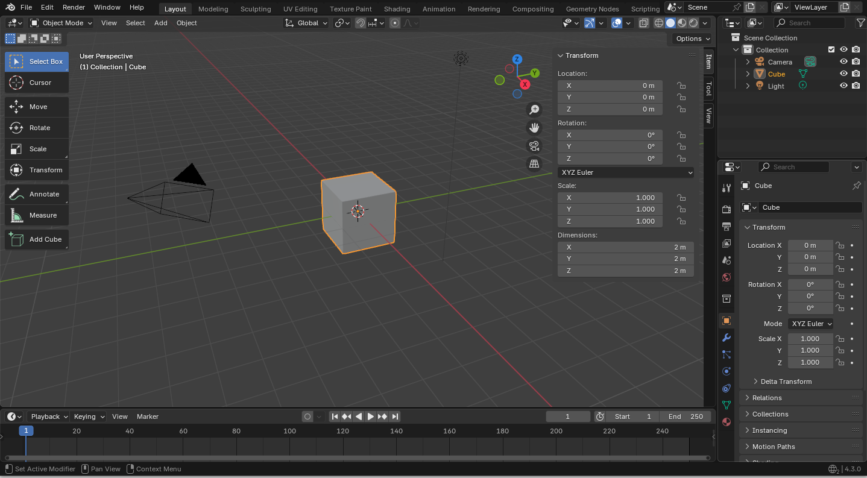
1
2
3
4
15
5
14
6
This is the 3D Viewport
7
13
8
12
11
10
9

Slide 4
Overview of interface
LEGEND
1 Topbar Main Menu
2 Topbar workspaces
3 Transform controls
4 Display & Shading
5 Outliner window
6 Viewport navigation gizmos
7 Sidebar tabs
8 Properties window
9 Timeline frames controls
10 Timeline playback controls
11 Timeline
12 Editor type menu
13 Toolbar
14 Toolbar options
15 Working mode

Slide 5
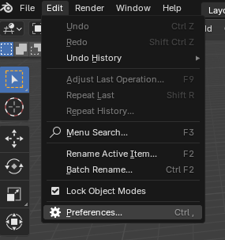
Blender Preferences
Let’s start by changing a couple of preferences and install an add-on.
Go to Edit menu and choose Preferences...

Slide 6
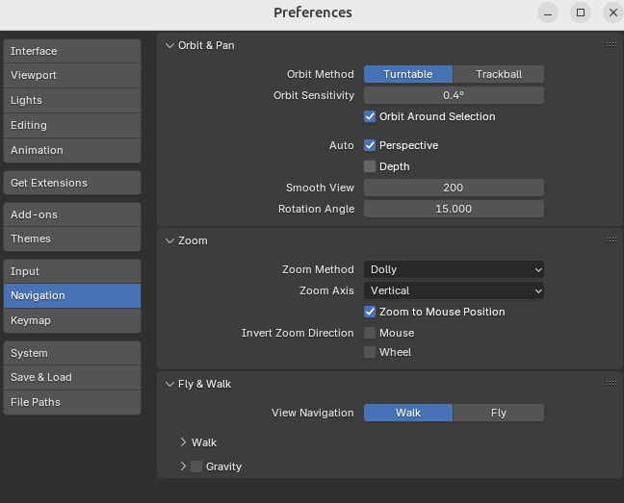
Blender Preferences
In the Navigation tab check…
Orbit Around Selection
Zoom to Mouse Position

Slide 7
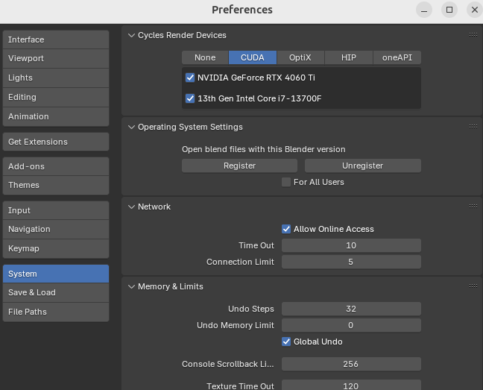
Blender Preferences
In the System tab check…
If any Cycles Render Devices is available. (CUDA has the best performance)
Check Allow Online Access

Slide 8
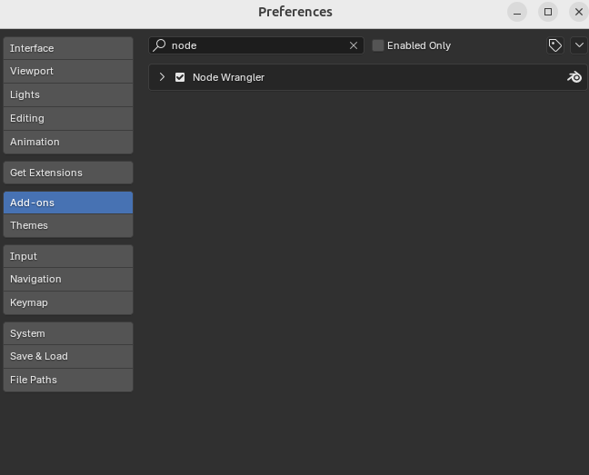
Blender Preferences
In the Add-ons tab check…
Write node to filter and check Node Wrangler

Slide 9
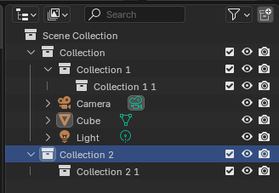
Useful tips - Organize
- Organize projects in folders!
- Save often and increased versions (filename_v1, filename_v2, etc.
- Blender files use .blend extension
- Blender autosaves/backups use .blend1 extension
- Use Outliner to organize blender projects…
Use collections (RMB to context menu)
Organize collections/objects (drag & drop)
name objects (double click on name)
Toggle visibility/render

Slide 10




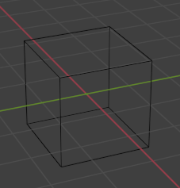
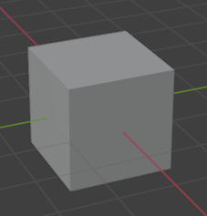
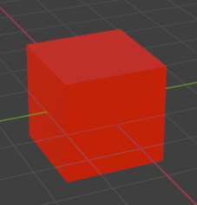
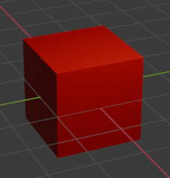
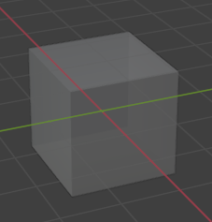

Useful tips – Viewport Display
Wireframe (+ X-Ray)
Solid
Material
Render
Solid + X-Ray

Slide 11
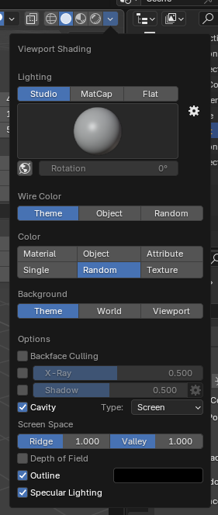
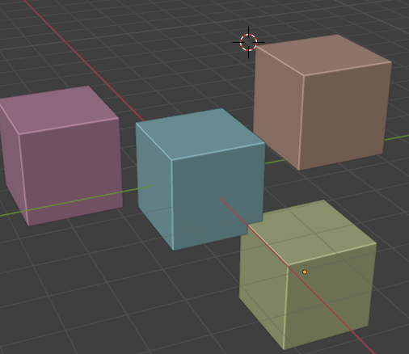
Useful tips – Viewport Display
My setup…
Solid (X-Ray when needed)
Random color
Cavity checked

