Slide 1
2.1 Character Step by Step
Ordu, 12.05 – 16.05 2025

Slide 2
Outline
Body blocking
Details and polish
Final steps
SAVE THE FILE OFTEN!

Slide 3
The body blocking

Slide 4

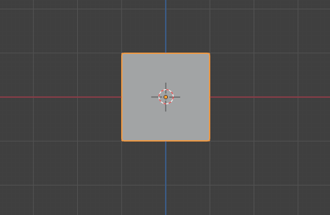
Let’s start!
- Set view to Front Ortographic (NUMPAD 1)
The red line is the X axis.
The blue line is the Z axis.
TIP you can press 1 and 3 to alternate between Vertex and Face seelct mode.

Slide 5
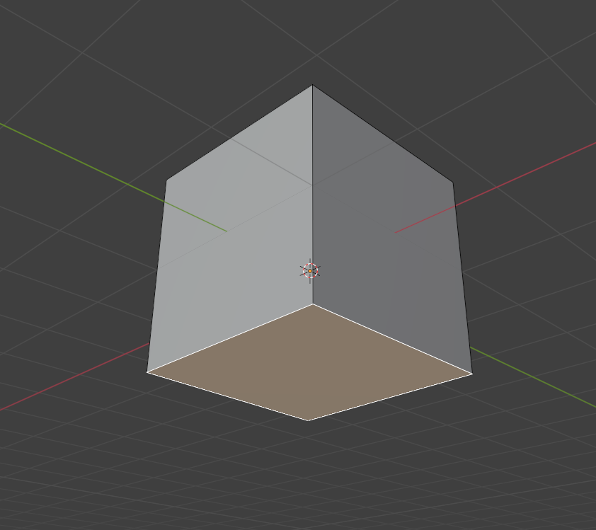
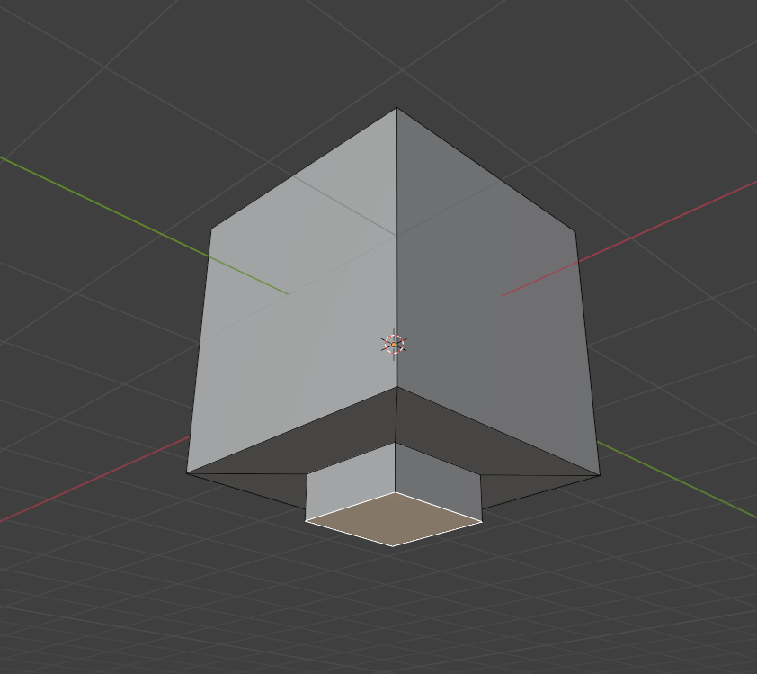
Let’s create a neck
- Inset (move mouse slowly toward center)
- Extrude (move mouse down)

Slide 6
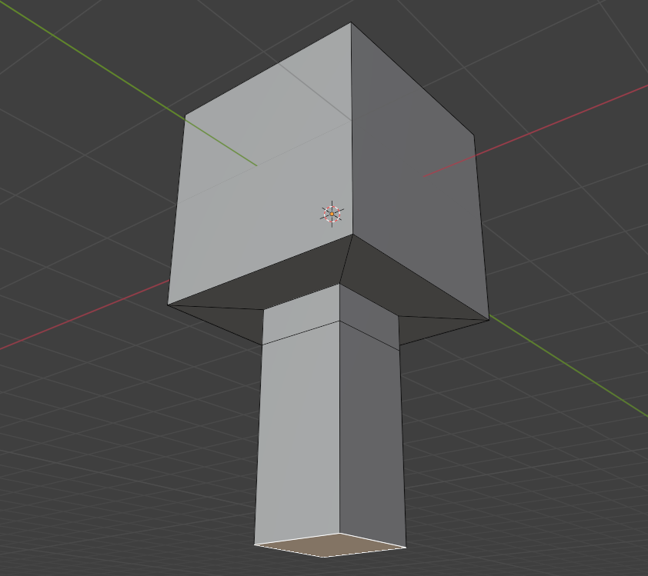
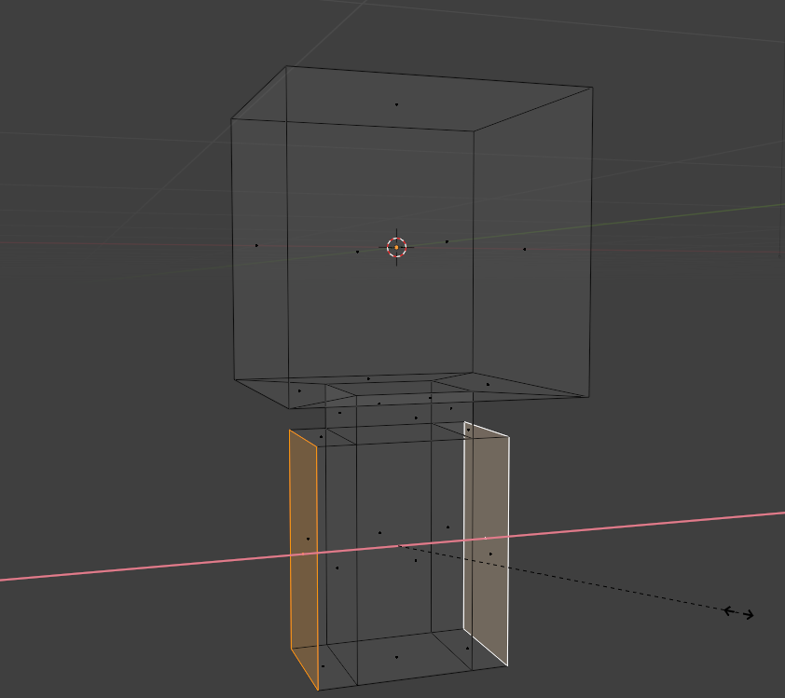
Let’s create the torso
- Extrude (move mouse down)
- Select 2 side faces (Shift)
- Extrude (click to create but don’t move mouse)
- Scale and lock on X axis

Slide 7
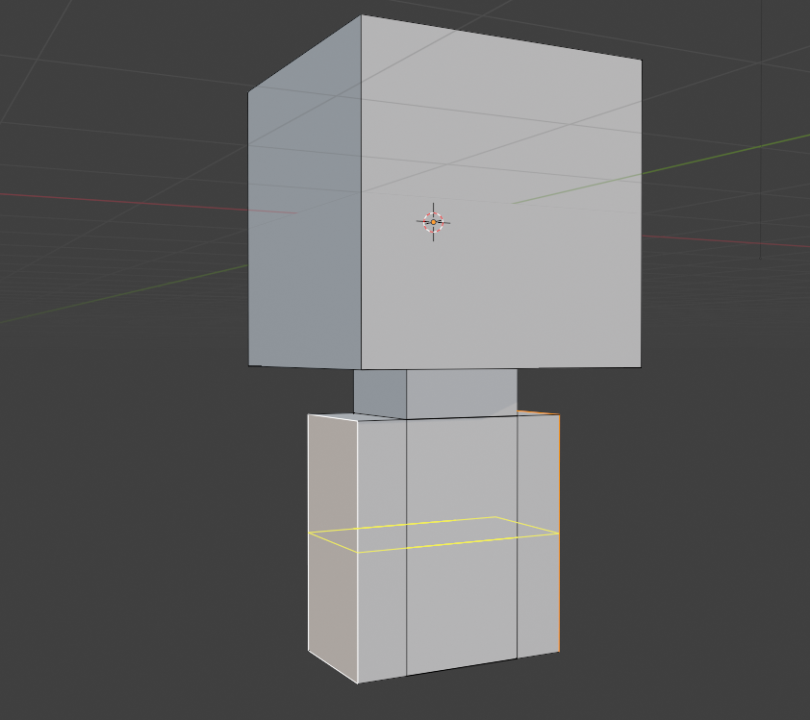
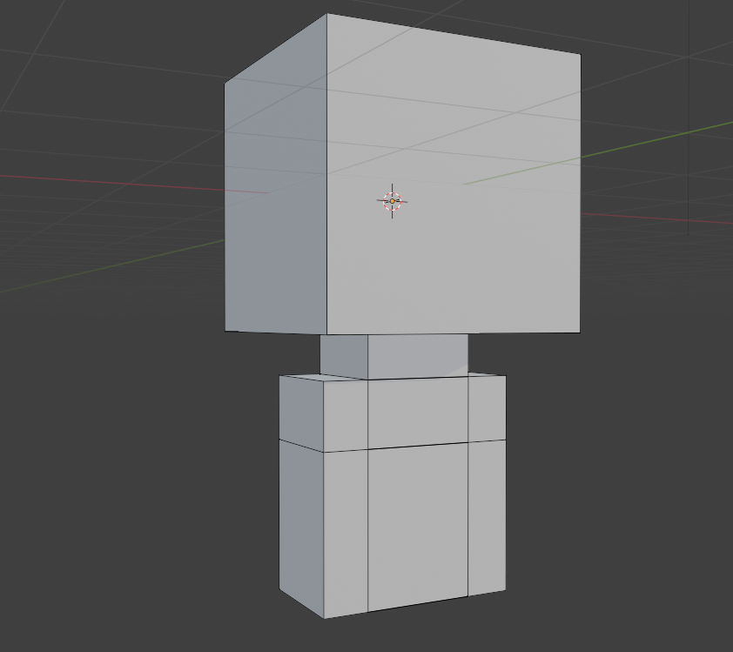
Let’s create the shoulders
- Ctrl+R to activate loop cut tool
- Click to create loop cut and move a bit up

Slide 8
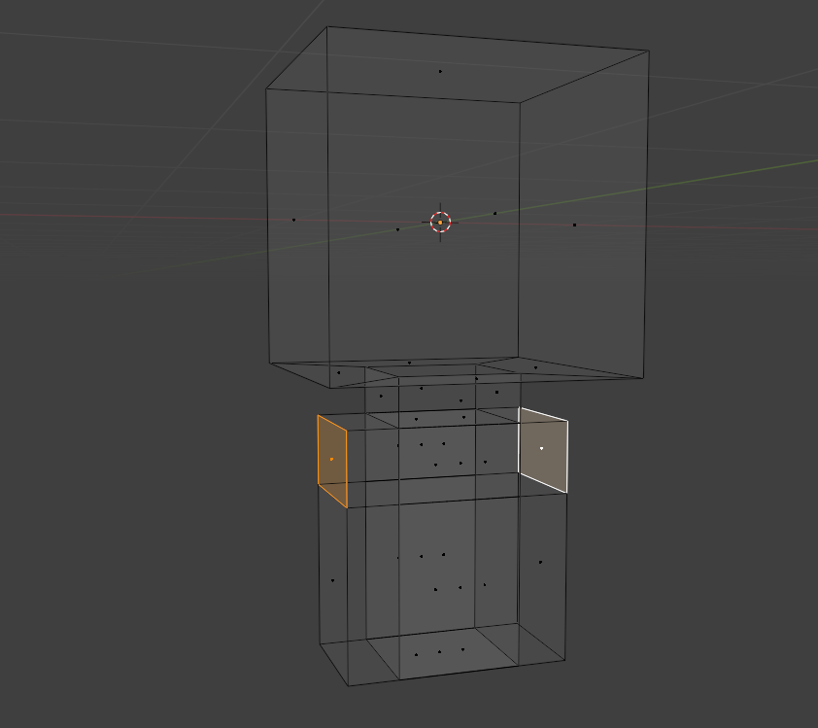
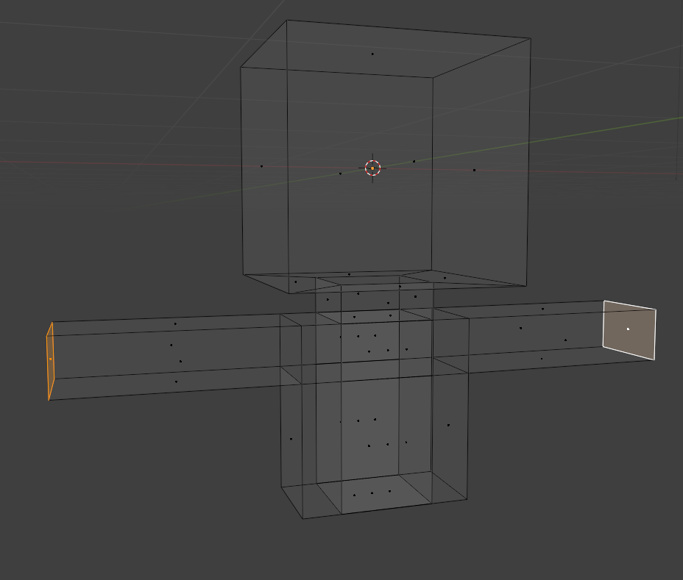
Let’s create the arms
- Select 2 side faces (Shift)
- Extrude (click to create but don’t move mouse)
- Scale and lock on X axis

Slide 9
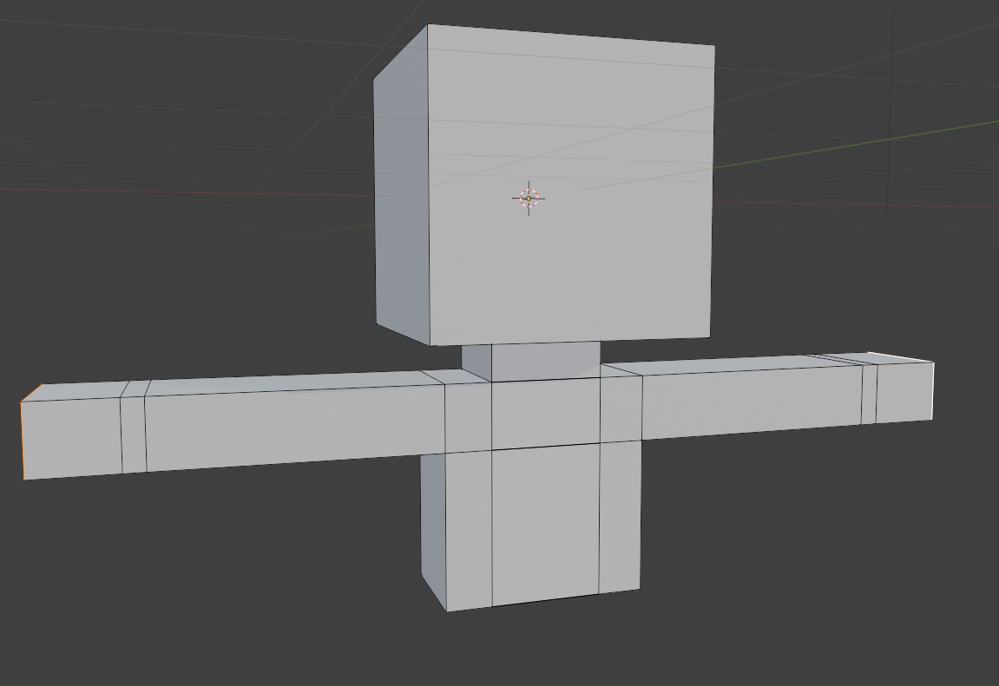
Let’s create hands
- Repeat the extrude process 2 more times

Slide 10
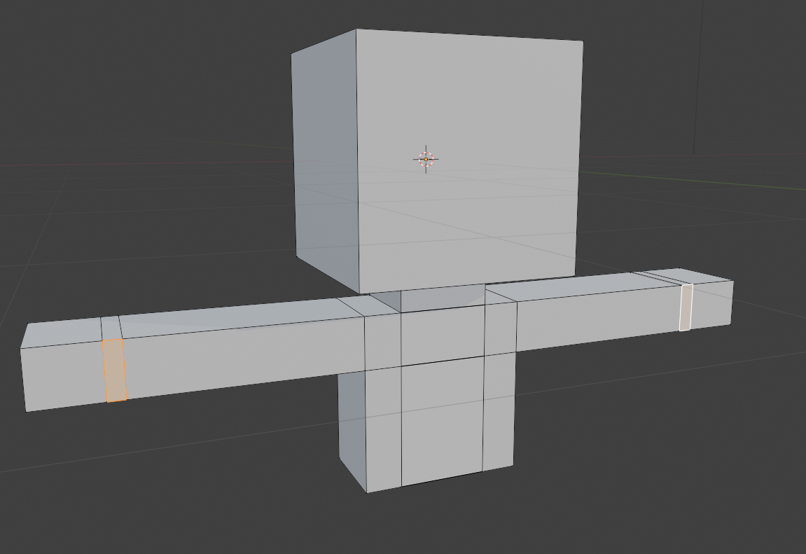
Let’s create thumbs
- Select the 2 faces (Shift)

Slide 11
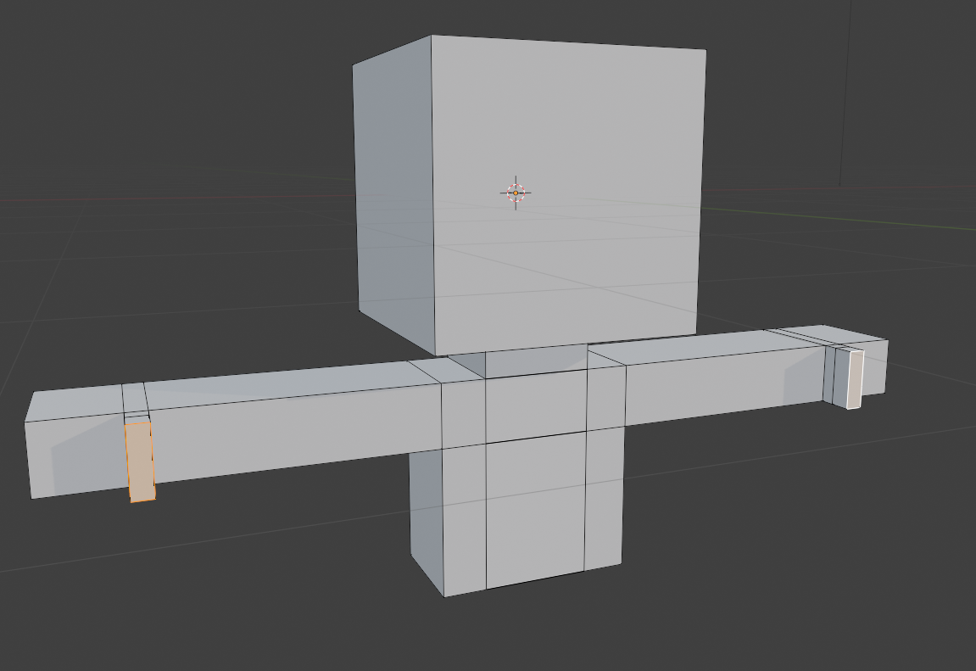
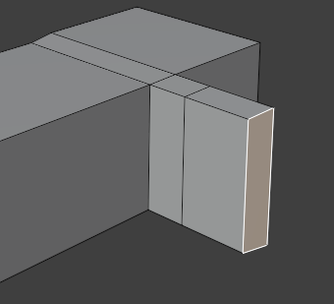
- Extrude a little and move mouse a little
- Extrude again and move mouse a little bit more

Slide 12
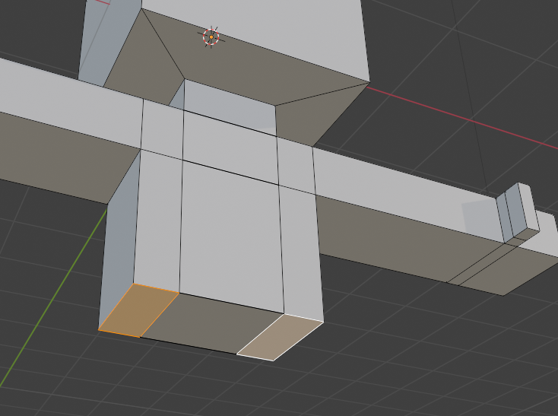
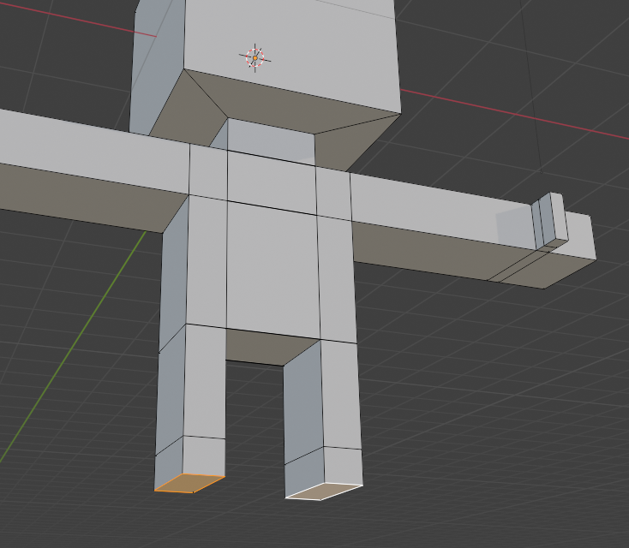
Let’s create the legs
- Select 2 side faces (Shift)
- Extrude and move down a bit
- Extrude again but move less

Slide 13
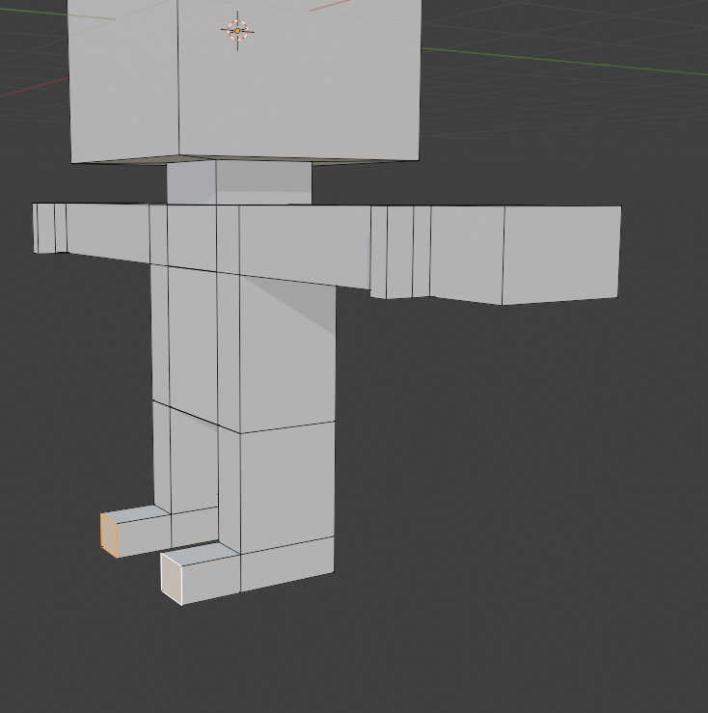
Let’s create the feet
- Select 2 front faces (Shift)
- Extrude and move mouse a bit

Slide 14
The details and polish

Slide 15
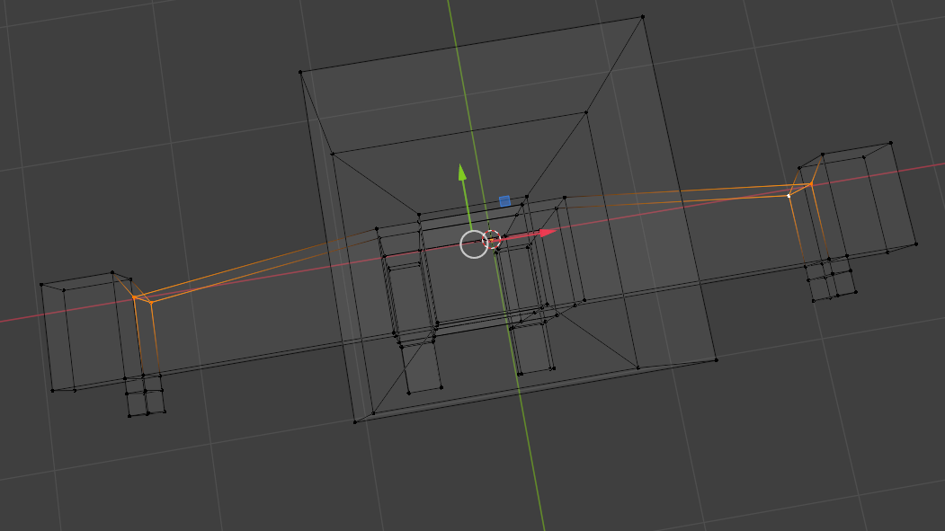
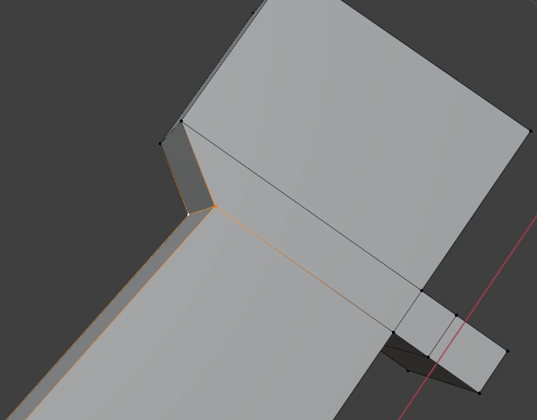
- Select the 4 vertices (back of the wrist)
- Move them a bit forward

Slide 16
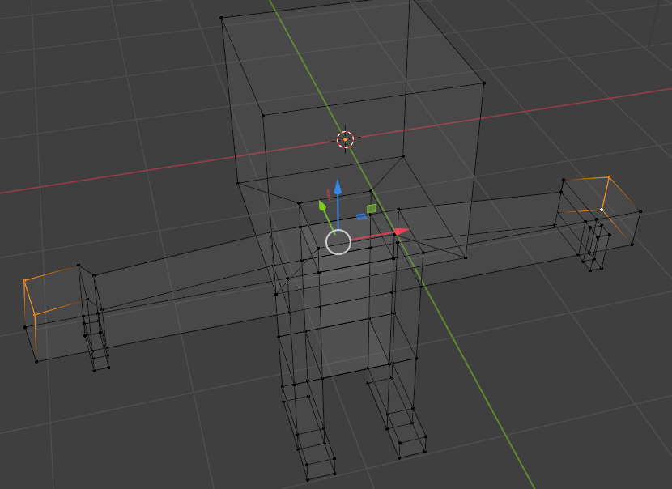
- Select the 4 vertices (back of the hand)
- Move them a bit forward

Slide 17
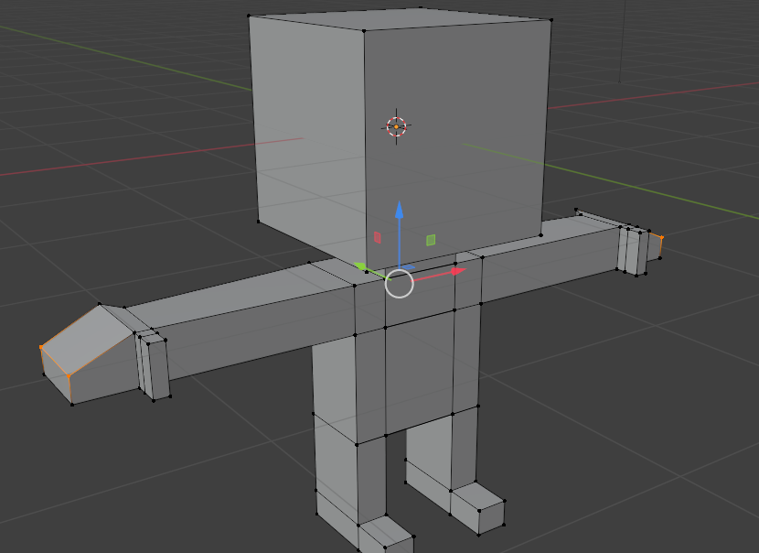
- Select the 4 vertices
- Move them a bit down

Slide 18
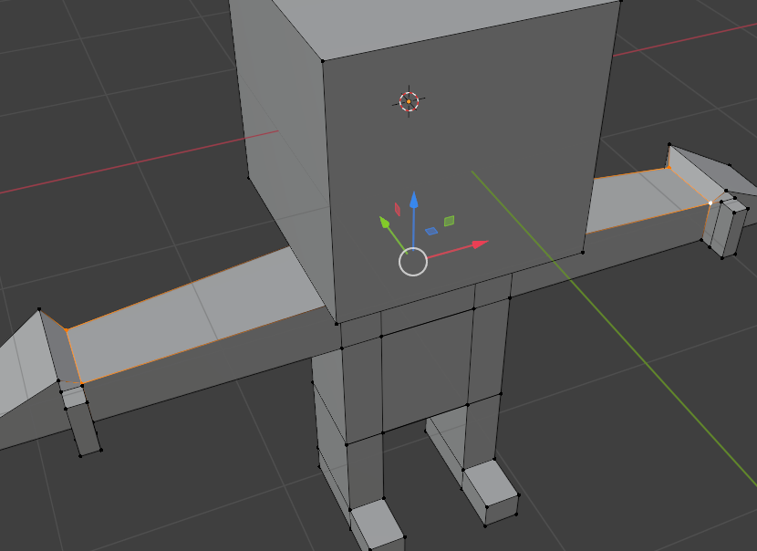
- Select the 4 vertices
- Move them a bit down

Slide 19
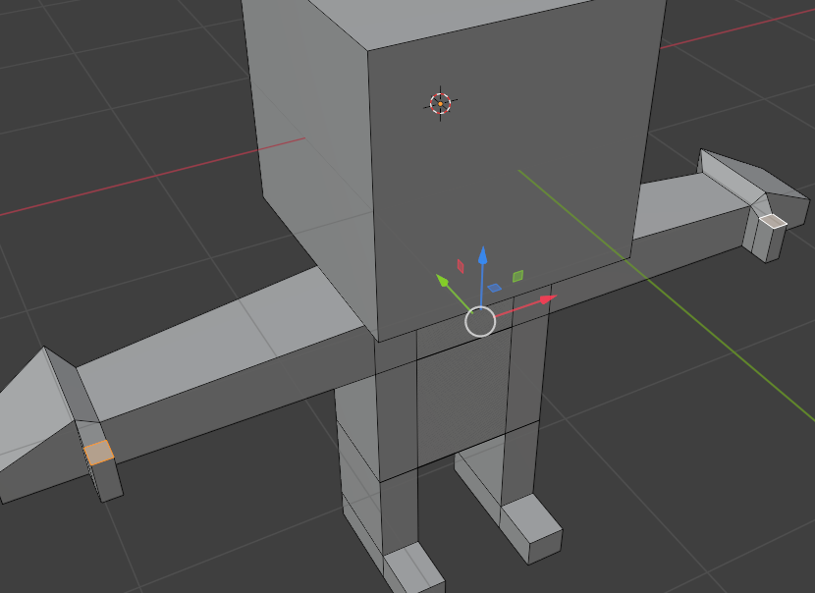
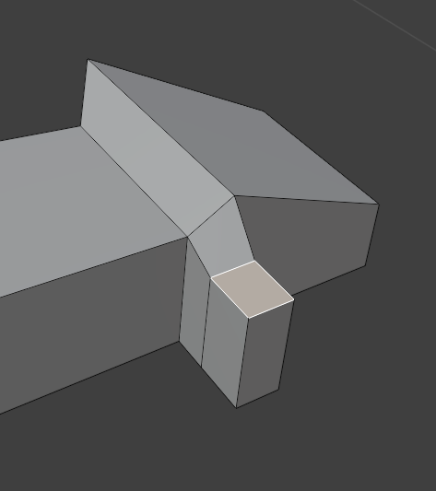
- Select the 2 faces
- Move them a bit down

Slide 20
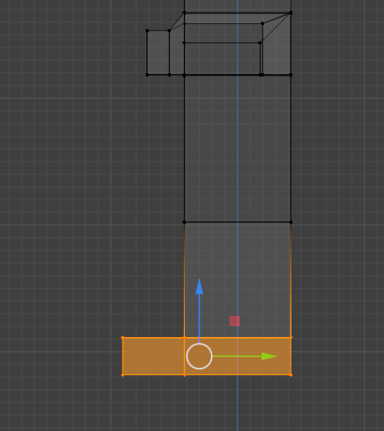
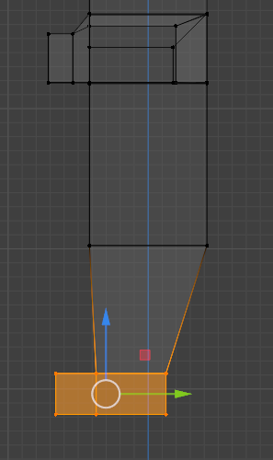
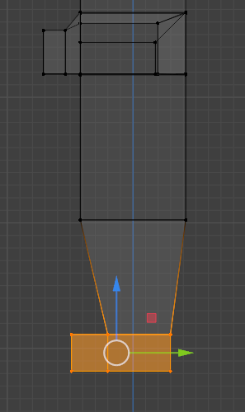
- Select the vertices from both feet
- Scale only on the Y axis
- Move them a bit to the back

Slide 21
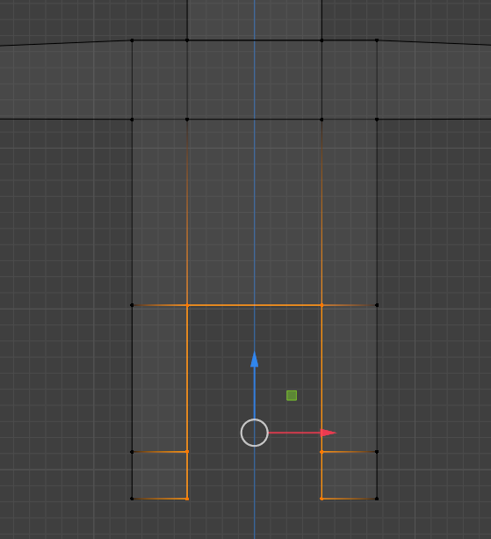
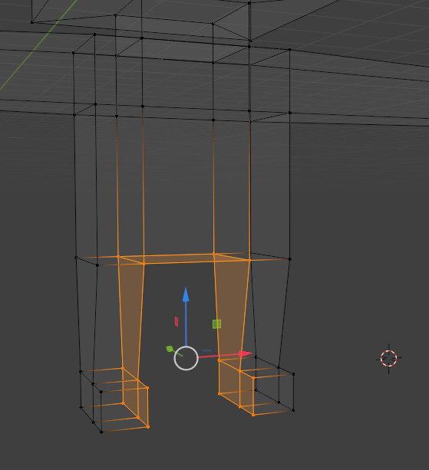
- Select the vertices from inside legs and feet

Slide 22
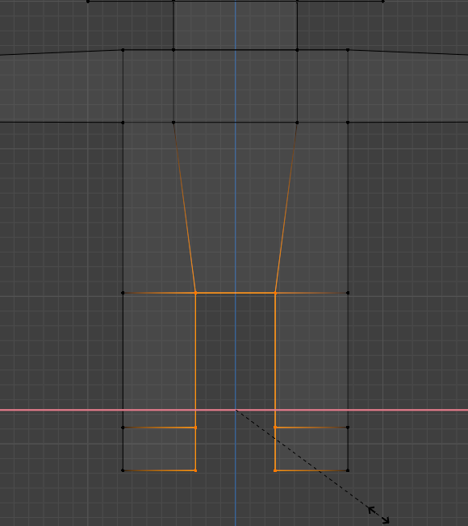
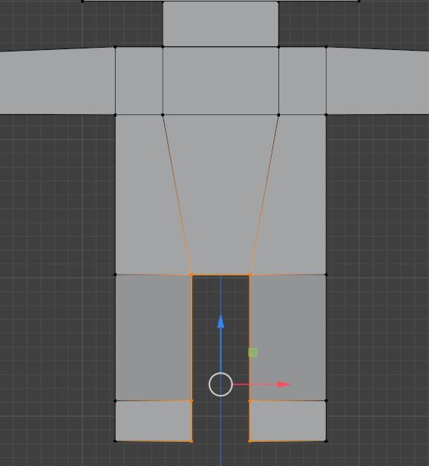
- Scale only on the X axis

Slide 23
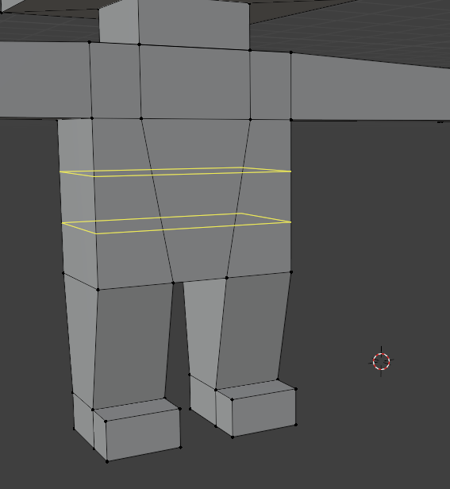
- Ctrl+R to activate loop cut tool
- Roll mouse wheel to create 2 loops
- Click to create loop cut and click again to fix them

Slide 24
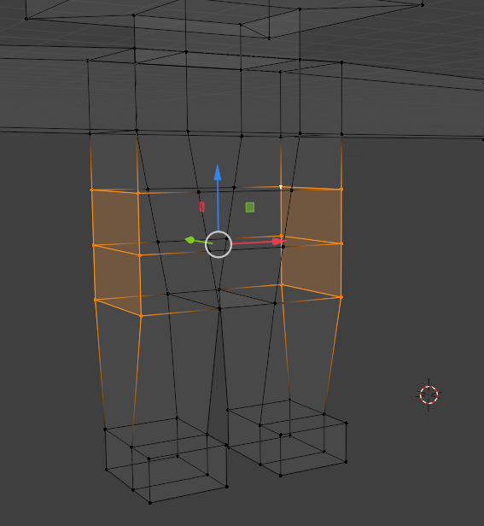
- Select the vertices from both sides like in the image.

Slide 25
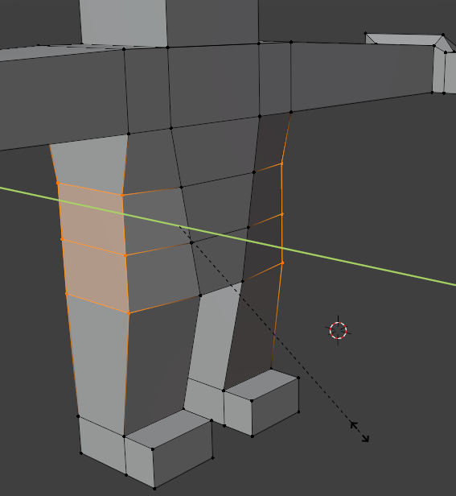
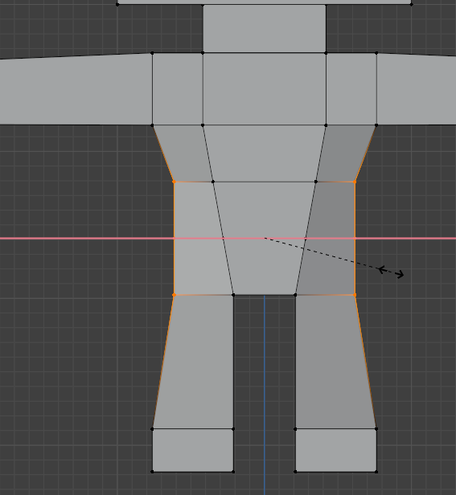
- Scale them only on the Y axis
- Scale them only on the X axis

Slide 26
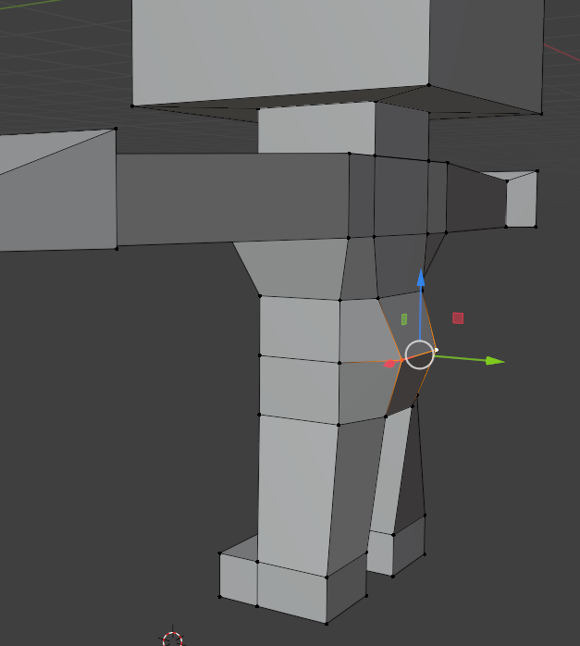
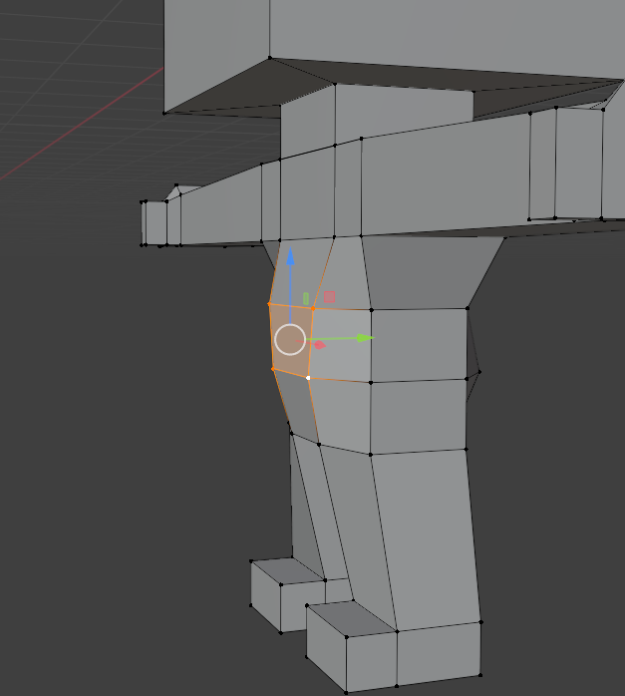
- Scale them only on the Y axis

Slide 27
- Select these 2 Vertices and move them to create the buttocks
- Select these 4 Vertices and move them to create a belly

Slide 28
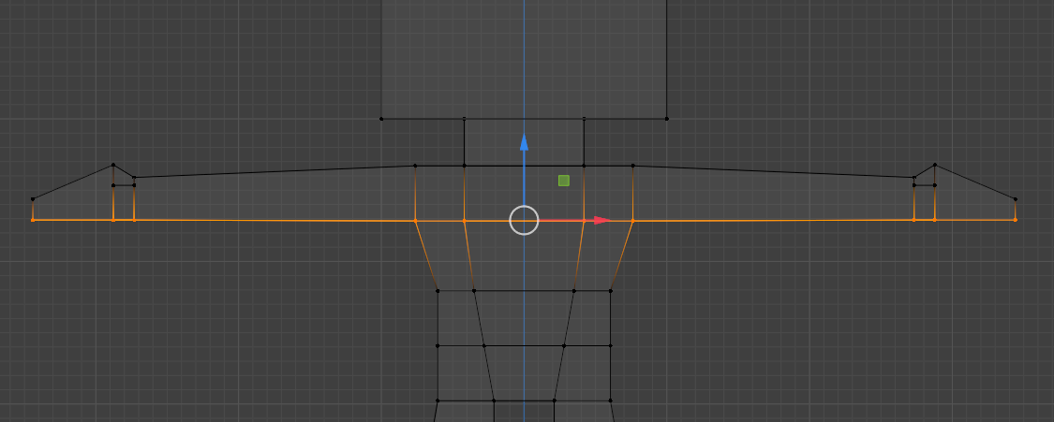
- Select all these Vertices and move them up to shape the arms a little thiner

Slide 29
Final steps

Slide 30
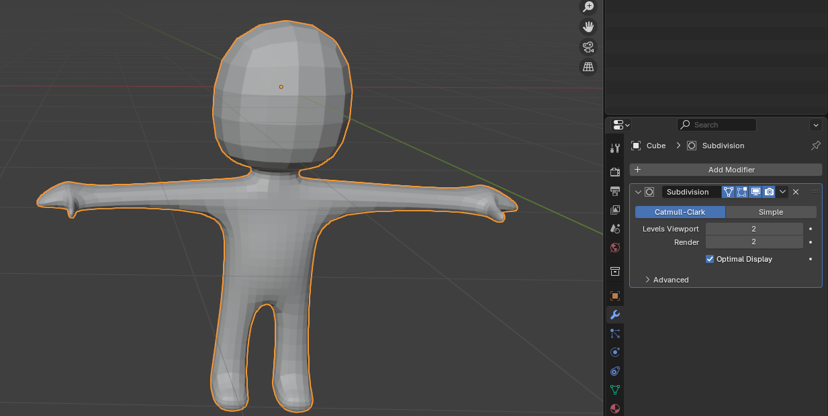
- Add modifier Subdivision Surface with Levels Viewport = 2.

Slide 31
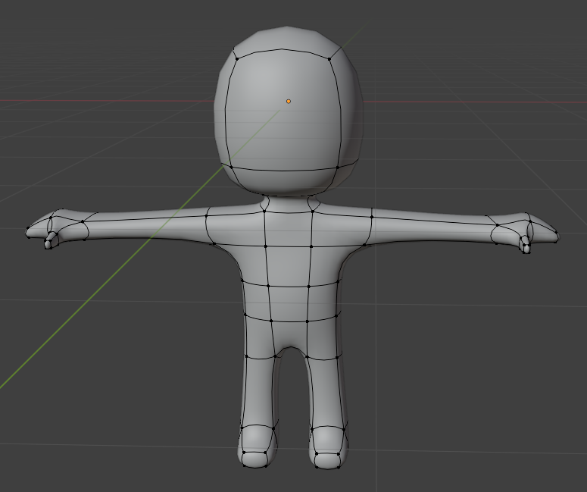
- Use the context menu (Right Mouse Button) and select Shade Smooth
You can now try to customize a little bit more ;)

