Slide 1
3.1 HDRI lighting
Ordu, 12.05 – 16.05 2025

Slide 2
1. What is HDRI lighting?
HDRI Lighting is technically called 'image-based lighting'. Image-based lighting works by applying a high dynamic range image map (HDRI map) onto an environment light in 3D software.
HDRI is short for High Dynamic Range Image. It's a panoramic photograph that covers the entire field of vision that contains a large amount of data which can be used to emit light into a CG scene.

Slide 3
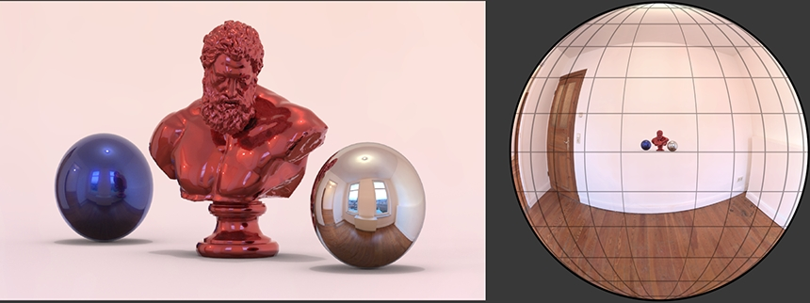

Slide 4
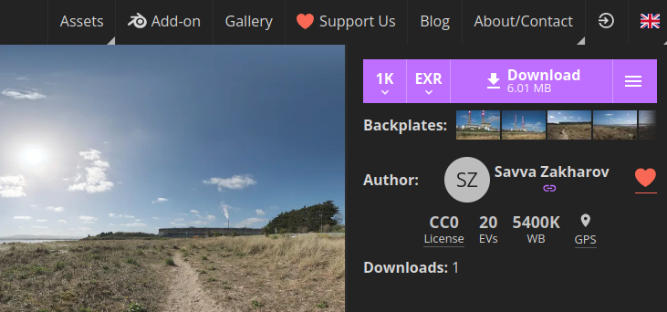
2. Where do I get HDRI?
Visit https://polyhaven.com
After choosing the HDRI, choose 1K and Download.

Slide 5
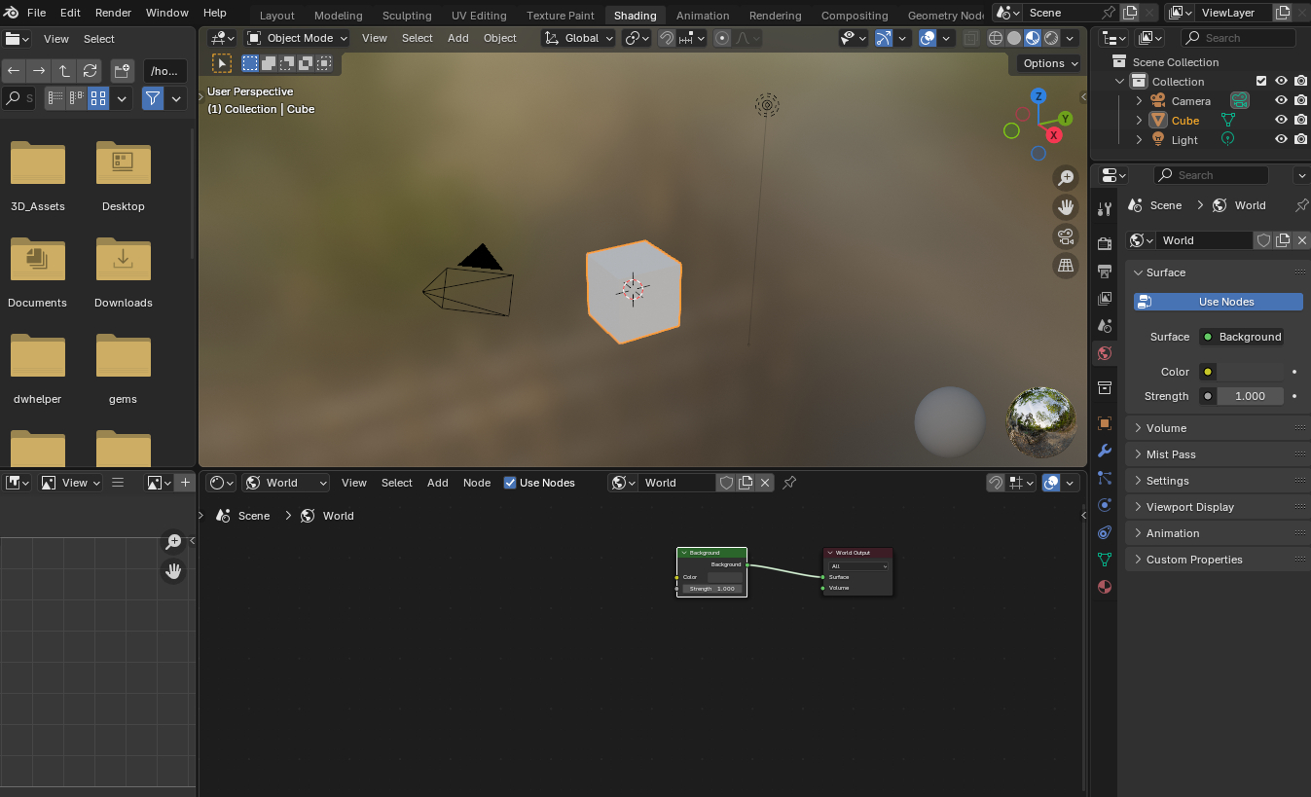
3. In Blender...
Go to Shading workspace
Change shader type to World
Select node Background

Slide 6
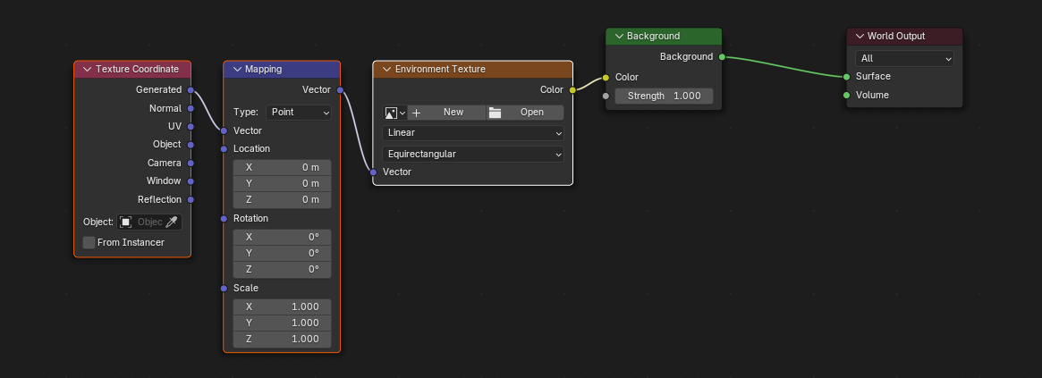
Press Ctrl+T (only works if Node Wrangler addon is active)
Open HDRI
You can rotate light/shadows by rotating around Z axis

