Slide 1
3- Materials and lighting
Ordu, 12.05 – 16.05 2025

Slide 2
Outline
1 material to 1 object
2 materials to 1 object
Principled BSDF
Useful tips
Special shaders
Lighting

Slide 3
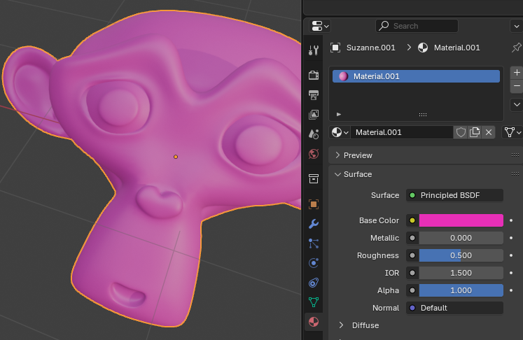
1 material to 1 object
- Select object
- Go to Material options and create a New material

Slide 4
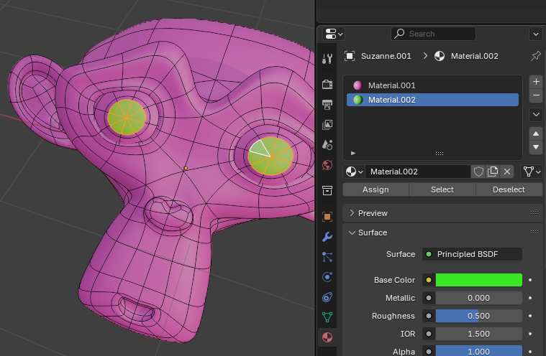
2 materials to 1 object
- Add one material to object
- Create a New (+) material
- In Edit Mode, select faces and click Assign button

Slide 5
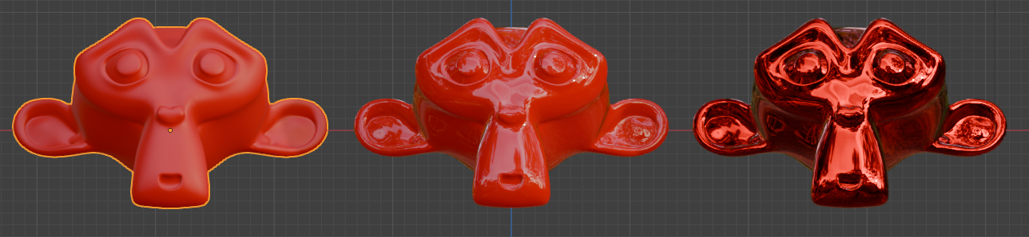
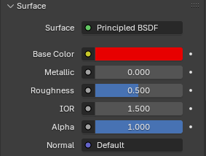
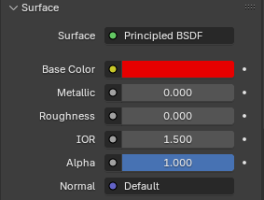
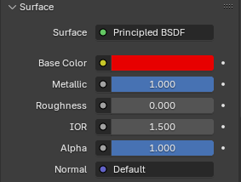
Principled BSDF basics

Slide 6
Useful tips
Principed BSDF main values:
Base Color (Overall color of the material)
Roughness (roughness of the surface for reflection and transmission)
Metallic (blends between dielectric and metallic )
IOR (Index of refraction specular reflection and transmission)
Alpha (Controls the transparency)
Transmission (for water and glass)
Emission (for light emitting objects)

Slide 7
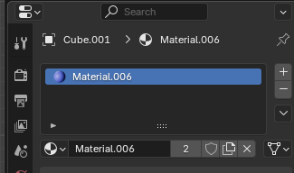
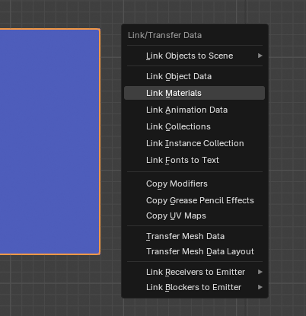
Useful tips
- One material can be used by many object. Number indicates how many objects are using this material.
- If number is clicked, a new material with same values is created
To copy a material to several objects...
- First select objects. Last selected object is the object to copy material from.
- Press Ctrl+L and select Link Materials.

Slide 8
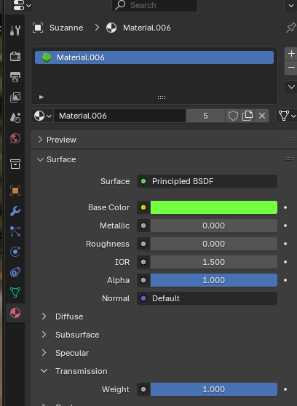
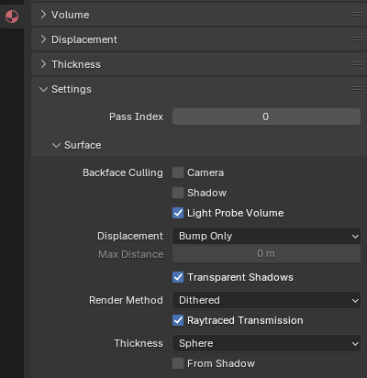
Special shaders – Glass/water (EEVEE)
Choose Base Color
Choose IOR
Increase Transmission Weight
Check Raytraced Transmission

Slide 9
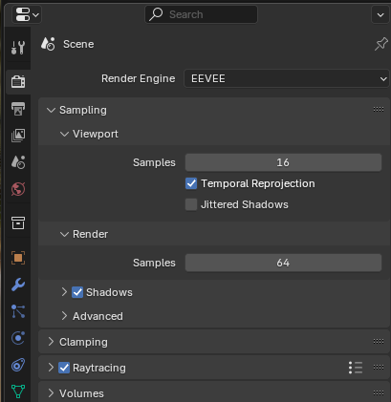
Special shaders – Glass/water (EEVEE)
In render engine (EEVEE) settings,
check Raytracing
TIP Cycles doesn’t need this settings, you can just use Glass Shader, but rendering is very sloooooooowwwwwwww

Slide 10
Special shaders...
Use the Shader Editor
Shader Editor is your friend!

Slide 11
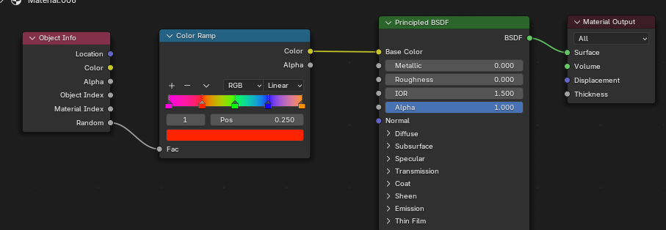
Special shaders – Random color
Use Object Info and Color Ramp nodes.

Slide 12
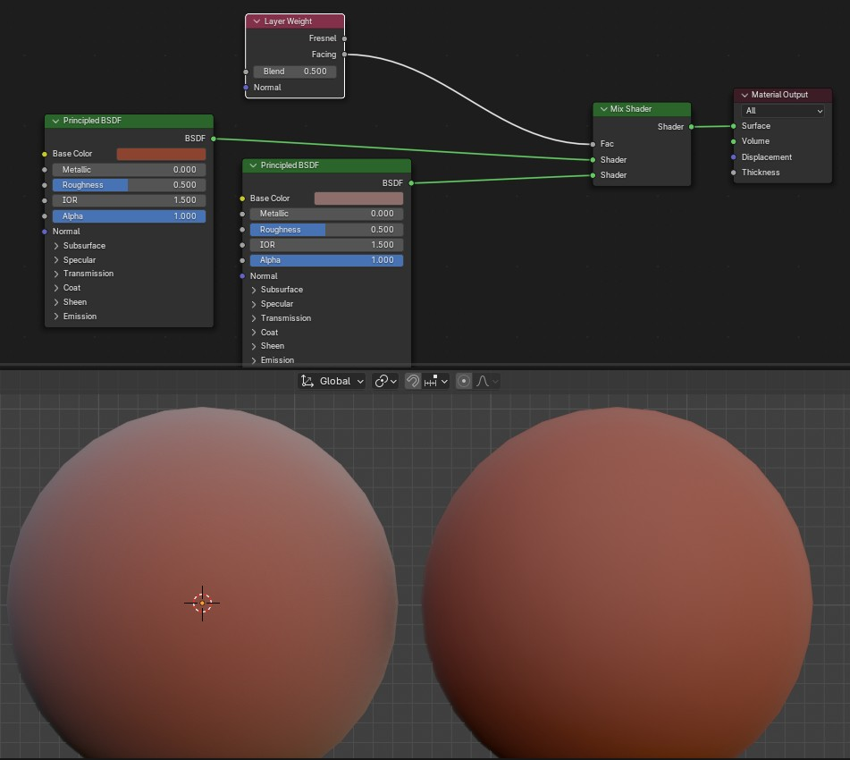
Special shaders – Mix colors (facing)

Slide 13
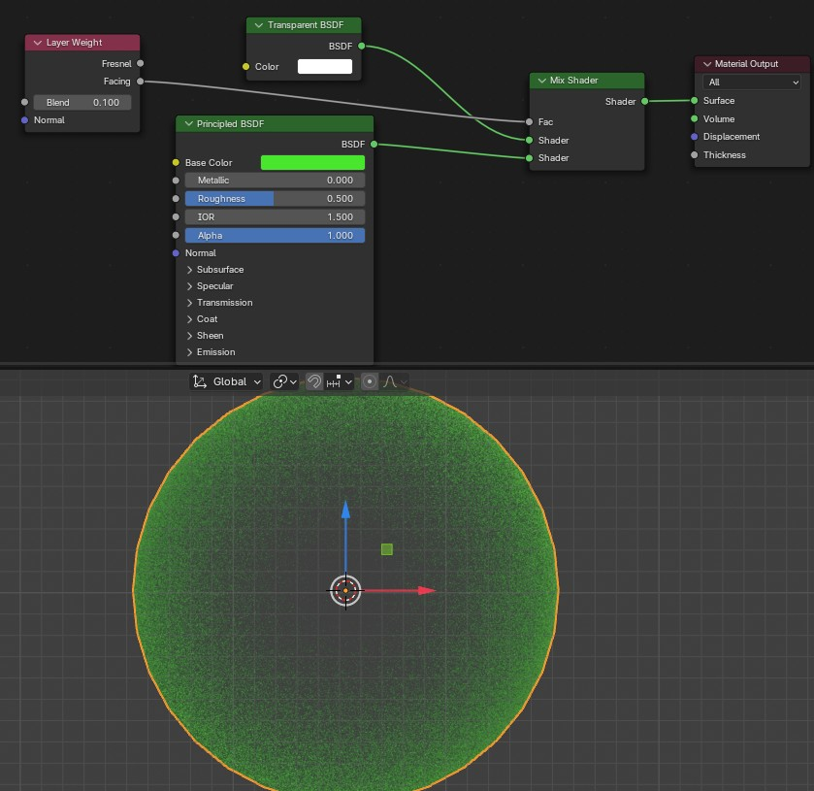
Special shaders – Mix colors (facing)

Slide 14
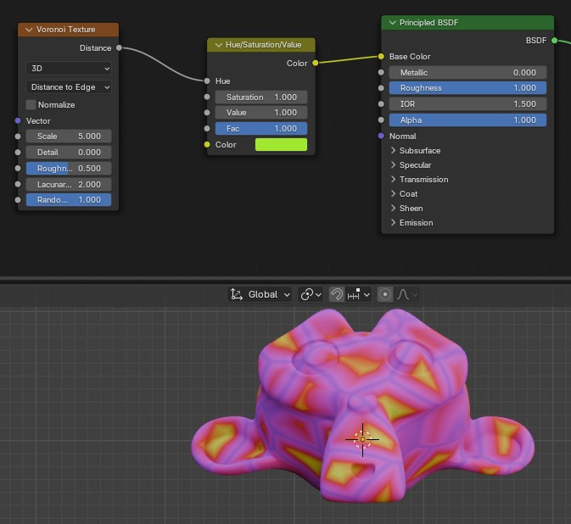
Special shaders – Mix colors (texture)

Slide 15
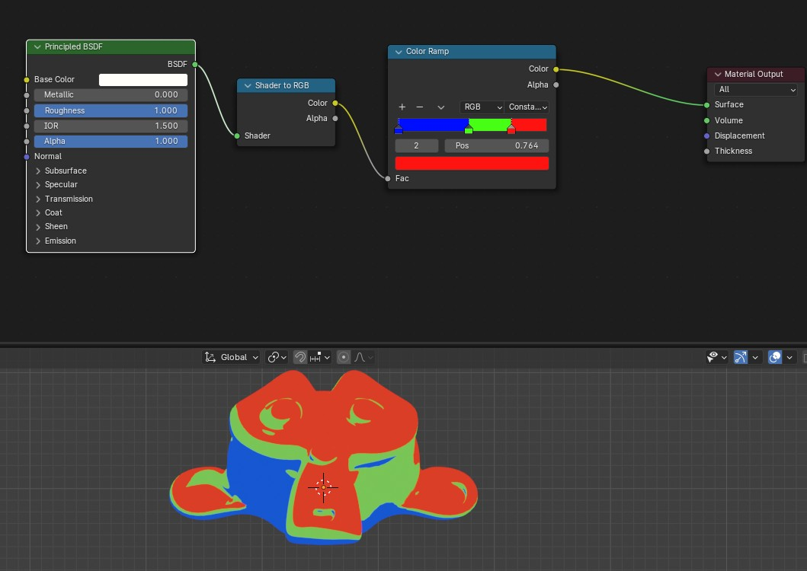
Special shaders – Stylized

Slide 16
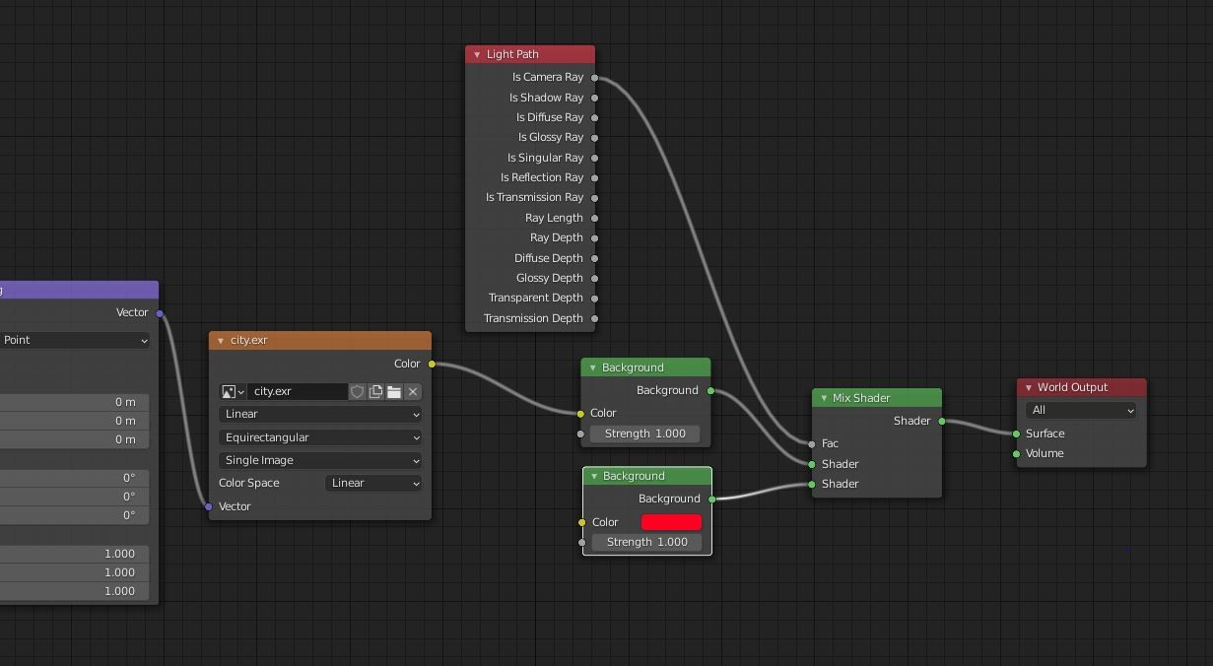
Lighting – 2 Backgrouds (1 for lighting)

