Slide 1
4.1 Animation with Mixamo.com
Ordu, 12.05 – 16.05 2025

Slide 2
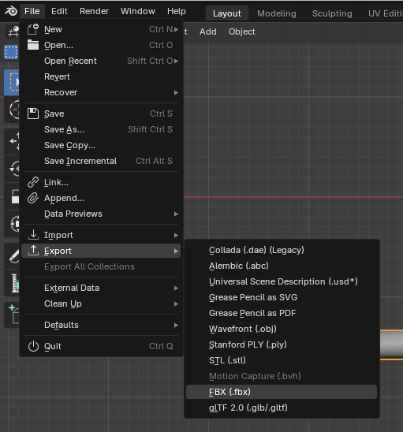
1. Export from Blender
Select just the character and go to…
File > Export
And choose FBX

Slide 3
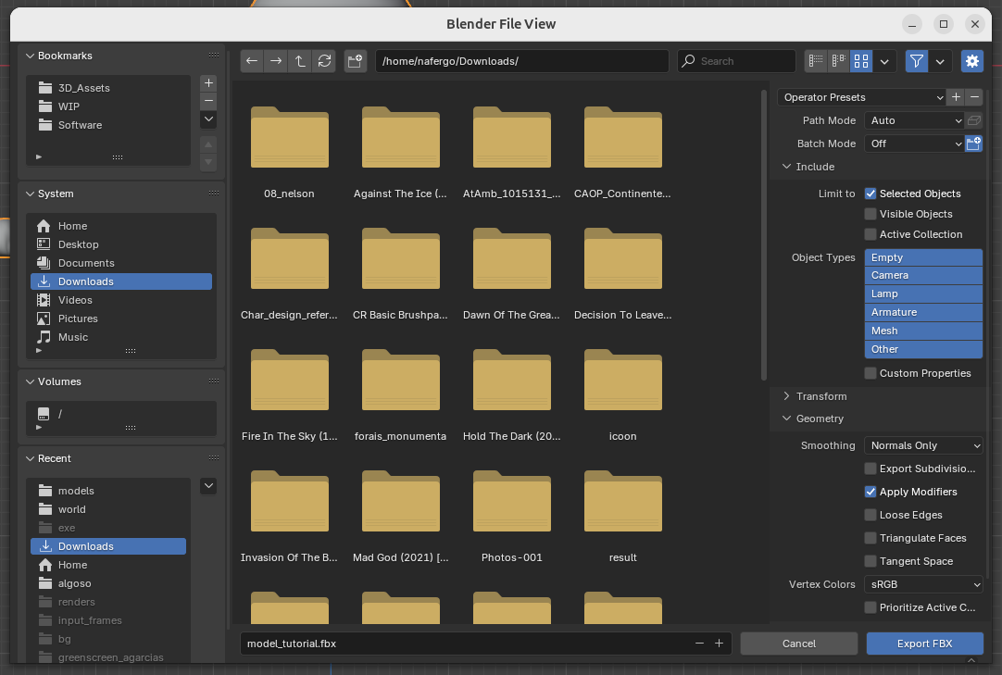
Make sure these checkboxes are checked...
Selected Objects
Apply Modifiers

Slide 4
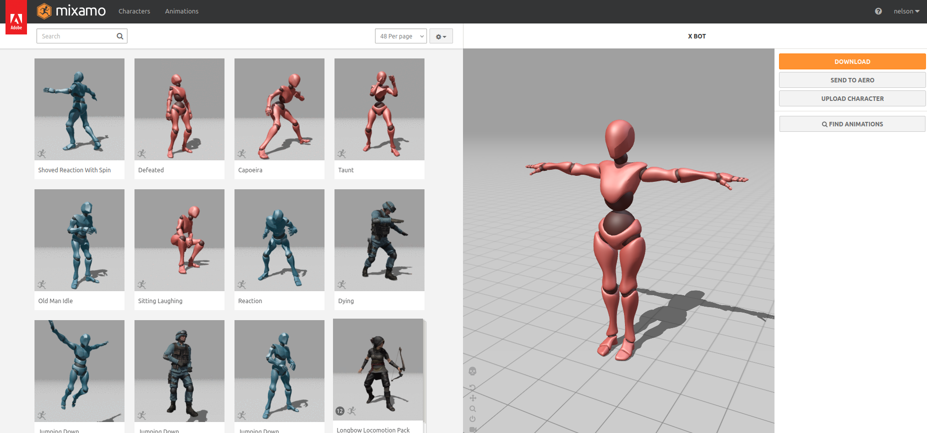
2. Upload FBX to Mixamo.com

Slide 5
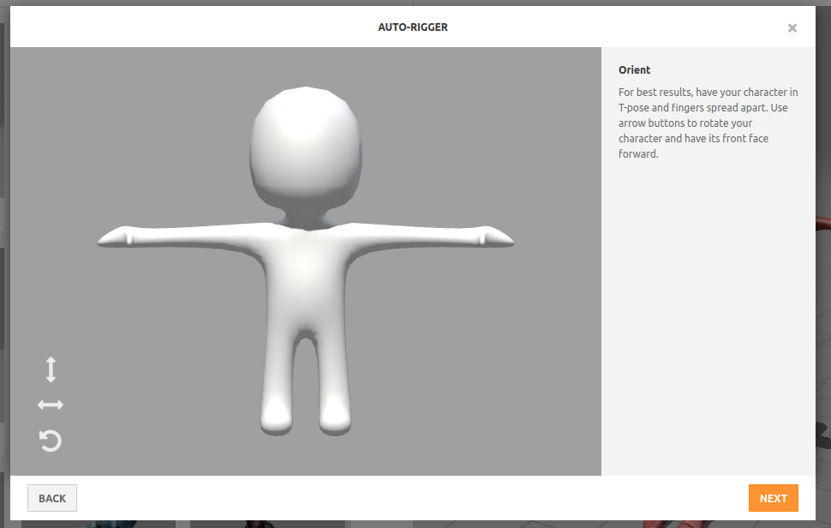
3. Use the auto-rigger to rig the character
If everything is good, something similar should be visibile…
Press NEXT

Slide 6
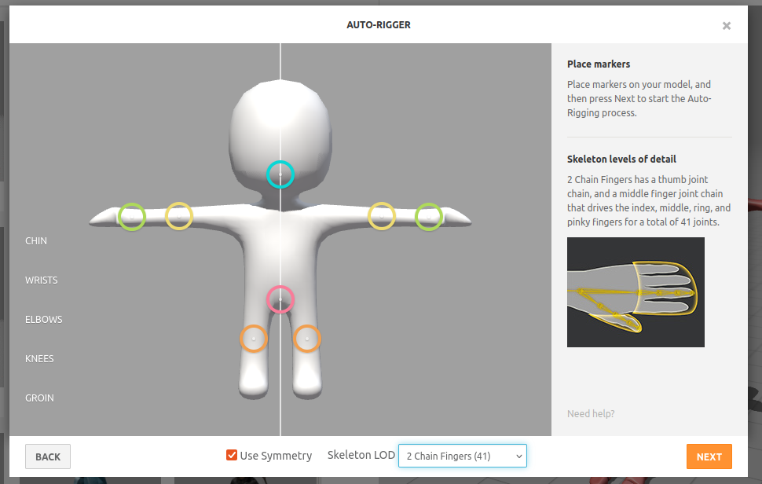
Position markers and choose LOD
Press NEXT

Slide 7
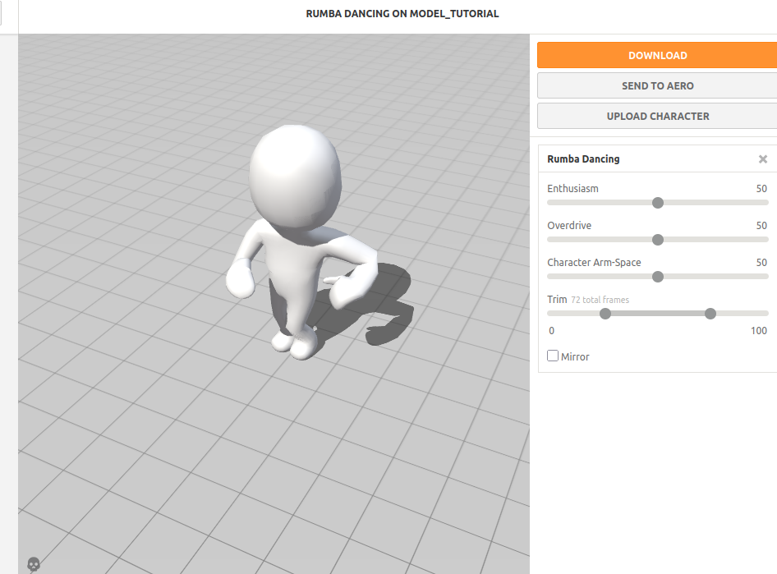
4. Try and choose an animation
You can change some animation settings…
When happy, press DOWNLOAD

Slide 8
4. Try and choose an animation
You can change some animation settings…
When happy, press DOWNLOAD

Slide 9
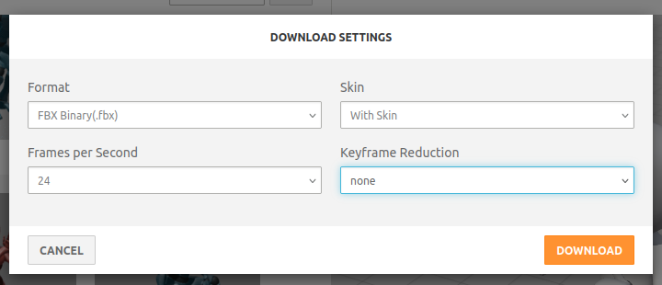
5. Download from Mixamo
Use FBX Binary with 24 FPS and With Skin.
Press DOWNLOAD

Slide 10
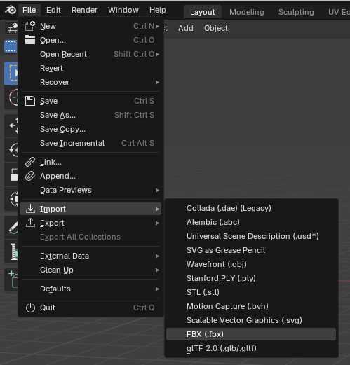
6. Import to Blender
Go to…
File > Import
And choose FBX

Slide 11
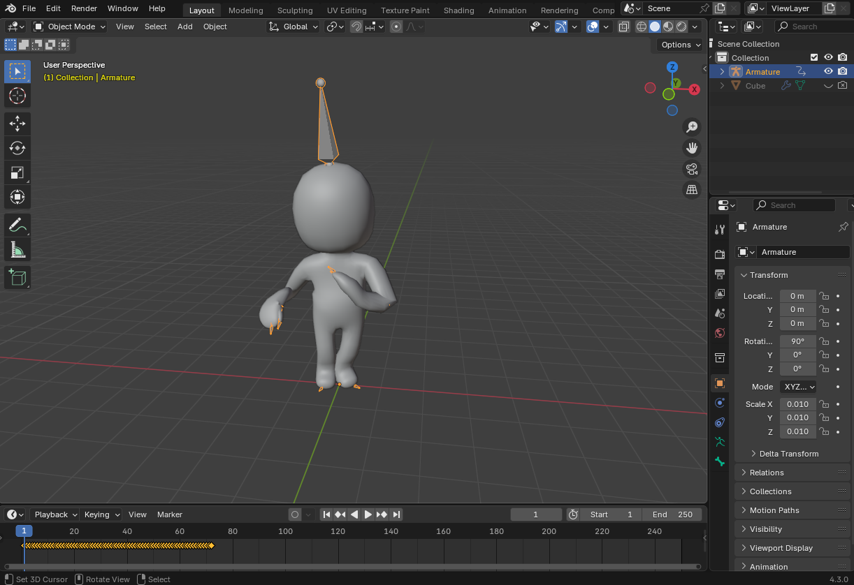
Select the armature to move/position around
Hide objects not needed
You can copy and paste the keyframes below to repeat animation

