Slide 1
4.2 Animation on a path
Ordu, 12.05 – 16.05 2025

Slide 2
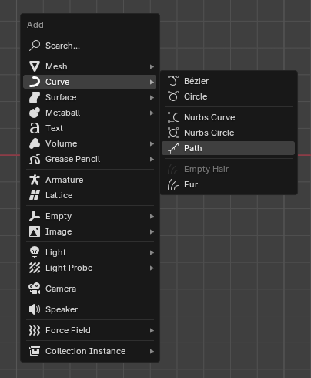
Add a path
Make sure the beginning of the path (first point) and the origin of the path are at the center of the world.

Slide 3
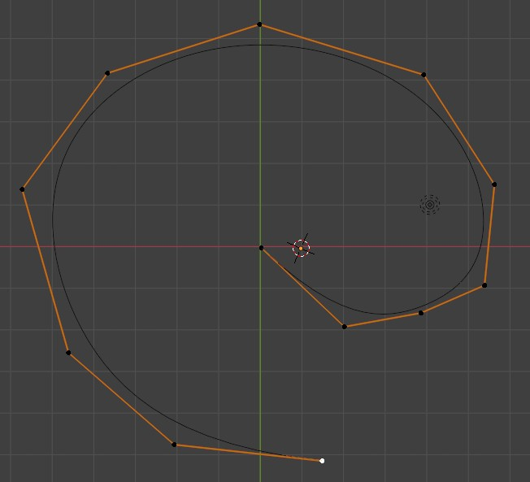
Select a point a make extrudes...

Slide 4
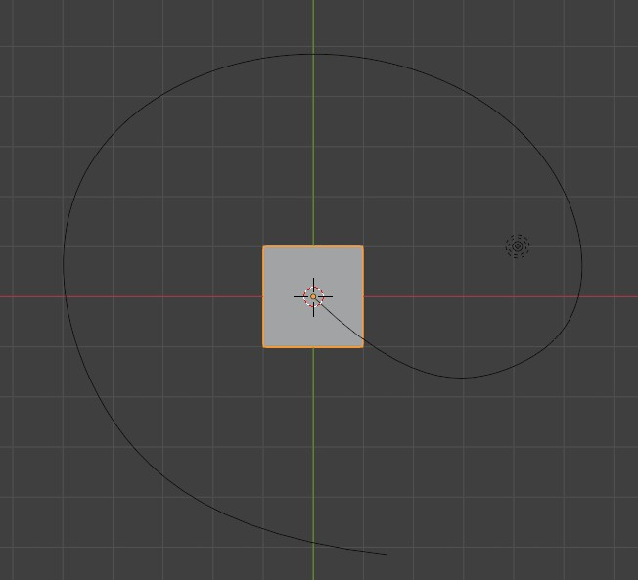
Add object
Add your object at the center of the world. Object’s origin should be at center of the world.
Object is aligned with path.

Slide 5
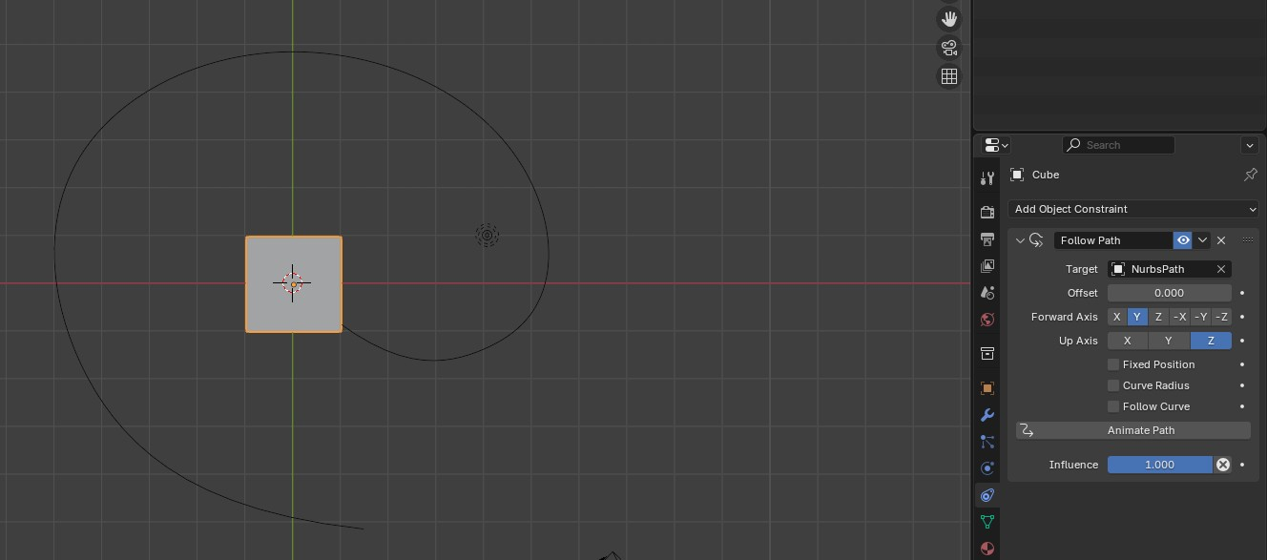
Add constraint to object
Select the object and then...
Add a Follow Path constraint to your object.
If needed, correct the forward axis.
Check Follow Curve
Click Animate path

Slide 6
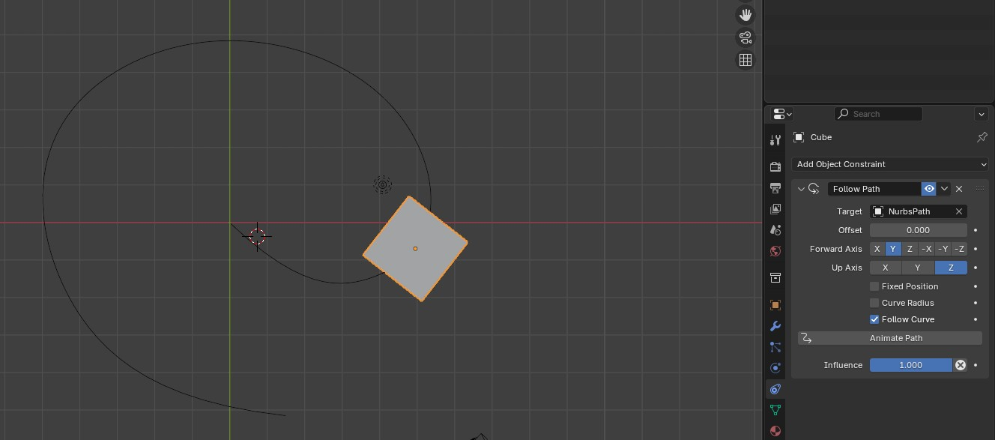
Object should be animated...

Slide 7
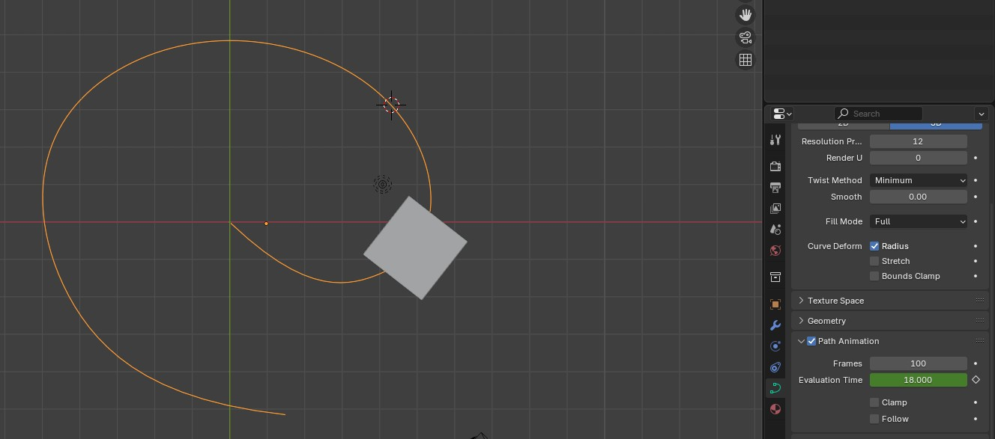
Select the Path...
By default, the Path Animation takes 100 frames. Change the value as needed.

Slide 8
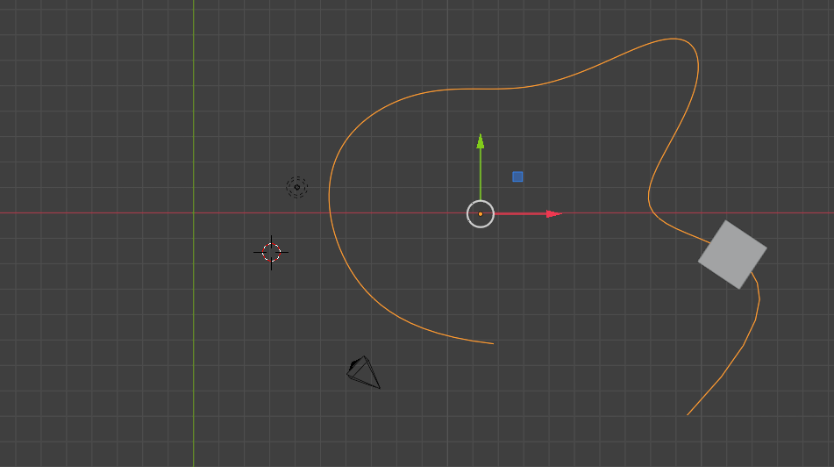
Edit and/or move the path as you wish

Slide 9
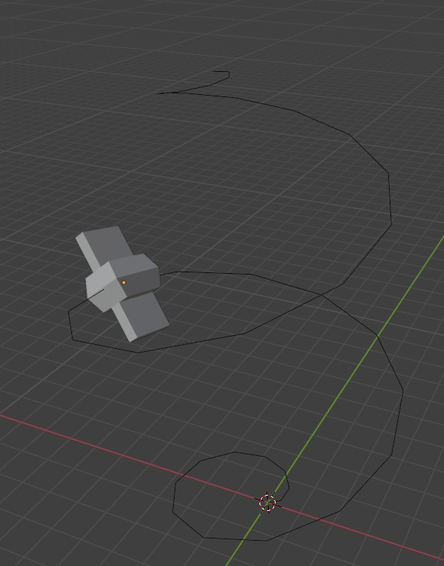
Make it fly...

