Slide 1









BOOK 3
PROJECT

Slide 2


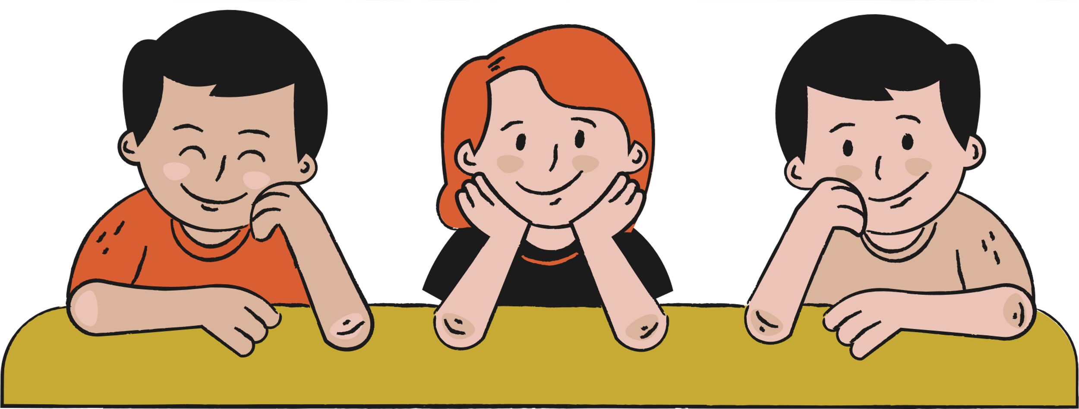


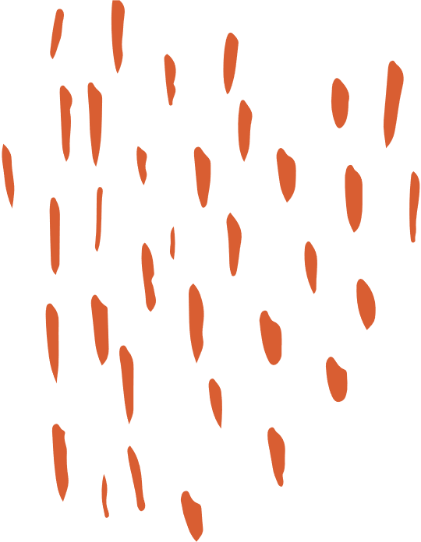
Prepare
This Before
Class
DOUBT
CHECK
INFORM

Slide 3

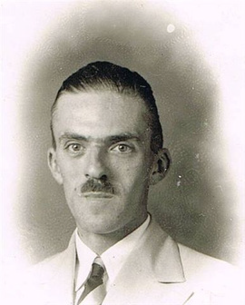
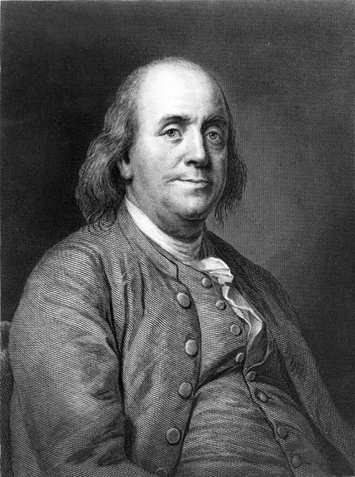

History of Magazines
in America
Overview
The first American magazines were published in 1741. Philadelphia printers Andrew Bradford and Benjamin Franklin — who owned rivaling newspapers — both raced to publish the first American magazine.

Slide 4
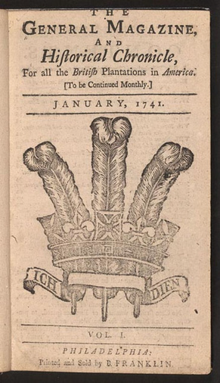
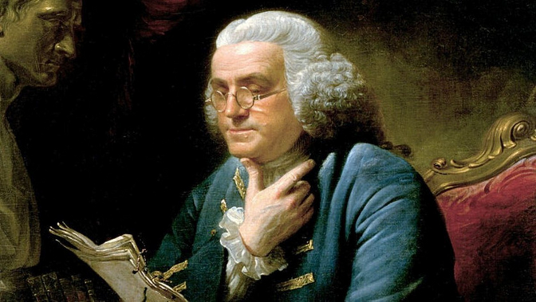
History of Magazines
in America
Overview
Bradford ultimately claimed the honor by publishing American Magazine first. Benjamin Franklin's General Magazine was published three days later. Neither magazine met with much success: Bradford's publication folded after three months, and Franklin's lasted only six months.

Slide 5
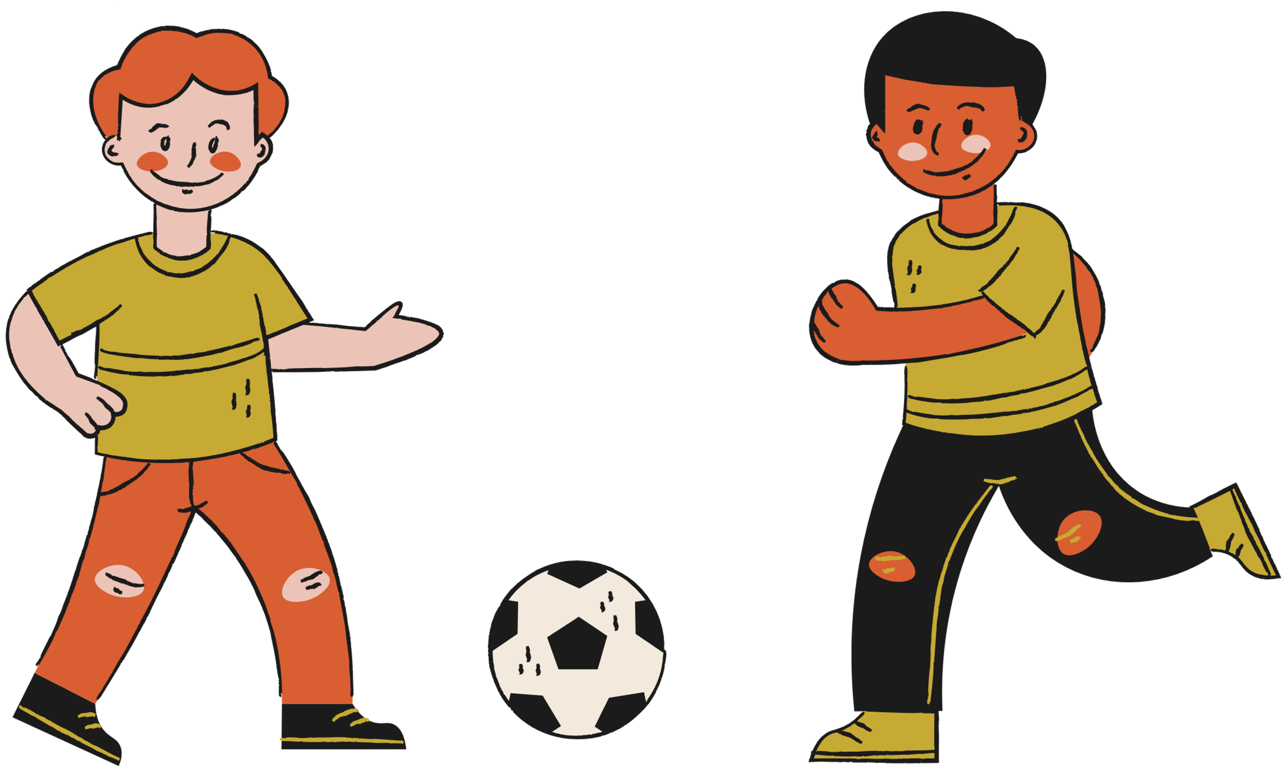

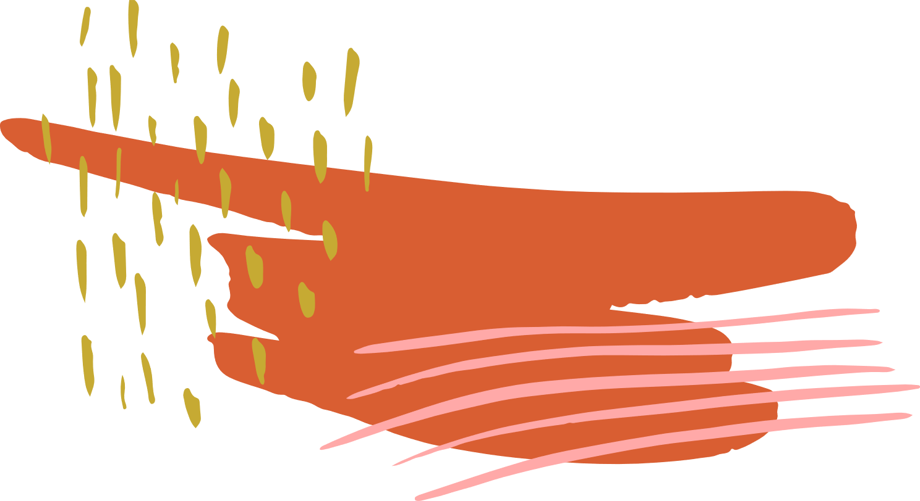
Situation Update
Despite these short-lived ventures, magazines became incredibly popular in America. By the end of the 18th century, there were more than 100 magazines in the United States. Some of the most influential early American magazines were the Pennsylvania Magazine, which was edited by Thomas Paine, and the Massachusetts Magazine.

Slide 6
Situation Update
Early periodicals were so expensive that only the wealthy could afford them. By the 1830s, however, less expensive magazines aimed at the general public began to emerge. Rather than maintaining the intellectual air of their predecessors, these magazines focused on amusement and entertainment.

Slide 7




Today, there are thousands of magazines worldwide. Magazines inspire, inform, educate and entertain audiences across the globe. Nearly 600 years after the advent of the printing press, magazines continue to change the nature of things throughout the world.

Slide 8


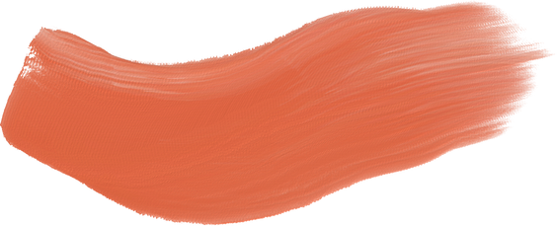







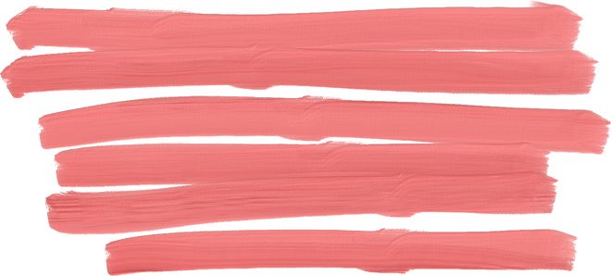

BRAZIL
As primeiras revistas brasileiras surgiram no Brasil em 1812 e traziam em suas publicações novelas populares, história antiga e moderna, costumes e artigos científicos. Aos poucos foram surgindo as revistas ilustradas, no século XX. Destacam-se as revistas Veja, a Época, a IstoÉ e Carta Capital.

Slide 9


Horoscopes,
Beauty tips,
Sports pages,
Film reviews,
cinema news,
Fashion, photo stories, comic strips, puzzles,
technology pages,
music,
Interviews
Recipes, jokes,
Problems Solutions (like a behavior or relationship tips)
Different
sections that magazines have

Slide 10

PARTS OF THE NEWS
TÍTULO
LEAD
CORPO
Engages the reader's interest.
Headline.
First paragraph of the text.
Presents information: who, where, when, how, what.
More detailed and complete information.

Slide 11

