Slide 1

LEARNING WITHOUT FORGETTING Authors: Zhizhong Li, Derek Hoiem
Presented By: Projna Saha
Student ID: 101194745

Slide 2
Overview
Problem Statement
Literature Review
Research Questions
Data Analysis
Methodology
Results
Validation
Conclusions

Slide 3

Problem Statement
In the Learning without Forgetting Method, authors address the problem of adapting a vision system to a new task while preserving performance on original tasks, without access to training data for the original tasks.
In their experiment, they demonstrated the effectiveness of LwF for image classification and one experiment on tracking, but in the future work, they mentioned to do more experiments on semantic segmentation, detection.

Slide 4
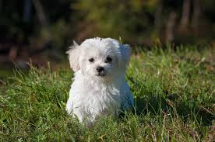
Graphic Representation of the Problem Statement
Image Classification:
You were shown an image and you classified the class it belonged to (a dog, in this instance).

Slide 5
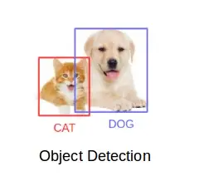
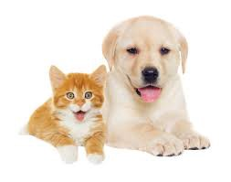
Graphic Representation of the Problem Statement
Object Detection:

Slide 6
Literature Review
Transfer Learning Methods:
Learning-without-forgetting
Fine-tuning [1]
Feature-extraction [2]
Joint-training [3]
Object Detection Techniques:
Selective Search [4] Object detectors
RCNN [5]
Fast R-CNN [6]
Faster R-CNN [7]

Slide 7
Proposed Method
In this experiment, we use a pretrained model Faster RCNN which is trained on Coco dataset to apply the LWF approach to solve the object detection problem.
We create a new model by adding a new task on top of the old model.
Then we train our new model with PennFudan dataset.
We compare the old and new models using the PennFudan dataset after training and show the evaluation results.

Slide 8
Research Questions
RQ1: In the object detection problem, how well a model can learn for a new task on a new dataset if modify old model with new task?
RQ2: How do the results differ from the authors' findings?

Slide 9
Dataset Description
COCO Dataset:
COCO is a large-scale object detection, segmentation, and captioning dataset.
Object segmentation
Train/val browser (123,287 images, 886,284 instances)
330K images (>200K labeled)
80 object categories and 91 stuff categories
5 captions per image
https://cocodataset.org/#download
PennFudan Dataset:
This is an image database containing images that are used for pedestrian detection in the experiments.
170 images with 345 labeled pedestrians,
96 images are taken from around University of Pennsylvania,
74 are taken from around Fudan University.
https://www.cis.upenn.edu/~jshi/ped_html/PennFudanPed.zip

Slide 10
Dataset Preprocessing
The dataset contains into two parts: Image, Mask
We haven't converted the mask to RGB, because each color corresponds to a different instance with 0 being background
Convert the PIL Image into a NumPy array
Instances are encoded as different colors.
Get bounding box coordinates for each mask

Slide 11
Model Description
Employ Mask R-CNN in this model, which is built on top of Faster R-CNN.
Load two instance segmentation model pre-trained on COCO
Get number of input features and output features for both models
Adding new class of new model out features
Replace the pre-trained head with the newly edited out features for new model and old model remain unchanged.
Now getting the number of input features for the mask classifier and replace the mask predictor with a new hidden layer.

Slide 12
Experiment Setup
Optimizer: SGD with learning rate 0.005 with momentum of 0.09 and weight delay of 0.0005.
Scheduler: For testing the best learning rate, stepLR with step size 3.
No of Epochs: 50
Alpha Value: 0.01, alpha value is used for balancing the loss function
Freeze the old model parameters, so that old model could not train with the new dataset.
Train the new model with PennFudan Dataset.
Loss Function: alpha* new model + (1-alpha) *old model

Slide 13
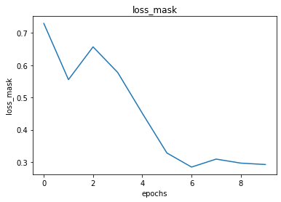
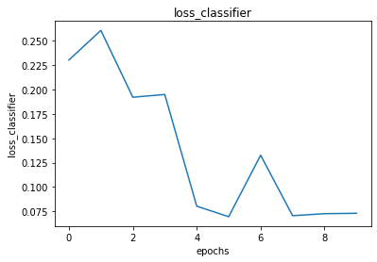
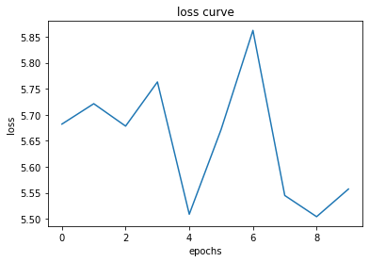
Results (Loss Function)

Slide 14
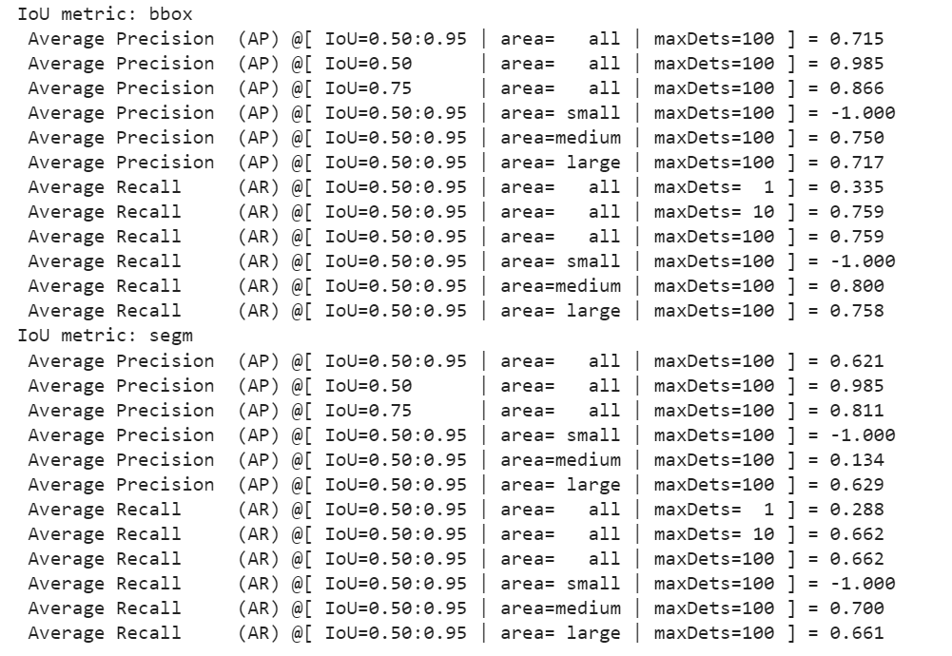


Results (Validation: Old Model)

Slide 15
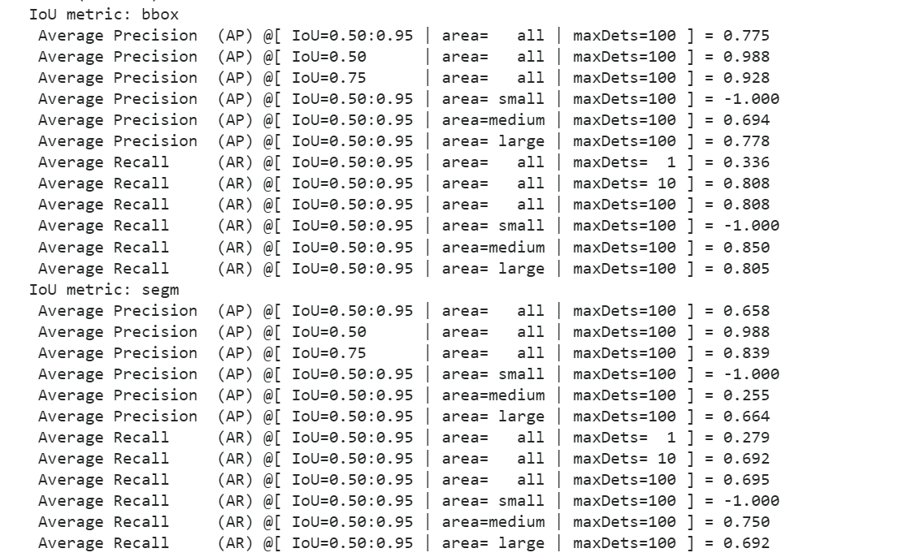
Results (Validation: New Model)

Slide 16
Result Comparison

Slide 17
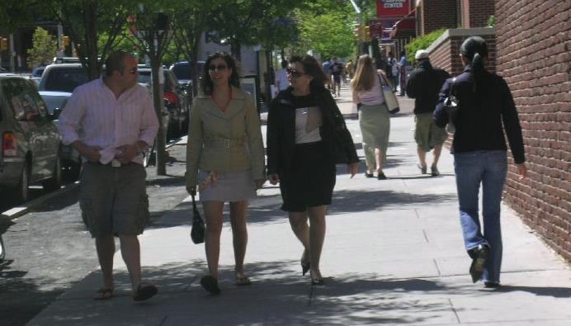
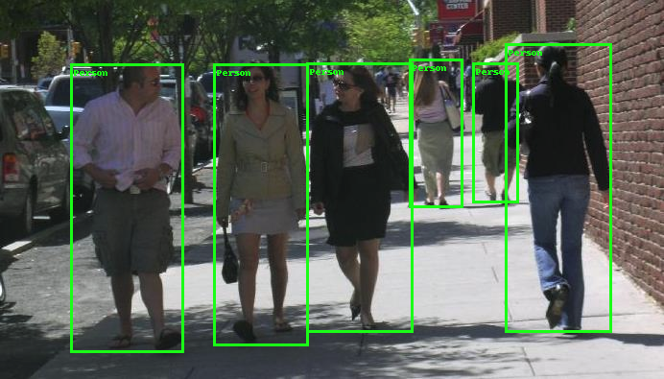
Result (Visual Representation of Object Detection)

Slide 18
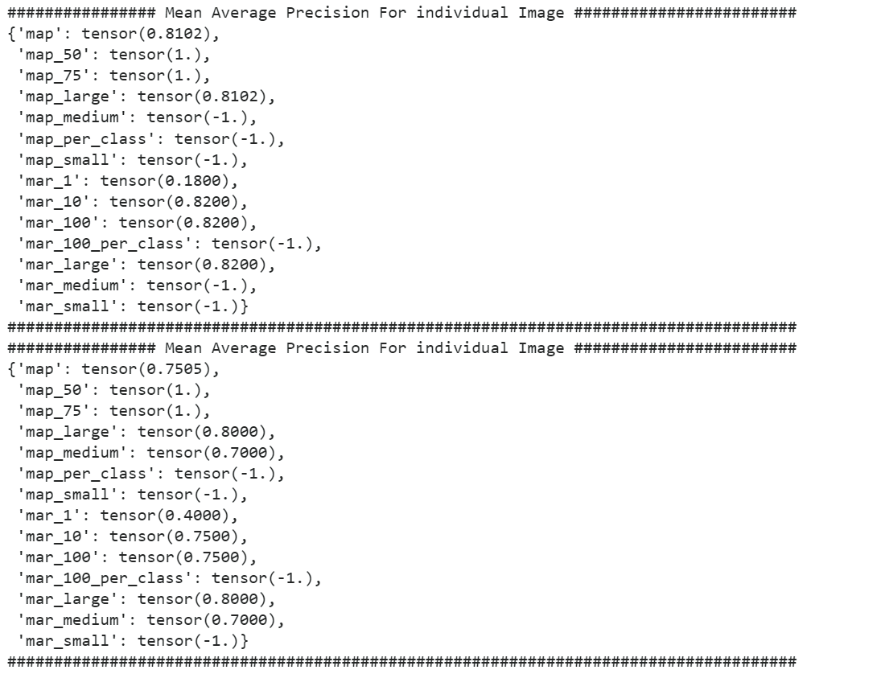
Mean Average Precision(mAP) For Individual Images
In All area mAP: 81%
In 50% area mAP: 100%
In Large area MAP: 81%
Not considering ‘Small’ area, so the result is negative.

Slide 19
Comparison Between Our Model's Object Detection Using Lwf Vs The Author's Lwf For Image Classification
Accuracy | Old Model | New Model
ImageNet-> VOC | 56.2 | 76.1
ImageNet->CUB | 54.7 | 57.7
ImageNet->Scenes | 55.9 | 64.5
Places365->VOC | 50.6 | 70.2
 | Old Model | New Model
mAP for bbox | 76.18 | 83.26
mAR for bbox | 70.58 | 73.04
mAP for segment | 66.02 | 68.08
mAR for segment | 63.42 | 62.16
Author’s LwF
Our LwF
For image classification, Authors used accuracy for their evaluation metrics whereas, for object detection, Mean Average Precision and recall is the standard evaluation metrics.
From both of the results, we observed that old model has less accuracy than the new model which was expected because old model does not have the new task information.
With comparison to authors result to ours, our old model are performing better.

Slide 20
Limitations
Pretrained models are on Beta Stage. So, some of the features are still not available.
The object detection approach cannot correctly identify the partial or hidden object if the sample image is too crowded.
There are just two classes available to us for object detection: person and background. In light of the fact that the pedestrian dataset, which only comprises two categories, is connected to the PennFudan dataset.
Hardware Limitation: Because of limited hardware resources, we couldn’t train the model to get the best results.

Slide 21
Conclusions
Object detection can retain the old knowledge which is acting same as LwF.
It detects the object effectively.
The object detection approach cannot correctly identify the object if the sample image is too crowded.
Because of the exhaustion problem, we were unable to run the model on a large dataset; however, if we were able to run the model on a large dataset, the results may be much better.
In LwF, Old model always underperforms than new model and, in our experiment, it follows the same result.

Slide 22
Future Work
The research is now confined to identifying objects in images; but, in the future, the technology might be extended by working on motion pictures or videos to track the item.
The PennFudan dataset only includes two types for object detection: background and pedestrian. In the future, research may concentrate more on choosing datasets so that the model can create categories to characterize the objects, such a crowd of people or a lot of traffic.
Faster RCNN has problems with detecting object, if there is lot of crowd. YOLOv7 is the most accurate and fastest technique for object detection[8] but YOLOv7 is upcoming soon on PyTorch.

Slide 23
Related Publications
[1] R. Girshick, J. Donahue, T. Darrell, and J. Malik, “Rich feature hierarchies for accurate object detection and semantic segmentation,” in The IEEE Conference on Computer Vision and Pattern Recognition (CVPR), June 2014.
[2] J. Donahue, Y. Jia, O. Vinyals, J. Hoffman, N. Zhang, E. Tzeng, and T. Darrell, “Decaf: A deep convolutional activation feature for generic visual recognition,” in International Conference in Machine Learning (ICML), 2014.
[3] R. Caruana, “Multitask learning,” Machine learning, vol. 28, no. 1, pp. 41–75, 1997.
[4] J. R. Uijlings, K. E. van de Sande, T. Gevers, and A. W. Smeulders, “Selective search for object recognition,” International Journal of Computer Vision (IJCV), 2013.
[5] R. Girshick, J. Donahue, T. Darrell, and J. Malik, “Rich feature hierarchies for accurate object detection and semantic segmentation,” in IEEE Conference on Computer Vision and Pattern Recognition (CVPR), 2014.
[6] R. Girshick, “Fast R-CNN,” in IEEE International Conference on Computer Vision (ICCV), 2015.
[7] Shaoqing Ren, Kaiming He, Ross Girshick, and Jian Sun. 2015. Faster R-CNN: towards real-time object detection with region proposal networks. In Proceedings of the 28th International Conference on Neural Information Processing Systems - Volume 1 (NIPS'15). MIT Press, Cambridge, MA, USA, 91–99.
[8] Comparison of different Object Detection Techniques (source)

Slide 24

Thank you

