Slide 1


MixTipsz Curling Simulator
Gábor & Kristóf

Slide 2

Gambling
    Gambling is bad, please don’t do it!
    Or buy our product and win!!!!
    And your penis will be longer by 7 cm!

Slide 3
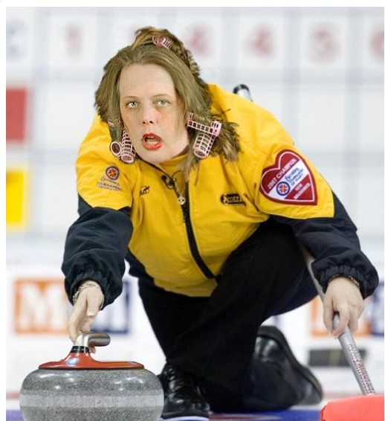
Our Duty
    Write a program that simulates a match than calculates the possible outcome
    Our program is a curling simulator
    Curling: 2 sikamikáló is sikamikáling in a lane, 1 lökő is löking a stone and thats it, HOT GRILLS!! ->

Slide 4

Plans
    To learn
    Better Teamwork
    Implement our simulator
    Write a working code

Slide 5

Struggles
    Lack of tudás
    Understand the task
    Random is random

Slide 6
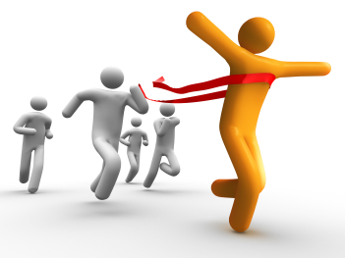
Results
    Learning Java
    Better understanding OOP
    Tonnes of money made by

