Slide 1

Exit
Replay
Play

Slide 2
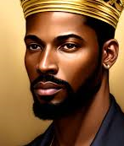


Slide 3


