Slide 1

Innovation Project
By Group 3

Slide 2
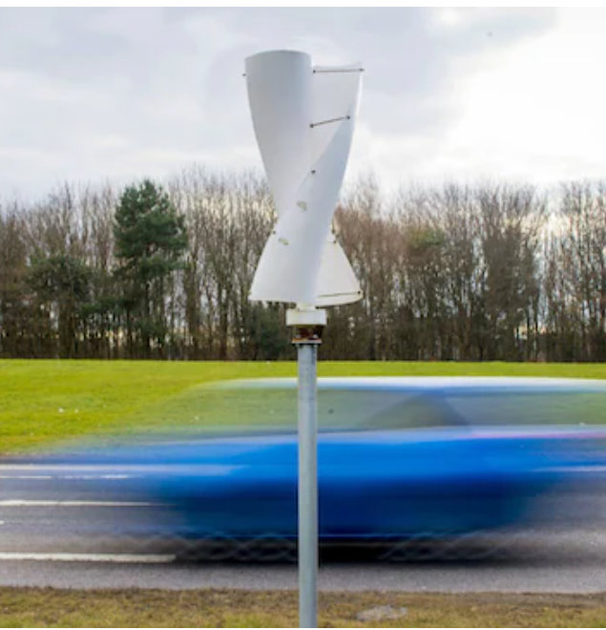
Innovation – Roadside wind turbine
On the side of a busy main road, small wind turbine spins in the wind of passing cars and trucks. As it rotates, it charges a battery that is below the ground. We were inspired to create the turbine as he stood on the side of a road. “At first, the breeze from the cars was just a welcome relief from the humidity,” he says. “Then we started to think about how we could use that energy.” The turbine stands two-and-a-half metres tall.

Slide 3
Continuation
Made of recyclable carbon fibre, it weighs just nine kilogrammes, making it easy to transport and install. The fully-charged battery can hold a kilowatt of electricity, enough to run two lamps and a fan for around 40 hours. The idea is that this could be a source of electricity for rural communities in developing countries, or could power traffic lights or road signs in urban areas.

Slide 4
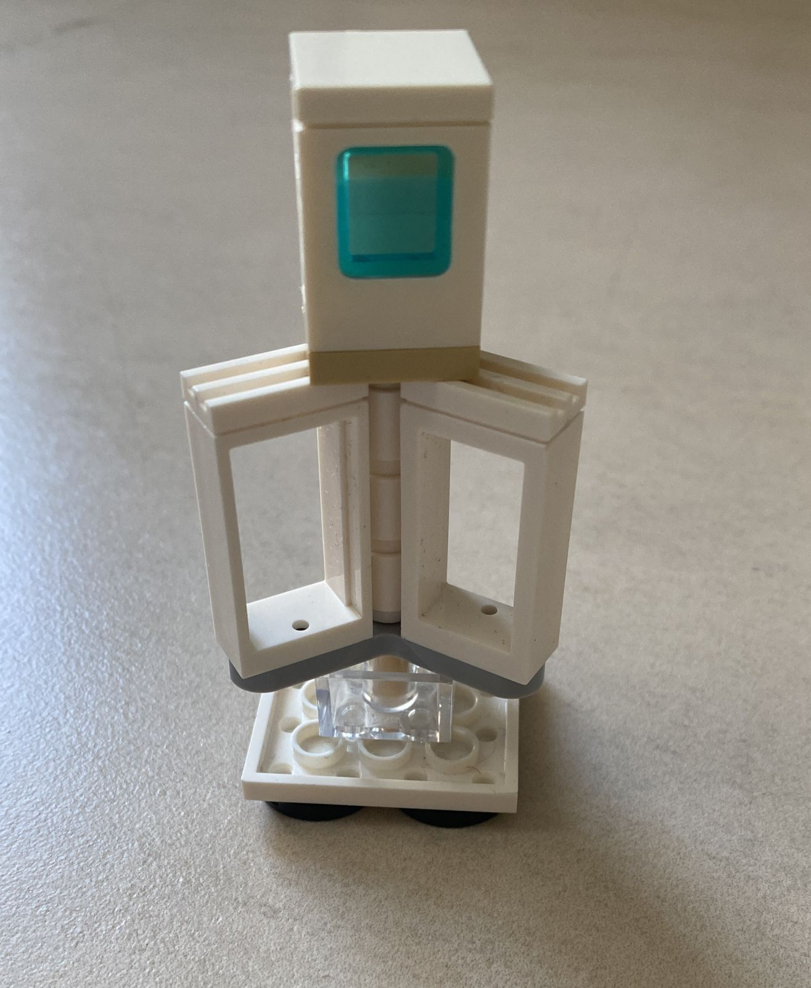
Group 3
IHS

Slide 5


