Slide 1
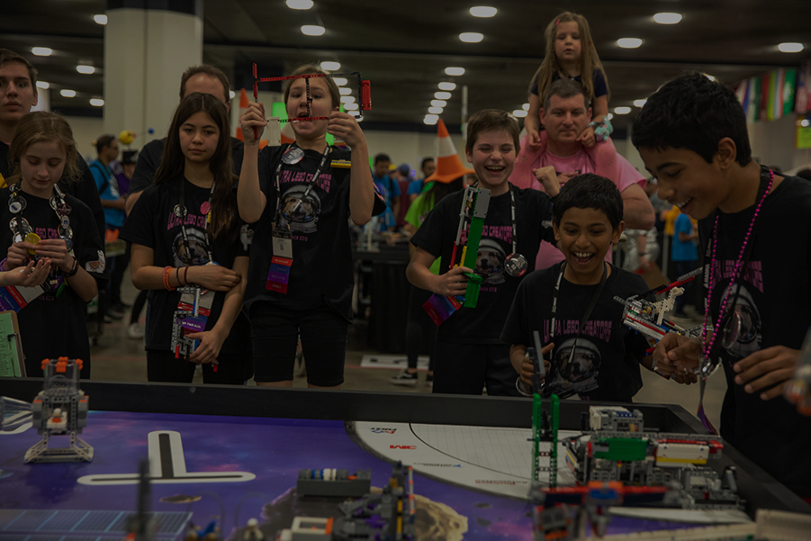

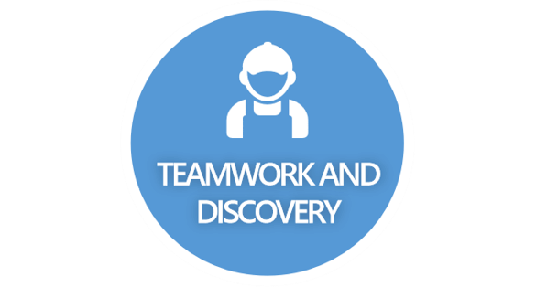


CORE VALUES PPT
MADE BY TEAM 3
INCLUSIVNESS
FUN AND
GAMIFICATION

Slide 2



TEAMWORK AND
DISCOVERY

Slide 3



INNOVATION

Slide 4
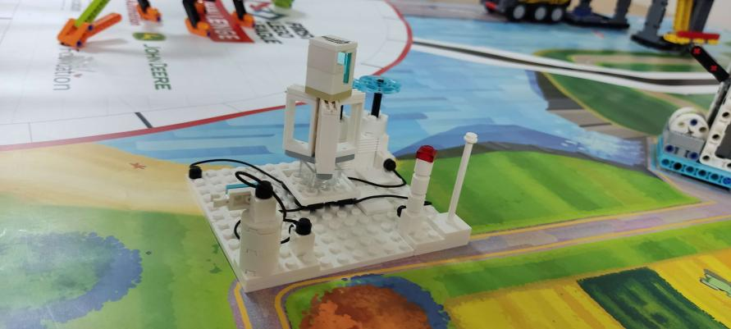
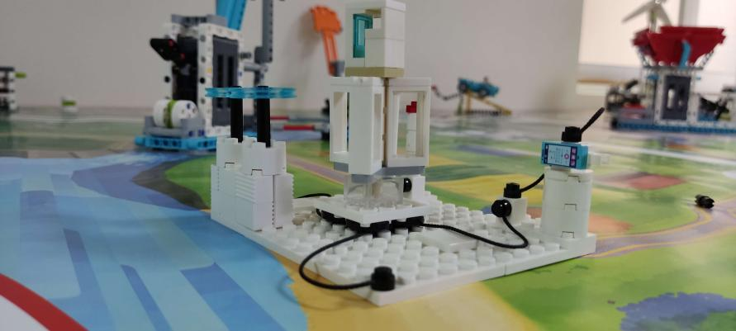
Innovation project – What is it?
One of the main components of our project is the innovation project, which is a small model of sustainable architecture and technology, promoting creativity and, as the name says, innovation.
Our innovation project is centered around a roadside wind turbine. Roadside wind turbines are prototypical inventions meant to reduce energy wastage during traffic and on major highways in urban areas.

Slide 5
Innovation project – Where is it?
It is based on the phenomenon of high wind energy being generated when cars go down roads at high speeds.

Slide 6
Innovation project – why is it helpful?
Our innovation project promotes sustainable innovation while coupling together cost-effectiveness and making sustainability and energy available for all.

Slide 7



IMPACT

Slide 8
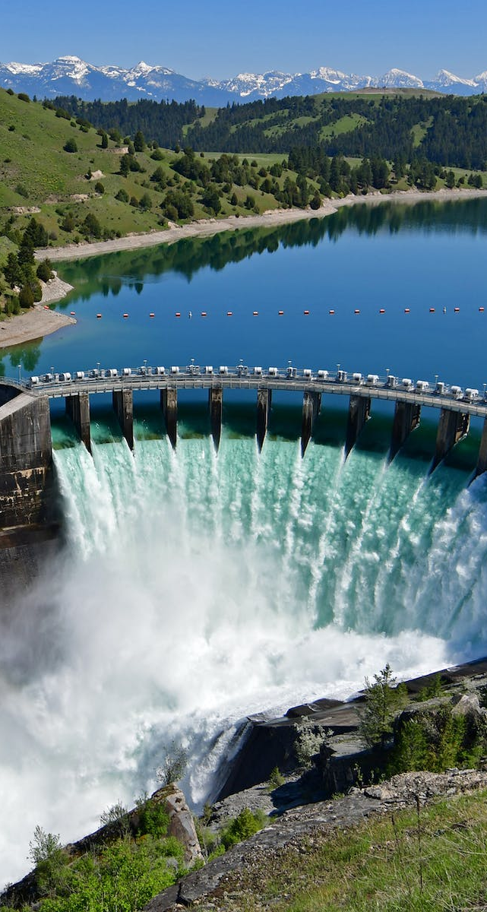
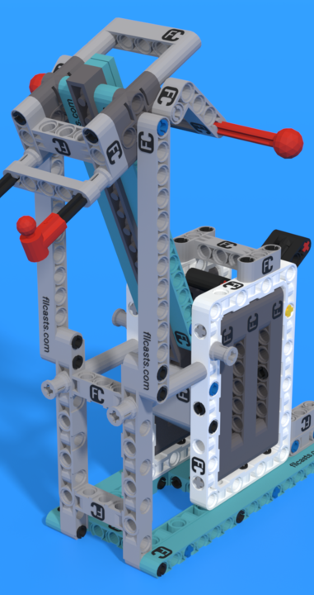
Impact – what is it?
We have designed our robot to solve problems that solve issues of sustainability in society, such as making hydroelectric dams, promoting solar energy, etc.

Slide 9
Impact – where is the impact?
These modifications and changes have a huge impact on society as a whole and can promote faster and higher rates of development.

Slide 10
Impact –why is it important?
They can have a large impact on poorer sections of society and can alleviate menial jobs that are taken advantage of while using energy sources like fossil fuels.

Slide 11



INCLUSIVENESS

Slide 12
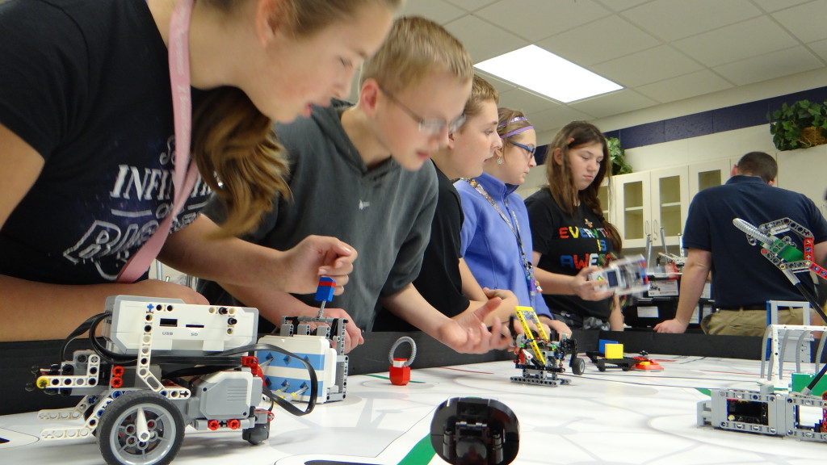
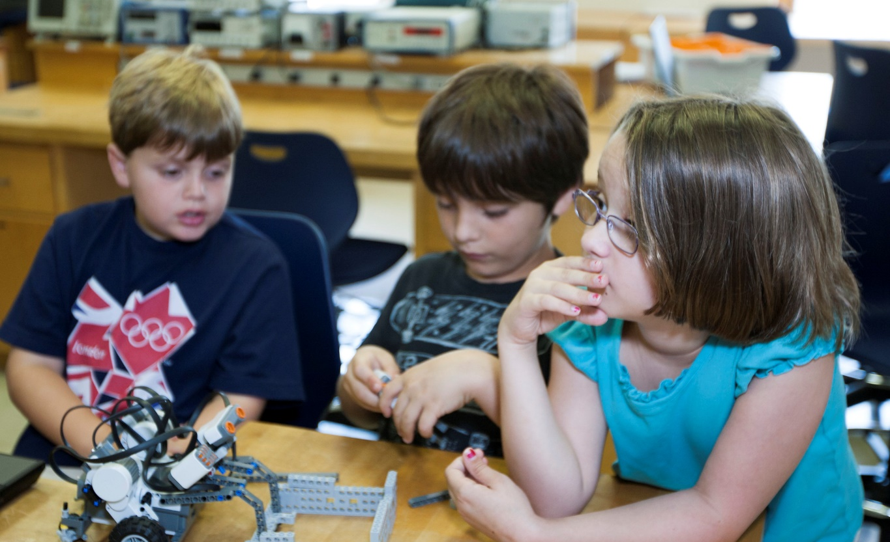
Teamwork and Discovery – what is it?
Teamwork can be described as how all the members of the team cooperate to achieve a successful result. Our team has inculcated the value of teamwork in our project by sharing our work with each other and taking help from each other when we need it.

Slide 13
Teamwork and Discovery- where have we used it?
We have helped each other research and discover new innovative and sustainable ideas, especially for the innovation project.

Slide 14
Teamwork and Discovery- why is it important?
Teamwork helps us make our individual projects as well as the team project better through constructive criticism. It has helped us make modifications to our projects, for example, we take the help of the coders and robot game designers to complete and answer questions in the engineering notebook.

